Slide 1
INHERITANCE and COMPOSITION

Slide 2
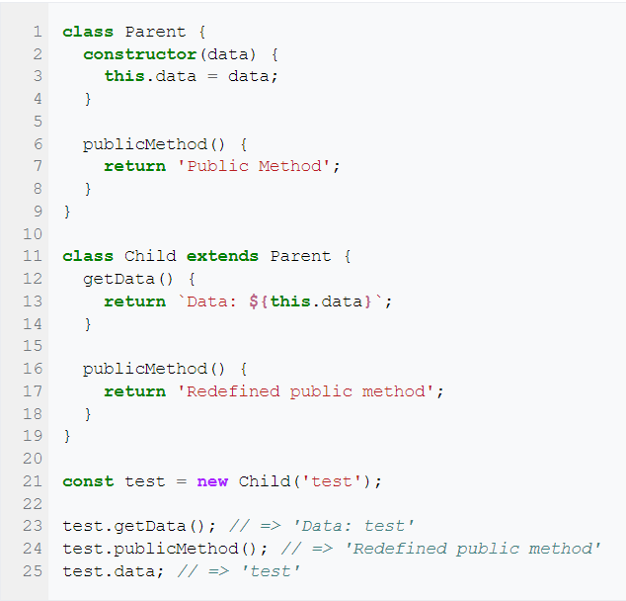
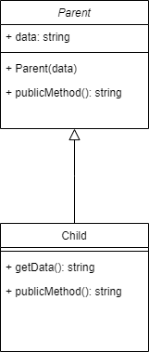
INHERITANCE

Slide 3
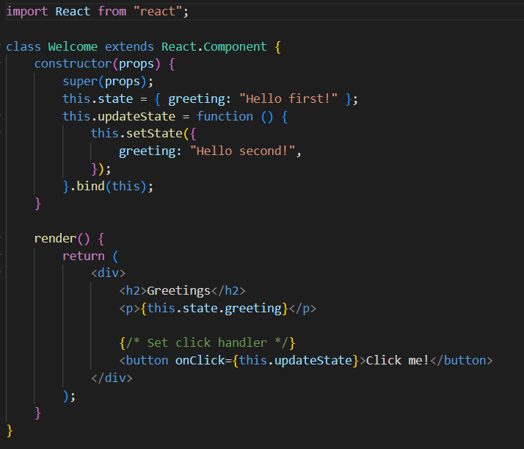
INHERITANCE IN REACT

Slide 4
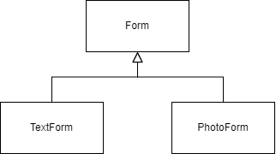
COMPONENTS INHERITANCE

Slide 5
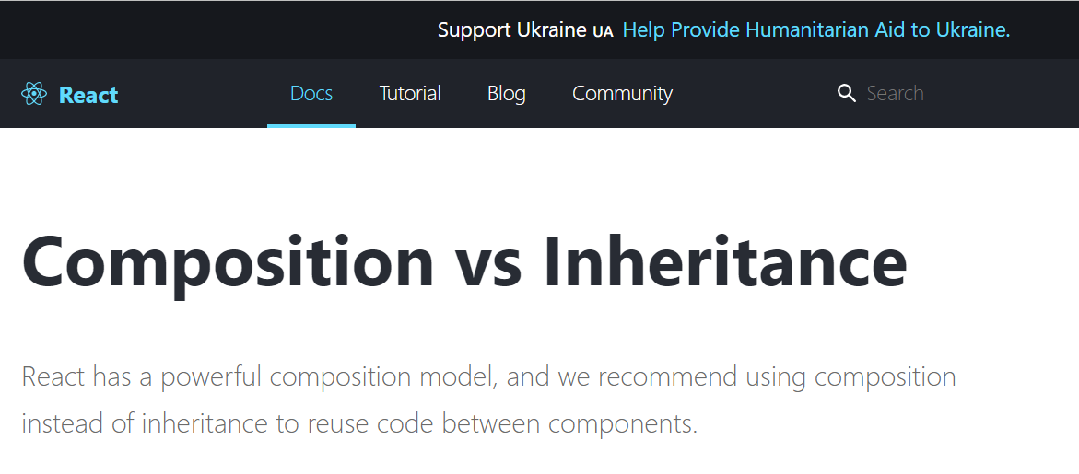

Slide 6
Composition in OOP
Composition is one of the fundamental concepts in object-oriented programming. It describes a class that references one or more objects of other classes in instance variables. This allows you to model a has-a association between objects.
You can find such relationships quite regularly in the real world. A car, for example, has an engine and modern coffee machines often have an integrated grinder and a brewing unit.

Slide 7


