Slide 1
CONTEXT

Slide 2
When to Use Context
Context is designed to share data that can be considered “global” for a tree of React components, such as the current authenticated user, theme, or preferred language.
Context is primarily used when some data needs to be accessible by many components at different nesting levels. Apply it sparingly because it makes component reuse more difficult.
If you only want to avoid passing some props through many levels, component composition is often a simpler solution than context.

Slide 3
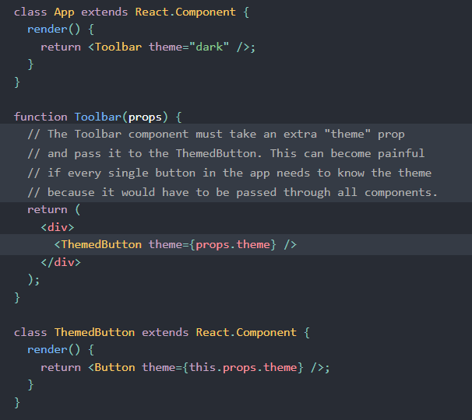
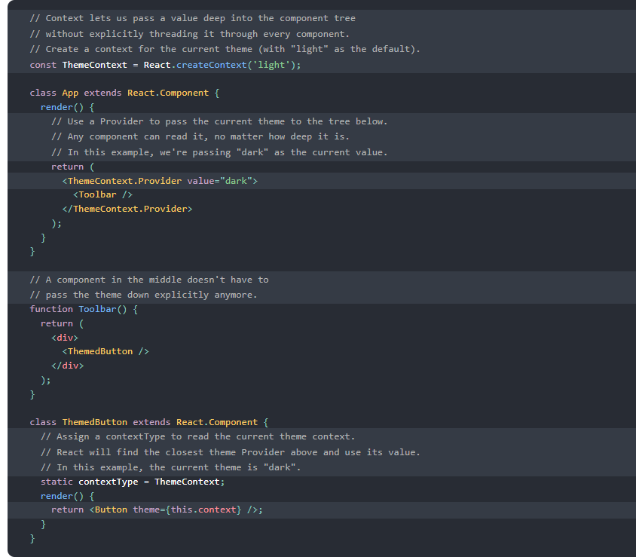
When to Use Context

Slide 4
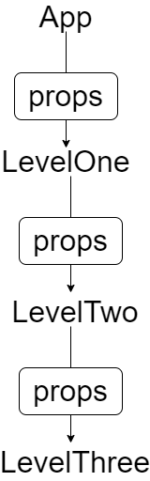
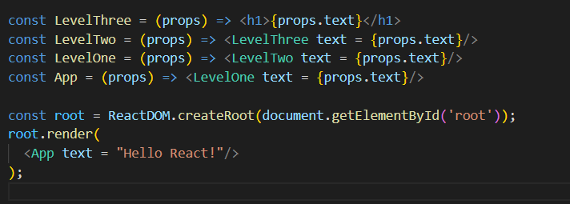
Props

Slide 5
Context
Context provides a way to pass data through the component tree without having to pass props down manually at every level.
Context

Slide 6
Context API
Creates a Context object. When React renders a component that subscribes to this Context object it will read the current context value from the closest matching Provider above it in the tree.
The defaultValue argument is only used when a component does not have a matching Provider above it in the tree. This default value can be helpful for testing components in isolation without wrapping them.
Note: passing undefined as a Provider value does not cause consuming components to use defaultValue

Slide 7

Context.Provider
Every Context object comes with a Provider React component that allows consuming components to subscribe to context changes.
The Provider component accepts a value prop to be passed to consuming components that are descendants of this Provider. One Provider can be connected to many consumers. Providers can be nested to override values deeper within the tree.
All consumers that are descendants of a Provider will re-render whenever the Provider’s value prop changes.

Slide 8
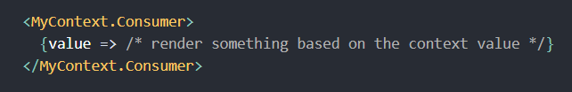
Context.Consumer
A React component that subscribes to context changes. Using this component lets you subscribe to a context within a function component.
Requires a function as a child. The function receives the current context value and returns a React node. The value argument passed to the function will be equal to the value prop of the closest Provider for this context above in the tree. If there is no Provider for this context above, the value argument will be equal to the defaultValue that was passed to createContext().

Slide 9

useContext
Accepts a context object (the value returned from React.createContext) and returns the current context value for that context. The current context value is determined by the value prop of the nearest <MyContext.Provider> above the calling component in the tree.
When the nearest <MyContext.Provider> above the component updates, this Hook will trigger a rerender with the latest context value passed to that MyContext provider. Even if an ancestor uses React.memo or shouldComponentUpdate, a rerender will still happen starting at the component itself using useContext.
Don’t forget that the argument to useContext must be the context object itself (useContext(MyContext))
A component calling useContext will always re-render when the context value changes. If re-rendering the component is expensive, you can optimize it by using memoization.

Slide 10
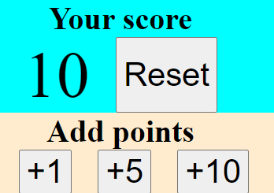
App “Your Score”
App
Score
AddingScore
ButtonAdd

Slide 11


