Slide 1
Additional Hooks

Slide 2
Memoization
In computing, memoization or memoisation is an optimization technique used primarily to speed up computer programs by storing the results of expensive function calls and returning the cached result when the same inputs occur again. Memoization has also been used in other contexts (and for purposes other than speed gains), such as in simple mutually recursive descent parsing. Although related to caching, memoization refers to a specific case of this optimization, distinguishing it from forms of caching such as buffering or page replacement.
Memoization - Wikipedia

Slide 3
useMemo
Returns a memoized value.
Pass a “create” function and an array of dependencies. useMemo will only recompute the memoized value when one of the dependencies has changed. This optimization helps to avoid expensive calculations on every render.
If no array is provided, a new value will be computed on every render.
Hooks API Reference – React (reactjs.org)

Slide 4
useMemo
Pay attention!
The function passed to useMemo runs during rendering. Don’t do anything there that you wouldn’t normally do while rendering. For example, side effects belong in useEffect, not useMemo.
You may rely on useMemo as a performance optimization, not as a semantic guarantee. In the future, React may choose to “forget” some previously memoized values and recalculate them on next render, e.g. to free memory for offscreen components. Write your code so that it still works without useMemo — and then add it to optimize performance.
Hooks API Reference – React (reactjs.org)

Slide 5
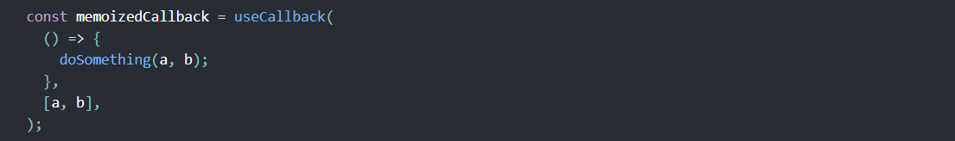
useCallback
Returns a memoized callback.
Pass an inline callback and an array of dependencies. useCallback will return a memoized version of the callback that only changes if one of the dependencies has changed. This is useful when passing callbacks to optimized child components that rely on reference equality to prevent unnecessary renders (e.g. shouldComponentUpdate).
useCallback(fn, deps) is equivalent to useMemo(() => fn, deps).
Hooks API Reference – React (reactjs.org)

Slide 6
Notes from developers
The array of dependencies is not passed as arguments to the function. Conceptually, though, that’s what they represent: every value referenced inside the function should also appear in the dependencies array. In the future, a sufficiently advanced compiler could create this array automatically.
Recommended to use the exhaustive-deps rule as part of eslint-plugin-react-hooks package. It warns when dependencies are specified incorrectly and suggests a fix.
Hooks API Reference – React (reactjs.org)

Slide 7
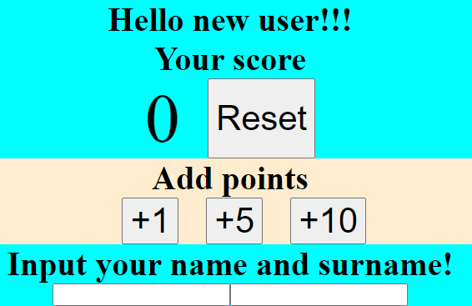
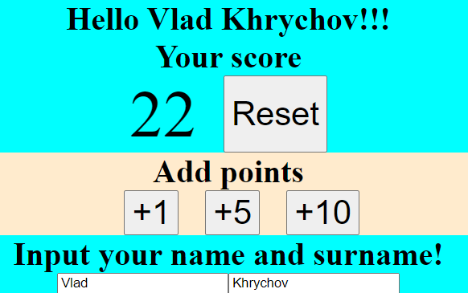
Practice

Slide 8


