Slide 1
REACT ONLINE MARATHON
Sprint 14. Tests (Session 1) Introduction to testing
By Yuriy Bezgachnyuk, October, 2020

Slide 2
AGENDA
Quality
Why Testing is necessary
Testing Applications
Test Types
Test Approaches
Test Levels
Code Quality
Code quality metrics

Slide 3

QUALITY
Quality: the degree to which a system, component, or process meets:
specified requirements
customer or user needs and expectations
We don’t have any measurement units to measure the QUALITY!!!
So, we can only evaluate the quality
using some metrics

Slide 4
WHY TESTING IS NECESSARY?

Slide 5
ONLY ONE PROGRAM IN THE WORLD DOESN’T HAVE ANY BUGS
DO YOU KNOW WHAT THE PROGRAM?
PROGRAM WHICH ISN’T WRITTEN ☺

Slide 6



WHY TESTING IS NECESSARY?
People make mistakes
We should assume that our work contains mistakes
Software is a part of our life
Notes:
Because we should assume our work contains mistakes, we all need to check our own work.
However, some mistakes come from bad assumptions and blind spots, so we might make the same mistakes when we check our own work as we made when we did it.
So we may not notice the flaws in what we have done.
Ideally, we should get someone else to check our work - another person is more likely to spot the flaws.
We know that in ordinary life, some of our mistakes do not matter, and some are very important. It is the same with software systems.
These days, almost everyone is aware of software systems. We encounter them in our homes, at work, while shopping, and because of mass-communication systems.
More and more, they are part of our lives. We use software in day-to-day business applications such as banking and in consumer products such as cars and washing machines.
However, most people have had an experience with software that did not work as expected:
an error on a bill,
a delay when waiting for a credit card to process
and a website that did not load correctly are common examples of problems that may happen because of software problems.

Slide 7

TESTING & QUALITY
Testing helps us to measure (evaluate) the quality of software in terms of:
the number of defects found;
the tests run;
and the system covered by the tests
Notes:
Testing helps us to measure the quality of software in terms of the number of defects found, the tests run, and the system covered by the tests.
We can do this for both the functional attributes of the software (for example, printing a report correctly) and for the non-functional software requirements and characteristics (for example, printing a report quickly enough).
Testing can give confidence in the quality of the software if it finds few or no defects, provided we are happy that the testing is sufficiently rigorous.
Of course, a poor test may uncover few defects and leave us with a false sense of security.
A well-designed test will uncover defects if they are present and so, if such a test passes, we will rightly be more confident in the software and be able to assert that the overall level of risk of using the system has been reduced.
When testing does find defects, the quality of the software system increases when those defects are fixed, provided the fixes are carried out properly.

Slide 8
TESTING APPLICATIONS

Slide 9

TEST TYPE
Test Type it’s a group of test activities aimed at testing a component or system focused on a specific test objective
Test activities can be grouped by:
Test Approaches (manual / auto)
Test Levels
Test Objectives

Slide 10
TEST TYPES
Acceptance
Black Box
Conformance
Security
Grey Box
Internationalization
Performance
Load
Usability
System
GUI
Beta
Stress
Functional
White Box
Ad-hoc
Compatibility
Sanity
Exploratory
Integration
Unit
Recovery
Smoke
Capacity
Error-Handling
Regression
Alpha
Install/uninstall
Negative
Localization
Confirmation

Slide 11
TEST LEVELS
Need, wish,
policy, low
User requirements
Preparation Acceptance test
Acceptance test execution
System requirements
Preparation System test
System test execution
Global design
Preparation Integration test
Integration test execution
Detailed design
Component text execution
Implementation

Slide 12
TEST LEVELS
Acceptance
Test levels are groups of test activities that are organized and managed together.
According to ISTQB there are next test levels:
Component testing
Integration testing
System testing
Acceptance testing
System
Integration
Component (Unit)

Slide 13
COMPONENT LEVEL
Acceptance
Testing on the Component Test Level is called Component (Unit, Module) testing
System
Component (Unit) Test Level
Who | Software Engineers (DEVs)
When | Component is developed
Why | To validate that each unit of the software performs as designed
How | White-box testing
Integration
Component (Unit)

Slide 14
TEST DRIVEN DEVELOPMENT

Slide 15
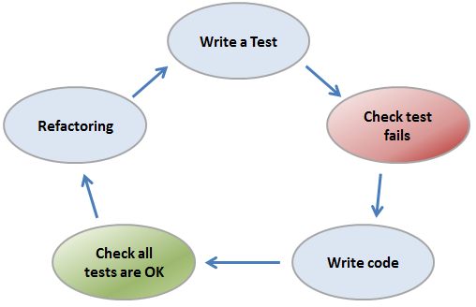
TDD – TEST DRIVEN DEVELOPMENT
The Test Driven Development (TDD) is a software engineering practice that requires unit tests to be written before the code they are supposed to validate. Coming from the Agile world in which it is a basic practice of the Extreme programming (XP) method, TDD is nowadays recognized as a discipline in its own right that is also used outside the agile context.

Slide 16
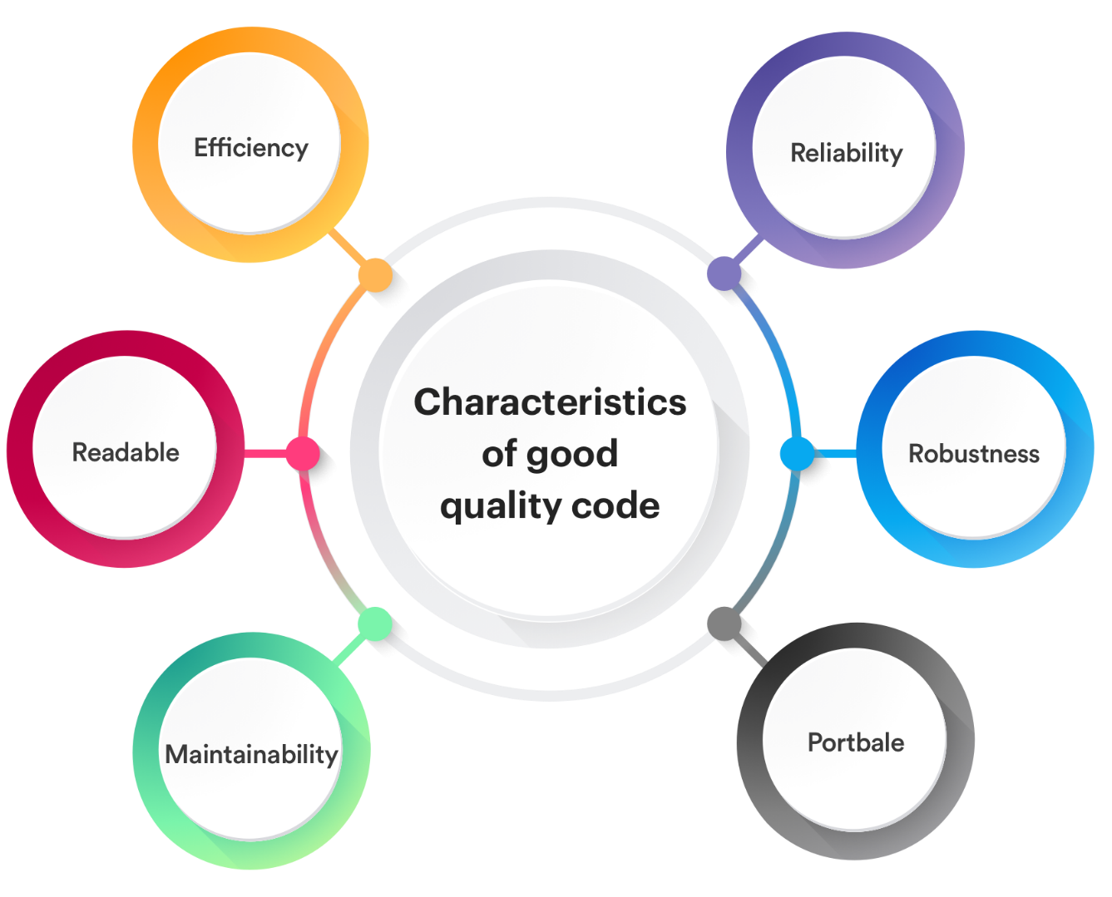
CODE QUALITY
Quality itself is quite difficult to define
Code quality is subjective – It requires human judgment
From a human point of view source code can be written in a way that influences the effort needed to comprehend its behavior
A well written program it’s a program where cost of implementing a feature is constant throughout the program's lifetime

Slide 17
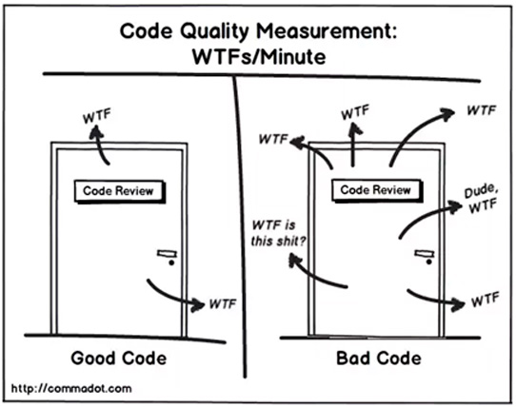
CODE QUALITY METRICS
Metrics are used by software industry to quantify the development operation and maintenance of software
They give us knowledge of the status of an attribute of the software and help us to evaluate it in an objective way
A software quality metric it’s a function which inputs are software data and whose output is a single numerical value that can be interpreted as the degree to which software possesses a given attribute that affects its quality

Slide 18
CODE QUALITY METRICS
Balanced scorecard | Halstead Complexity
Bugs per line of code | Instruction path length
Code coverage | Number of classes and interfaces
Cohesion | Number of lines of code
Comment density | Number of lines of customer requirements
Connascent software components | Program execution time
Coupling | Program load time
Cyclomatic (McCabe’s) complexity | Program size (binary)
DSQI (Design Structure Quality Index) | Robert Cecil Martin’s software package metrics
Function point analysis | Weighted Micro Function Points

Slide 19

CODE COVERAGE
Code Coverage – In computer science, test coverage is a measure used to describe the degree to which the source code of a program is executed when a particular test suite runs
To measure what percentage of code has been exercised by a test suite, one or more coverage criteria are used. Coverage criteria are usually defined as rules or requirements, which a test suite needs to satisfy

Slide 20
COVERAGE CRITERIA
Function coverage – has each function (or subroutine) in the program been called?
Statement coverage – has each statement in the program been executed?
Edge coverage – has every edge in the Control flow graph been executed?
Branch coverage – has each branch (also called DD-path) of each control structure (such as in if and case statements) been executed? For example, given an if statement, have both the true and false branches been executed? This is a subset of edge coverage.
Condition coverage (or predicate coverage) – has each Boolean sub-expression evaluated both to true and false?

Slide 21
INTEGRATION LEVEL
Acceptance
Testing on the Integration Test Level
is called Integration testing
Integration Test Level
Who | DEVs, QCs
When | Units to be integrated are developed
Why | To expose faults in the interaction between integrated units
How | White-box/ Black-box/ Grey-box Depends on definite units
System
Integration
Component (Unit)

Slide 22
SYSTEM LEVEL
Acceptance
Testing on the System Test Level
is called System testing
System Test Level
Who | QCs
When | Separate units are integrated into System
Why | To evaluate the system’s compliance with the specified requirements
How | Black-box testing
System
Integration
Component (Unit)

Slide 23
ACCEPTANCE LEVEL
Acceptance
Testing on the Acceptance Test Level is called
Acceptance testing
Acceptance Test Level
Who | People who have not been involved into development
When | Component is developed
Why | To evaluate the system’s compliance with the business requirements and assess whether it is acceptable for delivery
How | Black-box testing
System
Integration
Component (Unit)

Slide 24
ACCEPTANCE TESTING
Common forms of acceptance testing include the following:
User acceptance testing
Operational acceptance testing
Contractual and regulatory acceptance testing
Alpha and beta testing
Alpha & Beta
Internal Acceptance Testing (Alpha Testing)
External Acceptance Testing (Beta Testing)
Notes:
User acceptance testing (UAT)
The acceptance testing of the system by users is typically focused on validating the fitness for use of the system by intended users in a real or simulated operational environment. The main objective is building confidence that the users can use the system to meet their needs, fulfill requirements, and perform business processes with minimum difficulty, cost, and risk
Operational acceptance testing (OAT)
The acceptance testing of the system by operations or systems administration staff is usually performed in a (simulated) production environment. The tests focus on operational aspects, and may include:
Testing of backup and restore
Installing, uninstalling and upgrading
Disaster recovery
User management
Maintenance tasks
Data load and migration tasks
Checks for security vulnerabilities
Performance testing
The main objective of operational acceptance testing is building confidence that the operators or system administrators can keep the system working properly for the users in the operational environment, even under exceptional or difficult conditions.
Contractual and regulatory acceptance testing
Contractual acceptance testing is performed against a contract’s acceptance criteria for producing custom-developed software. Acceptance criteria should be defined when the parties agree to the contract. Contractual acceptance testing is often performed by users or by independent testers.
Regulatory acceptance testing is performed against any regulations that must be adhered to, such as government, legal, or safety regulations. Regulatory acceptance testing is often performed by users or by independent testers, sometimes with the results being witnessed or audited by regulatory agencies.
The main objective of contractual and regulatory acceptance testing is building confidence that contractual or regulatory compliance has been achieved.
Alpha and beta testing
Alpha and beta testing are typically used by developers of commercial off-the-shelf (COTS) software who
want to get feedback from potential or existing users, customers, and/or operators before the software
product is put on the market.
Who performs it?
Internal Acceptance Testing (Also known as Alpha Testing) is performed by members of the organization that developed the software but who are not directly involved in the project (Development or Testing). Usually, it is the members of Product Management, Sales and/or Customer Support.
External Acceptance Testing is performed by people who are not employees of the organization that developed the software. Beta testing is performed by potential or existing customers, and/or operators at their own locations. Beta
testing may come after alpha testing, or may occur without any preceding alpha testing having occurred.
One objective of alpha and beta testing is building confidence among potential or existing customers, and/or operators that they can use the system under normal, everyday conditions, and in the operational
environment(s) to achieve their objectives with minimum difficulty, cost, and risk. Another objective may
be the detection of defects related to the conditions and environment(s) in which the system will be used,
especially when those conditions and environment(s) are difficult to replicate by the development team.
References: http://softwaretestingfundamentals.com/acceptance-testing/

Slide 25
TERMS and ABBREVIATIONS
Manual Testing
Automation Testing
Test Levels
Alpha & Beta Testing
Unit / Integration / System / Acceptance Testing
Code Quality Metrics
Code Coverage

Slide 26
To be continued …

Slide 27


