Slide 1
REACT ONLINE MARATHON
Sprint 14. Tests (Session 2) Unit Testing, JS Testing Frameworks: Jest, Jasmine
By Yuriy Bezgachnyuk, November, 2020

Slide 2
AGENDA
Unit Testing
Test Double
Jasmine/Jest Introduction

Slide 3
JUST FOR REMIND
Acceptance
Testing on the Component Test Level is called Component (Unit, Module) testing
System
Component (Unit) Test Level
Who | Software Engineers (DEVs)
When | Component is developed
Why | To validate that each unit of the software performs as designed
How | White-box testing
Integration
Component (Unit)

Slide 4
UNIT TESTING
The primary goal of unit testing is to take the smallest piece of testable software in the application, isolate it from the remainder of the code, and determine whether it behaves exactly as you expect.
Function
Testing Behavior
Piece of code

Slide 5
WHY UNIT TESTING
Reduces the level of bugs in production code
Saves you development time
Saves time in debugging later
A good unit tests a form of documentation
Forces you to confront the problem head on
Allows you to make big changes into the code quickly
Unit tests can be run as frequently as required with different set of input (as a important part of CI process)
Unit test help you really understand the design of the code which you are working on. Instead of writing code to do something, you are starting by outlining all the conditions you are subjecting the code to do and what outputs you’d expect from that

Slide 6
HOW DO YOU PERFORM UNIT TESTING
Start
The goal of unit testing to separate each part of the program and test that the individual parts are working correctly and as intended
While performing unit tests, application code functions are executed in a test environment with sample input
The output obtained is then compared with the expected output for that input. If they match the test passes. If not it is a failure
Unit tests are great for confirming the correctness of the code
Add Test
Run Unit Test
X
Make changes
X
Run Unit Test
Stop

Slide 7
MOCKING
Mocking is a very popular approach for handling dependencies while unit testing
Mocking is a way to replace a dependency in a unit under test with a stand-in for that dependency. The stand-in allows the unit under test to be tested without invoking the real dependency
Dependency
Test
Unit under test
Mock

Slide 8
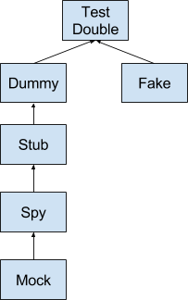
TEST DOUBLE
Most of information systems consist of a lot of modules/components/services, etc. All these parts have dependencies between each other
One of the main postulate of Unit Testing – isolation
Test Double – special testing technique for substitution real dependencies (components/services, etc.) on a test-specific equivalent
Dummy
Fake
Stubs
Spies
Mock
*More details here: https://martinfowler.com/bliki/TestDouble.html

Slide 9
Before starting learning JS Frameworks for testing you need to know that almost all of them have the same structure

Slide 10


Slide 11
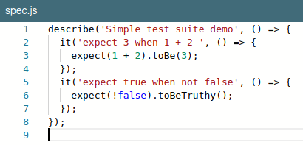
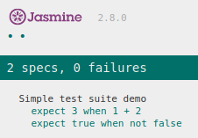
JASMINE INTRO
Jasmine is a behavior-driven testing framework for JavaScript programming language
It’s a bunch of tools that you can use to test JavaScript code
Core methods: describe(<test_suit_name>) – define a test suite it(<specification>) – define a test specification expect(...) – define a test expectation
Simple test

Slide 12
MATCHERS*
Common Matchers
toEqual() checks if two thing are equivalent
toBe() checks if two things are the same object, not just they are equivalent
Truthiness
toBeNull() matches only null
toBeUndefined() matches only undefined
toBeDefined() is the opposite of toBeUndefined
toBeTruthy() matches anything that an if statement treats as true
toBeFalsy() matches anything that an if statement treats as false
*In Jest framework name of the matchers are the same!!!

Slide 13
MATCHERS (2)
Numbers
toBeGreaterThan()
toBeGreaterThanOrEqual()
toBeLessThan()
toBeLessThanOrEqual()
toBeCloseTo()
The toBeGreaterThan and toBeLessThan matchers check if something is greater than or less than something else
toBeCloseTo allows you to check if a number is close to another number, given a certain amount of decimal precision as the second argument

Slide 14
MATCHERS (3)
Strings
toMatch()
The toMatch matcher used for RegExp checks expect("jasmine@example.com").toMatch("\w+@\w+\.\w+");
Arrays and iterables
toContain(<what>) – checks if <what> is a member of a sequence (array)

Slide 15


Slide 16
JEST
Jest is a delightful JavaScript Testing Framework with a focus on simplicity
Developed by Facebook
Features:
Zero config – Jest aims to work out of the box, config free, on most JavaScript projects
Snapshots – Make tests which keep track of large objects with ease. Snapshots live either alongside your tests, or embedded inline
Isolated – Tests are parallelized by running them in their own processes to maximize performance
Code coverage – present in the box no additional configuration needed
Easy mocking – Jest uses a custom resolver for imports in your tests, making it simple to mock any object outside of your test’s scope

Slide 17
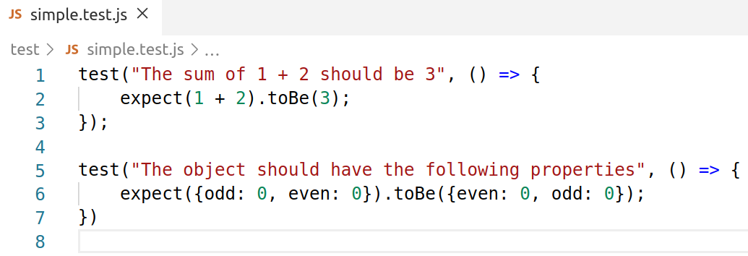
TESTING WITH JEST
The basic functionality of testing is incapsulated into test() method
The signature of test method is following test(name, fn, timeout) also the it() alias can be used (so, the code will be the same as in jasmine ☺)

Slide 18
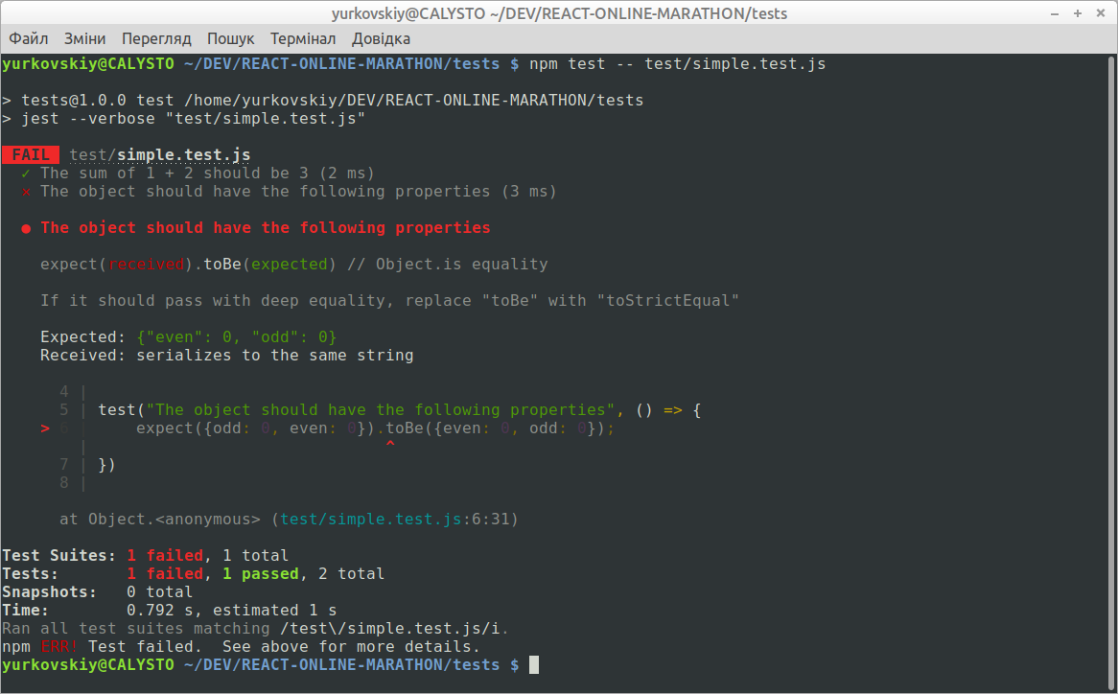

Slide 19
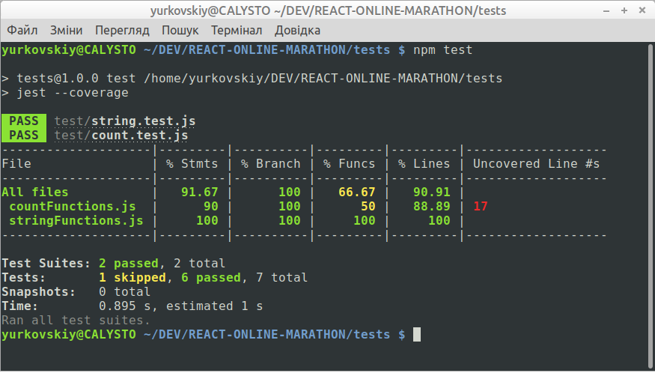
JEST (CODE COVERAGE)
The code coverage is present in jest framework no additional packages needed!
Just run jest with --coverage key

Slide 20
TERMS and ABBREVIATIONS
Unit Testing
Test Double
Mocking
Stubbing
Code Quality Metrics
Code Coverage

Slide 21
To be continued …

Slide 22


