Slide 1
REACT ONLINE MARATHON
Sprint 14. Tests (Session 3) Jest Advanced. Testing React Components [Intro] By Yuriy Bezgachnyuk, November, 2020

Slide 2
AGENDA
Advanced Jest features
Testing async code
Promises, async, await
Configuring tests
Mock
Snapshots (Testing React Components)

Slide 3


Slide 4
Testing Async code
It's common in JavaScript for code to run asynchronously. When you have code that runs asynchronously, Jest needs to know when the code it is testing has completed, before it can move on to another test. Jest has several ways to handle this:
Callbacks
Promises
async/await
*Here some info https://jestjs.io/docs/en/asynchronous

Slide 5
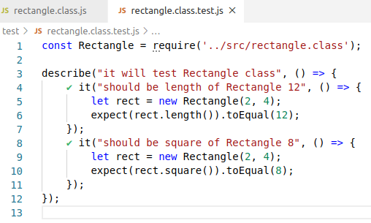
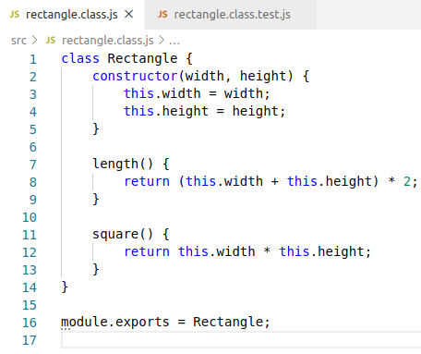
CONFIGURING TESTS
Often while writing tests you have some setup work that needs to happen before tests run, and you have some finishing work that needs to happen after tests run
Try to always follow the DRY principle!!!

Slide 6
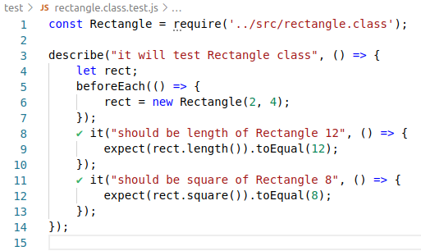
CONFIGURING TESTS [METHODS]
Repeating setup for many tests
If you have some work you need to do repeatedly for many tests, you can use beforeEach and afterEach
One-Time Setup
In some cases, you only need to do setup once, at the beginning of a file. This can be especially bothersome when the setup is asynchronous, so you can't do it inline. Jest provides beforeAll and afterAll to handle this situation
Scoping
By default, the before and after blocks apply to every test in a file. You can also group tests together using a describe block. When they are inside a describe block, the before and after blocks only apply to the tests within that describe block

Slide 7
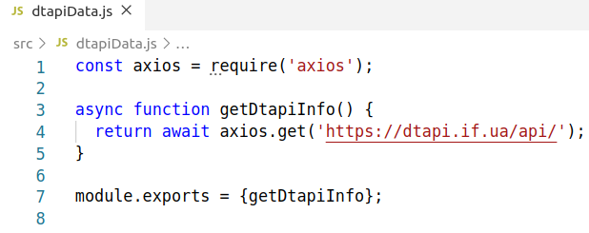
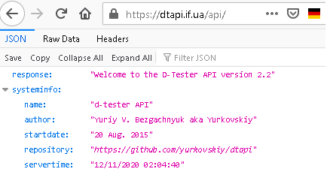
JEST [Mocking]
Mock functions allow you to test the links between code by erasing the actual implementation of a function
Let’s consider that we have some function which is making the call to the external server by using AJAX approach

Slide 8
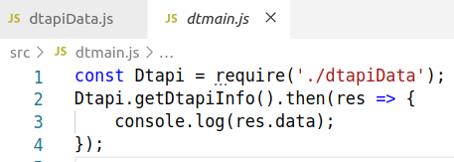
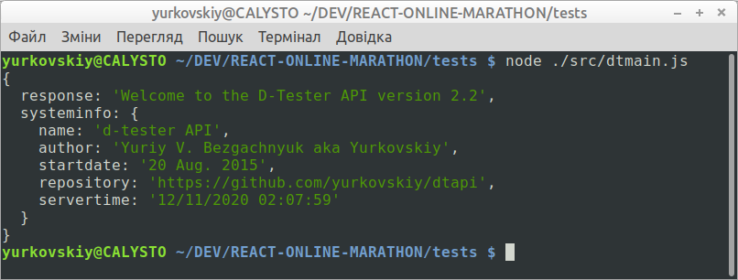
JEST [Just Example]

Slide 9
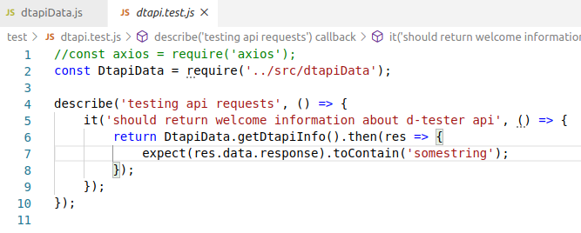
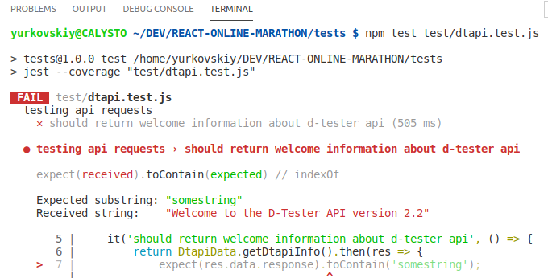
JEST [Example w/o mocking]

Slide 10
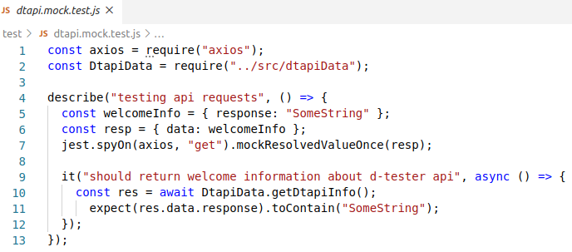
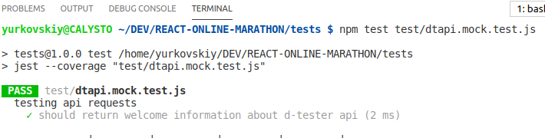
JEST [Example with mocking]
Data for substitution

Slide 11
JEST SNAPSHOTS
Snapshot tests are a very useful tool whenever you want to make sure your UI does not change unexpectedly
A typical snapshot test case renders a UI component, takes a snapshot, then compares it to a reference snapshot file stored alongside the test. The test will fail if the two snapshots do not match: either the change is unexpected, or the reference snapshot needs to be updated to the new version of the UI component
Example needed! ☺

Slide 12
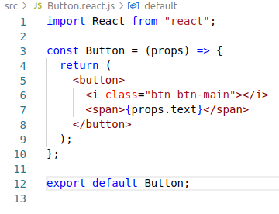
JEST SNAPSHOTS [EXAMPLE]
Let’s consider that the Button component is developed by using the following code
Let’s write some tests with using Jest snapshots
For using snapshots the component renderer is needed. One of the popular package is React Test Renderer
React Test Renderer renders React components to JSON trees. It is used by the Snapshot Testing feature of Jest and is available as react-test-renderer npm package

Slide 13
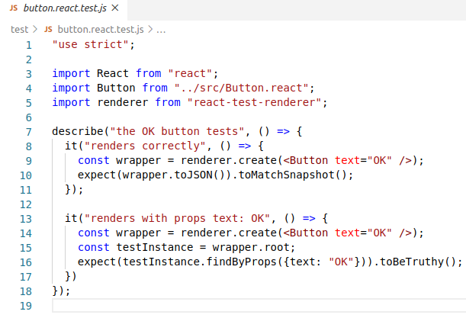
TESTING SNAPSHOTS
Let’s write some tests for testing Button component
Important
Jest creates snapshot file when the first time test run
So, when the test will be updated then it will be failed due to “old” snapshot
To solve the problem with “old” snapshot just add --updateSnapshot key when running tests

Slide 14
TERMS and ABBREVIATIONS
Mocking
Stubbing
Spies
Snapshots

Slide 15
Probably the end ☺

Slide 16


