Slide 1
REACT HOOKS
By Dmytro Minochkin

Slide 2

HOOKS?

Slide 3

HOOKS?!

Slide 4
REACT FUNCTIONAL COMPONENTS
Cools new way to create slick component
Problem
No way of using state in functional components
No way of using lifecycle methods in functional components
Called Stateless Functional Components

Slide 5
REACT HOOKS
“Hooks are the functions that let you “hook into” the React state and lifecycle features in functional components.”
React provides many built-in hooks and also allows us to create our own custom hooks.

Slide 6
USESTATE
allows us to use state inside the functional component.
useState hook accepts a parameter which is the initial value of the state
In class-based components, state is always an object but when using useState, you can provide any value as the initial value
number, string, boolean, object, array, null, etc
The useState hook returns an array
first value is the current value of the state
second value is the function which we will use to update the state
similar to setState method

Slide 7
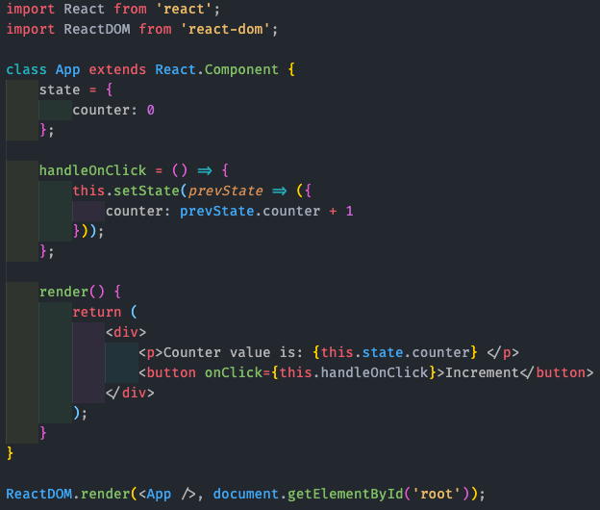
USESTATE

Slide 8
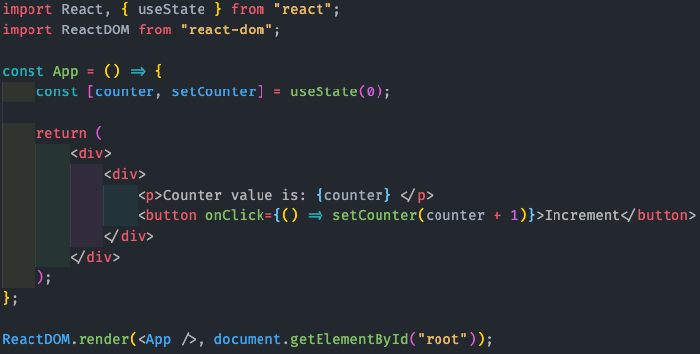
USESTATE

Slide 9
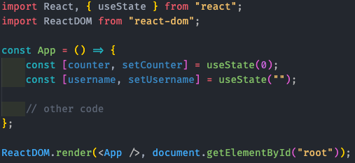
USESTATE
We can have multiple useState calls in a single functional component

Slide 10
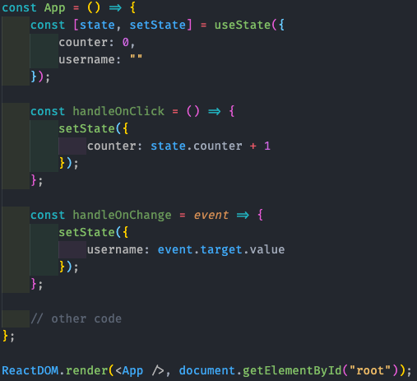
USESTATE
The state is not merged when using useState hook
Because of this, it’s recommended to use multiple useState calls instead of using single useState to store object.
Notes:
This is because using an object in useState will completely replace the object instead of merging it when we set state using setState method.

Slide 11
USEEFFECT
Lets us implement lifecycle methods in functional components
The useEffect hook accepts a function as its first parameter and optional array as the second argument
useEffect lets you perform side effects in a functional component
Data fetching, setting up a subscription, and manually changing the DOM in React components are all examples of side effects
useEffect serves the same purpose as componentDidMount, componentDidUpdate, and componentWillUnmount combined together

Slide 12
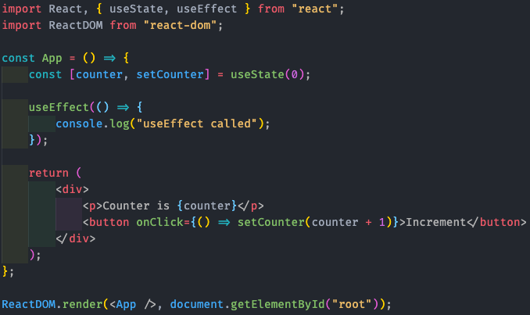
USEEFFECT
If you run the code, you will see that function provided in useEffect is invoked immediately on page load
when the component is mounted.
It will also be called when the component is re-rendered when any state or prop changes

Slide 13

USEEFFECT
If you want the effect to be called only when the component is mounted, you need to provide an empty array as the second argument to useEffect call.

Slide 14
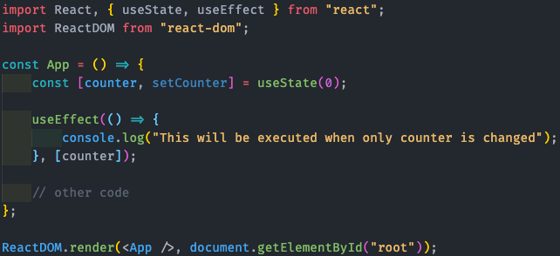
USEEFFECT
By providing the variable in dependencies array, the effect will be executed only when those variables are changed

Slide 15
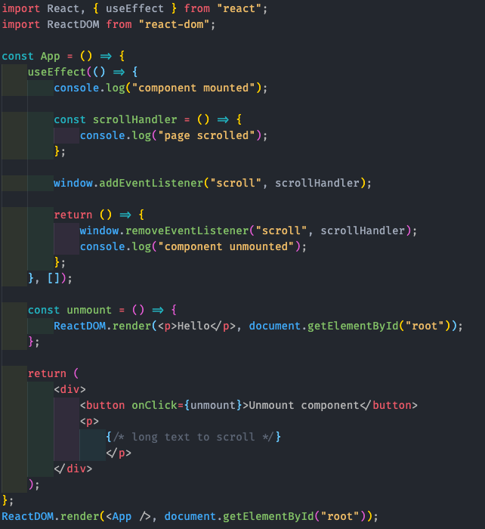
CLEANING UP THE EFFECT
If you return a function from the useEffect, it will be called before the component will be unmounted
similar to componentWillUnmount method.

Slide 16
USEEFFECT
It is important to note that in the child component, useEffect will be called for every re-render of the parent component.
You can also have multiple useEffect calls in a single functional component, each doing different tasks, and React will call them in the order they are defined in the component.

Slide 17
USEREDUCER
Allows us to use redux for handling complex calculations without the need of installing the redux library
So it helps to avoid the creation of boilerplate redux action, reducer code
useReducer is usually preferable to useState when you have complex state logic that involves multiple sub-values or when the next state depends on the previous one

Slide 18
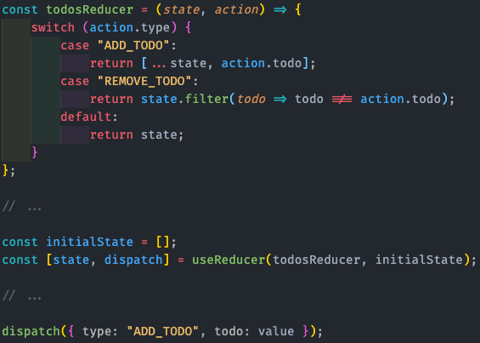
USEREDUCER

Slide 19
SUMMARY
Only call Hooks at the top level.
Don’t call Hooks inside loops, conditions, or nested functions.
By following this rule, you ensure that Hooks are called in the same order each time a component renders.
That’s what allows React to correctly preserve the state of Hooks between multiple useState and useEffect calls.
Only call Hooks from React function components.
Don’t call Hooks from regular JavaScript functions.

Slide 20


