Slide 1
VIRTUAL DOM
By Dmytro Minochkin

Slide 2
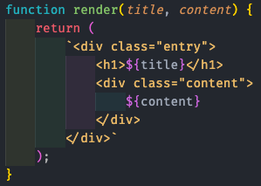
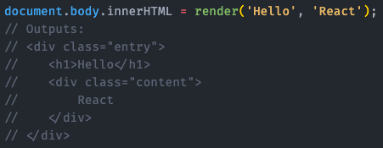
SIMPLE TEMPLATING

Slide 3
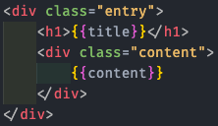
TEMPLATING - HANDLEBARS

Slide 4
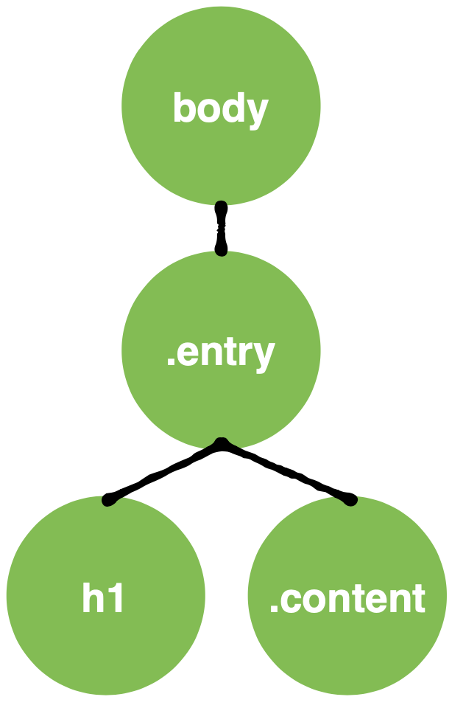
INEFFICIENT
Recreating the entire DOM every time you want to update

Slide 5
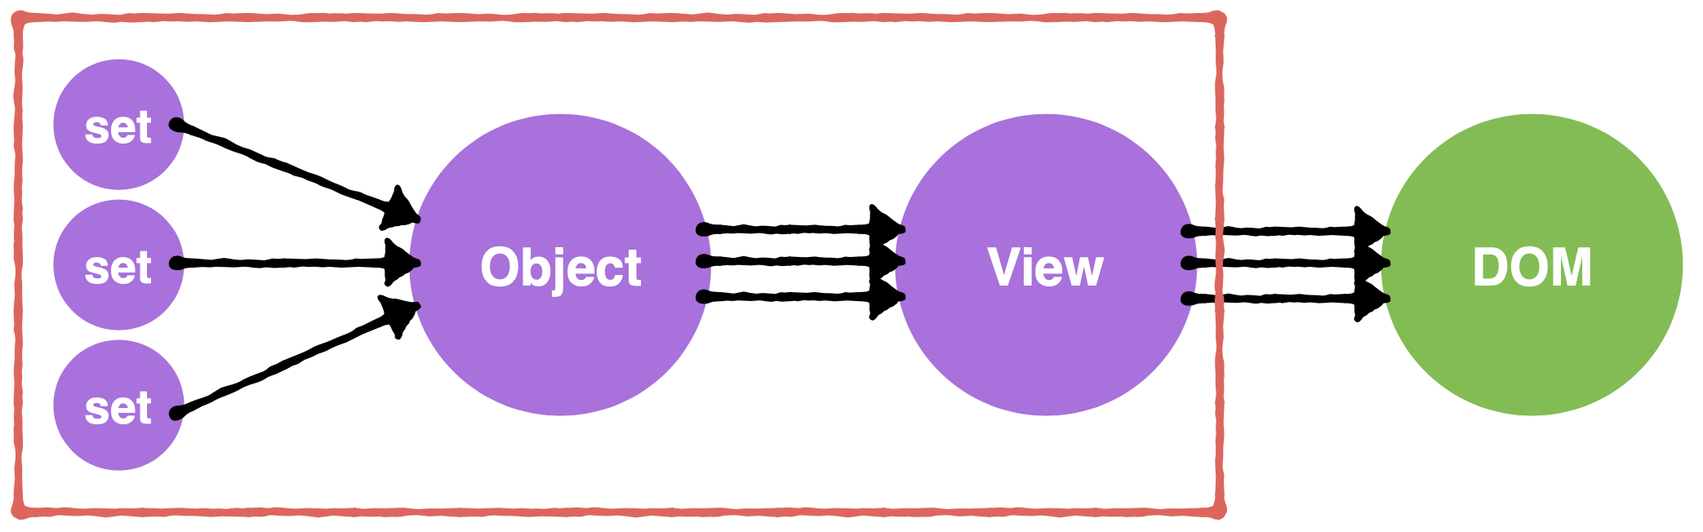
THE PROBLEM AT SCALE
Developer code

Slide 6
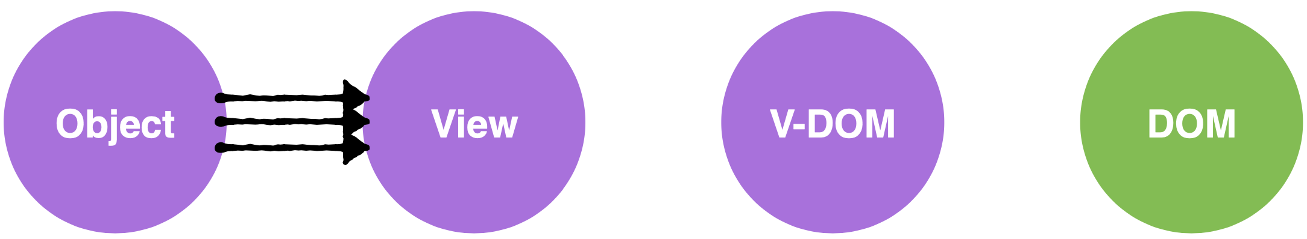
MEET VIRTUAL DOM

Slide 7
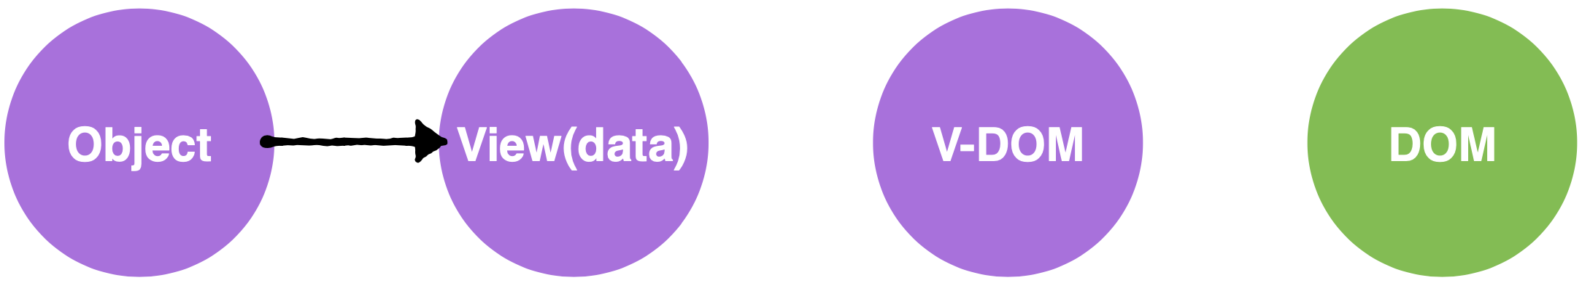
MEET VIRTUAL DOM

Slide 8
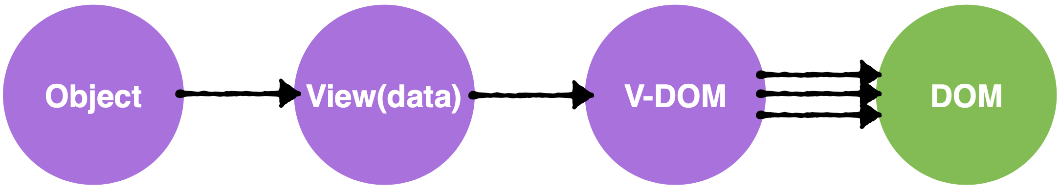
MEET VIRTUAL DOM

Slide 9
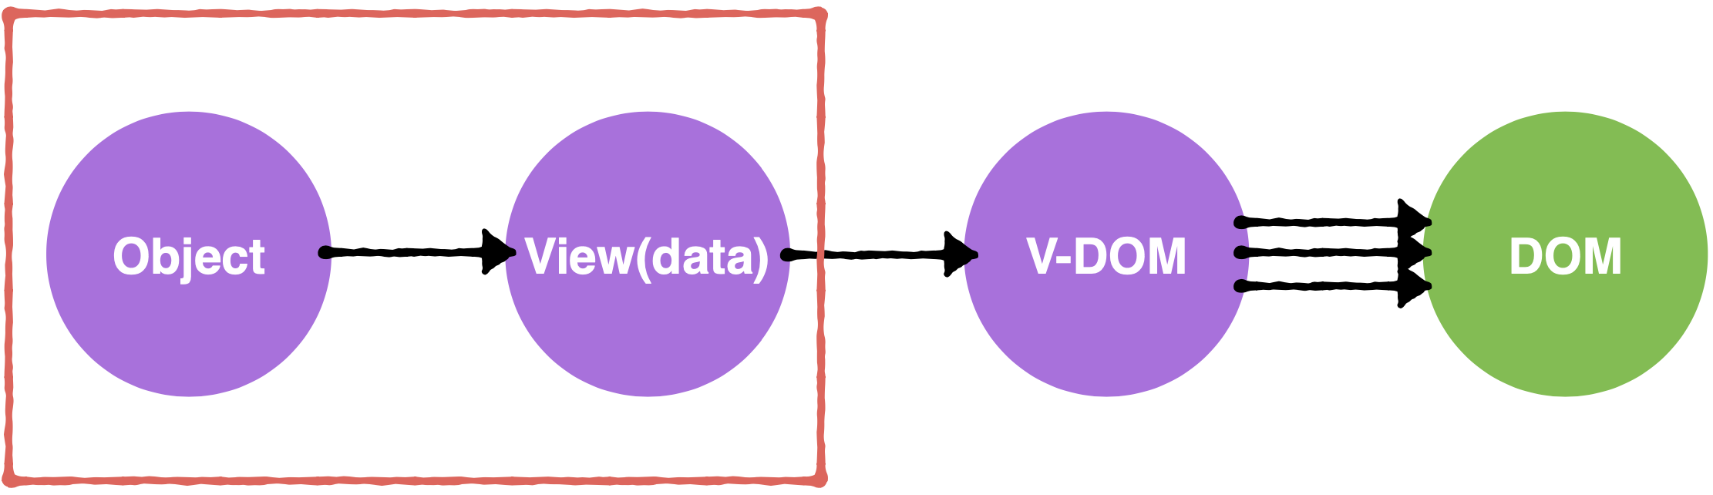
MEET VIRTUAL DOM
Developer code

Slide 10
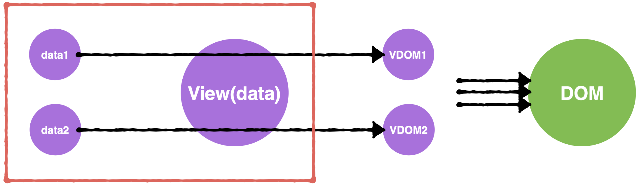
DIFF
<div class="entry">
<h1>
- Templating
+ Virtual DOM
</h1>
<div class="content">
Easy to understand
</div>
</div>

Slide 11
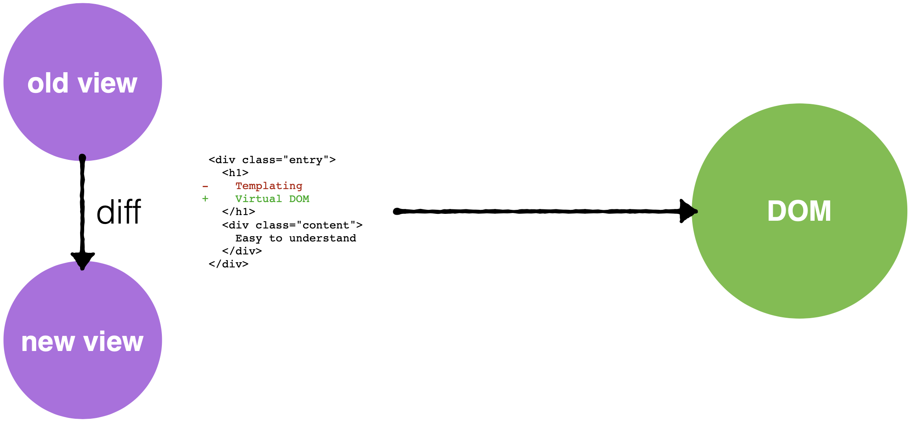
DIFF

Slide 12
SUMMARY
Stateless component
Fast O(n)
Decouple view layer with DOM

Slide 13


