Slide 1
React Online Marathon

Slide 2

Tools

Slide 3

Babel
Babel Input -arrow function
Babel is a toolchain that is mainly used to convert code into a backwards compatible version of JavaScript in current and older browsers or environments
https://babeljs.io/
Babel Output -ES5 equivalent

Slide 4
Babel
To work with BabelJS we need following setup −
NodeJS
Npm
Babel-CLI
Babel-Preset
IDE for writing code

Slide 5
Babel
Babel comes with a built-in CLI where the code can be easily compiled on the command line. It also has features like plugins and presets to be used along with the command making it easy to transpile the code at one go.

Slide 6
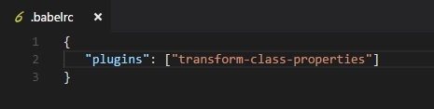
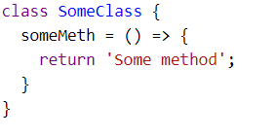
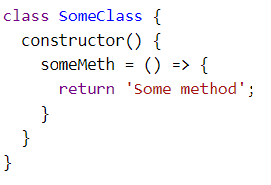
Babel
Babel-Plugins
Plugins are config details for Babel to transpile the code. Babel supports a number of plugins, which can be used individually, if we know the environment in which the code will execute.

Slide 7
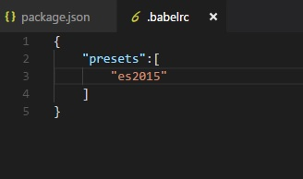
Babel
Babel-Presets
Babel presets are a set of plugins, i.e., config details to the babel-transpiler that instruct Babel to transpile in a specific mode. We need to use presets, which has the environment in which we want the code to be converted. For example, es2015 preset will convert the code to es5.

Slide 8
Babel
Babel has two parallel config file formats, which can be used together, or independently.
Project-wide configuration
babel.config.json files, with the different extensions
File-relative configuration
.babelrc.json files, with the different extensions
package.json files with a "babel" key

Slide 9
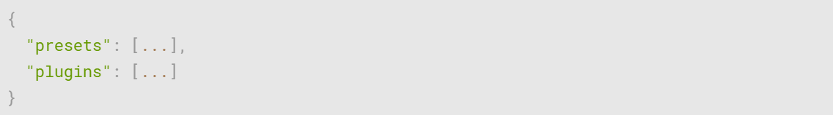
Babel
babel.config.json and .babelrc.json

Slide 10
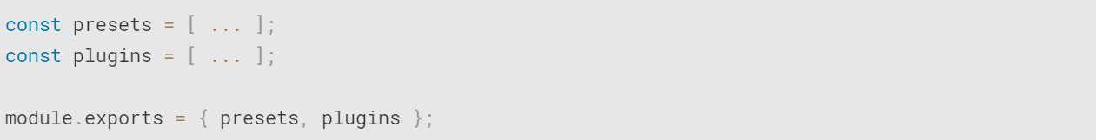
Babel
babel.config.json and .babelrc.json also can be written using JavaScript

