Slide 1

React Online Marathon

Slide 2

Tools
Notes:
Тулзи, тобто інструменти, що використовуються у веб розробках. Починаємо з npm.

Slide 3
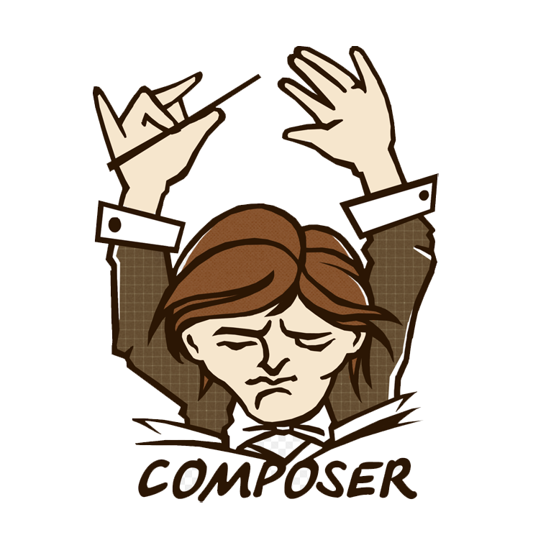
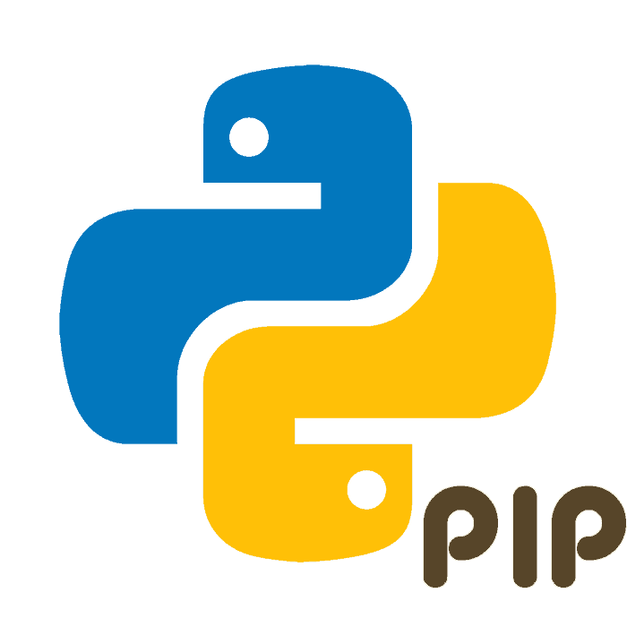


npm
npm is the package manager for Node.js, analogous to:
https://www.npmjs.com/
Notes:
Npm – менеджер пакетів для нодеджс,
скожими в цьому до нього інструментами є піп в розробка на пайтон , мевен для джави, джем для рубі, композер в пі-ейч-пі

Slide 4


npm
There are several alternatives, like Yarn and Turbo, but npm is automatically installed when you install Node.js
Notes:
Є альтернативні до npm менеджери пакетів, наприклад – yarn, turbo. Npm характерно відрізняє те, що автоматично інсталюється разом з node.js

Slide 5
package.json
It is a valid JSON object
Required name and version fields
the "name" field contains your package's name, and must be lowercase and one word, and may contain hyphens and underscores
the "version" field must be in the form x.x.x and follow the semantic versioning guidelines
Some used fields in package.json:
description
keywords
dependencies
homepage
bugs
scripts
Notes:
Є альтернативні до npm менеджери пакетів, наприклад – yarn, turbo. Npm характерно відрізняє те, що автоматично інсталюється разом з node.js

Slide 6
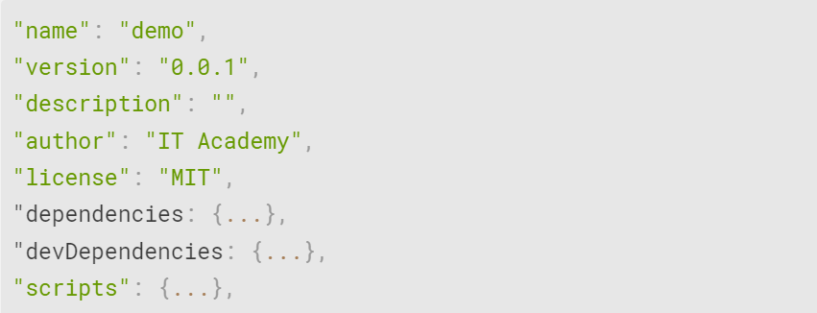
package.json
Here is how a short basic package.json looks like:
Notes:
Є альтернативні до npm менеджери пакетів, наприклад – yarn, turbo. Npm характерно відрізняє те, що автоматично інсталюється разом з node.js

Slide 7
Installing Packages
npm comes along with Node.js
to install a package run:
npm install <package-name>
npm install <tarball file>
npm install <tarball url>
install a package globally:
npm install –g <package-name>

Slide 8
Installing Packages
Some options:
Option | Meaning
-g, --global | installs the current package context as a global package
-P, --save-prod | package will appear in your dependencies (this is the default unless -D or -O are present)
-D, --save-dev | package will appear in your devDependencies
-O, --save-optional | package will appear in your optionalDependencies

Slide 9
Installing Packages
Some options:
Option | Meaning
--no-save | prevents saving to dependencies
-E, --save-exact | saved dependencies will be configured with an exact version rather than using npm's default SemVer range operator
-B, --save-bundle | saved dependencies will also be added to your bundleDependencies
--production | npm will not install modules listed in devDependencies

Slide 10
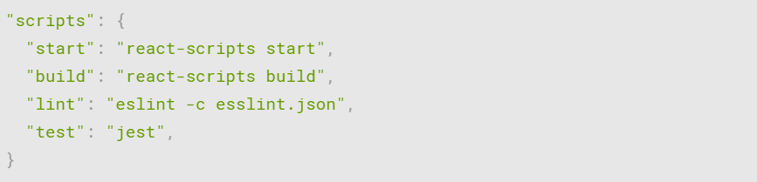
scripts
Here we put out project’s scripts: building, testing, linting, deploying, etc.
Each project can have custom-made scripts adapted for a unique use-case.

Slide 11
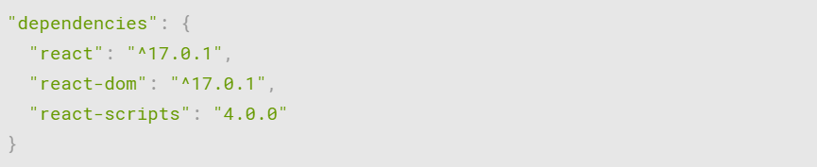
dependencies
Required for building the project. They are specified in a simple object that maps a package name to a version range.

Slide 12
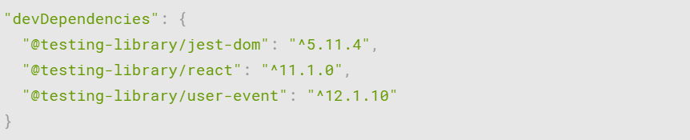
devDependencies
The dependencies needed only for the development of the project but not for building it. For example, testing frameworks are not bundled into the final code build but are used only in development.

Slide 13
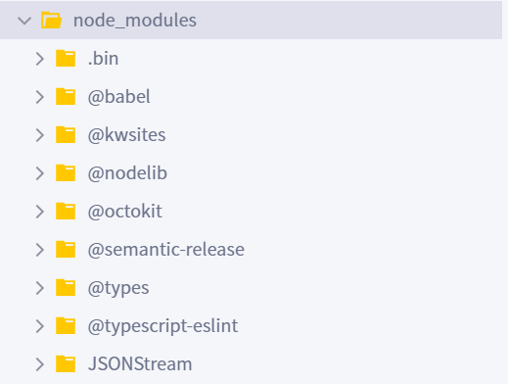
node_modules
When you run npm install, npm installs the required packages into your project root directory in a folder called node_modules

Slide 14
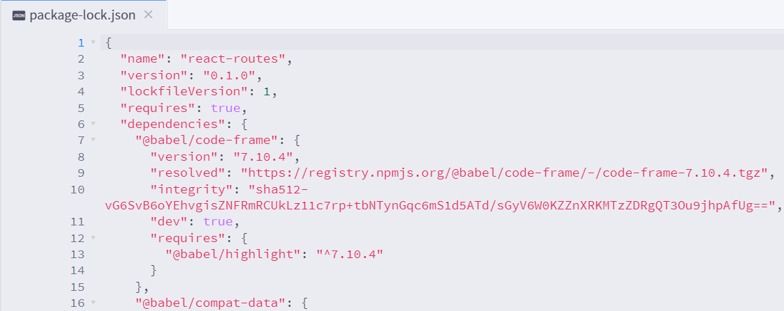
package-lock.json
package-lock.json is generated automatically for any operations where npm modifies either the node_modules tree, or package.json. It describes the exact tree that was generated, such that subsequent installs can generate identical trees.

Slide 15
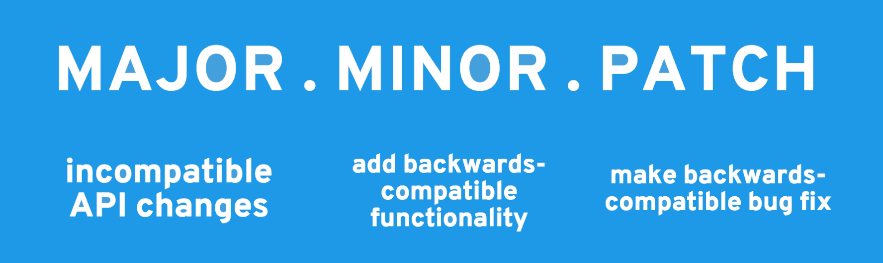
Semantic Versioning
By default, when installing a npm package without specifying a version, npm installs the latest version published to the NPM registry.
Npm ecosystem uses Semantic Versioning, or SemVer, as the standard for version numbers which follows the convention:

Slide 16
Semantic Versioning
You can specify which update types your package can accept from dependencies in your package's package.json file
Notation | Meaning
~version | Approximately equivalent to version
version | Must match version exactly
>version | Must be greater than version
>=version | etc
1.2.x | 1.2.0, 1.2.1, etc., but not 1.3.0
* | Matches any version
latest | Obtains latest release

