Slide 1
React Online Marathon

Slide 2

Tools

Slide 3
Webpack
At its core, webpack is a static module bundler for modern JavaScript applications.
https://webpack.js.org/

Slide 4
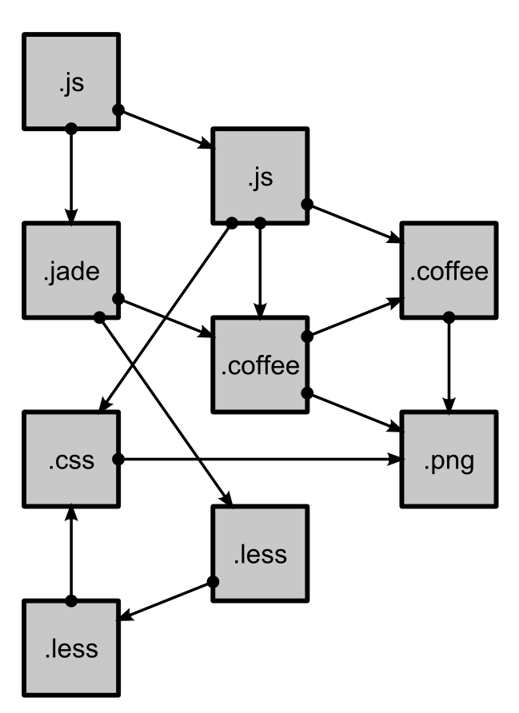
Webpack
At its core, webpack is a static module bundler for modern JavaScript applications. When webpack processes your application, it internally builds a dependency graph which maps every module your project needs
modules with dependencies

Slide 5
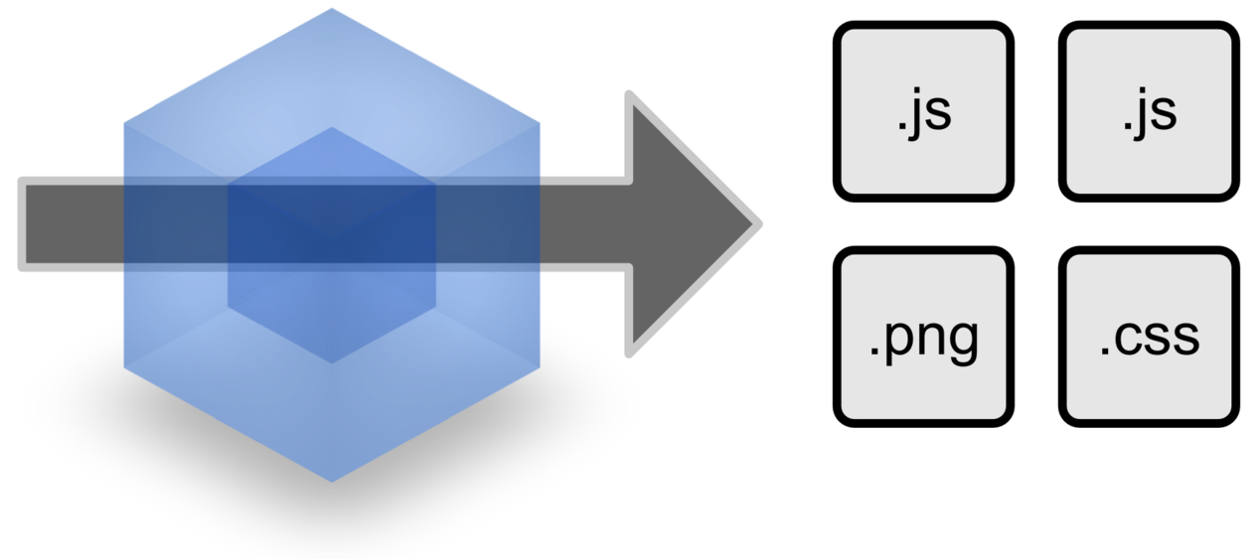
Webpack
static assets
At its core, webpack is a static module bundler for modern JavaScript applications. When webpack processes your application, it internally builds a dependency graph which maps every module your project needs and generates one or more bundles

Slide 6


Webpack
Webpack may not require to use a configuration file. It will assume the entry point of your project is src/index.js and will output the result in dist/main.js minified and optimized for production
entry point
result
index.js
main.js
src
dist

Slide 7
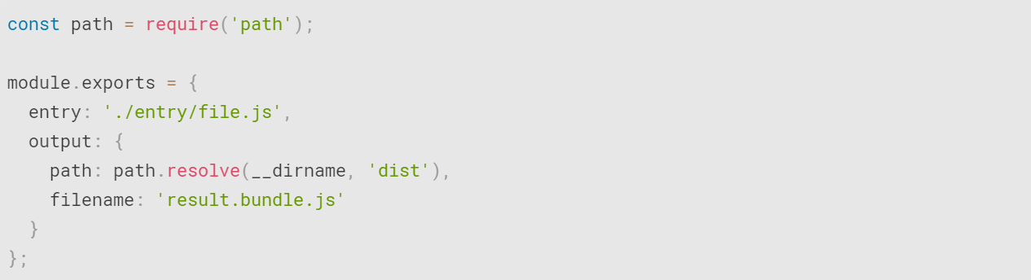
Webpack
If need to extend this functionality you can create a webpack.config.js file in the root folder

