Slide 1
Welcome!
Fintech Bootcamp
Project 2

Slide 2
Rita
Introduction
Project Title
Project Summary
Florante
About the Project
Project & Modelling Tools
Data Preparation
Dennis
Signal Indicators
Lachlan
Neural Networks
David
BTC & Machine Learning

Slide 3
Introduction
Fintech Bootcamp
Project 2

Slide 4
Algorithmic Trading Bot
Project 2
FinTech
Boot
Camp
Group 1
1.O
Crypto currency

Slide 5












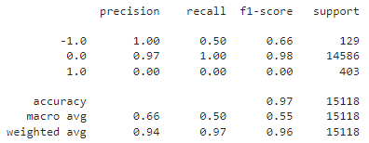



Algorithmic Trading Bot
Project 2
FinTech
Boot
Camp
Group 1
1.O
Crypto currency
BTC
Bitcoin
ETH
Ethereum
96%
EVERY HOUR
DOGE
Dogecoin
05.12.2022
Project Goal
Predicting trading signal for testing data
Bot Team Members
Create an algorithmic trading bot coupled with machine learning that successfully trades and outperforms simple buy and hold above mentioned coins.
Rita Thomas
Dennis Mader
Lachlan Andrews
David Newman
Florante Miranda
94%
96%

Slide 6

About The Project
The value of crypto is very volatile and often fluctuates by huge amounts within a short period of time. This can leave some investors holding the bag when prices come crashing down
Creating an algorithmic trading bot coupled with machine learning could help offset some risk as the machine learning portion could potentially predict future prices by using previous price history as a guide
Problem to be solved
How are we going to solve it
What analysis you might be able to give/insights
What we are trying to predict/classify with the usage of a machine learning algorithm i.e. X features for y prediction
Part of our analysis will be to compare different types of free machine learning modules on offer to see which one is better suited for this exercise
The features we will be using are indicators such as BB, EMA, RSI (possibly more) combined with entry/exit signals in order to predict total portfolio value

Slide 7
Project & Modelling Tools
Libraries
Pandas, numpy, yfinance, finta
Applications
hvplot, matplotlib
Deep Learning Modelling
TensorFlow,
Logistic Regression, Skit-learn, Keras

Slide 8
Data Preparation
STEP 1
STEP 2
Take in the data via the Yfinance library(over 2yr; 1h interval) and turn it into a dataframe
Add daily/hourly returns column
Generate the Features and Target Sets
STEP 3
STEP 4
Create feature set / Create target set
Split the Data Into Training and Testing Datasets
STEP 5
Standardizing the Data

Slide 9
Data Preparation
STEP 6
STEP 7
Incorporate the SVM Machine Learning Into the Trading Strategy
Backtesting a Machine Learning Trading Algorithm
STEP 8
STEP 9
Add a Logistic Regression Model
Compare the performance of the logistic regression and SVM models using the classification reports generated with the testing data

Slide 10
Demo

Slide 11
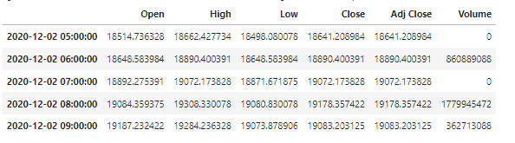
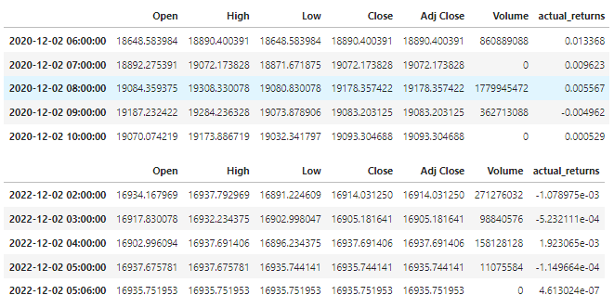
Code/Results
Create dataframe using data downloaded from yFinance; ticker = “BTC-USD”
Add hourly returns column, calculate using closing prices and pct_change function

Slide 12
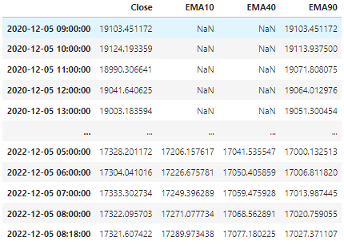
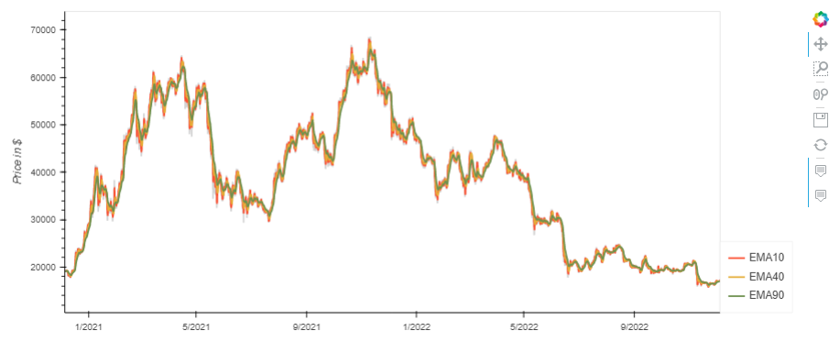
Code/Results
Generating trading indicators for potential use for the trading algorithm - EMA
Visualize close price for the investment & moving averages

Slide 13
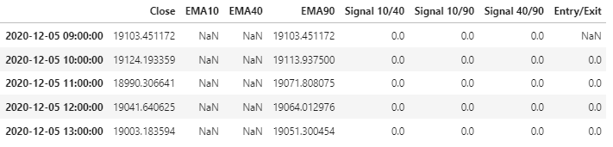
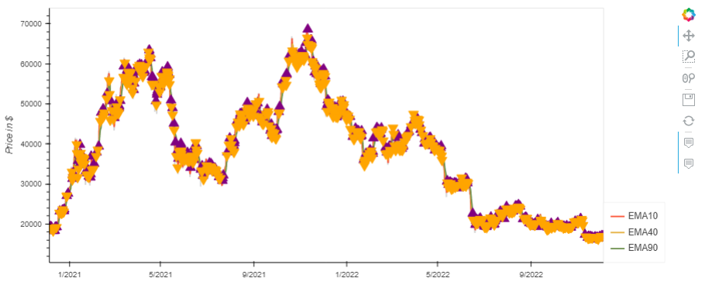
Code/Results
Set EMA signals & Calculate Entry/Exit points: 50/100; 50/200; 100/200
Visualize / Overlay plots:
Entry/exit positions relative to close price
Close price for investment
Moving Averages
Set initial capital = 100000

Slide 14
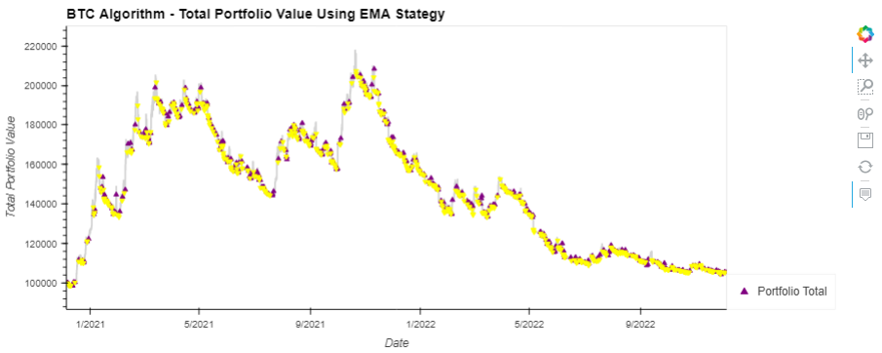
Code/Results
Testing 3-EMA Indicators: 50/100; 50/200; 100/200
Determine ‘Positions’
based on the result of dual EMA crossover Signals
The points in time where a 1-coin position is bought or sold
Calculate
The total portfolio value
The portfolio returns
Portfolio cumulative returns
Visualize / Overlay plots:
Entry/exit positions relative to close price
Close price for investment
Moving Averages

Slide 15
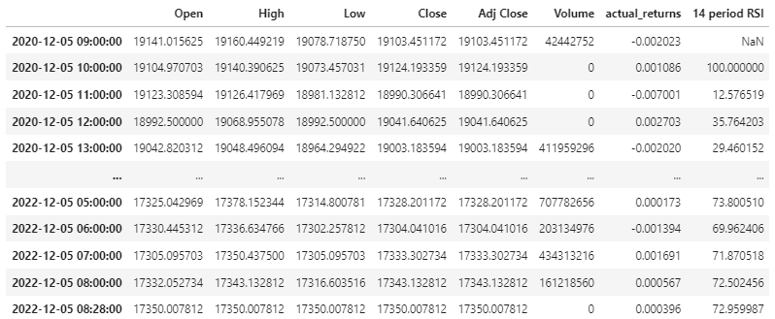
Code/Results
Generating trading indicators for potential use for the trading algorithm - Relative Strength Index (RSI)

Slide 16
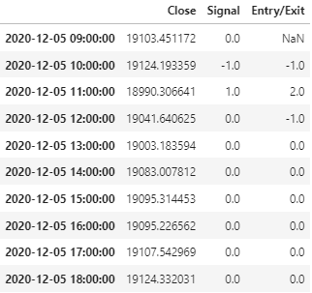
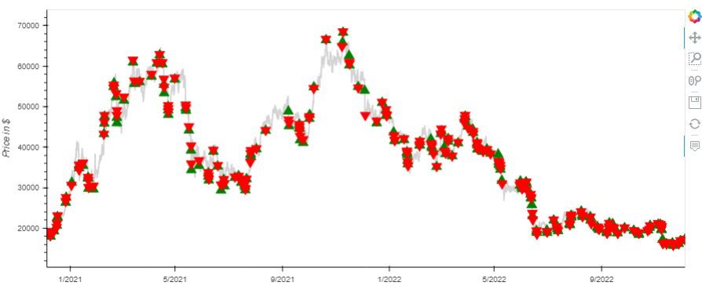
Code/Results
Create
DataFrame for RSI Signals
A trading algorithm for RSI signals & Set Signals column
Generate the trading signals – 1 (entry) or -1 (exit) for a long position trading algorithm
Visualize / Overlay plots:
Entry/exit positions relative to close price
Close price for investment

Slide 17
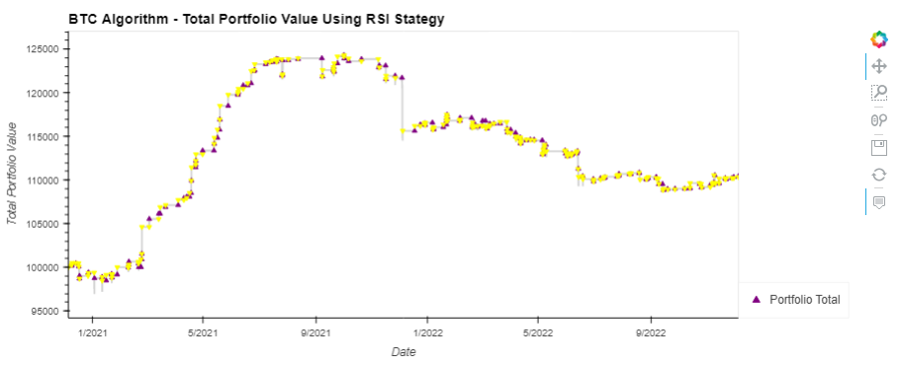
Code/Results
Testing RSI Indicators
Determine ‘Positions’
When RSI <= 25, Buy; RSI >= 80, Sell
Where 1-coin position is bought or sold
Calculate
The total portfolio value
The portfolio returns
Portfolio cumulative returns
Visualize / Overlay plots:
Entry/exit positions relative to close price
Close price for investment
Moving Averages

Slide 18

Code/Results
Standardizing the Data
Create a StandardScaler instance
Apply the scaler model to fit the X-train data
Transform the X_train and X_test DataFrames using the X_scaler

Slide 19
Code/Results
Incorporate the SVM Machine Learning Into the Trading Strategy
Create the classifier model
Fit the model to the data using X_train_scaled and y_train
Use the trained model to predict the trading signals for the training data
Display the sample predictions

Slide 20
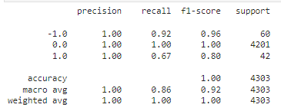
Code/Results
Evaluate the model using a classification report
training_report = classification_report(y_train, training_signal_predictions)
print(training_report)

Slide 21
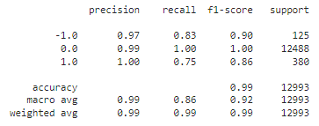
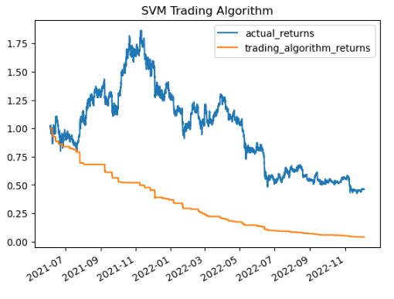
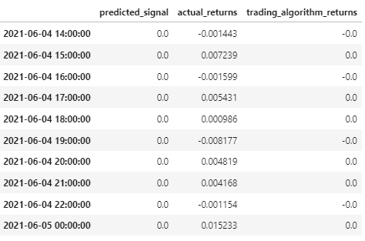
Code/Results
Backtesting a Machine Learning Trading Algorithm
Use the trained model to predict the trading signals for the testing data
Evaluate the model's ability to predict the trading signal for the testing data
Create a new empty predictions DataFrame
Calculate and plot the cumulative returns for the `actual_returns` and the `trading_algorithm_returns

Slide 22
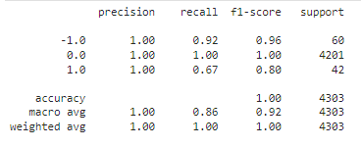
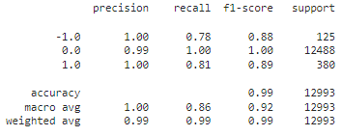
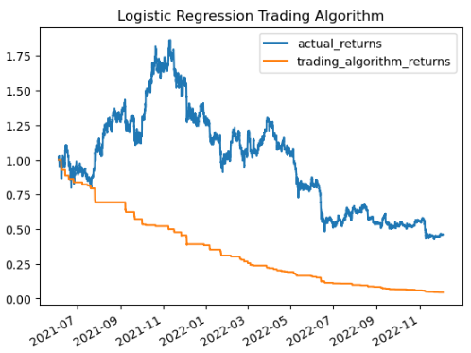
Code/Results
Add Logistic Regression Model
Create an instance of the LogisticRegression Model
Fit the LogisticRegression Model
Use trained LogisticRegression Model
Generate Classification report
Use the trained model to predict the trading signals from the testing data
Generate testing Classifiication report using training data and the LogisticRegression model’s predictions
Calculate and plot the cumulative returns for the `actual_returns` and the `trading_algorithm_returns`

Slide 23
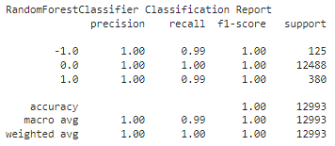
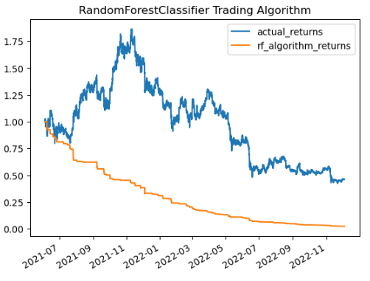
Code/Results
Add Logistic Regression Model (RandomForestClassifer)
Create an instance of the RandomForestClassifier Model
Fit the RandomForestClassifier Model
Use trained RandomForestClassifier Model
Generate Classification report
Plot RandomForestClassifier returns compared to the `actual_returns`

Slide 24
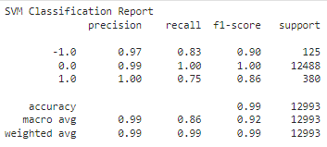
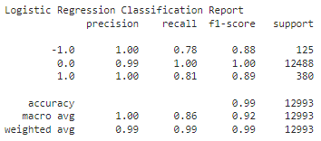
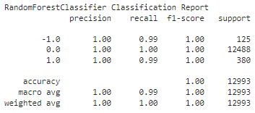
Code/Results
Compare the performance of the SVM, Logistic Regression, and RandomForestClassifier using the classification reports generated with the testing data
Generate SVM Classification report
Generate Logistic Regression Classification Report
Generate Logistic Regression Classification Report

Slide 25
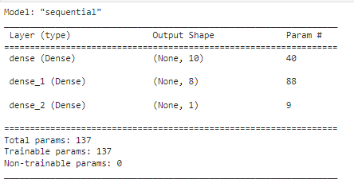
Code/Results
Predicting Signals Neural Networds
Define the number of inputs for the model = 3
Define the number of nodes for the first hidden layer = 10
Define the number of nodes for the second hidden layer = 8
Generate Classification report
Initialising the Sequential Number

Slide 26
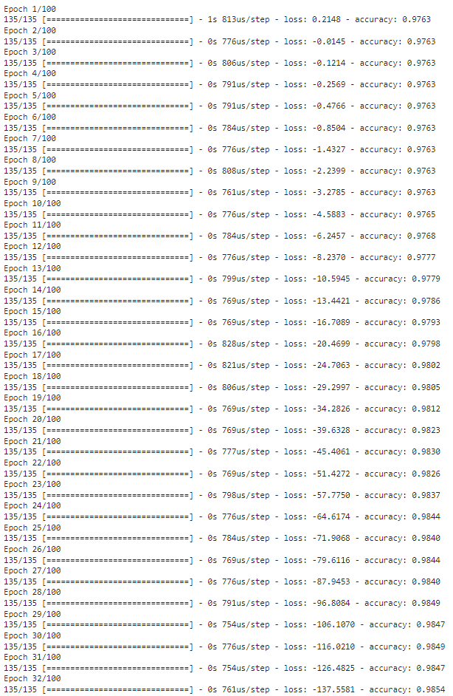
Compile the Sequential model
Code/Results
Predicting Signals Neural Networds
Compile the Sequential Model
Fit the model using 100 epochs and the training data

Slide 27
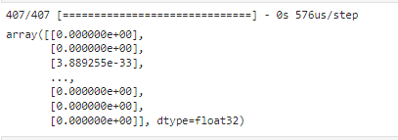
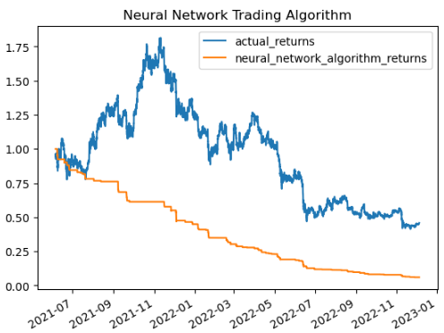
Compile the Sequential model
Code/Results
Predicting Signals Neural Networds
Evaluate the model loss and accuracy metrics using the evaluate method and the test data
Display the evaluation results
Predict the model
Display the evaluation results
neural_network_algorithm_returns = actual_returns * predicted_signal

Slide 28
Thank You!
Compile the Sequential model
End of Presentation

Slide 29
Questions?
Compile the Sequential model

