Slide 1
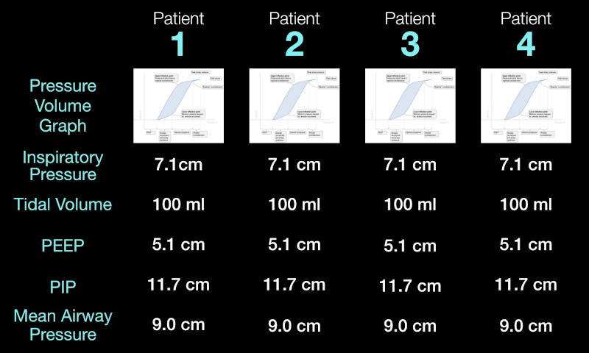
Tubing Data Information Screen
Each column is a patient connected to the port labelled with the number
Each row is a descriptor of the state of the patients's airways
Positive End-Expiratory Pressure
Peak Inspiratory Pressure
At the intersection of a row and column, there is the value of the row's descriptor for the column's patient

