Slide 1




VeriVoice
Voice biometric authentication on MOSIP e-Signet enabling refugee proof-of-life(for remote aid claiming), social cash transfer claims, and wallet payments for government services from a feature phone.

Slide 2

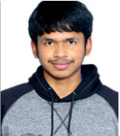



East Africa
Team introduction
Zanzibar,Tanzania| VeriVoice
Indian Institute of Technology Madras, Zanzibar Campus
Nidheesh Deepu Nair
Adireddy Tarun
Snigdha Tripurari
Nirmesh Pat
Anirudha Chowdhury
Nirmesh Niraj Patalbansi
‹#›
All rights reserved. This document is proprietary and confidential.

Slide 3
Time: 1 min
Use case introduction: Focus sector and the challenge that digital ID will solve.
VeriVoice adds a voice authentication layer on top of existing national ID systems — a citizen calls from any keypad phone, speaks a challenge phrase, and a two-stage check (voice biometric match on encrypted templates + speech transcription liveness) verifies their identity against their MOSIP e-Signet-linked national ID, granting access to cash transfers, pension disbursements, and government wallet payments without a smartphone, internet connection, or literacy requirement.
01
What problem are you trying to solve? Who is affected by this issue?
Claiming social cash transfers (Inua jamii, SAGE), proof of life for aid money(Somaliland) are either offline or smartphone based, due to the lack of an authentication layer.Biometric alternatives (fingerprint readers, facial recognition) are not accessible via a keypad phone, OTPs are defeated by rampant SIM-swap fraud(OTP, PIN gets intercepted), and no accessible authentication option exists for the people who own a basic phone but cannot read a screen or visit a service centre.
The affected includes - Rural low-literacy citizens,Feature-phone users,Elderly citizens,Refugees and displaced persons,Victims of SIM-swap fraud.
02
How will your use case idea solve this problem?
‹#›
All rights reserved. This document is proprietary and confidential.

Slide 4
VeriVoice adds a voice authentication layer on top of existing national ID systems (MOSIP esignet) a citizen speaks a challenge phrase over any GSM phone call, a dual-gate check verifies their voice biometric and phrase liveness, then issues a signed consent token to authorise the service. No smartphone, no fingerprint scanner, no OTP, no literacy required.
Low-literacy and elderly citizens navigate entirely via voice prompts in their language. Feature-phone users authenticate over a regular call. Refugees speak once to prove life and claim aid remotely. SIM-swap victims get a credential that cannot be intercepted.
03
How is your solution using Digital ID? Describe
VeriVoice does not create a new identity - it adds a voice interface to the national ID that already exists. During enrolment, a citizen's identity is verified against their national ID through MOSIP e-Signet (fully implemented in the codebase via OIDC, PKCE, and JWT validation) before any voice capture occurs. The resulting encrypted voice template is cryptographically bound to that verified national ID number, not stored as a standalone biometric.
Every authentication event resolves back to the national ID record. Every consent given generates an Ed25519-signed token carrying the citizen's ID, the ministry, the data scope, and a timestamp — purpose-limited, revocable, and auditable within the national DPI audit trail. Voice is simply the accessible interface through which the citizen exercises rights that are grounded in their Digital ID.

Slide 5
Time: 1 min
Problem statement: Provide a short description of the problem
The problem spans the social protection, digital finance, and humanitarian aid sectors across East Africa - affecting rural, low-literacy, and feature-phone-dependent citizens who are systematically locked out of government services by authentication systems that assume smartphone access and digital literacy they do not have.
In Kenya's rural areas, only 21.7% of women and 28.3% of men used the internet in 2024, compared to 54.8% in urban areas - and 0% of those with no formal education used the internet at all.
Kenya lost Ksh810 million to mobile banking fraud in 2024 a 344% increase : driven by SIM-swap schemes, with 9.8% of mobile money users experiencing direct financial loss and 123,000 fraudulent SIM cards used to steal Sh500 million.
The GSMA Voice ID pilot verified 216,780 people with over USD $5M disbursed in Somaliland alone GSMA — proving the model works at scale in East Africa, while also proving no open, privacy-preserving, nationally-anchored version existed.
Uganda alone hosts approximately 1.8 million refugees and asylum-seekers - the largest refugee population in Africa - with the majority from South Sudan and DRC.
‹#›
All rights reserved. This document is proprietary and confidential.

Slide 6
What is the current process for accessing benefits, completing transactions, or engaging with systems?
Kenya's eCitizen app requires a facial scan for payment authorisation and wallet transfers - inaccessible without a smartphone.
Inua Jamii and SAGE beneficiaries must physically visit M-PESA agents or government pay points with their original ID for every disbursement cycle.
Uganda's SAGE pension verification relies entirely on plug-in fingerprint scanners and manual paper registers operated by field agents.
Humanitarian aid organisations like CARE travel hundreds of kilometres per disbursement cycle to verify recipients by thumbprint or signature.
Mobile money PIN resets and SIM replacements require in-person visits or OTP-based verification over SMS( both defeated by SIM-swap attacks).
2.What barriers do citizens or businesses face in this process, and who is most affected?
Rural low-literacy citizens (rural Kenya, Uganda, Tanzania, bottom income quintile, no formal education) :Cannot navigate text-heavy USSD menus or ecitizen app.
Feature-phone users (70% of East Africa, predominantly rural and peri-urban, low-income) : Entirely excluded from eCitizen payment authorisation and wallet transfers, which require a facial scan.
Elderly SAGE and Inua Jamii beneficiaries (65+ years, rural Uganda and Kenya, subsistence-level income) : Long physical travel to pay points every disbursement cycle with original ID; worn fingerprints routinely fail biometric scanners.
Humanitarian NGOs (operating across Uganda, Kenya, Somalia - chronically underfunded) :Forced into long field travel per disbursement for collecting proof of life and verification/authentication.
3.How does the absence of an integrated digital ID cause or worsen these barriers?
Refugees and displaced persons - Siloed registries with no shared identity layer allow the same individual to register across UNHCR PRIMES, national ID, and NGO databases simultaneously, enabling duplicate aid claims with no mechanism to detect them.
Victims of SIM-swap fraud - No biometric anchor to the national ID means authentication relies entirely on SIM ownership and OTPs, giving attackers full account access the moment they control the phone number.

Slide 7
4.What is the scale and urgency of this problem?
SIM-swap fraud: Kenya lost Ksh810 million to mobile banking fraud in 2024, a 344% increase, with 123,000 fraudulent SIMs used to drain Sh500 million from M-Pesa alone.
No accessible authentication layer: 59.2% of Kenya and 84.7% of Uganda's population remains offline, meaning most citizens hold a national ID but have no digital interface to use it.
eCitizen exclusion: 70.2% of Kenya's population is rural, yet eCitizen's facial scan requirement locks out everyone without a smartphone from government wallet services.
Refugees unable to access aid: Uganda hosts 1.8 million refugees, Africa's largest population, with UNHCR now delivering only $5 per refugee per month against a $16 minimum, partly because manual verification costs consume aid budgets.
NGO last-mile verification cost: CARE Somalia field officers travelled hundreds of kilometres per disbursement cycle for manual thumbprint verification, a direct operational drain on chronically underfunded humanitarian budgets.
Agent and intermediary theft: 53% of mobile money agents in Uganda reported fraud in the past year, and low-literacy beneficiaries depending on intermediaries face undisclosed charges and outright theft with no recourse.
Social cash transfer exclusion: Inua Jamii and SAGE beneficiaries must physically visit agents with original ID every cycle; those who cannot travel or whose fingerprints fail simply do not receive their entitlement.

Slide 8
Time: 1 min 30 sec
Proposed solution overview
01
What is your solution, and how does it solve the problem described previously?
VeriVoice adds a voice authentication layer on top of existing national ID systems — a citizen enrolls once, then calls from any GSM keypad phone, speaks a challenge phrase, and a dual-gate check (voice biometric match on encrypted templates + speech transcription liveness) verifies their identity and authorises access to cash transfers, pension disbursements, and government wallet payments without a smartphone, internet, or literacy requirement.
02
How is your solution using Digital ID? Describe
VeriVoice does not create a new identity - it adds a voice interface to the national ID that already exists. During enrolment, a citizen's identity is verified against their national ID through MOSIP e-Signet (fully implemented in the codebase via OIDC, PKCE, and JWT validation) before any voice capture occurs. The resulting encrypted voice template is cryptographically bound to that verified national ID number, not stored as a standalone biometric.
Every authentication event resolves back to the national ID record. Every consent given generates an Ed25519-signed token carrying the citizen's ID, the ministry, the data scope, and a timestamp — purpose-limited, revocable, and auditable within the national DPI audit trail. Voice is simply the accessible interface through which the citizen exercises rights that are grounded in their Digital ID.
‹#›
All rights reserved. This document is proprietary and confidential.

Slide 9
03
What will be the USP/ unique feature of your solution? Describe other key features of your solution, if any
Open DPI layer: Any government ministry or humanitarian organisation can integrate it, not locked to a single telco.
National ID anchored: Voice is cryptographically bound to the citizen's existing national ID via MOSIP e-Signet, not a standalone biometric database.
Privacy-preserving matching: Voice matching runs on homomorphically encrypted templates so the server never sees the enrolled voiceprint, even during verification.
Auditable consent tokens: Every authentication generates an Ed25519-signed, purpose-limited consent token that is fully auditable and revocable by the citizen.
Any GSM phone: The entire flow runs over a regular phone call with no smartphone, internet, or literacy required.
Dual-gate liveness: Authentication requires both a voice biometric match and correct phrase transcription, preventing replay attacks.
Bilingual: English and Swahili supported natively with language-specific ASR models already deployed.
04
What requirements must be met for the solution to be feasible?
GSM network coverage (already exists across East Africa), national ID registry API access via MOSIP e-Signet for production enrollment, assisted registration centres for first-time voice capture, and MNO partnership agreements with Safaricom, Airtel, and MTN Uganda for short-code IVR integration.

Slide 10
Time: 1 min
Information flow (Technical)
Key Tools & Libraries (Complete List)
Core Framework:
fastapi — REST API framework
uvicorn[standard] — ASGI server
pydantic / pydantic-settings — Data validation and configuration
sqlalchemy / alembic — ORM and database migrations
Voice Biometrics & ASR:
speechbrain — ECAPA-TDNN speaker verification model
torch / torchaudio — PyTorch ML runtime and audio tensor operations
openai-whisper — Whisper large-v3 for English ASR
transformers — HuggingFace library for Swahili ASR (badrex/w2v-bert-2.0-swahili)
gTTS — Google Text-to-Speech for IVR prompts
pydub / soundfile — Audio format conversion
Cryptography:
phe (python-paillier) — Paillier homomorphic encryption
pynacl — Ed25519 digital signatures for consent tokens
MOSIP e-Signet Integration:
authlib — OAuth2/OIDC client (AsyncOAuth2Client)
python-jose — JWT encoding with RS256 for private_key_jwt
PyJWT — JWT decoding with PS256/RS256 JWKS validation
httpx — Async HTTP client for e-Signet API calls
redis — OIDC state/nonce storage with TTL
Audio Processing:
librosa — Audio loading, resampling, VAD
scipy — Butterworth filtering, spectral subtraction
numpy — Numerical array operations
sounddevice — Audio I/O
IVR/Telephony:
twilio — Twilio Voice API integration
unidecode — Text normalization for transcript matching
Testing & Utilities:
pytest — Test framework
python-multipart — Multipart form handling
python-dotenv — Environment variable loading
Tech Stack
Core Language: Python 3.10+
Web Framework: FastAPI + Uvicorn
Frontend (Primary): Twilio Voice API / IVR
Frontend (Secondary): Streamlit
Speaker Verification: ECAPA-TDNN via SpeechBrain
ASR - English: OpenAI Whisper large-v3
ASR - Swahili: badrex/w2v-bert-2.0-swahili
Text-to-Speech: gTTS
Homomorphic Encryption: python-paillier
Digital Signatures: PyNaCl (Ed25519)
Identity Verification: MOSIP e-Signet (OIDC)
OIDC Client Auth: Authlib + python-jose
JWT Validation: PyJWT
Database: SQLite + SQLAlchemy
Migrations: Alembic
Caching/Session: Redis
Audio Processing: librosa, scipy, numpy, torchaudio
ML Runtime: PyTorch
HTTP Client: httpx
Infrastructure: Local server
‹#›
All rights reserved. This document is proprietary and confidential.

Slide 11
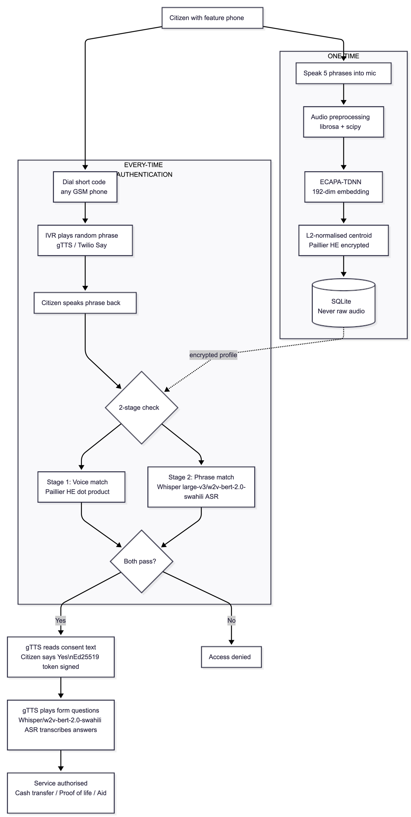
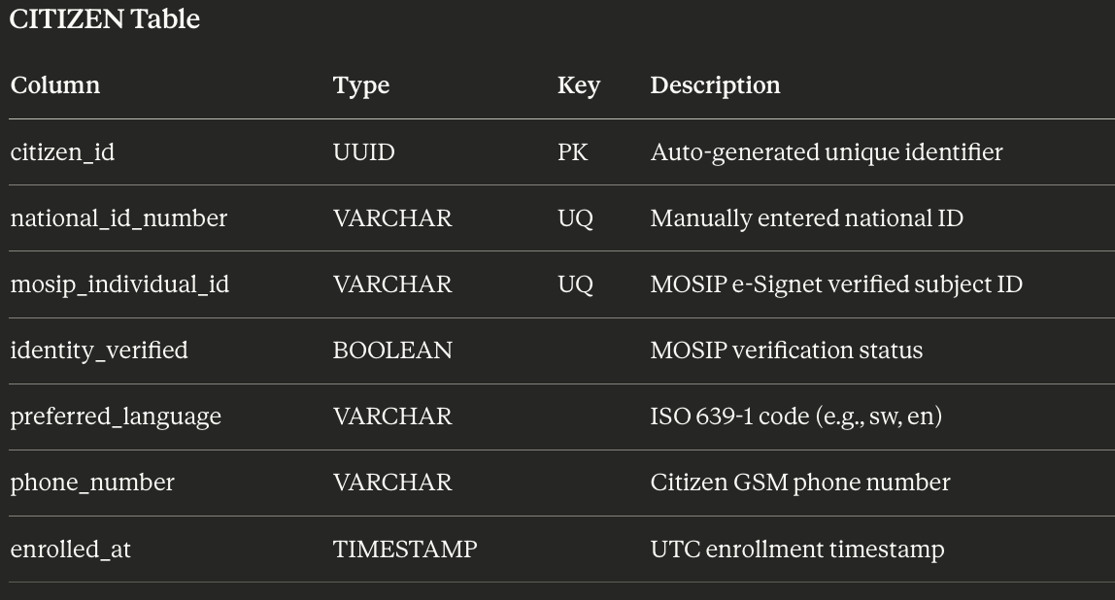
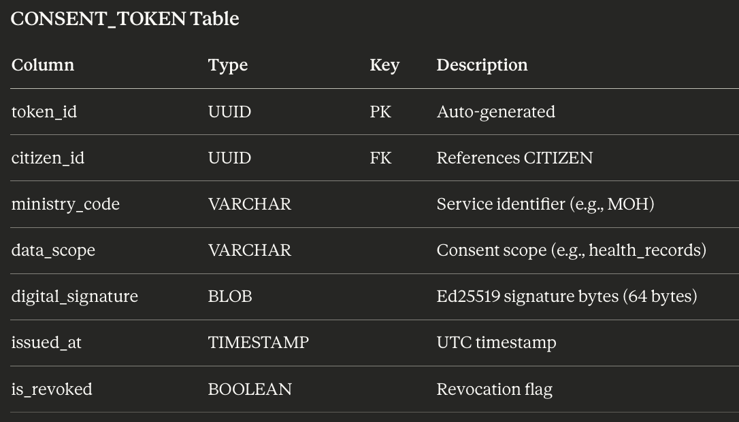

Slide 12
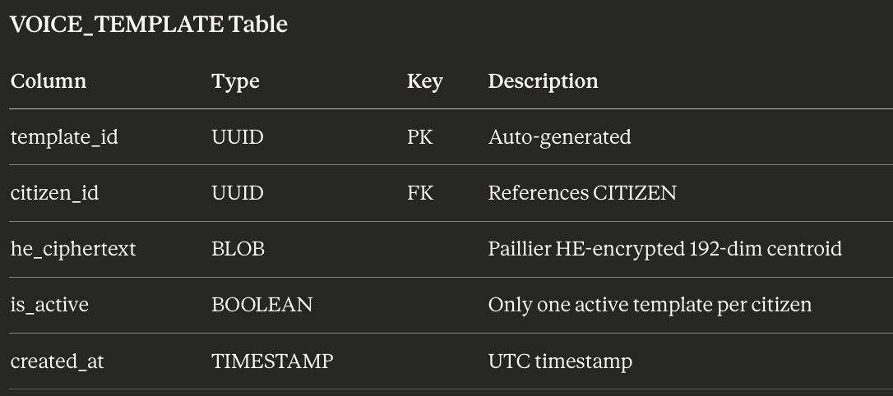
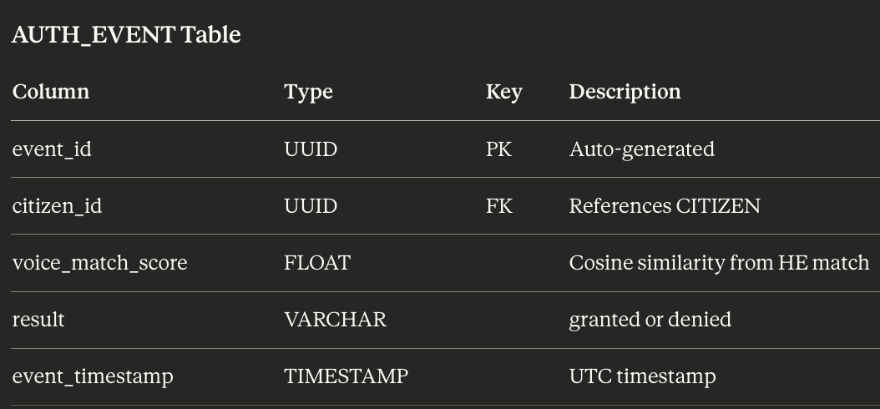
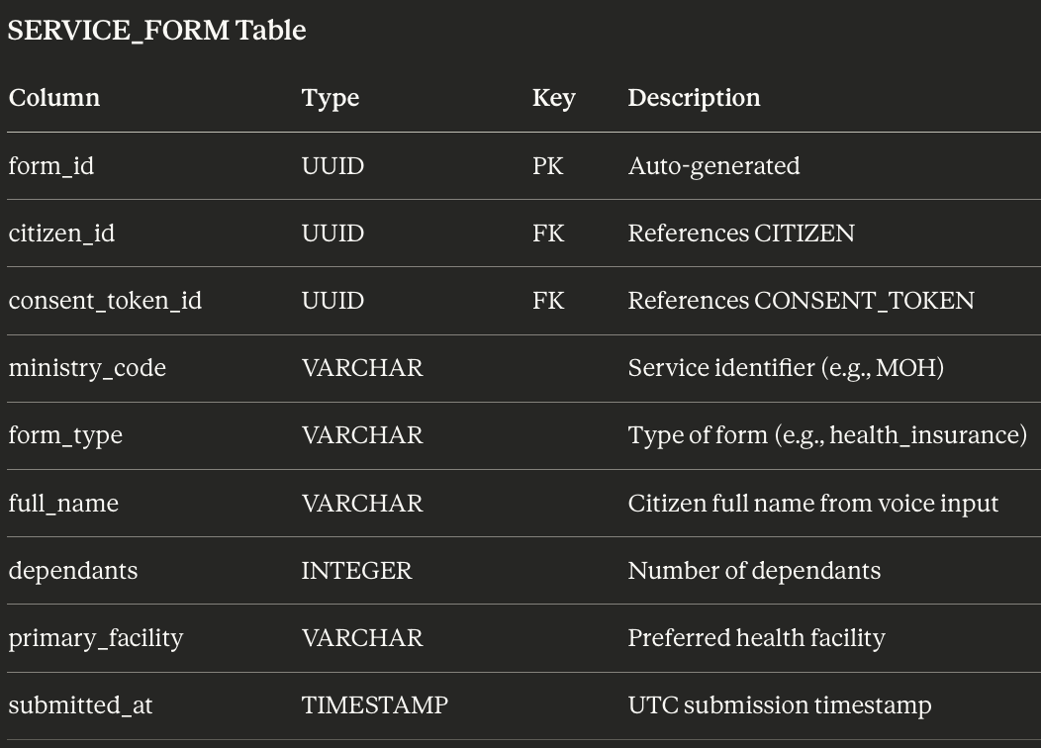
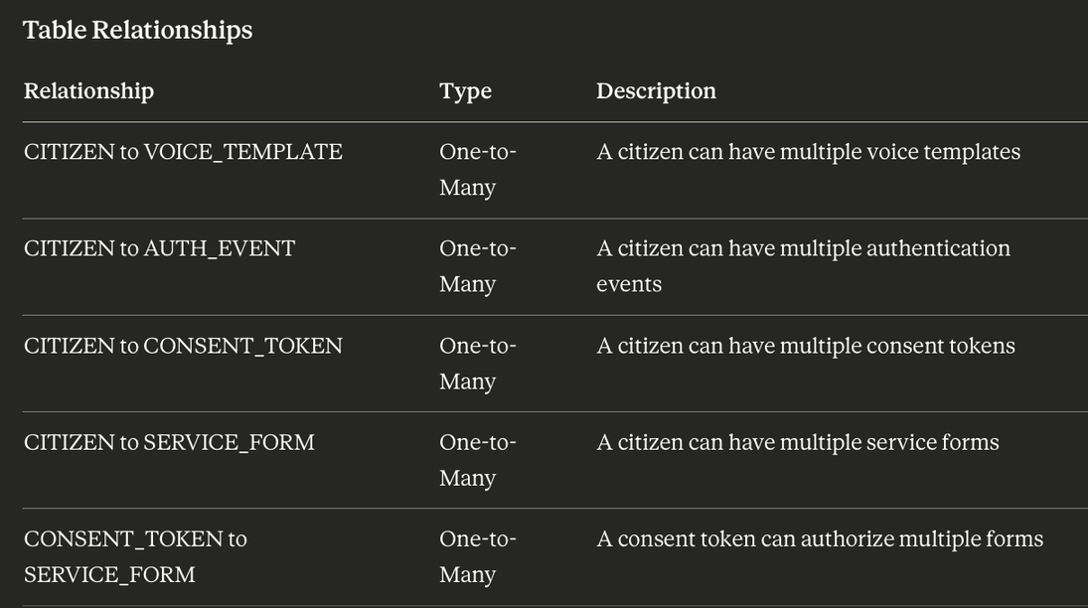

Slide 13
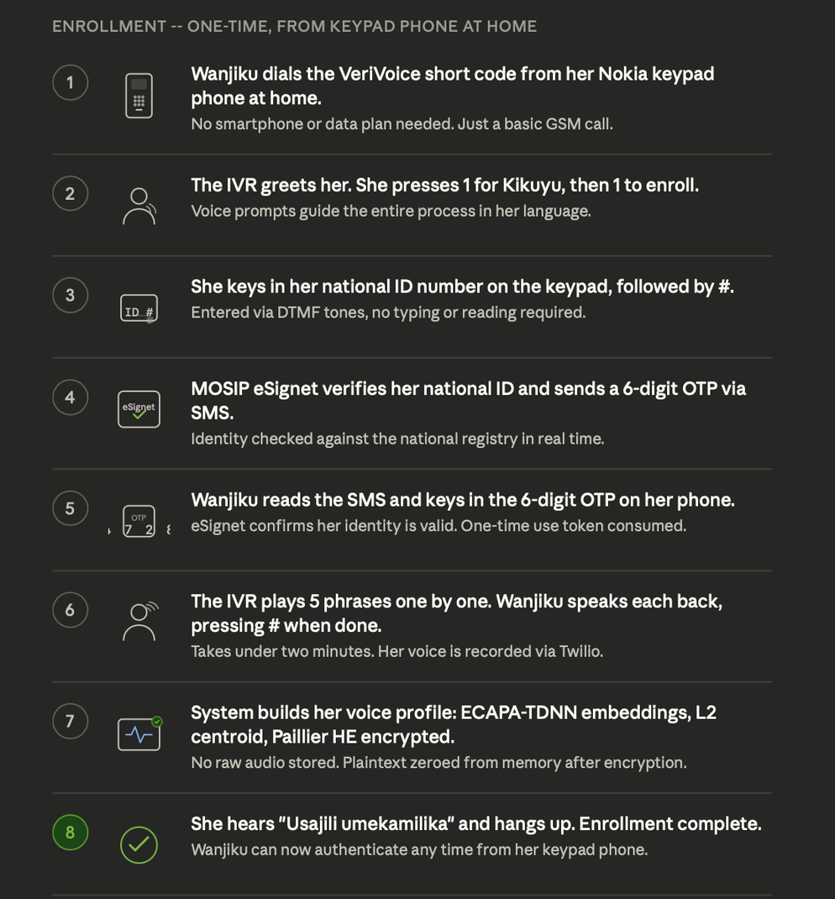
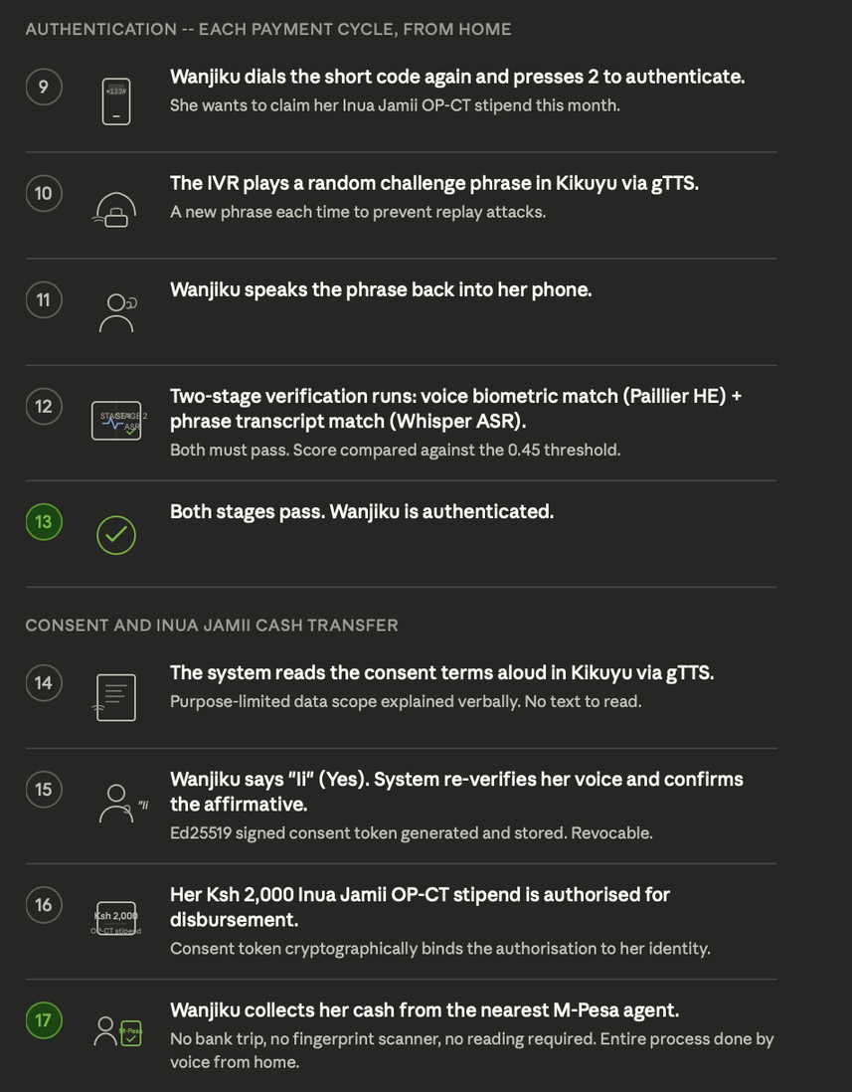
Time: 1 min 30 sec
User journey flow
‹#›
All rights reserved. This document is proprietary and confidential.

Slide 14
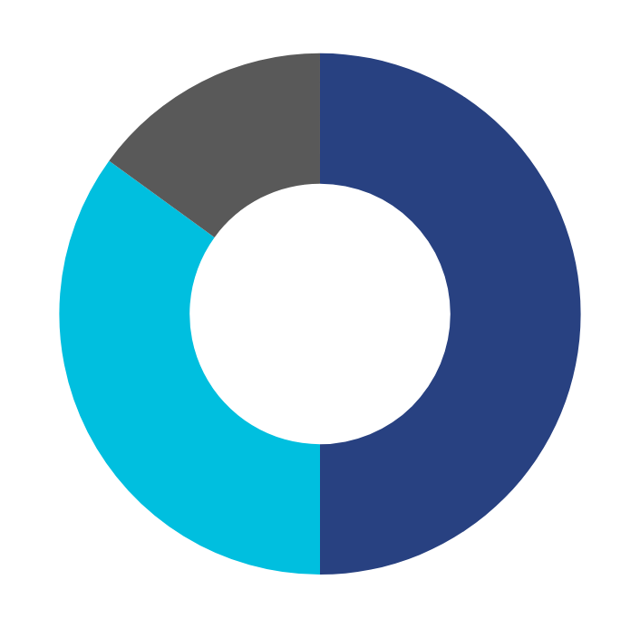




Time: 1 min 30 sec
Potential Impact
250mil
people in the EAC region lack access to a voice-compatible digital authentication layer, holding national IDs they cannot use remotely from a basic phone.
60%+
Direct beneficiaries are women.(Inua Jamii's 763,000 older persons beneficiaries are women).
50%
With Voice ID, CARE's operational costs were reduced by 50% (GSMA Voice ID pilot)
‹#›
All rights reserved. This document is proprietary and confidential.

Slide 15
Time: 1 min 30 sec
Challenges and stakeholder mapping
Challenges | Solution | Stakeholder
Cultural distrust of voice recording among rural and refugee communities; fear that voiceprints may be misused for surveillance or shared with authorities | Community consent workshops led by trusted local health workers and civil society organisations; audio explanations of rights in local languages before any enrolment; strict opt-in only participation with multimodal fallbacks | HelpAge Uganda, CARE Somalia, Paradigm Initiative, local refugee community leaders
Biometric data classification under Kenya Data Protection Act and Uganda PDPA requires regulatory approval before voice templates can be anchored to national ID; telco integration requires direct MNO interconnect agreements beyond Twilio; GSM audio compression degrades voice matching accuracy in field conditions | Engage Kenya ODPC and Uganda NITA-U early for biometric data classification as encrypted non-raw template rather than raw biometric; partner directly with Safaricom, Airtel, and MTN Uganda for GSM short-code integration modelled on Jitambulishe and SautiPass precedents; deploy GSM bandpass filter already built into the audio preprocessing pipeline | Kenya ODPC, Uganda NITA-U, Safaricom, Airtel Kenya, MTN Uganda, Kenya NIIMS, Uganda NIRA, Central Bank of Kenya, Bank of Uganda, World Food Programme, GSMA Mobile for Humanitarian Innovation
Deepfake audio and replay attacks could spoof the voice biometric layer; SIM-swap attackers could attempt to redirect IVR calls mid-authentication | Randomised challenge phrase generation already implemented prevents replay attacks; anti-spoofing and deepfake detection module planned for MVP; Twilio request signature validation already enforced on all webhook endpoints | Twilio, Communications Authority of Kenya, Uganda Communications Commission, cybersecurity regulators
‹#›
All rights reserved. This document is proprietary and confidential.

Slide 16

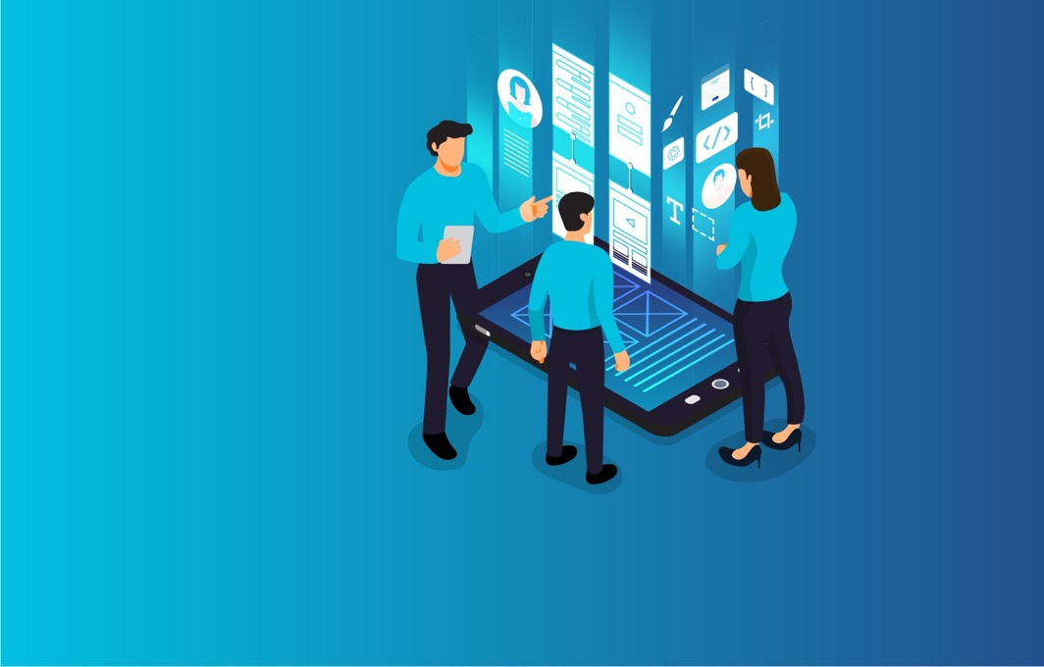
Not to be Presented
Thank you.

