Slide 1
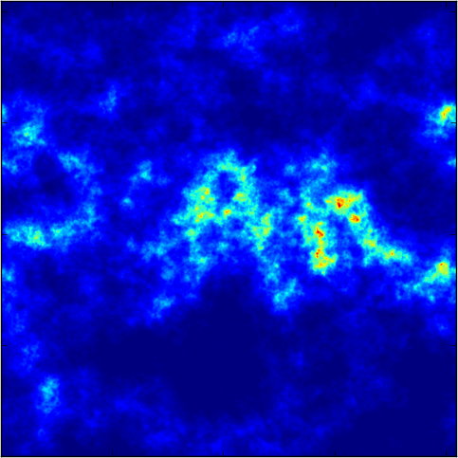
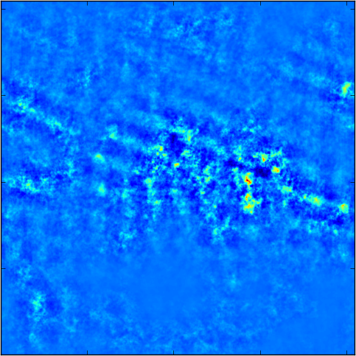
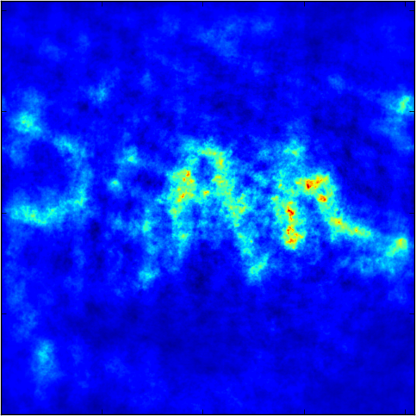
Short Spacing Configurations for Full Flux Recovery with the ngVLA
Quick Array Combinations (QAC): Simple interface for combining single dish and interferometric data
Input Model
ngVLA Core
45 m TP + SBA + Core
113 kJy
1.7 kJy
110 kJy

