Slide 1

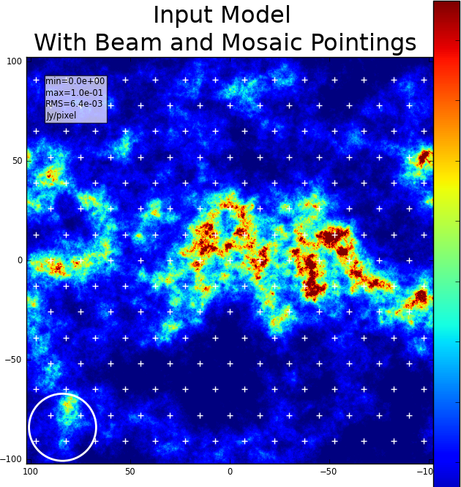
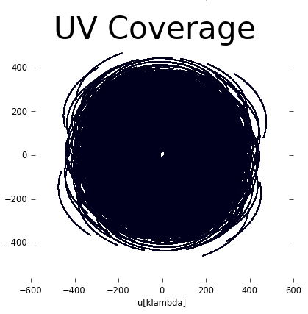
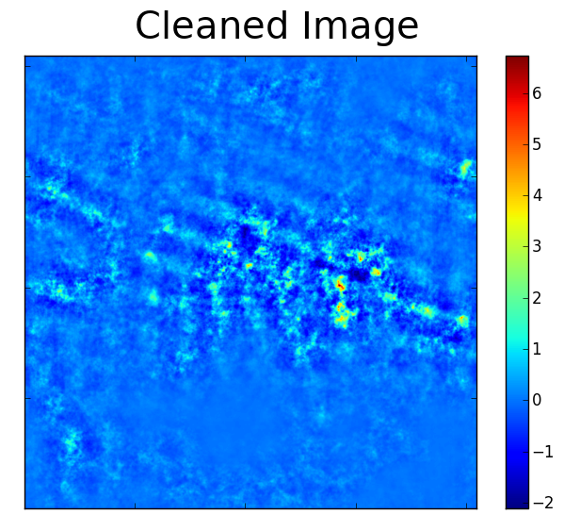
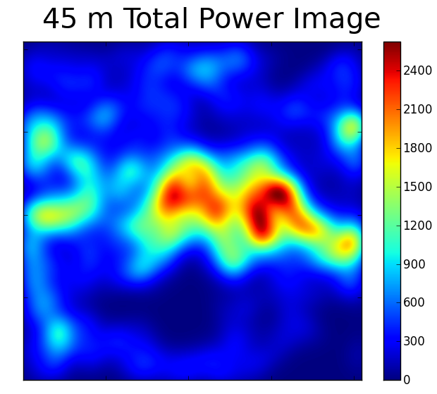
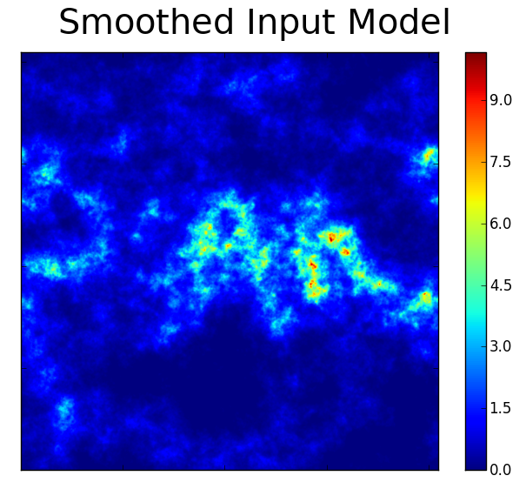
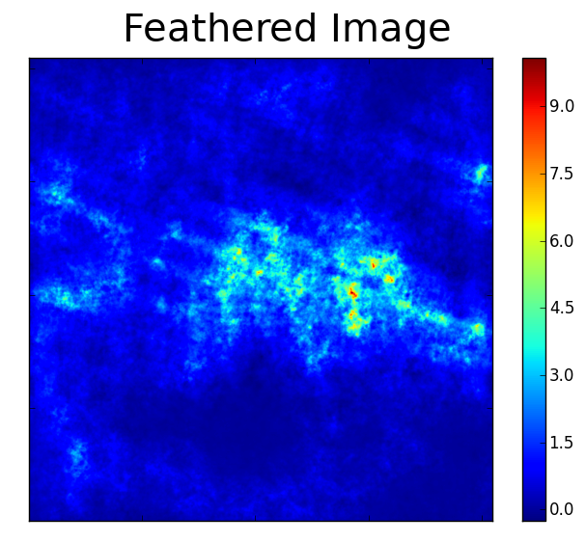
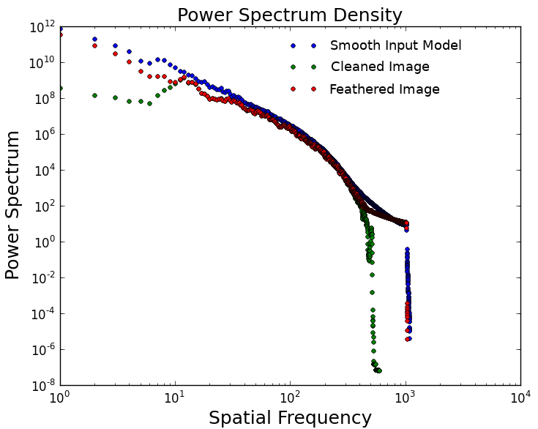
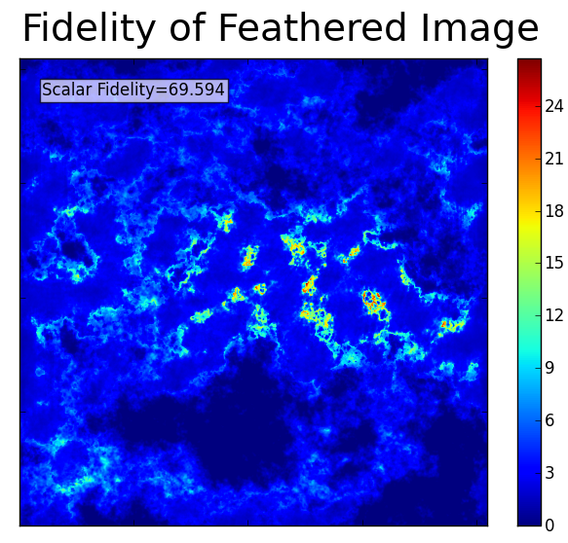
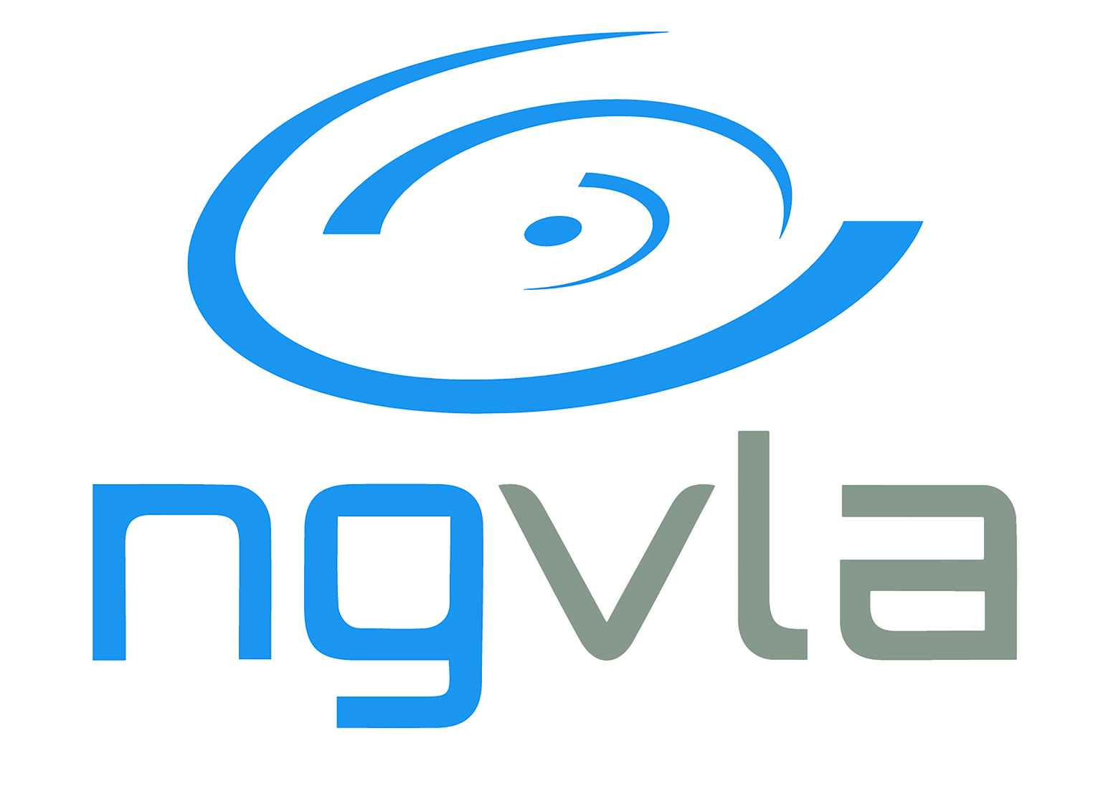

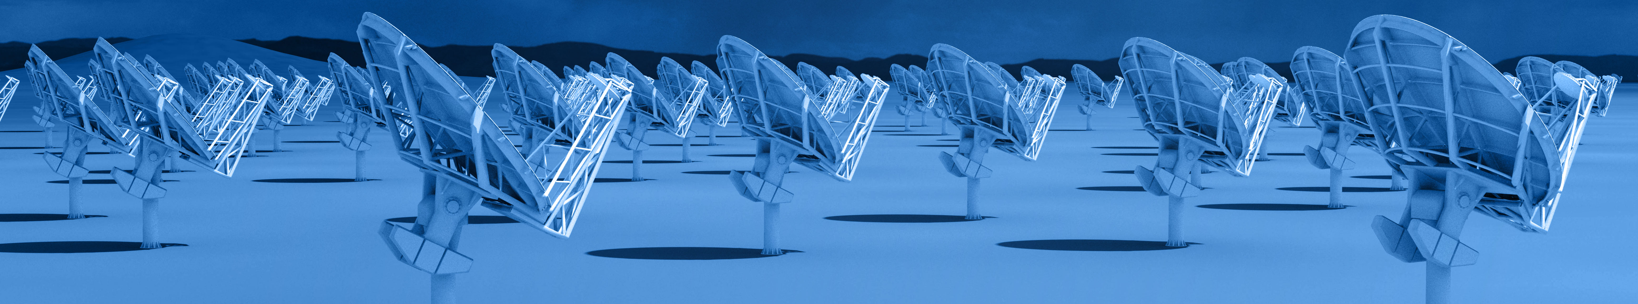


Short Spacing Configurations for Full Flux Recovery with ngVLA: Methodology and Workflow
Jordan Turner¹, Peter Teuben², Daniel Dale¹
¹University of Wyoming, ²Universiy of Maryland, College park
Quick Array Combinations (QAC): Simple Interface for Combining Single Dish and Interferometeric Data
Running a Simulated ngVLA Observation Using QAC: Short Baseline
QAC Simulated ngVLA Observation of Extended MW Emission with a
45 Meter Single-Dish for Total Power
Provides a set a functions written entirely in Python that mostly call CASA tools and tasks to help with combining data from a single dish with interferometric data.
Provides a simple interface for preforming simulated observations from a number of interferometeric arrays like the Next Generation Very Large Array and ALMA.
Hides much of the complexity of writing and executing CASA scripts to allow for easier access to array combination tools.
Provides a number of functions which help plot, compare, and analyze the combined data.
Publicly available on Github at:
                https://github.com/teuben/QAC
Running a Simulated ngVLA Observation Using QAC
1a
1b
Setup simulation with input parameters
  ngVLA interferometric array antenna configurations: Short Baseline Array (10 km baseline), Core (30 km baseline), Plains (100 km baseline), and revB (1000 km baseline)
  Integration times, e.g., 4 hours total with 1 minute integrations
  Single pointing or mosaic imaging
  Input model image (FITS or CASA image)
  Set input model image and pixel sizes to control effective angular size of the target
  Total power single-dish diameter, e.g., 18m, 45m, or 100m
Simulated observing with qac_vla()
TCLEAN images with qac_clean1()
Create an ‘on-the-fly’ total power map for the given dish size with qac_tp_otf()
Smooth input model with interferometer beam size with qac_smooth()
Combine interferometric with single-dish total power with qac_feather()
Get flux recovery statistics using qac_stats()
Measure Power Spectrum Density with qac_psd()
Measure fidelity between input and observation with qac_fidelity()
2
3
Results and Future Work
4
5
Simulations of ngVLA configurations using QAC show that a combination of the Short Baseline Array and Core antennae with a 45 m diameter single-dish provide best flux recovery of extended Milky Way emission
>45 m TP dish provides little benefits
Plan to perform these simulations on model galaxies
QAC will implement the TP2VIS code to avoid the pitfalls of using feather to combine the TP and INT data
Funded by the ngVLA Community Studies Program
7
8
The National Radio Astronomy Observatory is a facility of the National Science Foundation operated under cooperative agreement by Associated Universities, Inc.

