Slide 1
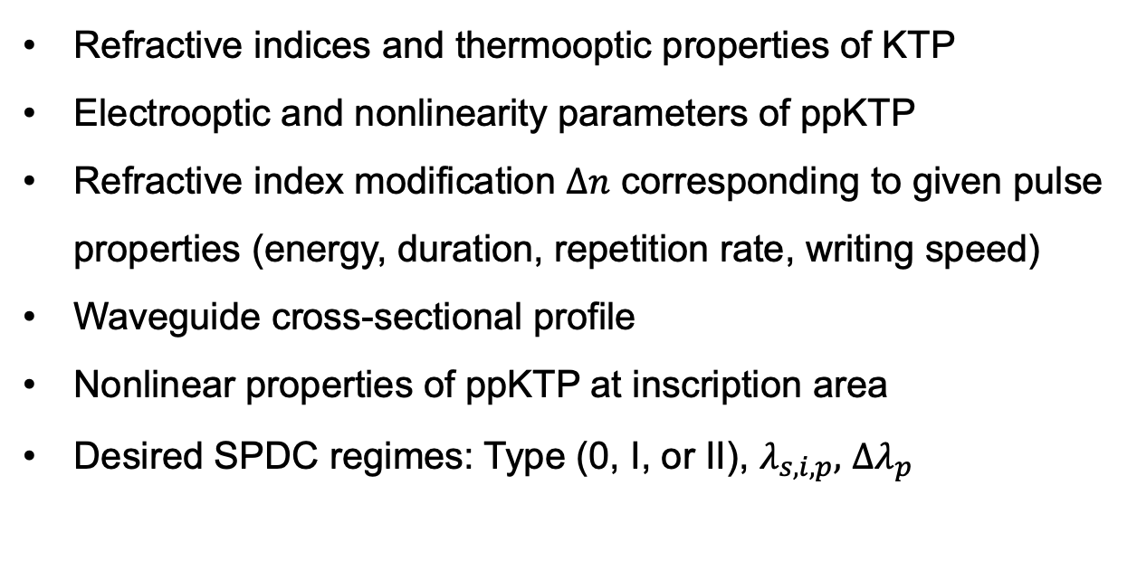
Requested Data from Raicol
Refractive indices and thermooptic properties of KTP
Electrooptic and nonlinearity parameters of ppKTP
Refractive index modification $∆n$ corresponding to given pulse properties (energy, duration, repetition rate, writing speed)
Waveguide cross-sectional profile
Nonlinear properties of ppKTP at inscription area
Desired SPDC regimes: Type (0, I, or II), $λ_{s,i,p},$ $∆λ_{p}$

Slide 2
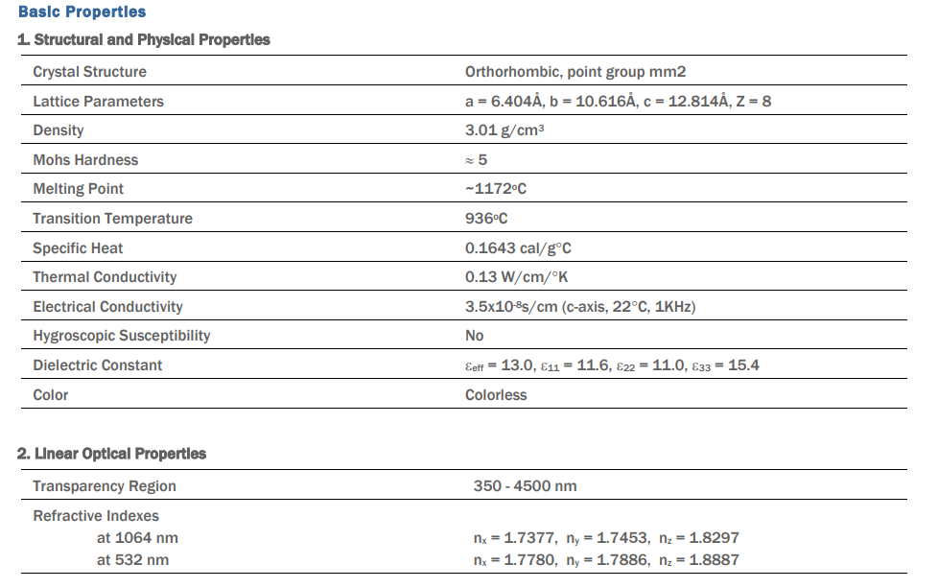
Refractive indices and thermooptic properties of KTP
Electrooptic and nonlinearity parameters of ppKTP

Slide 3
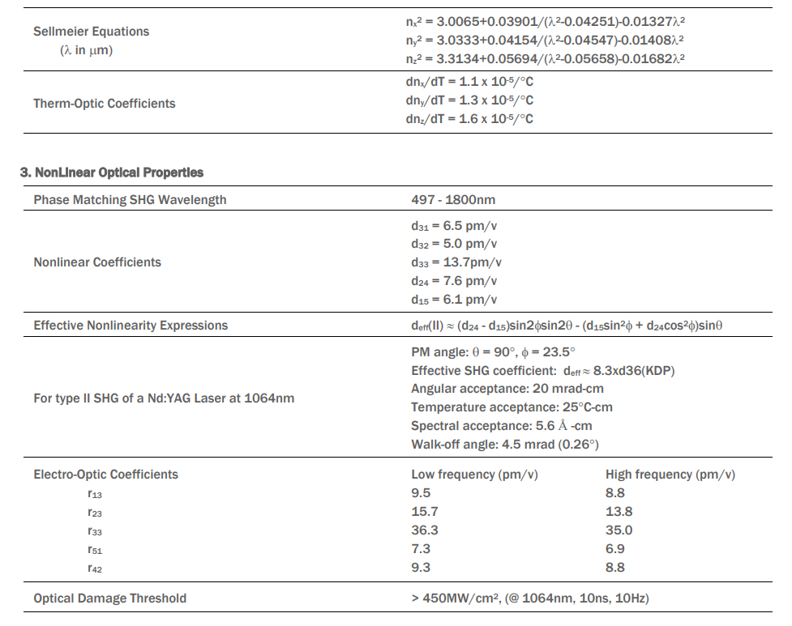

Slide 4
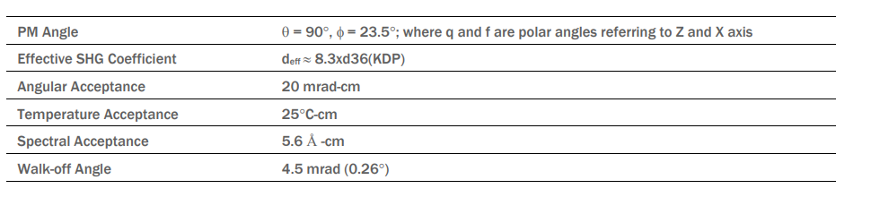
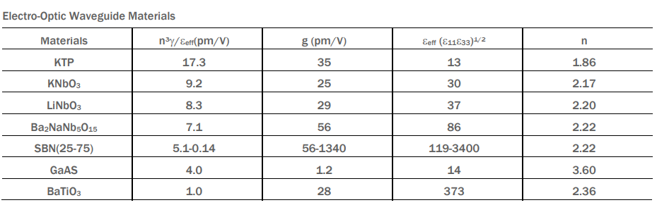

Slide 5
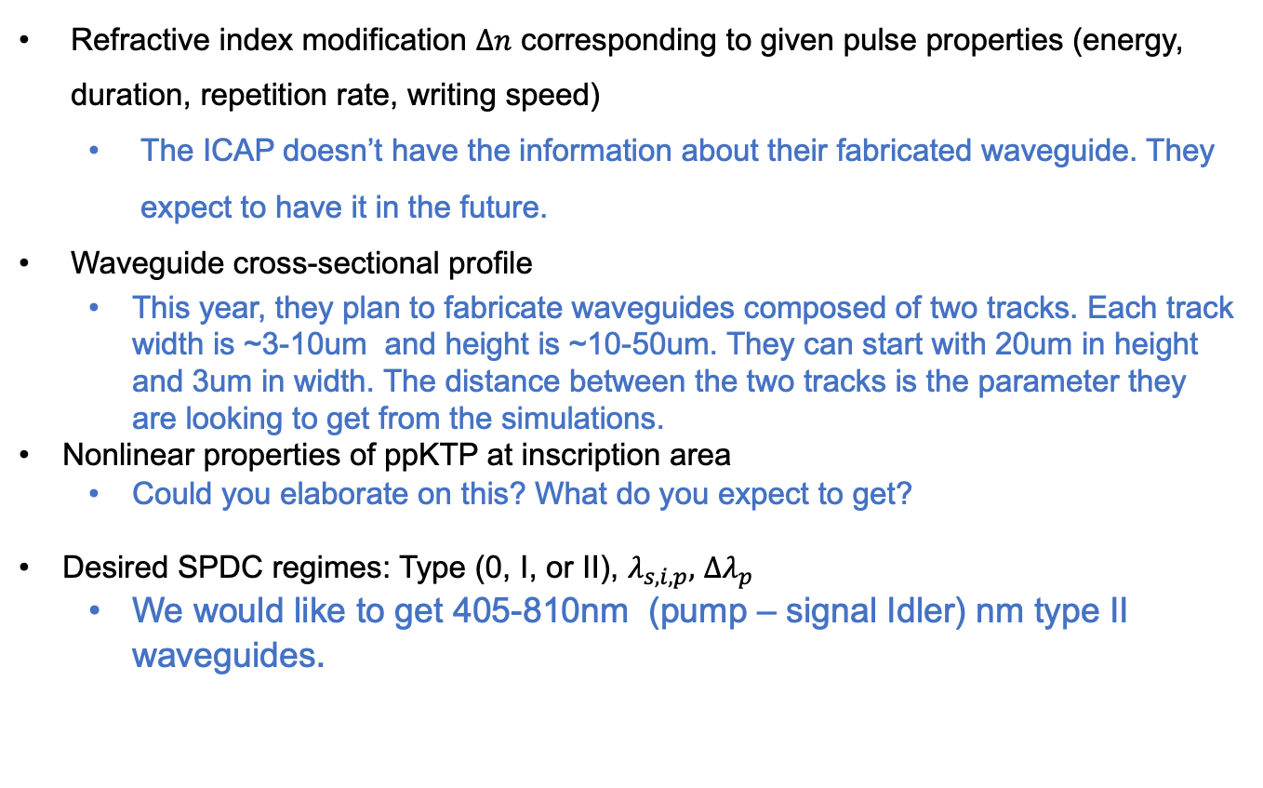
Refractive index modification $∆n$ corresponding to given pulse properties (energy, duration, repetition rate, writing speed)
The ICAP doesn’t have the information about their fabricated waveguide. They expect to have it in the future.
Waveguide cross-sectional profile
This year, they plan to fabricate waveguides composed of two tracks. Each track width is ~3-10um and height is ~10-50um. They can start with 20um in height and 3um in width. The distance between the two tracks is the parameter they are looking to get from the simulations.
Nonlinear properties of ppKTP at inscription area
Could you elaborate on this? What do you expect to get?
Desired SPDC regimes: Type (0, I, or II), $λ_{s,i,p},$ $∆λ_{p}$
We would like to get 405-810nm (pump – signal Idler) nm type II waveguides.

