Slide 1
Tic-Tac-Toe
Tevin Jeffrey
CS-370

Slide 2
The perfect game
If you play perfectly, you will either win or draw the game. If the opponent plays perfectly, you will always draw the game.

Slide 3
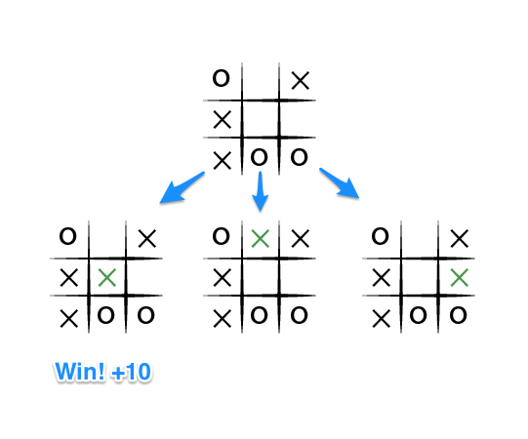
The goal is to maximize my endgame score. Player 1 is X
Notes:
If the top of this image represents the state of the game I see when it is my turn, then I have some choices to make, there are three places I can play, one of which clearly results in me wining and earning the 10 points. If I don't make that move, O could very easily win. And I don't want O to win, so my goal here, as the first player, should be to pick the maximum scoring move.

Slide 4
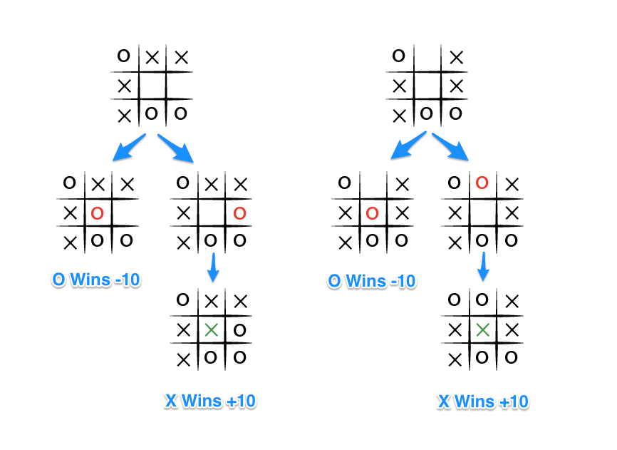
O also wants to win
Notes:
The choice is clear, O would pick any of the moves that result in a score of -10.

Slide 5
Minimax
If the game is over, return the score from X's perspective.
Otherwise get a list of new game states for every possible move
Create a scores list
For each of these states add the minimax result of that state to the scores list
If it's X's turn, return the maximum score from the scores list
If it's O's turn, return the minimum score from the scores list

Slide 6
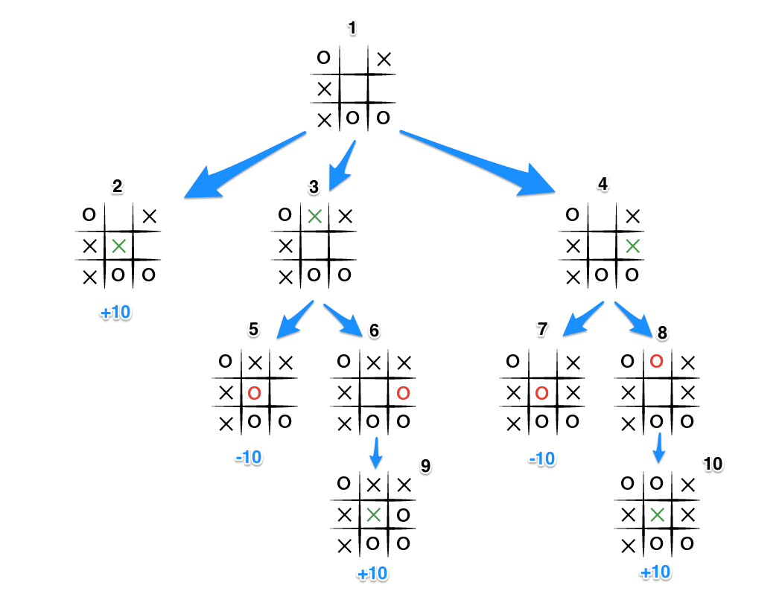
Notes:
t's X's turn in state 1. X generates the states 2, 3, and 4 and calls minimax on those states.
State 2 pushes the score of +10 to state 1's score list, because the game is in an end state.
State 3 and 4 are not in end states, so 3 generates states 5 and 6 and calls minimax on them, while state 4 generates states 7 and 8 and calls minimax on them.
State 5 pushes a score of -10 onto state 3's score list, while the same happens for state 7 which pushes a score of -10 onto state 4's score list.
State 6 and 8 generate the only available moves, which are end states, and so both of them add the score of +10 to the move lists of states 3 and 4.
Because it is O's turn in both state 3 and 4, O will seek to find the minimum score, and given the choice between -10 and +10, both states 3 and 4 will yield -10.
Finally the score list for states 2, 3, and 4 are populated with +10, -10 and -10 respectively, and state 1 seeking to maximize the score will chose the winning move with score +10, state 2.

Slide 7
private int minimax(final List<Cell> cells, int depth, CellState state) { if (board.isGameOver(cells)) { return score(cells, depth); } List<Integer> scores = new ArrayList<>(); List<Integer> moves = new ArrayList<>(); depth++; // Get a list of all possible remaining moves for (Cell possibleMove : BoardUtils.getPossibleMoves(cells)) { //Create a new board of possible games which the minimax algorithm // will recursively traverse List<Cell> possibleGame = getNewGame(cells); Cell currentMove = possibleGame.get(possibleMove.getIndex() - 1); if (state.equals(ai.getPlayerId())) { currentMove.setState(ai.getPlayerId()); } else { currentMove.setState(opponent.getPlayerId(); } scores.add(minimax(possibleGame, depth, state.equals(ai.getPlayerId())? opponent.getPlayerId() : ai.getPlayerId())); moves.add(possibleMove.getIndex()); }

Slide 8
// Do the min or the max calculation if (state.equals(ai.getPlayerId())) { // scores = [0, -10, 10, -10] // moves = [2, 3, 7, 9] int maxScoreIndex = max(scores.toArray(new Integer[scores.size()])); if (scores.size() > 0) { choice = moves.get(maxScoreIndex); return scores.get(maxScoreIndex); } return 0; } else { int minScoreIndex = min(scores.toArray(new Integer[scores.size()])); if (scores.size() > 0) { choice = moves.get(minScoreIndex); return scores.get(minScoreIndex); } return 0; }

Slide 9
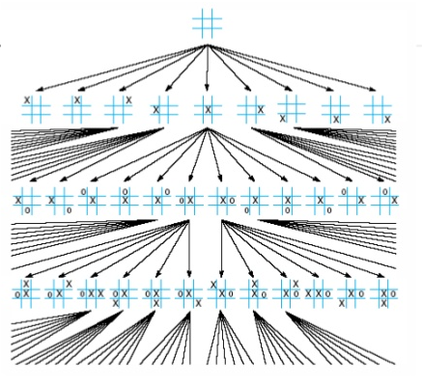
State space size?
A simple upper bound for the size of the game tree is 9! = 362,880. (There are nine positions for the first move, eight for the second, and so on.)

Slide 10
References
https://en.wikipedia.org/wiki/Game_complexity
http://neverstopbuilding.com/minimax

