Slide 1
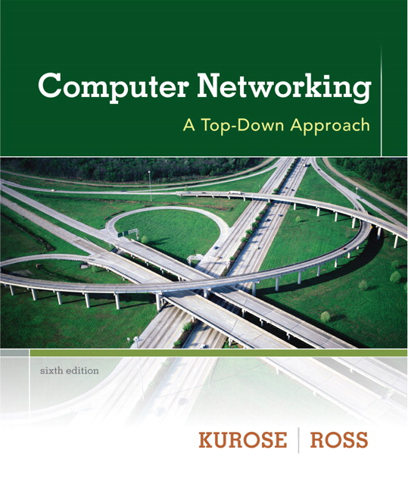

Chapter 1 Network Core
Computer Networking: A Top Down Approach 6th edition Jim Kurose, Keith Ross Addison-Wesley March 2012
A note on the use of these ppt slides:
We’re making these slides freely available to all (faculty, students, readers). They’re in PowerPoint form so you see the animations; and can add, modify, and delete slides (including this one) and slide content to suit your needs. They obviously represent a lot of work on our part. In return for use, we only ask the following:
If you use these slides (e.g., in a class) that you mention their source (after all, we’d like people to use our book!)
If you post any slides on a www site, that you note that they are adapted from (or perhaps identical to) our slides, and note our copyright of this material.
Thanks and enjoy! JFK/KWR
All material copyright 1996-2012
J.F Kurose and K.W. Ross, All Rights Reserved

Slide 2










The network core
mesh of interconnected routers
packet-switching: hosts break application-layer messages into packets
forward packets from one router to the next, across links on path from source to destination
each packet transmitted at full link capacity

Slide 3




Packet-switching: store-and-forward
L bits
per packet
source
3
2
1
R bps
R bps
destination
takes L/R seconds to transmit (push out) L-bit packet into link at R bps
store and forward: entire packet must arrive at router before it can be transmitted on next link
one-hop numerical example:
L = 7.5 Mbits
R = 1.5 Mbps
one-hop transmission delay = 5 sec
end-end delay = 2L/R (assuming zero propagation delay)
more on delay shortly …

Slide 4
Packet Switching: queueing delay, loss
R = 100 Mb/s
C
A
D
R = 1.5 Mb/s
B
E
queue of packets
waiting for output link
queuing and loss:
If arrival rate (in bits) to link exceeds transmission rate of link for a period of time:
packets will queue, wait to be transmitted on link
packets can be dropped (lost) if memory (buffer) fills up

Slide 5
Two key network-core functions
routing: determines source-destination route taken by packets
routing algorithms
forwarding: move packets from router’s input to appropriate router output
routing algorithm
local forwarding table
header value
output link
0100
0101
0111
1001
3
2
2
1
1
3
2
0111
dest address in arriving
packet’s header

Slide 6
Alternative core: circuit switching
end-end resources allocated to, reserved for “call” between source & dest:
In diagram, each link has four circuits.
call gets 2nd circuit in top link and 1st circuit in right link.
dedicated resources: no sharing
circuit-like (guaranteed) performance
circuit segment idle if not used by call (no sharing)
Commonly used in traditional telephone networks

Slide 7
Circuit switching: FDM versus TDM
Example:
FDM
4 users
frequency
time
TDM
frequency
time
Notes:
Two simple multiple access control techniques.
Each mobile’s share of the bandwidth is divided into portions for the uplink and the downlink. Also, possibly, out of band signaling.
As we will see, used in AMPS, GSM, IS-54/136

Slide 8
Packet switching versus circuit switching
packet switching allows more users to use network!
example:
1 Mb/s link
each user:
100 kb/s when “active”
active 10% of time
circuit-switching:
10 users
packet switching:
with 35 users, probability > 10 active at same time is less than .0004 *
N
users
…..
1 Mbps link
Q: how did we get value 0.0004?
Q: what happens if > 35 users ?
* Check out the online interactive exercises for more examples

Slide 9
Packet switching versus circuit switching
is packet switching a “slam dunk winner?”
great for bursty data
resource sharing
simpler, no call setup
excessive congestion possible: packet delay and loss
protocols needed for reliable data transfer, congestion control
Q: How to provide circuit-like behavior?
bandwidth guarantees needed for audio/video apps
still an unsolved problem (chapter 7)
Q: human analogies of reserved resources (circuit switching) versus on-demand allocation (packet-switching)?

Slide 10
Internet structure: network of networks
End systems connect to Internet via access ISPs (Internet Service Providers)
Residential, company and university ISPs
Access ISPs in turn must be interconnected.
So that any two hosts can send packets to each other
Resulting network of networks is very complex
Evolution was driven by economics and national policies
Let’s take a stepwise approach to describe current Internet structure

Slide 11
Internet structure: network of networks
Question: given millions of access ISPs, how to connect them together?
…
…
access
net
access
net
access
net
access
net
access
net
access
net
access
net
…
…
access
net
access
net
access
net
access
net
access
net
access
net
…
access
net
access
net
…
access
net

Slide 12
Internet structure: network of networks
Option: connect each access ISP to every other access ISP?
…
…
access
net
access
net
access
net
access
net
access
net
…
…
access
net
access
net
…
connecting each access ISP to each other directly doesn’t scale: O(N²) connections.
…
…
access
net
access
net
…
access
net
access
net
access
net
…
access
net
…
access
net
access
net
…
access
net

Slide 13
Internet structure: network of networks
Option: connect each access ISP to a global transit ISP? Customer and provider ISPs have economic agreement.
…
…
access
net
access
net
access
net
access
net
access
net
access
net
access
net
…
…
global ISP
access
net
access
net
access
net
access
net
access
net
access
net
…
access
net
access
net
…
access
net

Slide 14
Internet structure: network of networks
But if one global ISP is viable business, there will be competitors ….
…
…
access
net
access
net
access
net
access
net
access
net
access
net
access
net
ISP A
…
…
access
net
ISP B
access
net
ISP C
access
net
access
net
access
net
access
net
…
access
net
access
net
…
access
net

Slide 15
Internet structure: network of networks
But if one global ISP is viable business, there will be competitors …. which must be interconnected
Internet exchange point
…
…
access
net
access
net
access
net
access
net
access
net
IXP
access
net
access
net
ISP A
…
…
IXP
access
net
access
net
ISP B
ISP C
access
net
access
net
peering link
access
net
access
net
…
access
net
access
net
…
access
net

Slide 16
Internet structure: network of networks
… and regional networks may arise to connect access nets to ISPS
…
…
access
net
access
net
access
net
access
net
access
net
IXP
access
net
access
net
ISP A
…
…
IXP
access
net
access
net
ISP B
ISP C
access
net
access
net
access
net
regional net
access
net
…
access
net
access
net
…
access
net

Slide 17
Internet structure: network of networks
… and content provider networks (e.g., Google, Microsoft, Akamai ) may run their own network, to bring services, content close to end users
…
…
access
net
access
net
access
net
access
net
access
net
IXP
access
net
access
net
ISP A
…
…
Content provider network
IXP
access
net
access
net
ISP B
ISP B
access
net
access
net
access
net
regional net
access
net
…
access
net
access
net
…
access
net

Slide 18
Internet structure: network of networks
Tier 1 ISP
Tier 1 ISP
Google
IXP
IXP
IXP
Regional ISP
Regional ISP
access
ISP
access
ISP
access
ISP
access
ISP
access
ISP
access
ISP
access
ISP
access
ISP
at center: small # of well-connected large networks
“tier-1” commercial ISPs (e.g., Level 3, Sprint, AT&T, NTT), national & international coverage
content provider network (e.g, Google): private network that connects it data centers to Internet, often bypassing tier-1, regional ISPs

Slide 19
Tier-1 ISP: e.g., Sprint
POP: point-of-presence
to/from backbone
peering
…
…
…
…
…
to/from customers

