Slide 1
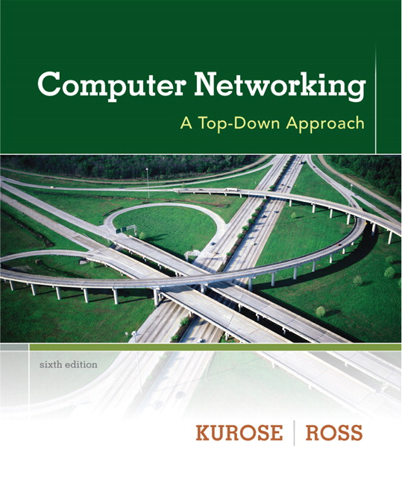

Chapter 1 Protocol Layers
Computer Networking: A Top Down Approach 6th edition Jim Kurose, Keith Ross Addison-Wesley March 2012
A note on the use of these ppt slides:
We’re making these slides freely available to all (faculty, students, readers). They’re in PowerPoint form so you see the animations; and can add, modify, and delete slides (including this one) and slide content to suit your needs. They obviously represent a lot of work on our part. In return for use, we only ask the following:
If you use these slides (e.g., in a class) that you mention their source (after all, we’d like people to use our book!)
If you post any slides on a www site, that you note that they are adapted from (or perhaps identical to) our slides, and note our copyright of this material.
Thanks and enjoy! JFK/KWR
All material copyright 1996-2012
J.F Kurose and K.W. Ross, All Rights Reserved

Slide 2
Protocol “layers”
Networks are complex,
with many “pieces”:
hosts
routers
links of various media
applications
protocols
hardware, software
Question:
is there any hope of organizing structure of network?
…. or at least our discussion of networks?

Slide 3
Organization of air travel
ticket (purchase)
baggage (check)
gates (load)
runway takeoff
airplane routing
ticket (complain)
baggage (claim)
gates (unload)
runway landing
airplane routing
airplane routing
a series of steps

Slide 4
Layering of airline functionality
ticket (purchase)
baggage (check)
gates (load)
runway (takeoff)
airplane routing
ticket (complain)
baggage (claim
gates (unload)
runway (land)
airplane routing
ticket
baggage
gate
takeoff/landing
airplane routing
airplane routing
airplane routing
departure
airport
intermediate air-traffic
control centers
arrival
airport
layers: each layer implements a service
via its own internal-layer actions
relying on services provided by layer below

Slide 5
Why layering?
dealing with complex systems:
explicit structure allows identification, relationship of complex system’s pieces
layered reference model for discussion
modularization eases maintenance, updating of system
change of implementation of layer’s service transparent to rest of system
e.g., change in gate procedure doesn’t affect rest of system
layering considered harmful?

Slide 6
Internet protocol stack
application: supporting network applications
FTP, SMTP, HTTP
transport: process-process data transfer
TCP, UDP
network: routing of datagrams from source to destination
IP, routing protocols
link: data transfer between neighboring network elements
Ethernet, 802.11 (WiFi), PPP
physical: bits “on the wire”
application
transport
network
link
physical

Slide 7
ISO/OSI reference model
presentation: allow applications to interpret meaning of data, e.g., encryption, compression, machine-specific conventions
session: synchronization, checkpointing, recovery of data exchange
Internet stack “missing” these layers!
these services, if needed, must be implemented in application
needed?
application
presentation
session
transport
network
link
physical

Slide 8

Encapsulation
source
message
M
application
transport
network
link
physical
segment
H_{t}
M
H_{t}
datagram
H_{n}
H_{n}
H_{t}
M
frame
H_{l}
H_{n}
H_{t}
M
link
physical
switch
destination
H_{n}
H_{t}
M
network
link
physical
M
application
transport
network
link
physical
H_{l}
H_{n}
H_{t}
M
H_{n}
H_{t}
M
H_{t}
M
H_{n}
H_{t}
M
H_{l}
H_{n}
H_{t}
M
router

