Slide 1
Introduction
Devendra Tewari

Slide 2
History
Originally designed and implemented by Dennis Ritchie on a DEC PDP-11
Influenced by B written by Ken Thompson in 1970
First C standard in 1988 by ANSI (C89)
Adopted by ISO in 1990 (C90)
Most recent standard C99 by ISO
Compiled language
Source code portable

Slide 3
C program – hello.c
#include <stdio.h> /* function main - print hello world */ int main() { printf("hello world!\n"); return 0; }

Slide 4
C program structure
Multi-line comments begin with /* and end with */, these are called delimiters
# is used to begin pre-processor directives
Execution of a C program begins at function main
main can return an int value to the operating system otherwise it should return void
Code blocks and function bodies begin with { and end with }
C statements end with a semicolon ;

Slide 5
Executing hello.c
Use GCC
gcc hello.c -o hello -Wall
Without -o option the output is named a.out
Execute
./hello
Output
hello world!

Slide 6
Compilation process
Compiler produces the executable by performing the following steps
Pre-processing
Compilation and assembly
Linking

Slide 7
Pre-processing
Conceptual first step in compilation
Two tasks commonly performed
File inclusion with #include directive
#include <stdio.h>
Macro substitution with #define directive
#define pf printf pf("hello world!")

Slide 8
Compilation and assembly
Lexical and semantic analysis to generate intermediate code
Transform the intermediate code to assembly or machine code
Creating an object file using GCC
gcc hello.c -c
The -c option tells GCC not to perform linking
A file called hello.o is produced

Slide 9
Linking
Linking combines all the object files and required library code to produce a single executable
gcc hello.o -o hello

Slide 10
Multiple source files – hello.c
#include "print.h" /* Function main - Print hello world */ int main() { print_hello(); }

Slide 11
Multiple source files – print.c
#include <stdio.h> #include "print.h" void print_hello() { printf("printing: hello world!\n"); }

Slide 12
Multiple source files – print.h
#ifndef _PRINT_H_ #define _PRINT_H_ extern void print_hello(); #endif //_PRINT_H_
#ifndef / #endif prevents pre-processor from including same file twice

Slide 13
Simple compilation
Compile and link using gcc
gcc hello.c print.c -o hello
Execute
./hello
Output
printing: hello world!

Slide 14
Complex Compilation - With Error
Compile hello.c using gcc; produces hello.c
gcc hello.c -c
Compile print.c; produces print.o
gcc print.c -c
Link using gcc
gcc hello.o -o hello
hello.o(.text+0x27):hello.c: undefined reference to `_print_hello' collect2: ld returned 1 exit status

Slide 15
Complex Compilation – Correcting the Error
Link using gcc
gcc hello.o print.o -o hello
Using ld
ld -o hello \ /lib/crt0.o -L/opt/gcc.3.3/lib/gcc-lib/i586-pc-interix3/3.3 \ hello.o print.o -lgcc -lc -lpsxdll -v
Calling gcc with -v switch shows how
Note path to libgcc.a in my Windows SFU installation

Slide 16
Using a Graphical Debugger
DDD is a graphical debugger for X Windows and it uses gdb, the command line debugger
Re-compile source code with extra debug information for gdb
gcc -g hello.c print.c -o hello
Execute ddd
ddd hello
Try stepping through code and adding watch expressions
Repeat with VS Code

Slide 17
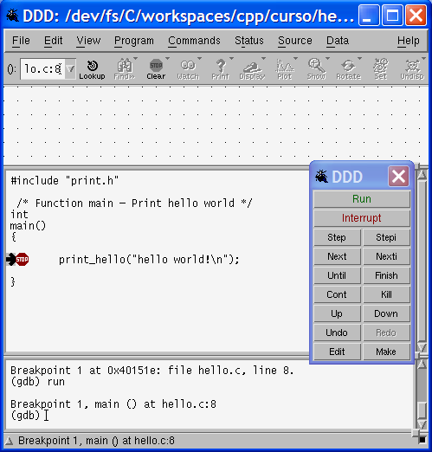
Debug Using DDD
Debug using DDD on Linux

Slide 18
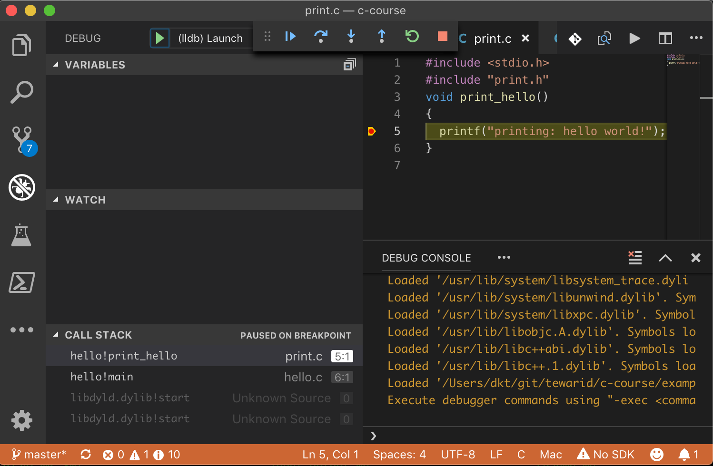
Debug Using VS Code
Debug using VS Code

Slide 19
Other Topics
Creating static and shared libraries
Dynamic linking
GCC compile, link and optimize options
Building applications with make
Using an IDE for C/C++ development

