Slide 1
Predicting the Pith Position from a Board-Face Image
A compact CNN for 15-point pith x-regression · Test MAE 3.82 mm
Candidate exercise — Doctoral Studentship in Building Technology (AI-Based Timber Quality Assessment)

Slide 2
Introduction: why locate the pith?
The pith is the centre of the tree stem; growth rings form around it.
Its position relative to a sawn board tells us where the board lay in the log — useful for wood characterisation, sawing decisions and strength grading.
Task in this exercise (simplified from the full 4-face, x+y problem):
Input: one RGB image (512×512) of one wide board face, 145 mm × 145 mm.
Output: pith x-position (mm) at 15 equally spaced z positions, bottom → top.
The pith may lie outside the board — predictions must not be clamped to [0, 145] mm.
Metric: mean absolute error (mm) over all 15 positions × 1000 test boards.
Data: 4000 labelled training boards, 1000 held-out test boards (split kept fixed; test never used for training).

Slide 3
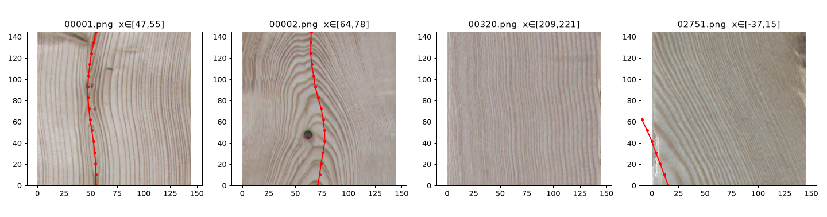
First look at the data
Ground-truth pith path (red) drawn over training images
Pith inside the board → rings form a clear symmetry axis with high curvature around it (left two).
Pith far outside (3rd image, x ≈ 215 mm) → rings become almost straight vertical stripes; position must be inferred from weak curvature and ring-spacing gradients.
Knots, colour variation and blur act as realistic nuisance factors.

Slide 4
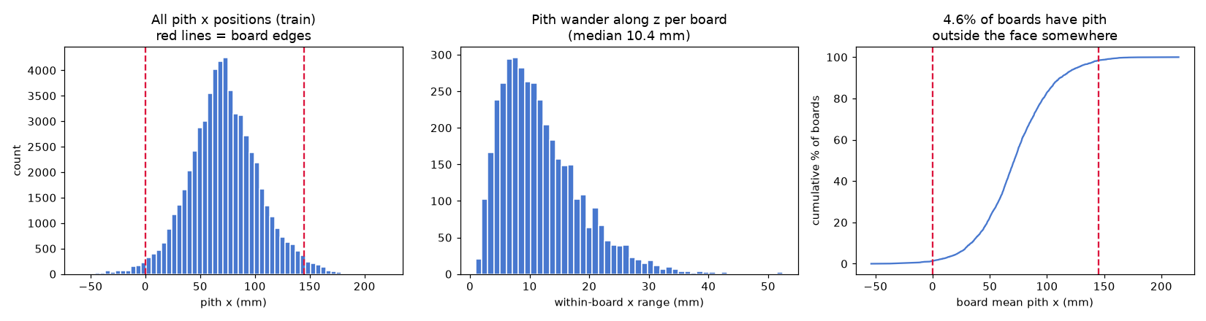
What the labels say
Statistics over the 4000 training boards
x spans −60 … +221 mm; 4.6% of boards have the pith outside the face for at least one z — a rare but important sub-population.
The pith path along z is smooth: median within-board wander is only 10.4 mm → z-neighbouring outputs are strongly correlated.
Naive baseline (always predict the training mean per position): 25.6 mm test MAE — the number any model must beat.

Slide 5
Problem formulation and key choices
Formulation: direct regression of 15 continuous values from one image (no clamping, so out-of-board positions are handled naturally).
Alternative considered — 1D heatmap + soft-argmax per z position: more mechanics for little expected gain at this scale; kept as future work.
Input resolution 224×224 (from 512): ring curvature and spacing cues survive Lanczos downscaling; ~5× faster than 512² on the available hardware.
Compact ~1.0 M-parameter CNN trained from scratch, rather than a pretrained ImageNet backbone:
single synthetic domain + 4000 samples → pretraining buys little; measured 4× faster per epoch than ResNet-18 on the CPU-only machine (2 vs 8 min).
Targets normalised t = (x − 72.5)/145; SmoothL1 (Huber) loss — robust to the few extreme out-of-board targets.
Augmentation uses the two exact physical symmetries: horizontal flip (x → 145 − x) and vertical flip (reverse the 15 targets). No unrealistic augmentations.
All model selection on a 3600/400 train/validation split — the 1000 test boards were touched exactly once, at the end.

Slide 6
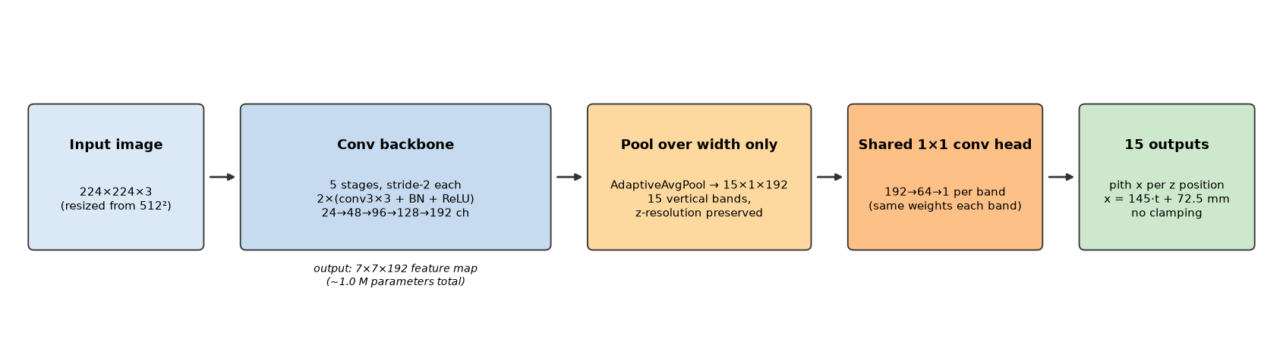
Architecture: pool over width, keep z structure
The output has spatial structure: target i depends mostly on rings near z-band i.
So the head pools the feature map over the width only → 15 vertical bands, each mapped to one x-value by a shared 1×1 convolution (same weights per band).
Deep layers still see the whole image (receptive field), so global context is not lost — the head just aligns parameters with the geometry of the task.

Slide 7
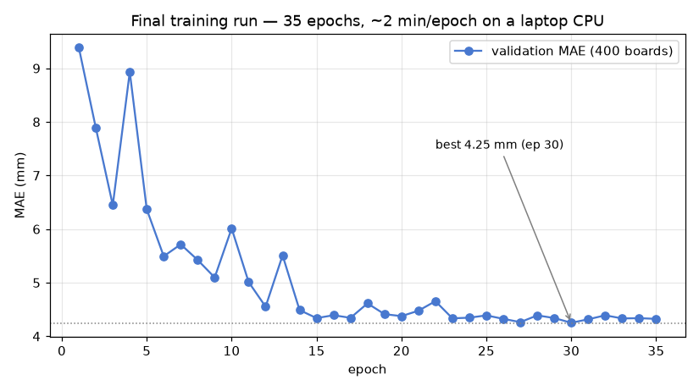
Training setup and convergence
AdamW, lr 3·10⁻⁴, weight decay 10⁻⁴, cosine schedule.
Batch 32, 35 epochs, SmoothL1 loss on normalised targets.
Best checkpoint chosen by validation MAE (4.25 mm at epoch 30).
Whole pipeline runs on a 4-core laptop CPU:
images pre-decoded once to a uint8 cache → no PNG decoding during training,
~2 min/epoch → ~65 min total training time.
Deterministic seeds for split and initialisation → reproducible.

Slide 8
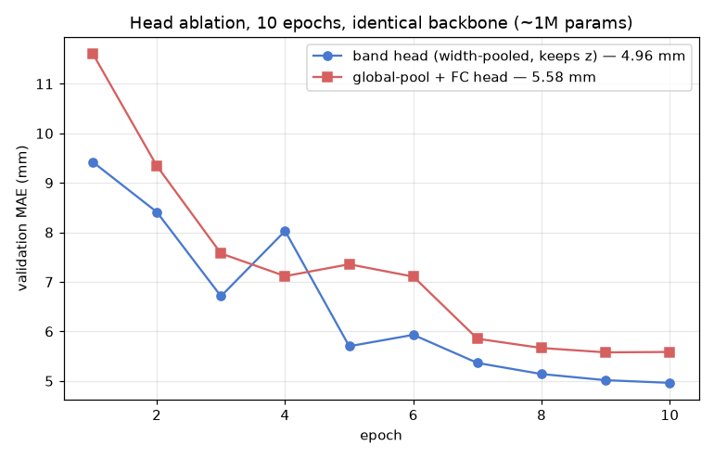
Does the structured head help? A controlled ablation
Same backbone, same data, same schedule, 10 epochs; only the head differs.
Band head (width-pooled, z-preserving): 4.96 mm val MAE.
Standard global-average-pool + FC(15): 5.58 mm val MAE.
The band head converges faster and ends ~11% better — consistent with the intuition that each output should read features from its own z-band.
Both heads beat the 25.6 mm baseline by ~5× already after one epoch.

Slide 9
Test-set results
1000 held-out boards, evaluated once with the selected checkpoint
Statistic | Value
Mean absolute error (the exercise metric) | 3.82 mm
Median absolute error | 1.78 mm
90th percentile absolute error | 7.67 mm
Per-board MAE, median / worst | 1.83 / 116 mm
Boards with pith fully inside the face (948) | 2.90 mm
Boards with pith partly outside (52) | 20.6 mm
Naive train-mean baseline | 25.6 mm
MAE is uniform across the 15 z positions (3.6–4.2 mm; slightly higher at the board ends, where one-sided context is available).
The error distribution is heavy-tailed: half of all boards are below 1.8 mm; a handful of far-outside-pith boards dominate the mean.

Slide 10
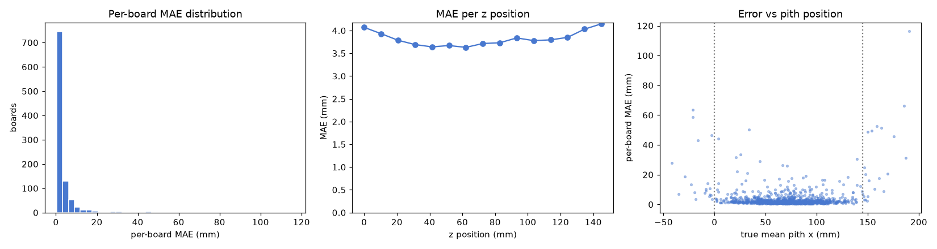
Where does the error come from?
Left: most boards are almost perfectly predicted; a thin tail of hard boards remains.
Right: error grows sharply once the true pith is beyond the board edges (dotted lines) — the model must extrapolate from nearly straight rings, and systematically underestimates large distances.

Slide 11
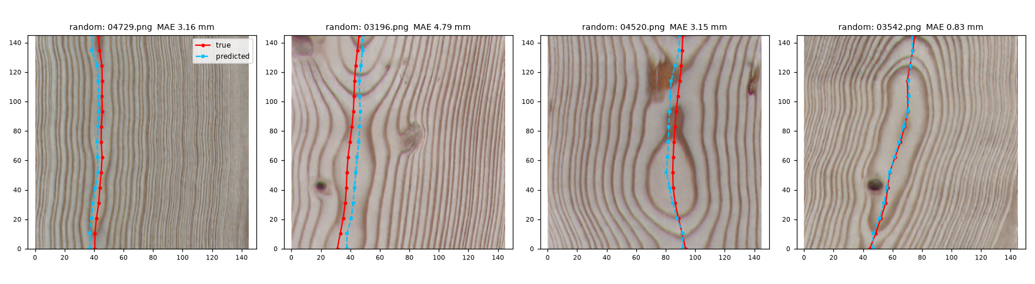
Visual check — randomly chosen test boards
red = ground truth, blue = prediction
Predictions track ring symmetry closely, unaffected by knots and colour patches.

Slide 12
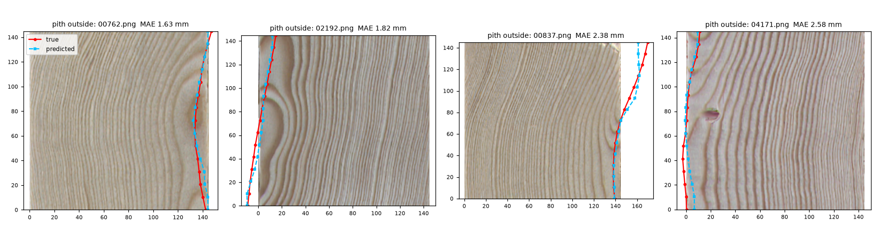
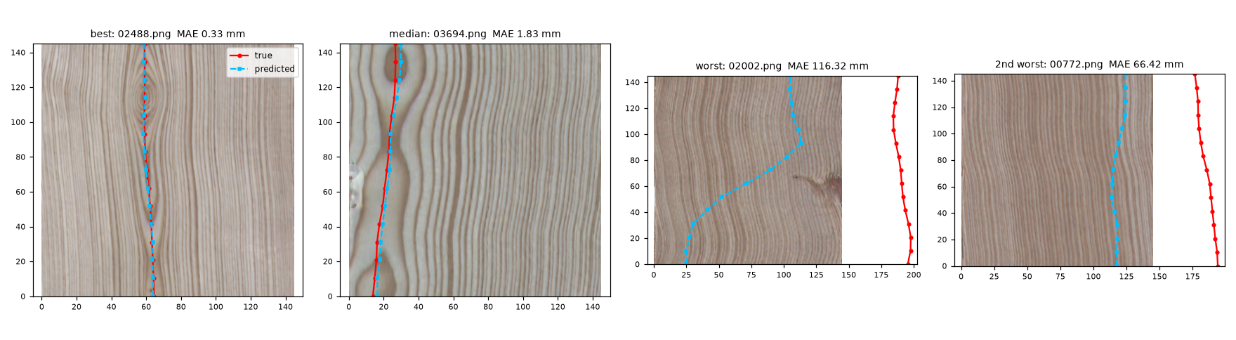
Visual check — pith outside the face, and failure cases
Top: pith just outside the face is handled well. Bottom right: the two worst test boards — pith 180–200 mm from the left edge; the model sees only near-vertical rings and underestimates the distance.

Slide 13
Limitations
Far-outside piths are the dominant failure mode (52/1000 boards contribute a large share of the total error).
Cause: weak visual signal (near-straight rings) + very few training examples that far out — an extrapolation problem in both image space and label space.
Possible remedies: oversample/reweight these boards, a log-distance target parameterisation, or a heatmap head over an extended x-range.
Synthetic data only: real board images add moisture stains, saw marks, lighting variation and camera geometry — domain gap not measured here.
The 15 outputs are predicted without an explicit smoothness prior; the data show the true path wanders only ~10 mm, which could be exploited (e.g. low-order polynomial output or a smoothness penalty).
Single-face x-only task: the full problem (x and y from four faces) needs multi-view fusion — the per-band head extends naturally to that setting.
No uncertainty estimate: for grading decisions a confidence measure (e.g. quantile regression) would matter.

Slide 14
Summary — what I learned
A ~1 M-parameter CNN trained from scratch in ~1 hour on a laptop CPU reaches 3.82 mm test MAE — ~7× better than the naive baseline, ~2.6% of the board width.
Understanding the data before modelling paid off:
the smooth pith path and the 4.6% outside-the-board sub-population shaped the loss, the no-clamping output and the evaluation breakdown;
physical symmetries gave exact, free augmentations.
Encoding output structure in the architecture (width-pooled, z-preserving head) beat a generic regression head by ~11% at zero parameter cost — small inductive biases matter at this data scale.
Honest evaluation = aggregate metric + stratified breakdown + visual checks; the mean alone hides that errors are concentrated in one rare, hard sub-population.
Next steps: extended-range heatmap head for far piths, uncertainty estimation, and scaling to the full four-face x/y problem.

