Slide 1
Principles of Compiler Design

Slide 2
1. Introduction
In modern computing, software is often developed on one system but executed on a completely different system. For example, programs for mobile phones, embedded systems, or microcontrollers are usually written on powerful desktop computers.
This situation creates the need for a special type of compiler known as a cross-compiler.

Slide 3
2. Definition of a Cross-Compiler
A cross-compiler is a compiler that runs on one type of machine (called the host machine) but generates executable code for a different type of machine (called the target machine).
Simple Definition
  A cross-compiler produces code for a platform other than the one on which it is running.

Slide 4
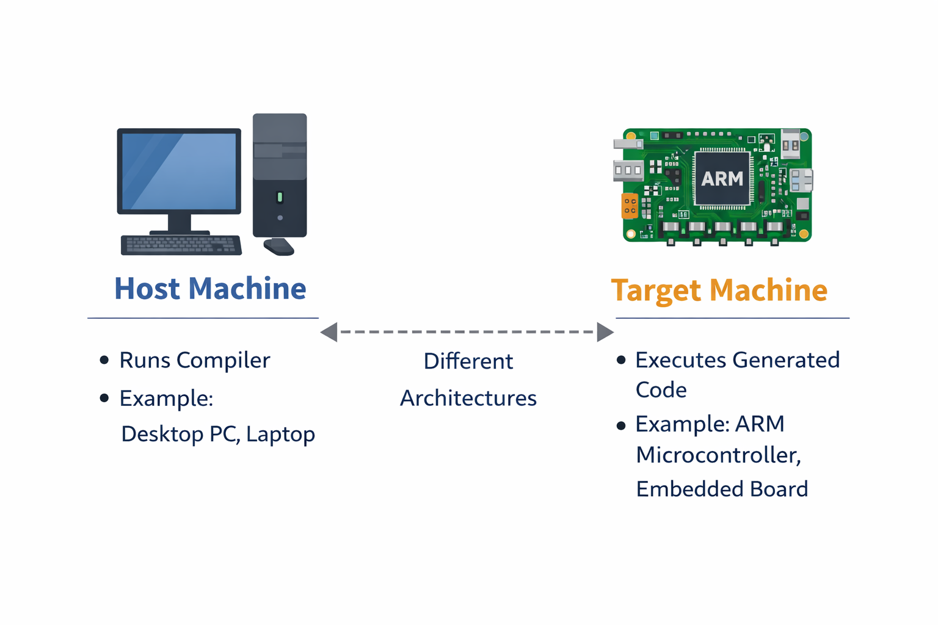
3. Host Machine vs Target Machine
To understand cross-compilers clearly, it is important to distinguish between:
Host Machine
The system where the compiler runs
Example: Windows PC, Linux PC
Target Machine
The system where the generated program will execute
Example: ARM processor, microcontroller, embedded board

Slide 5
4.Why Cross-Compilers Are Needed
Cross-compilers are essential because:
Target systems may lack resources
  Embedded systems often have limited memory and processing power
Convenience and speed
  Development is faster on powerful host machines
Hardware unavailability
  The target hardware may not be available during development
Industry-standard practice
  Almost all embedded and mobile software is built using cross-compilers

Slide 6
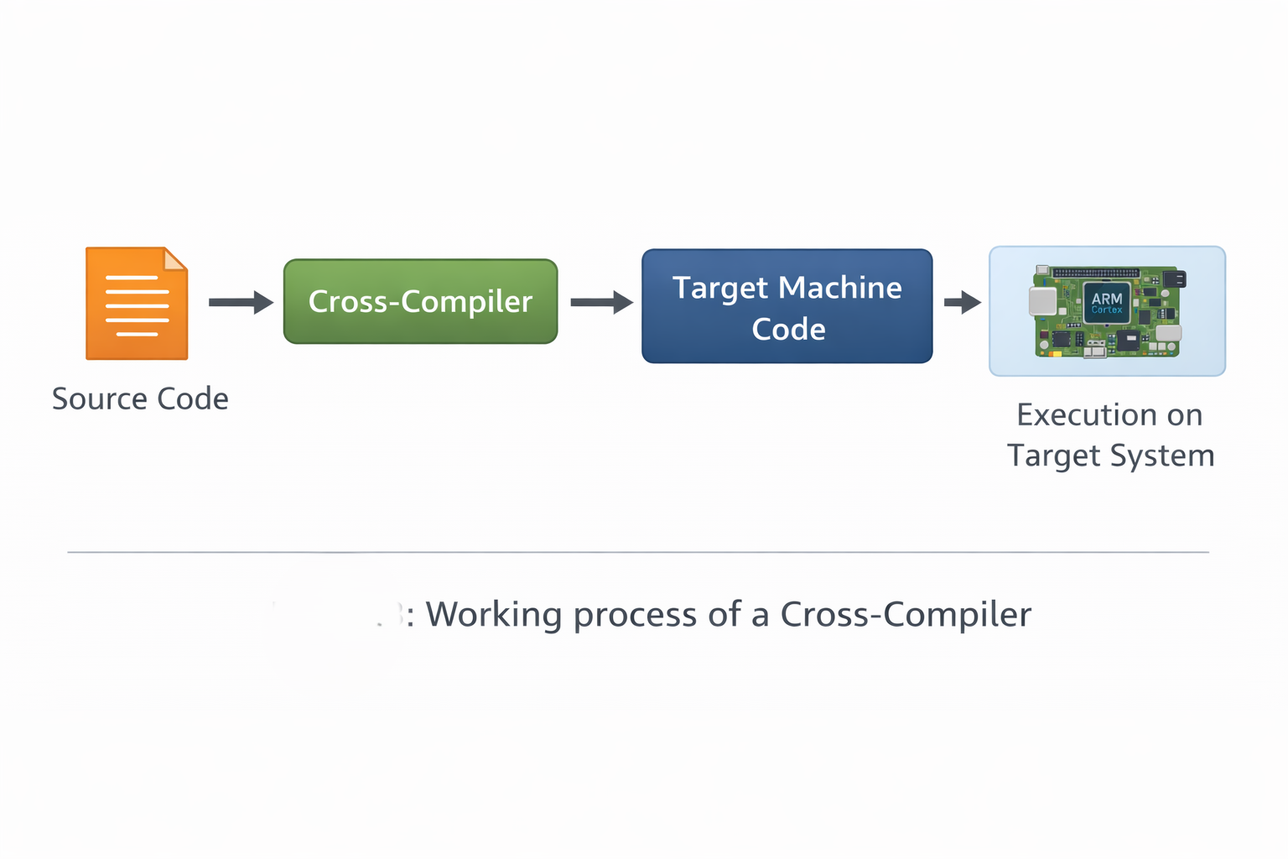
5. Working Principle of a Cross-Compiler
The working process of a cross-compiler includes:
Source code is written on the host machine
Cross-compiler translates the source code
Machine code is generated for the target architecture
The executable is transferred to the target system
The program runs on the target machine

Slide 7
6. Cross-Compiler vs Native Compiler
Feature | Native Compiler | Cross-Compiler
Runs on | Same system | Host system
Generates code for | Same system | Different system
Complexity | Simpler | More complex
Common use | Desktop apps | Embedded & mobile systems

Slide 8
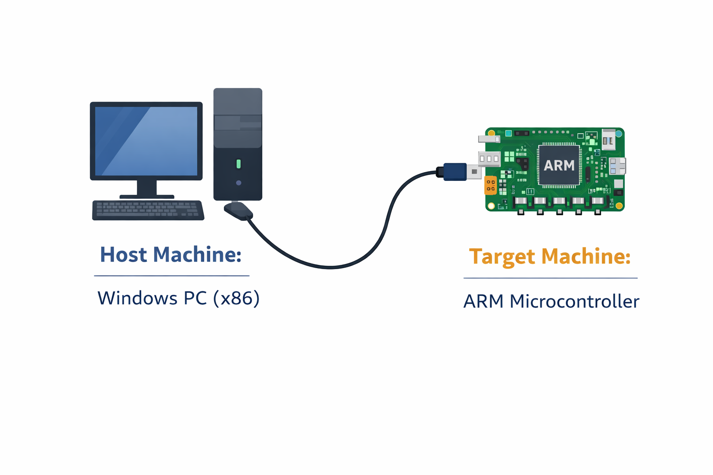
7. Practical Example
Example Scenario
Host Machine: Windows PC (x86)
Target Machine: ARM-based microcontroller
A developer uses an ARM cross-compiler on Windows to generate machine code that runs on the ARM processor.
Common Tools
GCC Cross-Compiler (e.g., arm-none-eabi-gcc)
Android NDK compilers
Embedded Linux toolchain

Slide 9
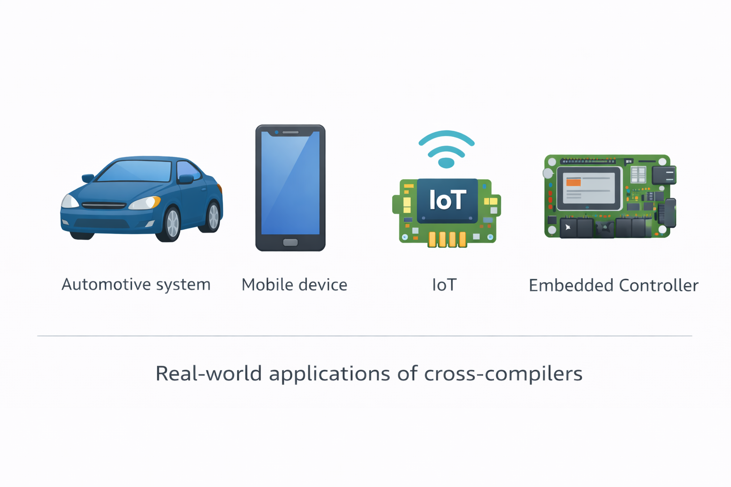
8. Real-World Applications
Cross-compilers are widely used in:
Embedded systems (washing machines, cars, medical devices)
Mobile phone application development
Operating system kernels
IoT devices
Game consoles

Slide 10
9. Advantages of Cross-Compilers
Enables development for resource-limited systems
Improves development efficiency
Supports multiple hardware architectures
Essential for embedded and system-level programming

Slide 11
10. Challenges of Cross-Compilers
More complex toolchain setup
Debugging can be difficult
Requires correct configuration of libraries and architectures

Slide 12
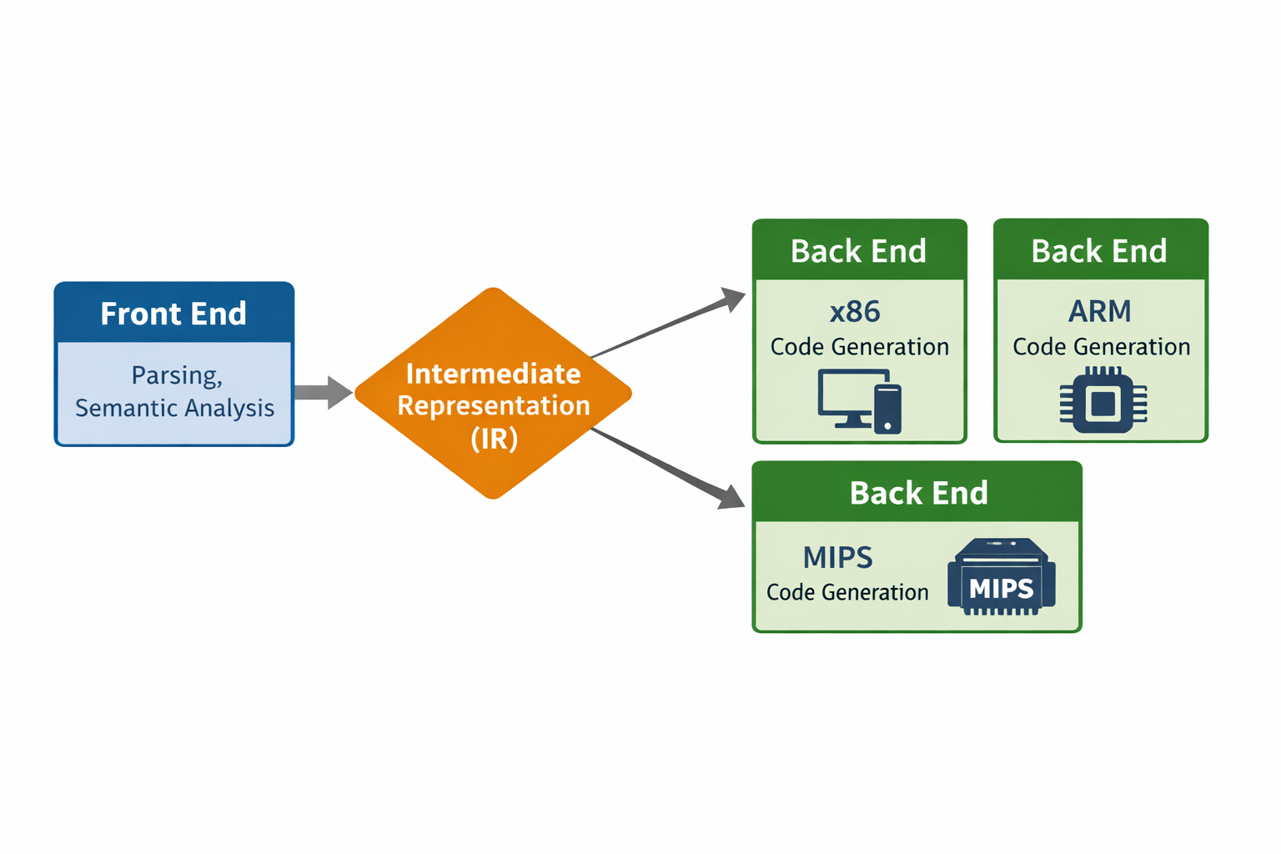
11.Role in Compiler Design
Demonstrates machine independence
Shows front-end / back-end separation
Importance of intermediate representation (IR)
Supports portability of code

Slide 13
12. Conclusion
A cross-compiler is a vital tool in modern software development. It allows programmers to write and compile code on one system while targeting another system. Cross-compilers are especially important in embedded systems, mobile computing, and hardware-specific application development.
Understanding cross-compilers helps students grasp key compiler concepts such as portability, code generation, and machine dependence.

