Slide 1

Part IV Internetworking Using TCP/IP
Part Contents
Internetworking
Internet Protocol Address
Datagram Forwarding
Support protocols And Technologies
TCP：Reliable Transport Service
UDP：Datagram Transport Service
The Future IP(IPv6)
Internet Routing And Routing Protocols

Slide 2
Part IV-Chapter 20 Internetworking
Internetworking
Motivation
No single networking technology is best for all needs
Universal Service
The Arbitrary pairs of computers can communicates
The Chief Problems With Multiple Network
It is needed to make the different physical networks to communicate with each other
A computer attached to a given network can only communicate with other computers attached to the same network
Each network in the organization formed an island
LAN ,WAN

Slide 3
Part IV-Chapter 20 Internetworking
Universal Service In A Heterogeneous network
The Chief Drawback OF The Heterogeneous Networks
Incompatibilities among network hardware and physical addressing prevent an organization from building a bridged network that includes arbitrary technologies
Internetworking
A scheme provides universal service among heterogeneous networks

Slide 4

Part IV-Chapter 20 Internetworking
Internetworking
IP Router
Additional hardware to interconnect a set of physical networks
Internet Protocol(IP)
Additional software on all the attached nodes provides universal service
Physical Network Connection With Routers
LAN to LAN
Building a virtual network on physical network
A virtual network
A conventional computer with separate NICs
LAN to WAN
WAN to WAN

Slide 5
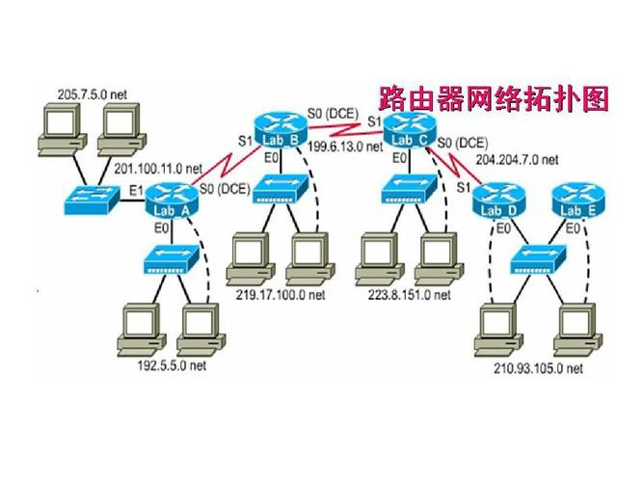
Part IV-Chapter 20 Internetworking
Internet Architecture
Any Topology Of Routers
Any number and type of networks
Any number of routers to use to interconnect them

Slide 6
Part IV-Chapter 20 Internetworking
Internetworking
internet
Interconnecting heterogeneous networks
Internet
The global internet
Intranet
An internet that is owned by a private organization

Slide 7
Part IV-Chapter 20 Internetworking
Internet Protocols
Virtual Network over physical network
It uses the physical NICs to transmit IP datagram between computer and router
They can overcome differences in frame formats and physical addresses to make communication possible among networks that use different technologies
IP Datagram Transmission
IP11→IP12,IP21→IP22
IP11
IP Router
IP12
IP21
IP22
NIC11
NIC12
NIC21
NIC22

Slide 8
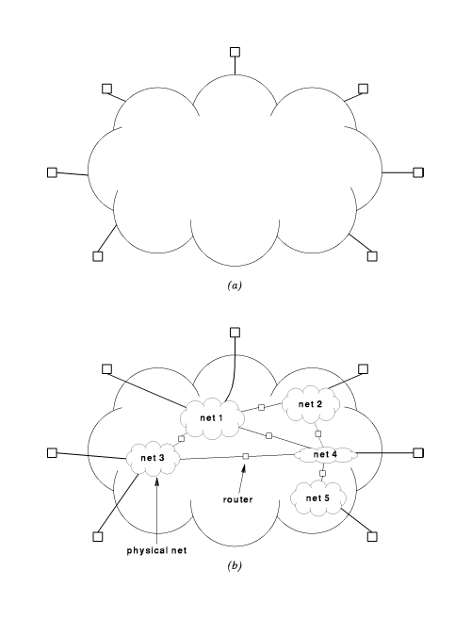
Part IV-Chapter 20 Internetworking
A Virtual Network
The illusion of a single network
Each computer is assigned a virtual address
Any computer can send an IP datagram to any other computer
The underlying physical structure
Routers interconnect physical networks

Slide 9
Part IV-Chapter 20 Internetworking
TCP/IP Protocol
Network Control Program(NCP) protocol
TCP/IP protocol
Designed for the ARPANET
Suitable for homogeneous network
Internet Protocol version 4(IPv4) in 1983
Suitable for heterogeneous network
Transmission Control Protocol version 3 in 1978
A reliable connection-oriented service
A connectionless layer

Slide 10
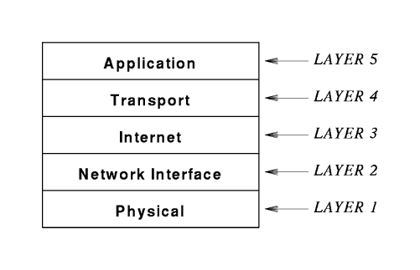
Part IV-Chapter 20 Internetworking
TCP/IP Reference Model
Protocols For Internetworking
Network Interface
Transmit frames over Physical Network
Datalink layer and Network layer in OSI model

Slide 11
Part IV-Chapter 20 Internetworking
Architecture Of TCP/IP Protocols

Slide 12
Part IV-Chapter 20 Internetworking
Host & Router
Host
A computer system that connects to an internet and runs application
It uses protocols from all layers
Router
It uses only parts of all layers
Below IP protocol

Slide 13
Part IV-Chapter 21 IP:Internet Addressing
Internet Protocol
It operates like any network
It is merely an abstraction imagined by its designers and created entirely by software
Internet Design
Addressing scheme
Packet formats
Delivery techniques independent of the details of the physical hardware
A Virtual Network

Slide 14
Part IV-Chapter 21 IP:Internet Addressing
IP Addressing scheme
Uniform addressing scheme
It is independent of the underlying MAC address
It is an abstraction created by software
The software uses the protocol address when it forwards IP datagram across the internet

Slide 15
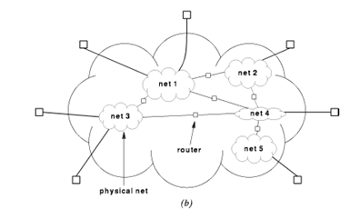
Part IV-Chapter 21 IP:Internet Addressing
Internet Protocol Address
IPv4 Address
An unique 32-bit binary number
They are assigned to the IP nodes which are the host and router
They must be used for IP communication
The IP Address Hierarchy
Network number
Host number

Slide 16
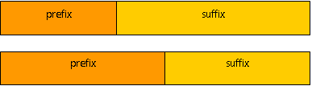
Part IV-Chapter 21 IP:Internet Addressing
The IP Address Hierarchy
Network Number
The prefix
It identifies the physical network to which the computer is attached
Their assignments must be coordinated globally
Host Number
The suffix
It identifies an individual computer on that network
Their assignments can be assigned locally without global coordination

Slide 17
Part IV-Chapter 21 IP:Internet Addressing
Internet Protocol Address
The Types of IP Addressing
Classful IP Addressing
Classless IP Addressing
The Hierarchy Division of IP Address
Adding bits to one part means subtracting bits from the other

Slide 18
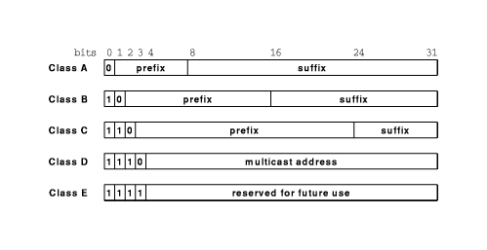
Part IV-Chapter 21 IP:Internet Addressing
Glassful IP Addressing
The type of class
The first four bits of an address determine the class
Primary classes
A，B，C
Unicast addresses

Slide 19
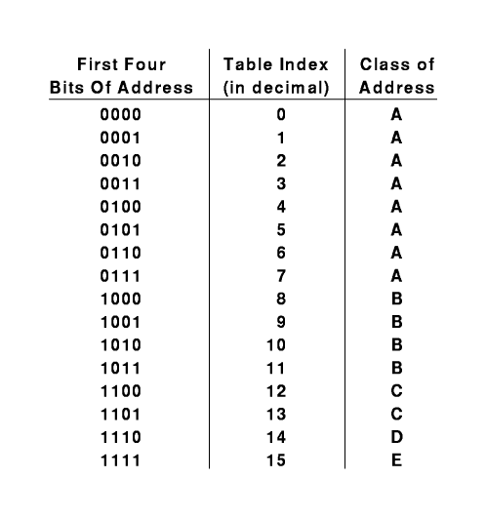
Part IV-Chapter 21 IP:Internet Addressing
Glassful IP Addressing
The Advantage of The Glassful IP Addressing
Short computation time

Slide 20
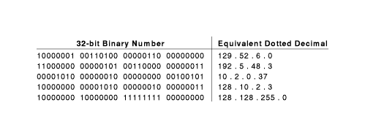
Part IV-Chapter 21 IP:Internet Addressing
The IP Address Natation
Dotted Decimal Notation
It expresses each 8-bit section of a 32-bit number as a decimal value
It uses periods to separate the sections

Slide 21
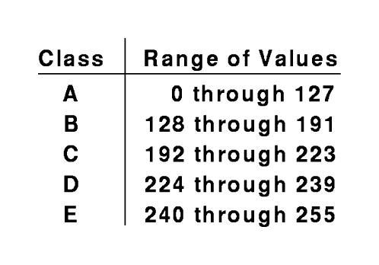
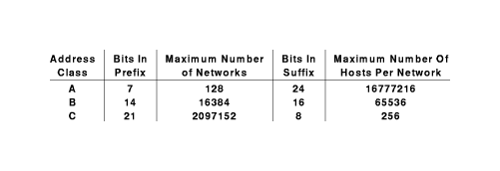
Part IV-Chapter 21 IP:Internet Addressing
Division Of The Address Space
The Range of Dotted Decimal Addresses
0.0.0.0—255.255.255.255

Slide 22

Part IV-Chapter 21 IP:Internet Addressing
Authority For Global IP Addresses
Internet Corporation for Assigned Name a and Number(ICANN)
It authorizes a set of registrars to assign prefix
Registrars make blocks of addresses available to ISPs
Internet Service Provider(ISP)
Internet Content Provider(ICP)
The enterprises provide addresses to ICPs
The subscribers
电信
移动
Baidu
google

Slide 23
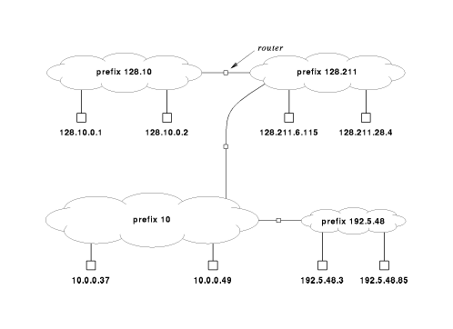
Part IV-Chapter 21 IP:Internet Addressing
A Classful Addressing
Intranet Address
Autonomous System
A Global IP Addressing Example

Slide 24
Part IV-Chapter 21 IP:Internet Addressing
Original Classful Addressing Scheme
The Limitation Of Original Glassful Addressing Scheme
The IP address space was being exhausted
Many addresses were unused
Classful address could be not shared by several physical networks

Slide 25
Part IV-Chapter 21 IP:Internet Addressing
Classless Addressing
It allows the division between prefix and suffix to occur on an arbitrary bit boundary
A network contains 9 hosts
Class C with 256 addresses
Classless with 16 addresses

Slide 26
Part IV-Chapter 21 IP:Internet Addressing
Classless Addressing
An Address Mask
The 32-bit value that specifies the boundary between the network prefix and the suffix
1 bits mark the network prefix and zero bits mark the host portion
The Subnet Mask Of B Class
11111111 111111111 00000000 00000000
255.255.0.0

Slide 27
Part IV-Chapter 21 IP:Internet Addressing
Computing Network Number
Computing Network Number
Prefix=A&M
A network contains 9 hosts
Suffix uses 4 bits
Subnet Mask is 255.255.255.240
A host IP address is 192.168.0.66
Network number=192.168.0.66&255.255.255.240=192.168.0.64
Host number=2

Slide 28
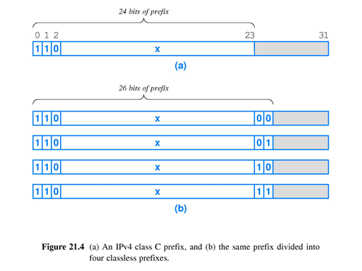
Part IV-Chapter 21 IP:Internet Addressing
An Example Of Division Of Network
Dividing 192.168.0.0 into four sub-networks
192.168.0.0:192.168.0.0—192.168.0.63
192.168.0.64: 192.168.0.64—192.168.0.127
192.168.0.128:192.168.128—192.168.0.191
192.168.0.192:192.168.192—192.168.0.255
Result
Submask is 255.255.255.192

Slide 29
Part IV-Chapter 21 IP:Internet Addressing
Classless Inter-Domain Routing Notation
It specifies the mask associated with an address by appending a slash and the size of the mask in decimal
128.10.0.0/16
CIDR is used to partition address
A Class C addresses is partitioned into 4 pieces
192.168.0.0/26
192.168.0.128/26
192.168.0.192/26
192.168.0.64/26

Slide 30
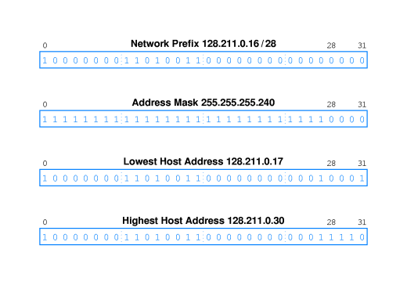
Part IV-Chapter 21 IP:Internet Addressing
CIDR Host Address

Slide 31
Part IV-Chapter 21 IP:Internet Addressing
IP Subnet
Feature
Two different subnets cannot communicate directly
192.168.1.1/24
Subnet is 192.168.1.0
192.168.2.1/24
Subnet is 192.168.2.0

Slide 32
Part IV-Chapter 21 IP:Internet Addressing
Special IP Addresses
Network Address
The host address that is zero
It can be used to denote a network
Examples：10.0.0.0，128.0.0.0，128.211.0.0，192.5.48.0
This Computer Address
The address that consists of all 0 bits
0.0.0.0

Slide 33
Part IV-Chapter 21 IP:Internet Addressing
Special IP Addresses
Directed Broadcast Address
When a packet is sent to it，the packet is delivered to all hosts on the network
The host address that contains all 1bits
Examples：10.255.255.255， 128.0.255.255，128.211.255.255，192.5.48.255
Limited Broadcast Address
A broadcast on a local physical network
The address that consists of all 1 bits
255.255.255.255

Slide 34
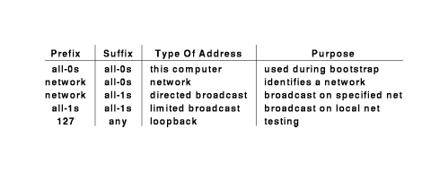
Part IV-Chapter 21 IP:Internet Addressing
Special IP Addresses
Loopback Address
Two application programs runs on a single computer and instructs them to use a loopback IP address when communicating
When one application sends data to another, data travels down the protocol stack to the IP software, which forwards it back up through the protocol stack to the second program
A network prefix 127 for use with loopback
Example：127.0.0.8，127.0.0.1

Slide 35
Part IV-Chapter 21 IP:Internet Addressing
Special IP Addresses
Private Address For Intranet
10.0.0.0—10.255.255.255
172.16.0.0—172.31.255.255
192.168.0.0—192.168.255.255
The Berkeley Broadcast Address
The host address that contains all 0 bits
Example：10.0.0.0，128.0.0.0，128.211.0.0，192.5.48.0

Slide 36
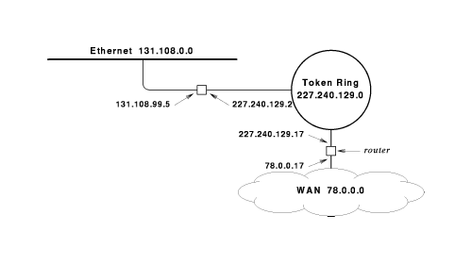
Part IV-Chapter 21 IP:Internet Addressing
The IP Addresses Assigned to Routers
Address Assign
Each IP address contains a prefix that specifies a physical network
A router has connections to multiple physical networks

Slide 37
Part IV-Chapter 21 IP:Internet Addressing
Routers And The IP Addressing Principle
IP Scheme
An IP address does not identify a specific computer
Each IP address identifies a connection between a computer and a network
Multi-Homed Hosts
A host that connects to multiple networks
It is used to increase reliability
It is used to increase performance

Slide 38
Part IV-Chapter 22 Datagram Forwarding
Communication Service Paradigm
Connect-oriented Service
Connectionless Service
A sender places the data in the appropriate frame format
The sender attaches the address of the receiver to the frame
The sender passes the frame to the network for delivery
The sender and receiver must establish a connection before any data can be transferred
Once a connection is in place, they can exchange data
When communication is complete，the connection must be terminated
ATM
Ethernet

Slide 39
Part IV-Chapter 22 Datagram Forwarding
TCP/IP Communication Service Paradigm
IP Communication Service Paradigm
TCP Communication Service Paradigm
Connection-oriented
Connectionless
High efficiency
Unreliable
Reliable
Low efficiency

Slide 40
Part IV-Chapter 22 Datagram Forwarding
Virtual IP Packet
IP datagram
It is used to transmit across the Internet over physical network
It is independent of the underlying hardware
It relies completely on hardware for transmission
Notes:
实验：Tracert www.163.com

Slide 41
Part IV-Chapter 22 Datagram Forwarding
IP Datagram Transmission Between IPs(1)
A source host→Router
Creating an IP datagram
Placing the destination address in the IP datagram header
Sending the IP datagram to the nearby router over a physical network by their NICs
Router→Next Router
Receiving the IP datagram
Selecting the next router by the destination address
Sending the IP datagram to the next router over a physical network by their NICs

Slide 42
Part IV-Chapter 22 Datagram Forwarding
IP Datagram Transmission Between IPs(2)
Final Router→A destination host
Receiving the IP datagram
Sending the IP datagram to the destination host over a physical network by their NICs
A source host→Router→…→Final-Router→the destination host
The adjacent IP Datagram is transmitted by the network interface layer

Slide 43

Part IV-Chapter 22 Datagram Forwarding
IP Datagram Structure
IP Datagram Header
The size of datagram header is fixed
It contains both the source IP address and the destination IP address
IP Datagram Data Area
The size of datagram Data Area is not fixed
The size of a datagram is determined by the network interface
Between a single octet and 64K octets

Slide 44
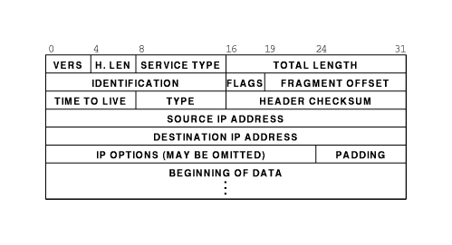
Part IV-Chapter 22 Datagram Forwarding
IP V4 Datagram
Header Format
Notes:
Ping TTL

Slide 45
Part IV-Chapter 22 Datagram Forwarding
Next-hop Forwarding An IP Datagram
Each router along the path receives the IP datagram
It extracts the destination address from the header
It uses the destination address to determine a next hop to which the datagram should be sent
It then forwards the datagram to the next hop By NICs
Next-hop
Either the final destination or next router

Slide 46
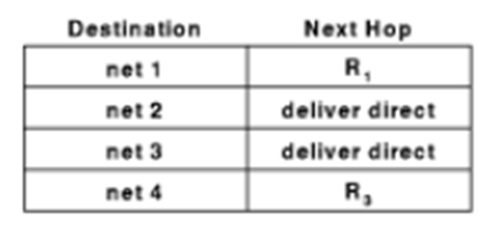
Part IV-Chapter 22 Datagram Forwarding
IP Routing Table
It is used to keep the next hop information
A destination network address
The next hop is the router address used to reach that destination

Slide 47
Part IV-Chapter 22 Datagram Forwarding
Next-hop Forwarding Tables
IP Route Table
It belongs to Internet Protocol
Next hop is another IP address
WAN Route Table
It belongs to Network Interface
Next hop is an interface

Slide 48
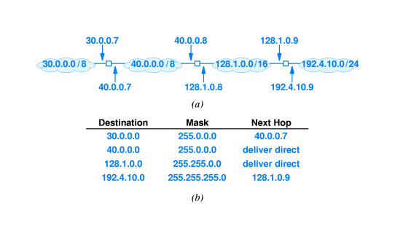
Part IV-Chapter 22 Datagram Forwarding
An Example of IP Routing Table
An Internet with four networks
The forwarding table found in center router

Slide 49
Part IV-Chapter 22 Datagram Forwarding
Forwarding
Routing
The process of using a routing table to select a next hop for a given datagram
Routing Computation
If (Mask[I]&D)==Destination[I]) forward to its NextHop[I]
Assume that the datagram contains a destination IP address D

Slide 50

Part IV-Chapter 22 Datagram Forwarding
An Example of Datagram Forwarding
A datagram destined for address 192.4.10.3
Computes the destination network address
255.255.255.0&192.4.10.3=192.4.10.0
It looks up the destination field with 192.4.10.0
It chooses next hop 128.1.0.9

Slide 51
Part IV-Chapter 22 Datagram Forwarding
Forwarding
The Relationship Between Destination and Next-hop
The Destination is used to compute the Next-hop
The datagram is sent directly to Next-hop
The header in the datagram remains the destination unchangeably

Slide 52
Part IV-Chapter 22 Datagram Forwarding
IP Strategy
Best-Effort Delivery
IP does not guarantee that it will handle the communication problems
Higher layers of protocol software are required to handle each of these errors

Slide 53
Part IV-Chapter 22 Datagram Forwarding
Transmission Problems
The Problems That IP Does Not Handle
Datagram duplication
Delayed or out-of-order delivery
Corruption of data
IP Datagram loss

Slide 54
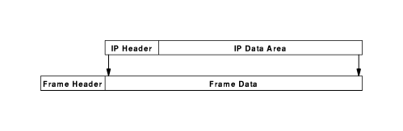
Part IV-Chapter 22 Datagram Forwarding
IP Datagram Transmission
IP Encapsulation
The entire IP datagram is placed in the data area of a frame
The Frame transmission
The IP datagram will be sent to the next node through frame

Slide 55
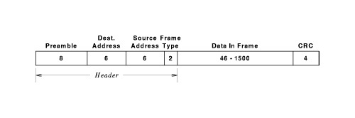
Part IV-Chapter 22 Datagram Forwarding
A Ethernet Frame Encapsulating an IP datagram
Frame type
Data in Frame
Destination Address
Hardware address of next hop resolved by ARP
0800
IP datagram

Slide 56
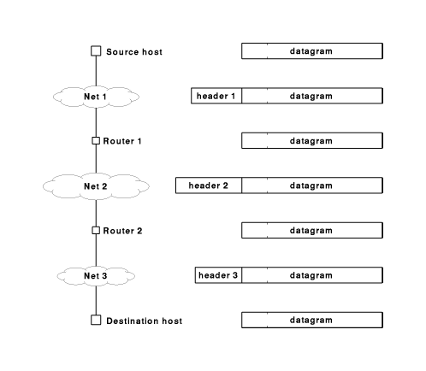
Part IV-Chapter 22 Datagram Forwarding
IP Datagram Transmission
IP Network
Network Interface

Slide 57
Part IV-Chapter 22 Datagram Forwarding
Frame transmission Across An Internet
Before it is transmitted across a given network，an IP datagram is encapsulated into a frame
When the frame arrives at the next hop，the IP datagram is removed from the incoming frame
Before being routed, the IP datagram is encapsulated into an outgoing frame

Slide 58
Part IV-Chapter 22 Datagram Forwarding
IP Datagram transmission Across An Internet
After the sender selects a next hop，the sender encapsulates the datagram in a frame and transmits the result across the physical network to the next hop
When the frame reaches the next hop，the receiving software removes the IP datagram and discards the frame
If the datagram must be forwarded across another network，a new frame is created

Slide 59
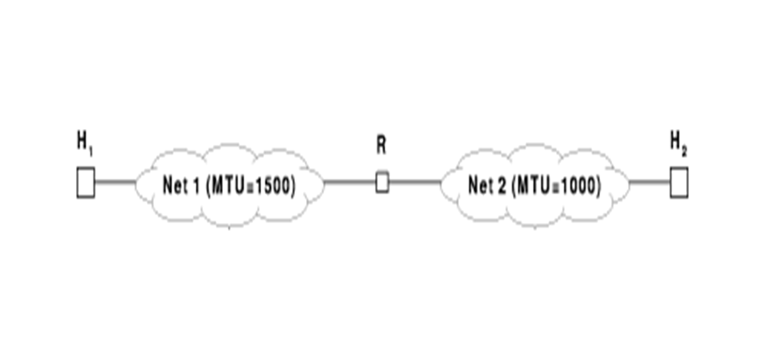
Part IV-Chapter 22 Datagram Forwarding
MTU (Maximum Transmission Unit)
The Maximum amount of data that a frame can carry
IP datagram must be smaller or equal to the network MTU or it cannot be encapsulated for transmission
MTU restrictions in heterogeneous networks
Router R will receive the datagram from Net1, but will not be able to send it across Net2

Slide 60
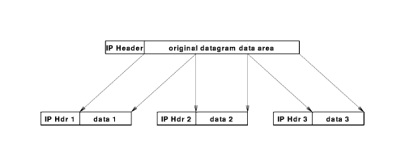
Part IV-Chapter 22 Datagram Forwarding
IP Fragmentation
Fragments
The router divides the IP datagram into smaller pieces called fragments
Transmission
Each fragment travels independently

Slide 61
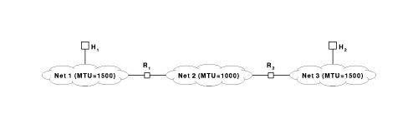
Part IV-Chapter 22 Datagram Forwarding
Reassembly Of A Datagram From Fragments
Process
The ultimate destination host should reassemble fragments
An Example of Fragmentation and Reassembly
Host H1 on Net1 sends a 1500-octet datagram to host H2 on Net3
Route creates a copy of the original datagram from fragments

Slide 62
Part IV-Chapter 22 Datagram Forwarding
Fragmentation Of IP Header
IDENTIFICATION
FLAGS
FLAGMENT OFFSET
Indicate whether the datagram is a fragment
A 13-bit field which specify where in the datagram the fragment belongs
A unique 16-bit number(usually sequential)

Slide 63
Part IV-Chapter 22 Datagram Forwarding
Fragment Loss Scheme
When the first fragment arrives from a given datagram，the receiver starts a timer
If all fragments of a datagram arrive before the timer expires，the receiver cancels the timer and reassembles the datagram
If the timer expires before all fragments arrives，the receiver discards those fragments that arrived

Slide 64
Part IV-Chapter 22 Datagram Forwarding
Fragment Loss Scheme
The Advantage
It reduces the amount of state information in routers
Unavailable Retransmission in Fragment Loss
The sender does not know about fragmentation
It allows routes to change dynamically
Routes may be different，which a retransmission would not necessary traverse the same routers

Slide 65
Part IV-Chapter 22 Datagram Forwarding
Fragmenting A Fragment
Another router along the path divides the fragment into smaller fragments
IP does not distinguish between original fragments and subfragments

Slide 66
Part IV-Chapter22 Datagram Forwarding
IP Routing Table in Host
IP Address&Mask Address
Default gateway address
Next hop
Deliver direct
Default route

Slide 67
Part IV-Chapter22 Datagram Forwarding
The Example of IP Routing Table in Host
Host IP Configuration
Mask Address:255.255.255.0
Default gateway address 192.168.0.1
Destination is 192.168.1.254
Destination network=192.168.0.0
Destination network=192.168.1.0
Next hop is 192.168.0.1
Routing Table in Host
Destination is 192.168.0.200
Next hop is 192.168.0.200 (Deliver direct)
IP Address:192.168.0.254
192.168.0.0 255.255.255.0 Deliver direct
0.0.0.0 0.0.0.0 192.168.0.1
Destination address for the same network address
Default gateway address for the different network address

Slide 68
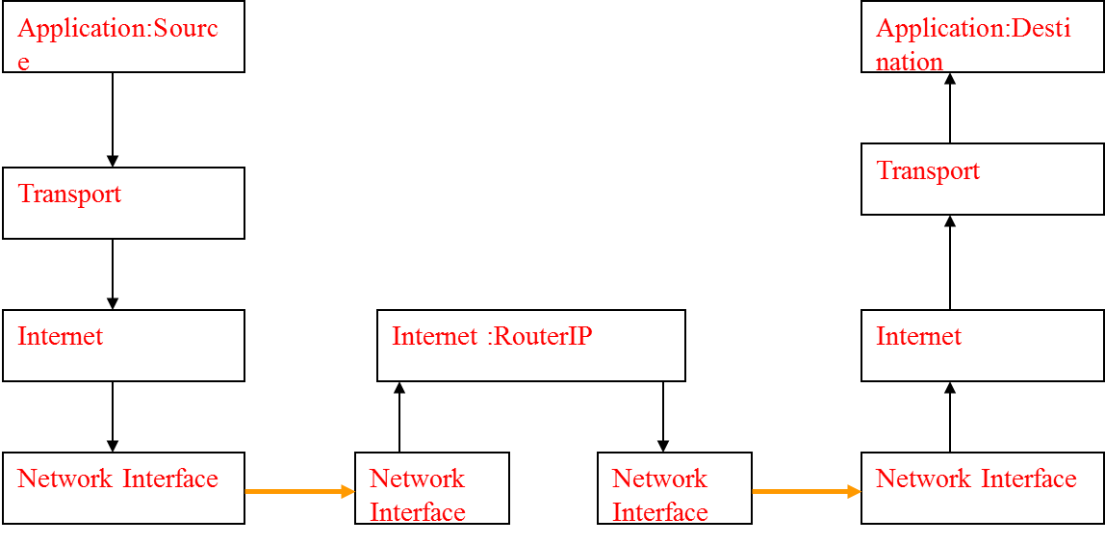
Part IV-Chapter22 Datagram Forwarding
IP Datagram Transmission
Process
Create an IP Datagram by Source host
IP datagram transfers across the Multi-hop IP Network
The transmission between adjacent IP nodes is implemented by the network interface layer

Slide 69
Part IV-Chapter21IP:Internet Addressing
Internet Protocol
Successes
Heterogeneous networks
Dramatic change in hardware technology
Extreme increases in scale
The Motivation For Changing IP
Its limited address space
New Internet application
Collaboration technology
Real-time audio and video

Slide 70
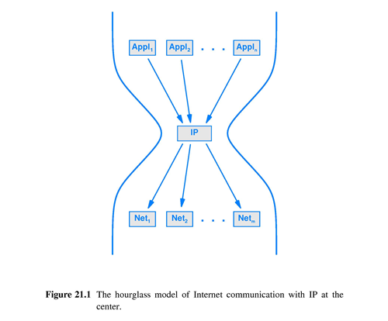
Part IV-Chapter21 IP:Internet Addressing
Difficulties Of Changing IP
IP is central to all Internet communication
Applications，
Networks
Changing IP requires a change to the entire Internet

Slide 71
Part IV-Chapter22 Datagram Forwarding
IP Version Number
IPv4
IPv5
IPv6
The current IP version
The next generation version
The experimental version

Slide 72
Part IV-Chapter22 Datagram Forwarding
IPv6 Features
Features Retained
Connectionless
Time to live
The New Features
Address Size is 128 bits
Header Format
Extension Headers
Support for audio and video
Extensible Protocol

Slide 73
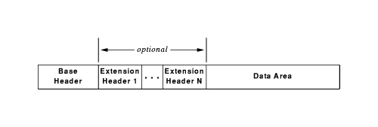
Part IV-Chapter22 Datagram Forwarding
IPv6 Datagram Format
Headers
One Base Header
Zero or More Extension Headers

Slide 74
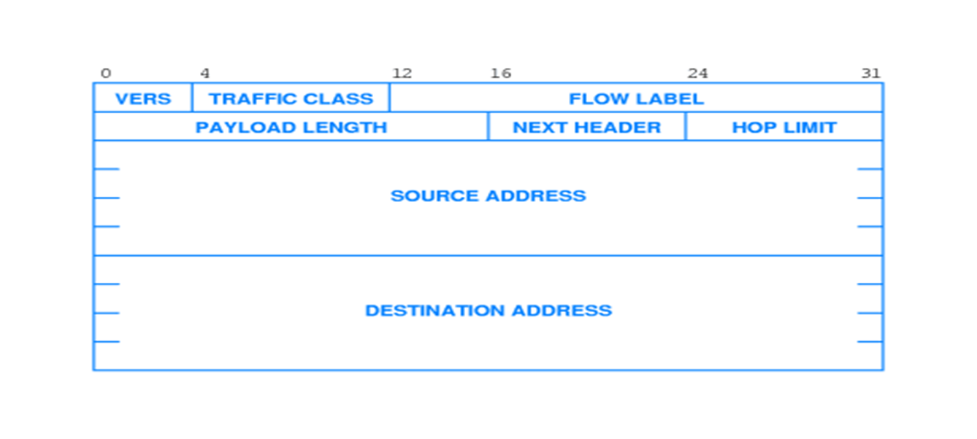
Part IV-Chapter22 Datagram Forwarding
IPv6 Datagram Format
Base Header
FLOW LABEL
NEXT HEADER
HOP LIMIT
TTL

Slide 75
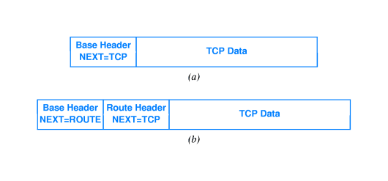
Part IV-Chapter22 Datagram Forwarding
IPv6 Headers
Examples

Slide 76
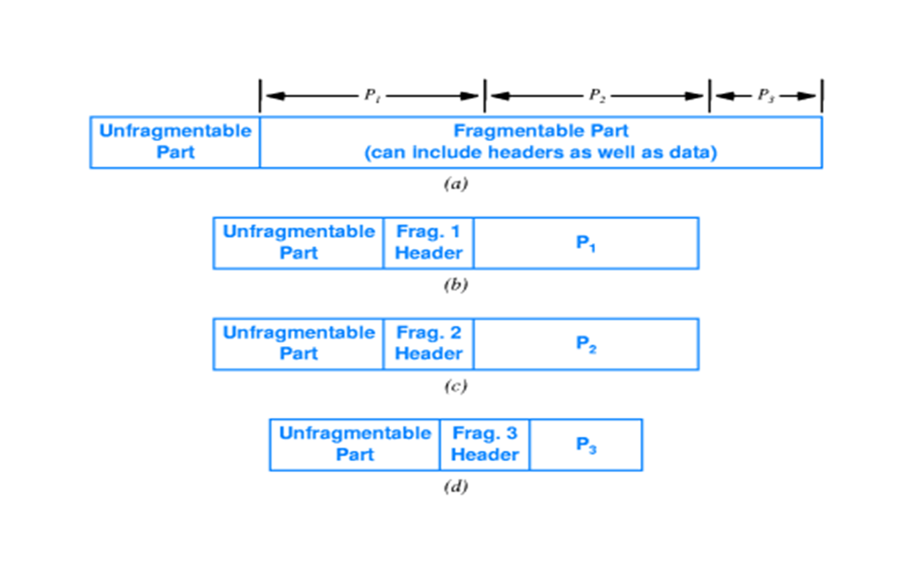
Part IV-Chapter22 Datagram Forwarding
IPv6 Fragmentation
Unfragmentable Part
The base header
A fragment extension header
fragmentation information

Slide 77
Part IV-Chapter21 IP:Internet Addressing
IPv6 Addresses
Prefix
64 bits
Global prefix
Subnet
Suffix
64 bits
It identifies a specific computer
It is assigned to an organization by ISP
Networks at the organization
A globally-unique value used for routing in the Internet
GLOBAL PREFIX
SUBNET
INTERFACE(COMPUTER)

Slide 78
Part IV-Chapter21 IP:Internet Addressing
The Types of IPv6 Addresses
Unicast
The address corresponds to a single computer
Multicast
The address corresponds to a set of computers, and membership in the set can changed at any time
Anycast or Cluster
The address corresponds to a set of computers that share a common prefix

Slide 79
Part IV-Chapter21 IP:Internet Addressing
IPv6 Colon Hexadecimal Notation
Each group of 16 bits is written in hexadecimal with a colon separating groups
Dot decimal Notation：105.220.136.100.255.255.255.255.0.0.18.128.140.10.255.255
69dc:8864:FFFF:FFFF:0000:1280:8C0A:FFFF
Zero Compression
Zero compression replaces sequences of zeroes with two colons
FF0C:0:0:0:0:0:0:B1
FF0C::B1

Slide 80

Part IV-Chapter23 Support Protocols And Technologies
IP Datagram Delivery
Internet Layer
Network Interface Layer

Slide 81
Part IV-Chapter23 Support Protocols And Technologies
The MAC Address of The Next Hop
Example 1
Host A (192.168.0.1)sends data to Host B(192.168.0.2)
Next hop is B
A
C
E
R1
R2
B
D
F
The next hop is deliver direct because A and B belong to the same network address
B’s hardware address

Slide 82
Part IV-Chapter23 Support Protocols And Technologies
The MAC Address of The Next Hop
Example 2
Host A(192.168.0.1) sends data to Host F(192.168.3.1)
Next hop is R1 (192.168.0.254)
A
C
E
R1
R2
B
D
F
The next hop is the default gate way because A and F have the different network address
R1’s hardware address

Slide 83
Part IV-Chapter23 Support Protocols And Technologies
The MAC Address of The Next Hop
Example 2
Host A→Router R1→Router R2→Host F
R1’s MAC address
F’s MAC address
R2’s MAC address
A
C
E
R1
R2
B
D
F

Slide 84
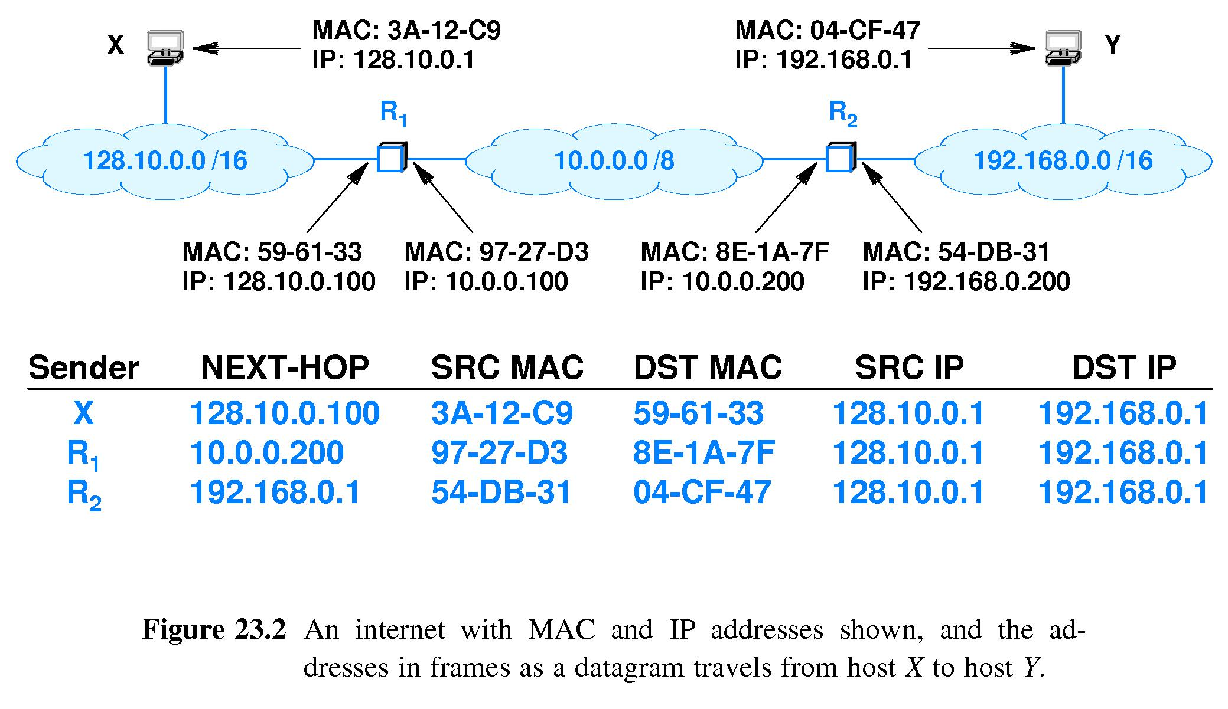
Part IV-Chapter23 Support Protocols And Technologies
Address Resolution
It translate the next-hop IP address to an equivalent before a frame can be sent

Slide 85
Part IV-Chapter23 Support Protocols And Technologies
Address Resolution Techniques
Table lookup
mappings between IP and hardware addresses
Closed-form computation
A mathematical function
Message exchange
Distributed computation

Slide 86
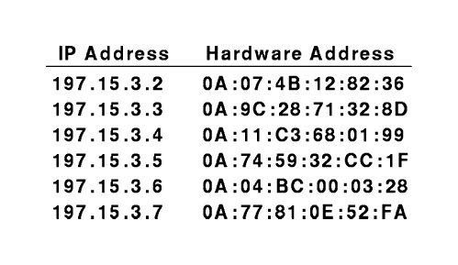
Part IV-Chapter23 Support Protocols And Technologies
Address Resolution
Table Lookup
Bindings or mappings are stored in a table in memory
The software searches when it needs to resolve an address
It is used with WAN
fram map ip 202.168.2.2 200

Slide 87
Part IV-Chapter23 Support Protocols And Technologies
Address Resolution
Closed-Form Computation
Hardware address=ip_address&oxff
IP=220.123.5.1，Physical Address=1
The configurable network number is 220.123.5.0
The protocol address assigned to a computer is chosen carefully so the computer’s hardware address can be computed from the protocol address
Only suitable for the network with configurable address
Seldom used

Slide 88
Part IV-Chapter23 Support Protocols And Technologies
Address Resolution
Message Exchange
ARP Request Message
message that requests the corresponding hardware address
ARP Response Message
The binding with IP address and hardware address
It is used with LAN
One Computer
Another computer
ARP Request
ARP Response

Slide 89
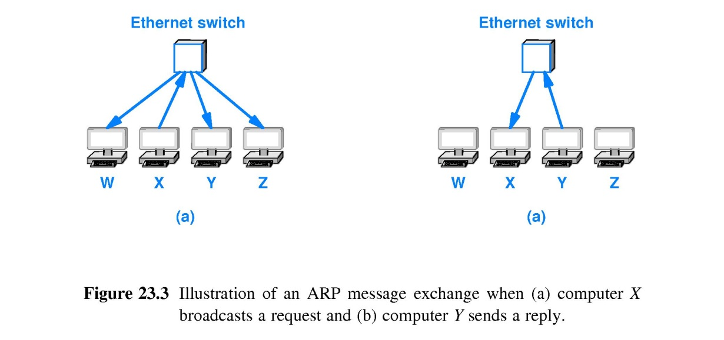
Part IV-Chapter23 Support Protocols And Technologies
Address Resolution Protocol(ARP)
Distributed Address Resolution With Message Exchange
X broadcasts an ARP request message to resolve Y on the network
All machines receive the ARP request message and examine the requested address
Only Y sends a directed ARP response containing its MAC address back to X
X will get Y’s MAC address from the ARP response message
All others discard the ARP request without sending a response

Slide 90
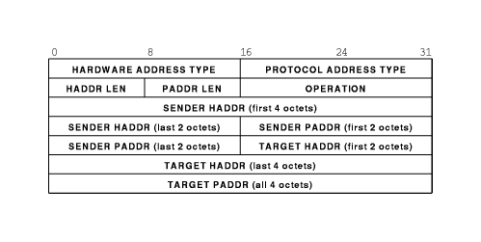
Part IV-Chapter23 Support Protocols And Technologies
ARP Message Format
OPERATION
1:ARP Request Message
2:ARP Response Message

Slide 91
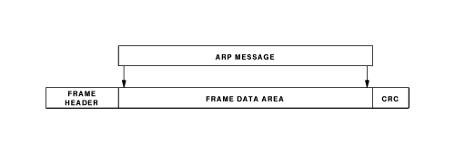
Part IV-Chapter23 Support Protocols And Technologies
ARP Encapsulation
Sender
Other hosts receive the request message and examine the IP address
Then broadcasts the frame to all hosts on the network
Places ARP request message in a hardware frame
The host mentioned in the request places ARP response message in a hardware frame
Then send the frame to the sender

Slide 92
Part IV-Chapter23 Support Protocols And Technologies
A Ethernet Frame Containing an ARP Message
Frame type
Data in Frame
Destination Address
FF:FF:FF:FF:FF:FF:FF
0806
ARP request message
Hardware address of next hop resolved by ARP
0806
ARP response message

Slide 93
Part IV-Chapter23 Support Protocols And Technologies
Identifying ARP Frame
A sender
Assigning the appropriate value (0x806)to the type field of a frame
Transmitting the frame
A receiver
Examining the OPERATION field in each incoming frame
If its value is equal to 2, the receiver gets MAC address from the ARP response message
If its value is equal to 1, the receiver resolves the ARP request message

Slide 94
Part IV-Chapter23 Support Protocols And Technologies
ARP Algorithm
ARP Caching
ARP software extracts and save the information from an ARP response message
ARP maintains a small table of bindings in memory as a cache
ARP Scheme
Whenever ARP performs address binding，it search the cache before using the network
If the binding is present，ARP uses the binding without transmitting a request
If the binding is not present in cache，ARP use network to perform address resolution

Slide 95
Part IV-Chapter23 Support Protocols And Technologies
ARP Algorithm Optimization
Possible Optimization of ARP
It would be possible for all computers to extract the sender’s binding and store it locally
Doing so wastes CPU time and memory because it is unlikely that all pairs of computers will need to communicate
Further Optimization of ARP
All other computers that contained the sender’s address binding in their catch will extract the new sender’s address binding from the request and update the old one in their caches
The destination computer will extract the sender’s address binding from the request and adds the binding to its catch

Slide 96
Part IV-Chapter23 Support Protocols And Technologies
Processing An Incoming ARP Message
The receiver extracts the sender’s address binding and checks to see if a binding is present in the cache
If so, the receiver uses the binding to replace the previously stored binding
If not so，the receiver discards the binding
If the message is an ARP response, the message is the binding requested
If the message is an ARP request, the receiver compares field TARGET PADDR with the local protocol address
If the two are identical, the receiver must send an ARP response and add sender’s address binding to cache
1.Updating ARP cache
2.Address Resolution
The receiver examines the OPERATION field of the message

Slide 97
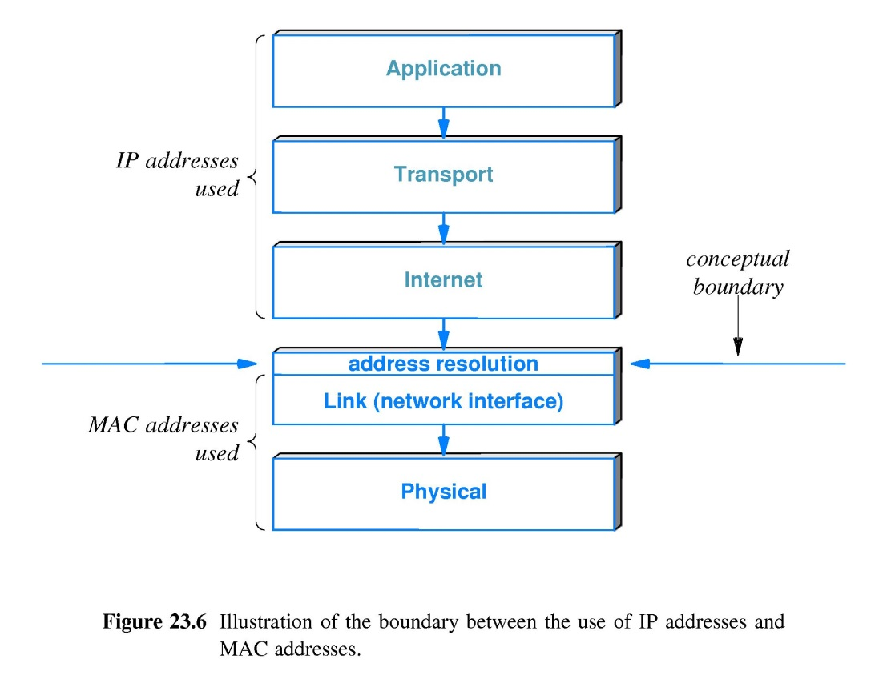
Part IV-Chapter23 Support Protocols And Technologies
The Conceptual Address Boundary

Slide 98
Part IV-Chapter23 Support Protocols And Technologies
Error Detection In IP
Channel Coding in IP Header with Checksum
It covers only the header of IP datagram
Whenever a datagram is received，the checksum is verified to ensure that the header arrived intact
TIME TO LIVE field in IPv4
If a checksum error occurs，the IP datagram must be discarded immediately without further processing because any field in the datagram header cannot be trusted
Prevent an IP datagram from circulation forever
HOP LIMIT field in IPv6

Slide 99
Part IV-Chapter23 Support Protocols And Technologies
IP Error Mechanism
An Error Reporting Mechanism
Internet Control Message Protocol(ICMP)
It is used to report errors back to the original source when an IP error occurs
IP attempts to report problems when they occur

Slide 100
Part IV-Chapter23 Support Protocols And Technologies
The Relationship Between IP and ICMP
IP uses ICMP when it sends an error message
ICMP uses IP to transport its messages

Slide 101
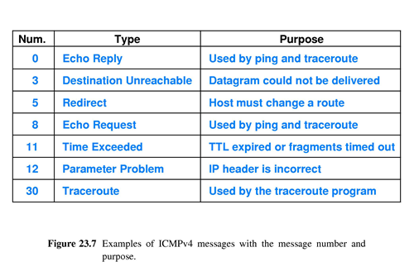
Part IV-Chapter23 Support Protocols And Technologies
ICMP Message Format
Type | Code | Checksum
ID |  | Seq
ICMP Body

Slide 102
Part IV-Chapter23 Support Protocols And Technologies
The Categories of ICMP Messages
ICMP Information Messages
Echo Request(Type=8)
Echo Reply(Type=0)
Address Mask Request(Type=17)
Address Mask Reply(Type=18

Slide 103
Part IV-Chapter23 Support Protocols And Technologies
ICMP Error Messages
Source Quench(Type=4)
Time Exceeded(Type=11)
TTL for Router(code=0)
Fragment Loss for Host (code=1)
Destination Unreachable(Type=3)
Unreachable Host(code=0)
Unreachable Network(code=1)
Fragmentation Required(code=4)
Redirect(Type=5)
Parameter Problem(Type=12)
A Change for a specific host(code=0)
A Change for a network(code=1)

Slide 104
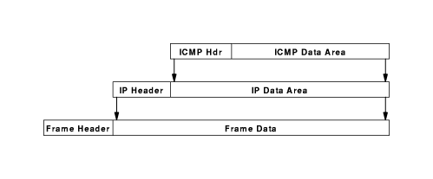
Part IV-Chapter23 Support Protocols And Technologies
ICMP Encapsulation
The ICMP message will be encapsulated once in an IP datagram
The IP datagram will be encapsulated multiple times in a frame for transmission
Two levels of encapsulation

Slide 105
Part IV-Chapter23 Support Protocols And Technologies
The Properties Of ICMP Message
The Destination of ICMP Error Message
The Source of the IP datagram
They do not have special priority in IP forwarded
If they causes an error，no error message is sent back

Slide 106
Part IV-Chapter23 Support Protocols And Technologies
Usage of ICMP
Ping Program
Traceroute Program
The destination’ ICMP will return ICMP echo reply message
It uses ICMP Time Exceeded messages to find a list of all routers along a path to a given destination
Tracert program named in MS Windows
Path MTU Discovery
It uses the IP fragmentation mechanism
Ping sends an ICMP echo request message to the destination
Ping declares that the destination is reachable
It uses ICMP Information Message

Slide 107
Part IV-Chapter23 Support Protocols And Technologies
The Implementation of Traceroute
Sets the TTL value in first datagram to 1 and sends it
Sets the TTL value in ith datagram to i and sends it
The first router will sends back an ICMP Time Exceeded message when discarding the first datagram
The Traceroute extracts the IP source address and announces the address of the first router along the path
The first router decrements the datagram counter and forwards the second datagram to the second router
The ith router discards the ith datagram and sends back an ICMP Time Exceeded message
The Traceroute extracts the IP source address and announces the address of the ith router along the path

Slide 108
Part IV-Chapter23 Support Protocols And Technologies
Traceroute Message
The destination host must be forced to reply some message
Using ICMP Echo Request Message in MS Windows
Using Nonexistent UDP port in UNIX
Traceroute Problem In Final Destination
The destination host cannot return any ICMP Time Exceeded message

Slide 109
Part IV-Chapter23 Support Protocols And Technologies
Path MTU Discovery Arithmetic
The software sets the datagram size to a given VALUE and sets a bit in the datagram header that specifies the datagram should not be fragmentation
The software sends the datagram to the destination
If the datagram is large than the MTU of a network along the path, the route will send back ICMP fragmentation required message to the software
Otherwise，the software announces the VALUE as the path MTU
Another loop after the datagram size becomes smaller

Slide 110
Part IV-Chapter23 Support Protocols And Technologies
IPv6 Address Binding With Neighbor Discovery
It defines an IPv6 multicast address to which all nodes on a network must listen
IPv6-ND multicasts an ICMPv6 message that asks neighbors to reply Address Resolution
Address Resolution response will contain MAC addresses
IPv6 Neighbor Discovery(IPv6-ND)
It relies on ICMPv6 messages

Slide 111
Part IV-Chapter23 Support Protocols And Technologies
Protocol Software Configuration
Host
First step occurs when a computer boot
Second step
Router
The configuration values is specified and saved on disk
It loads the values during startup
Basic set of configuration parameters that allow the protocol software to communicate over a local network
Additional information such as IP address, the address mask and the address of a local DNS server

Slide 112
Part IV-Chapter23 Support Protocols And Technologies
Bootstrap Protocol(BOOTP)
Allow a computer to obtain an IP address , an address mask and the address of the default gate way to a host
A host broadcast its request
BOOTP Server used the MAC address on an incoming frame to send a response via unicast
This Computer Address(0.0.0.0)
Limited Broadcast Address(255.255.255.255)
A fixed address assignment
Source address
Destination address

Slide 113
Part IV-Chapter23 Support Protocols And Technologies
Dynamic Host Configuration Protocol
Advanced Version Of BOOTP
DHCP Client-Server Model
When it boots，a host will use 255.255.255.255 to broadcast a DHCP Request
A DHCP Server
It allows a computer to join a new network and obtain an IP address without manual intervention
Host
It sends back a DHCP reply
Two types of DHCP addresses
Permanently assigned addresses
A pool of dynamic addresses to arbitrary hosts

Slide 114
Part IV-Chapter23 Support Protocols And Technologies
DHCP Encapsulation
The DHCP message will be encapsulated in an UDP datagram
The UDP datagram will be encapsulated in an IP datagram
Three levels of encapsulation
The IP datagram will be encapsulated in a frame for transmission
DHCP Message
UDP Header
UDP Data Area
IP Header
IP Data Area
Frame Header
Frame Data Area

Slide 115
Part IV-Chapter23 Support Protocols And Technologies
Dynamic Host Configuration Protocol
DHCP Scheme
When it receives a DHCP request，The DHCP server consults its database to find configuration information
Pooled Address
DHCP issues a lease on the address for a finite period of time
If the database contains a specific entry for the computer，the server returns a permanent address
If no entry exists for the computer，the server chooses the next IP address from the pooled addresses
The leased address keeps unchanged during the lease period
When the lease expires，the computer must renegotiate with DHCP to extend the lease
If DHCP denies an extension request，the computer must stop using the address

Slide 116
Part IV-Chapter23 Support Protocols And Technologies
Optimizations In DHCP
Recovery from loss or duplication
If no response is received, a host retransmits its DHCP request
Catching of a server address
Avoidance of synchronized flooding
Each computer delays a random time before transmitting or retransmitting a request
Host catches server’s address

Slide 117
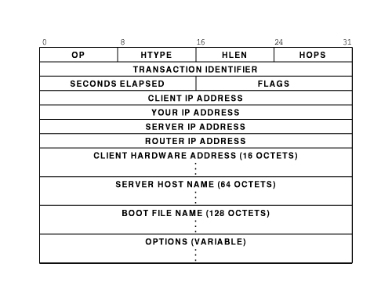
Part IV-Chapter23 Support Protocols And Technologies
DHCP Message Format
The fields under CLIENT IP ADDRESS
DHCP Response Message

Slide 118
Part IV-Chapter23 Support Protocols And Technologies
Indirect DHCP ServerAccess
DHCP Relay agent
It must be present on each network without DHCP Server
It must be configured with the address of the appropriate DHCP Server
It forwards requests and responses between a client and DHCP server

Slide 119
Part IV-Chapter23 Support Protocols And Technologies
IPv6 Autoconfiguration
First step to generate a prefix
Multicasting a request to all nodes to discover the network prefix being used
If no prefix is available, the node uses a value that is reserved for local communication
A node uses its MAC address as unique suffix for IPv6 based on EUI-64
Second step to generate a unique suffix

Slide 120
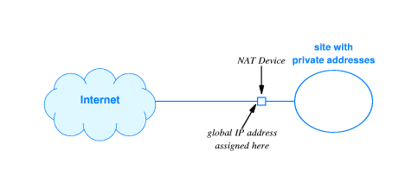
Part IV-Chapter23 Support Protocols And Technologies
Network Address Translation(NAT)
NAT device with two NICs and NAT software
It is placed on the connection between an intranet and the Internet
It can allow multiple hosts with private address share valid IP address

Slide 121
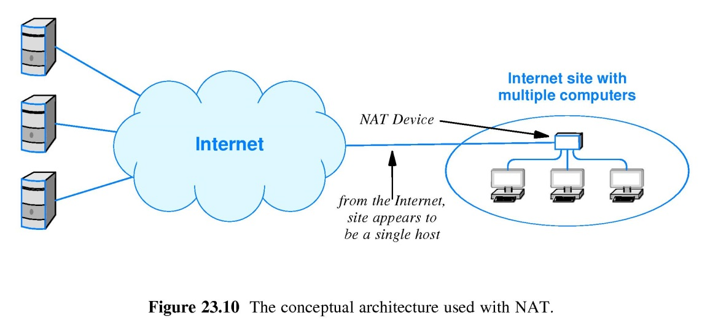
Part IV-Chapter23 Support Protocols And Technologies
NAT Operation
NAT assigns each computer a locally unique private address
Router are configured to forward global IP address
Before a datagram onto the Internet，NAT translates the private address to a global IP address
After a datagram from the Internet，NAT translates the a global IP address to the private address

Slide 122
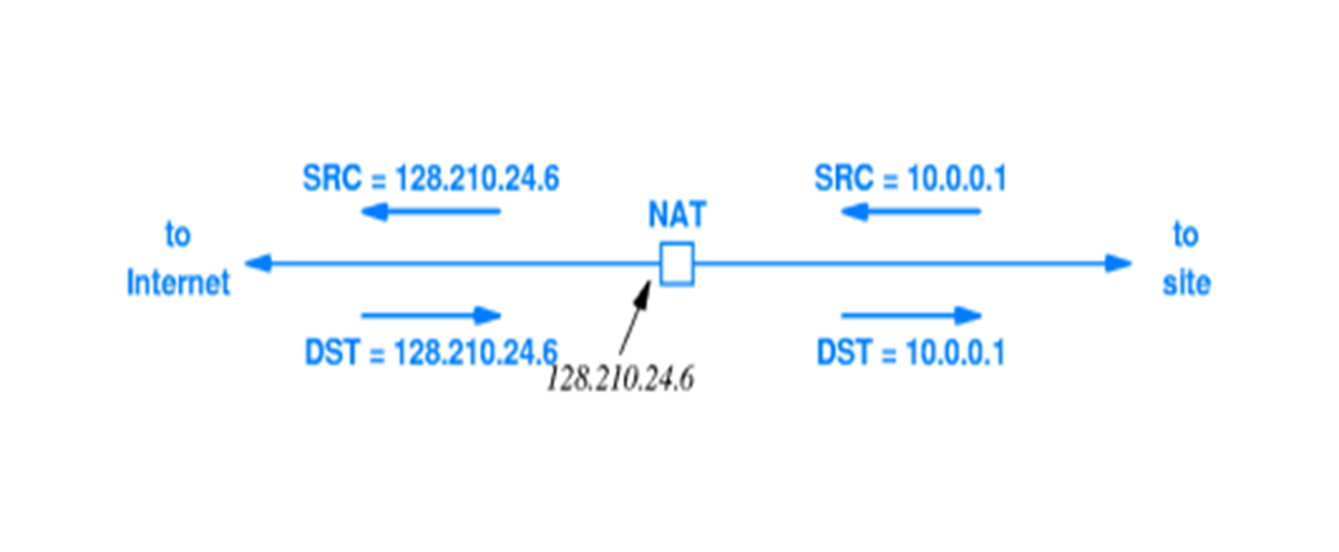
Part IV-Chapter23 Support Protocols And Technologies
Basic Address Translation
The NAT device must process each packet that enters or leaves the site
NAT rewrites IP address
NAT must recompute the IP checksum

Slide 123
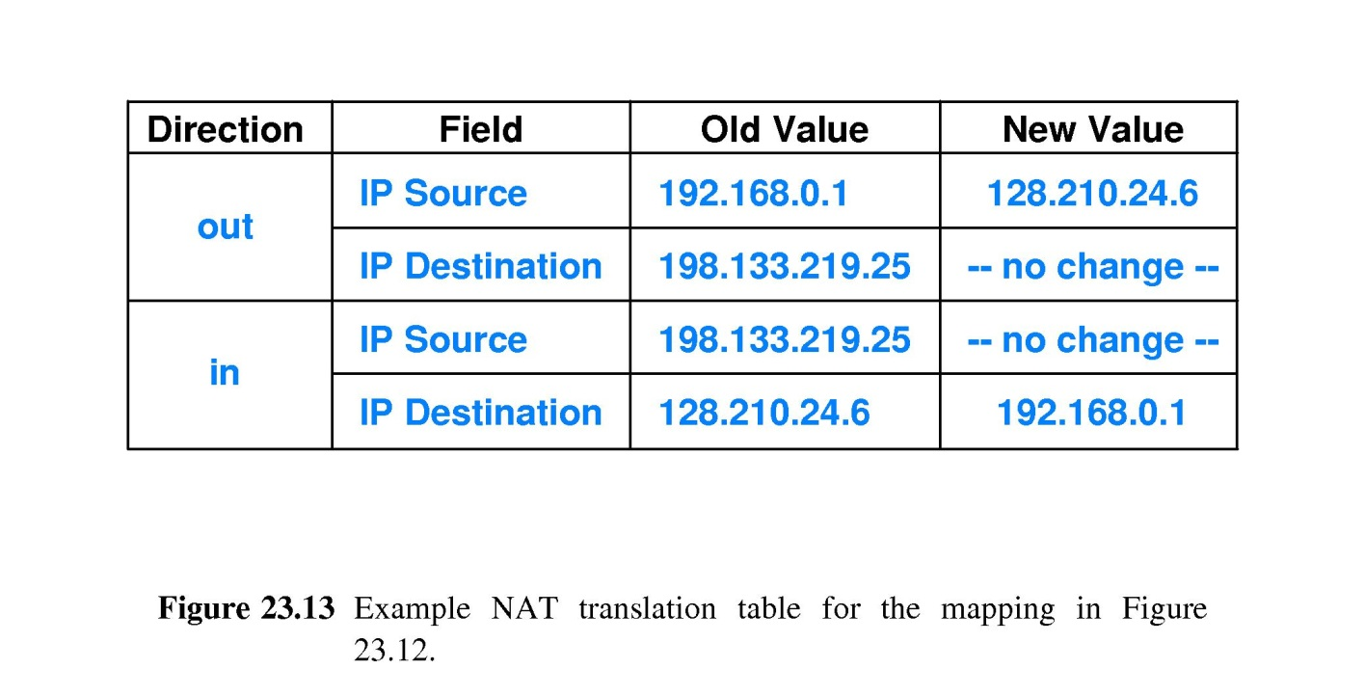
Part IV-Chapter23 Support Protocols And Technologies
NAT Translation Table
It is used to store the information needed to rewrite addresses

Slide 124
Part IV-Chapter23 Support Protocols And Technologies
Network Address Translation
Usage
Internet and Intranet users will share Intranet Servers
NAT Problems
Two or more hosts at a site cannot share an IP address at same time
Client
Client
Client
Client
Server
Client

Slide 125
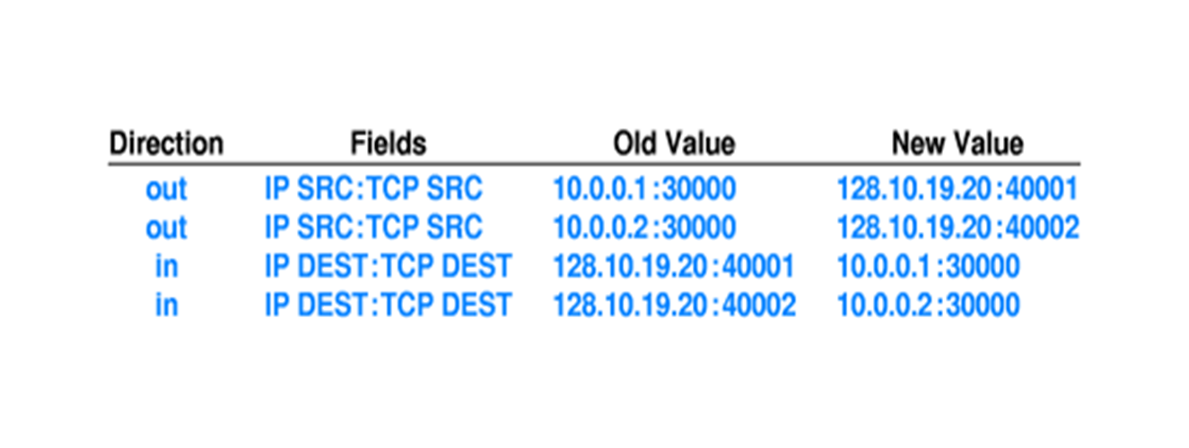
Part IV-Chapter23 Support Protocols And Technologies
Network Address and Port Translation
Applications can use protocol port number to distinguish among services
NAPT translates protocol port numbers as well as IP address
NAPT operates on individual transport connections instead of IP address
Usage
Intranet users will share an IP address at same time
But Internet users cannot share the Intranet servers

Slide 126
Part IV-Chapter23 Support Protocols And Technologies
Twice NAT
It requires the name server to interact with the NAT device
When an application on the Internet looks up the domain name of a computer at the site，the name server places an entry in the NAT translation table

Slide 127
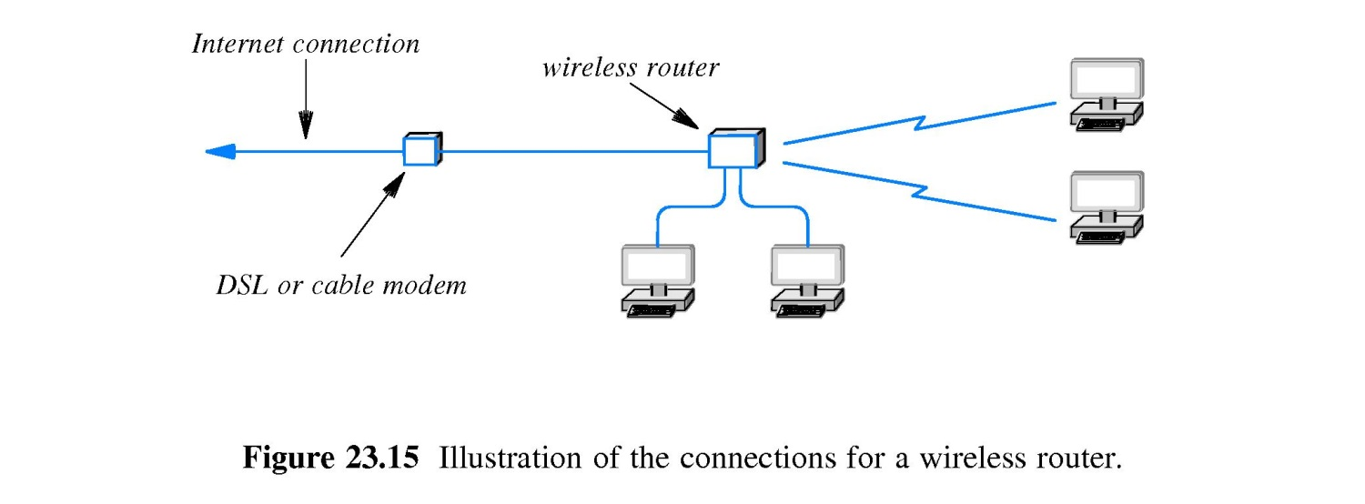
Part IV-Chapter23 Support Protocols And Technologies
Wireless Router
Dedicated NAPT hardware
Provides NAPT among four wired Ethernet and Wi-Fi wireless connections

