Slide 1
Sequential heuristic for the two-dimensional bin-packing problem
Genqian Hu

Slide 2
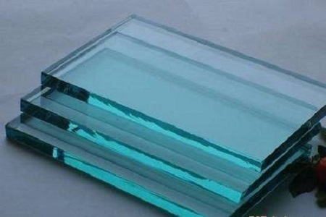

Problem Overview

Slide 3
Problem Overview
2BPOG: Items are oriented (O) and guillotine cuts are required (G) 2BPRG: Items may be rotated by 90 degrees (R) and guillotine cuts are required (G) 2BPOF: Items are oriented (O) and cutting is free (F) 2BPRF: Items may be rotated by 90 degrees (R) and cutting is free (F)

Slide 4
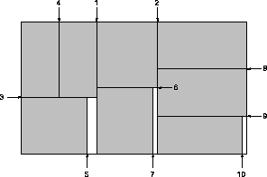
Guillotine Cuts

Slide 5
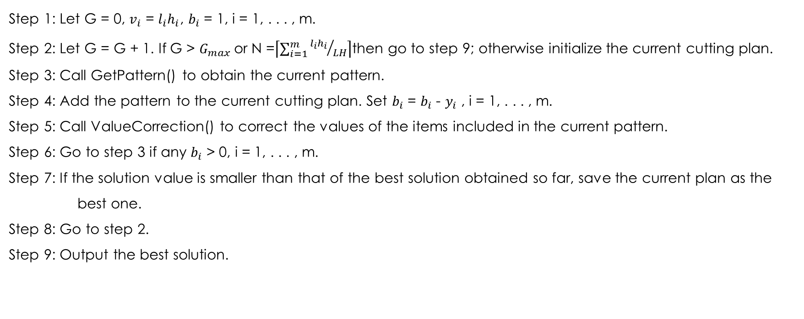
Algorithm Overview
Step 1: Let G = 0, $v_{i}$ = $l_{i}h_{i}$, $b_{i}$ = 1, i = 1, . . . , m. Step 2: Let G = G + 1. If G > $G_{max}$or N =$\left\lceil \sum_{i=1}^{m}{{l_{i}h_{i}}/{LH}}\right\rceil$then go to step 9; otherwise initialize the current cutting plan. Step 3: Call GetPattern() to obtain the current pattern. Step 4: Add the pattern to the current cutting plan. Set $b_{i}$ = $b_{i}$ - $y_{i}$ , i = 1, . . . , m. Step 5: Call ValueCorrection() to correct the values of the items included in the current pattern. Step 6: Go to step 3 if any $b_{i}$ > 0, i = 1, . . . , m. Step 7: If the solution value is smaller than that of the best solution obtained so far, save the current plan as the best one. Step 8: Go to step 2. Step 9: Output the best solution.

Slide 6
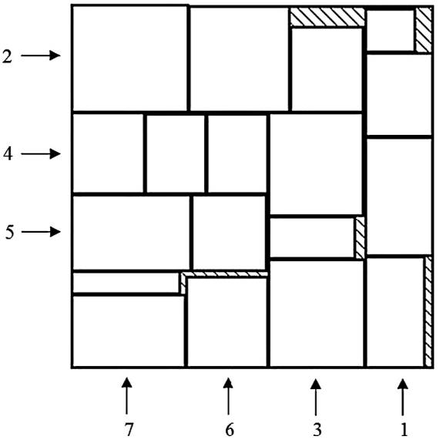
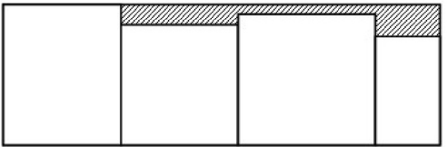
Guillotine Patterns Generation

Slide 7
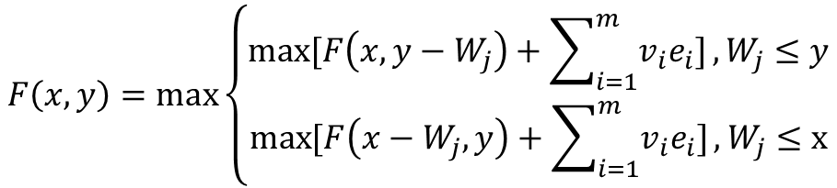
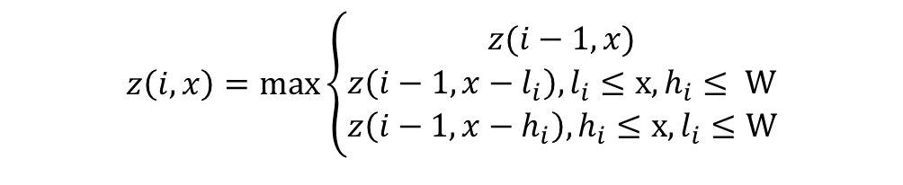
Guillotine Patterns Generation
$$z\left(i,x\right)=\max_{}\left\{\begin{aligned}z(i−1,x) \\ z\left(i−1, x−l_{i}\right),l_{i}≤x,h_{i}≤ W \\ z\left(i−1, x−h_{i}\right),h_{i}≤x,l_{i}≤W\end{aligned}\right.$$
q(i,x)=0
q(I,x)=1
q(i,x)=2
$$F\left(x,y\right)=\max_{}\left\{\begin{aligned}\max_{}{[F\left(x, y−W_{j}\right)+\sum_{i=1}^{m}{v_{i}e_{i}}]},W_{j}≤y \\ \max_{}{[F\left(x−W_{j}, y\right)+\sum_{i=1}^{m}{v_{i}e_{i}}]},W_{j}≤x\end{aligned}\right.$$

Slide 8
Free Patterns Generation
Bad region
envelope
Candidate points
The first item is packed with its left bottom corner.
A new item mustbe placed at a position where any packed item is below or to the left of it.

Slide 9
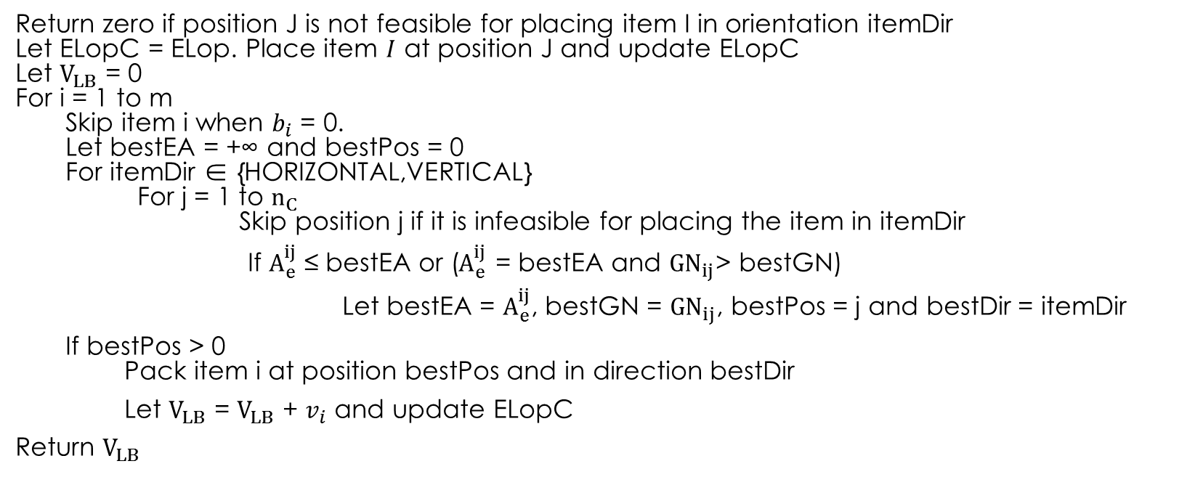
Free Patterns Generation
GetLB(i, j, itemDir, Elop):
Return zero if position J is not feasible for placing item I in orientation itemDir Let ELopC = ELop. Place item $I$ at position J and update ELopC Let $V_{LB}$ = 0 For i = 1 to m Skip item i when $b_{i}$ = 0. Let bestEA = +∞ and bestPos = 0 For itemDir ∈ {HORIZONTAL,VERTICAL} For j = 1 to $n_{C}$ Skip position j if it is infeasible for placing the item in itemDir
If $A_{e}^{ij}$ ≤ bestEA or ($A_{e}^{ij}$ = bestEA and ${GN}_{ij}$> bestGN)
Let bestEA = $A_{e}^{ij}$, bestGN = ${GN}_{ij}$, bestPos = j and bestDir = itemDir
If bestPos > 0 Pack item i at position bestPos and in direction bestDir
Let $V_{LB}$ = $V_{LB}$ + $v_{i}$ and update ELopC
Return $V_{LB}$

Slide 10
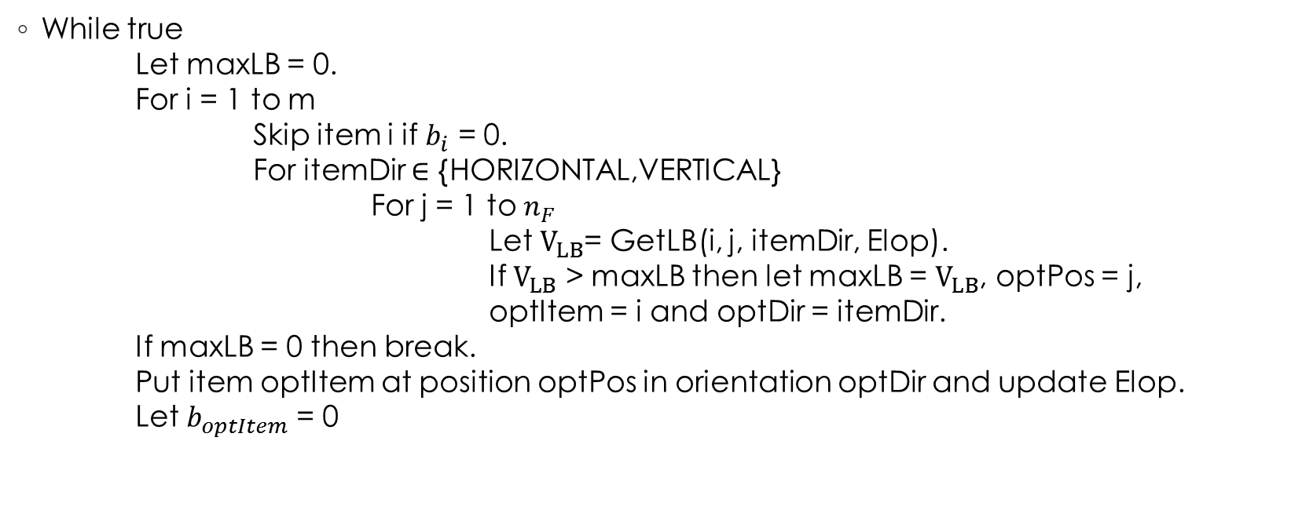
Free Patterns Generation
While true Let maxLB = 0. For i = 1 to m Skip item i if $b_{i}$ = 0. For itemDir $∈$ {HORIZONTAL,VERTICAL} For j = 1 to $n_{F}$ Let $V_{LB}$= GetLB(i, j, itemDir, Elop). If $V_{LB}$ > maxLB then let maxLB = $V_{LB}$, optPos = j, optItem = i and optDir = itemDir. If maxLB = 0 then break. Put item optItem at position optPos in orientation optDir and update Elop. Let $b_{optItem}$ = 0

Slide 11
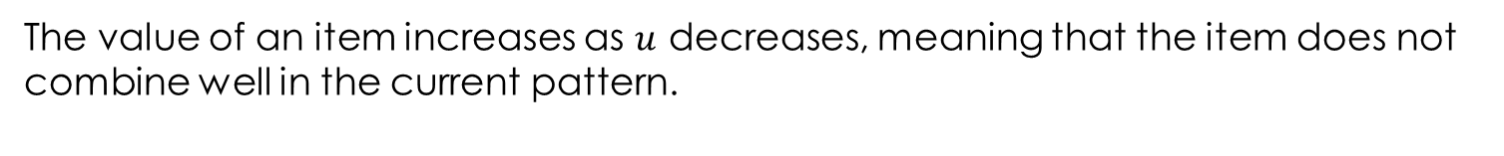

Value correction
Material utilization of the current pattern: $u=\frac{\sum_{i=1}^{m}{(y_{i}l_{i}h_{i})}}{LH}$
Update item i’s value: $v_{i}=kv_{i}+\frac{\left(1−k\right){(l_{i}h_{i})}^{P}}{u}$ , $k$∈[0,1], P>1
The value of an item increases as $u$ decreases, meaning that the item does not combine well in the current pattern.
Larger items are also given priority, because they are difficult to pack.

Slide 12
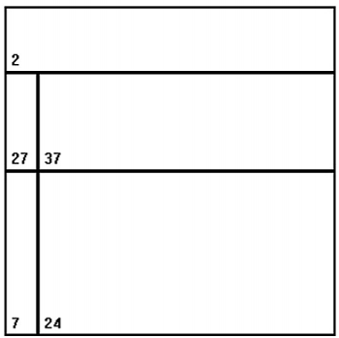
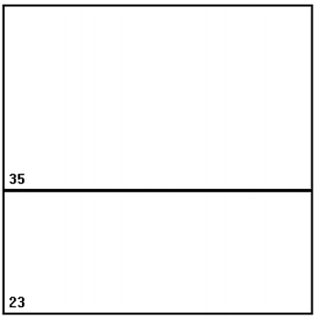
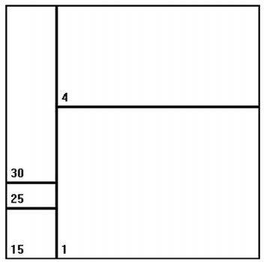
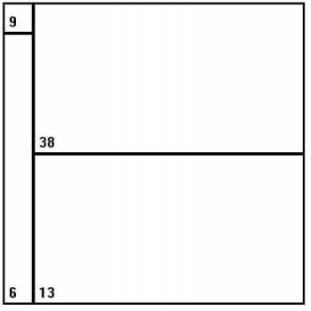
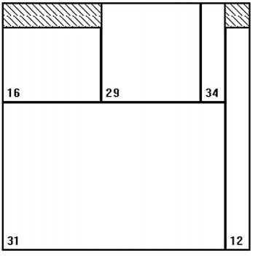
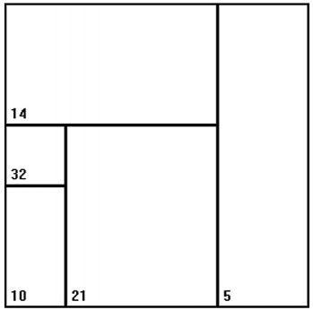
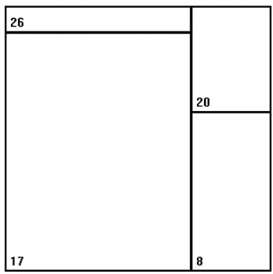
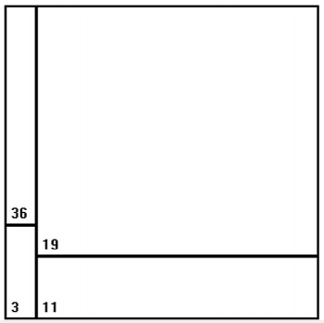
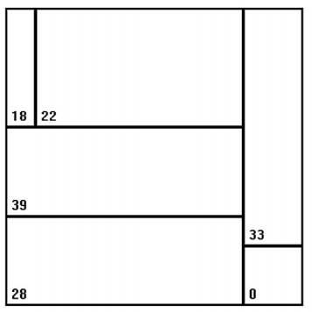
Results from paper

Slide 13
Reference
[1]Y. Cui, Y. Cui and T. Tang, "Sequential heuristic for the two-dimensional bin-packing problem", European Journal of Operational Research, vol. 240, no. 1, pp. 43-53, 2015.

