Slide 1
Support Vector Machines
-TDAC

Slide 2
Announcements
Astronomical Data Science Workshop Feb 17th and Feb 18th , Registration on TAMIDS website.
Tech Session 3: February 13th , LDA Classification

Slide 3
REVIEW
Data Preprocessing
Data Visualization
Model Building
Parameter Tuning
Model Selection

Slide 4
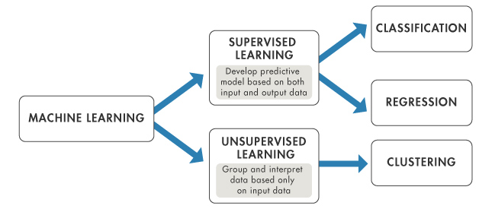
Review

Slide 5
History
Pre 1960
Learning methods with linear decision boundary
1963
Vapnik and Chervonenkis introduce maximal margin classifier (Linear SVM).
1980s
Neural Networks and Decision trees, enabling nonlinear decision boundaries.
Issues with local minima.
1990s
Vapnik, Cortes, Guyon develop Kernel SVMs and concept of soft margin

Slide 6
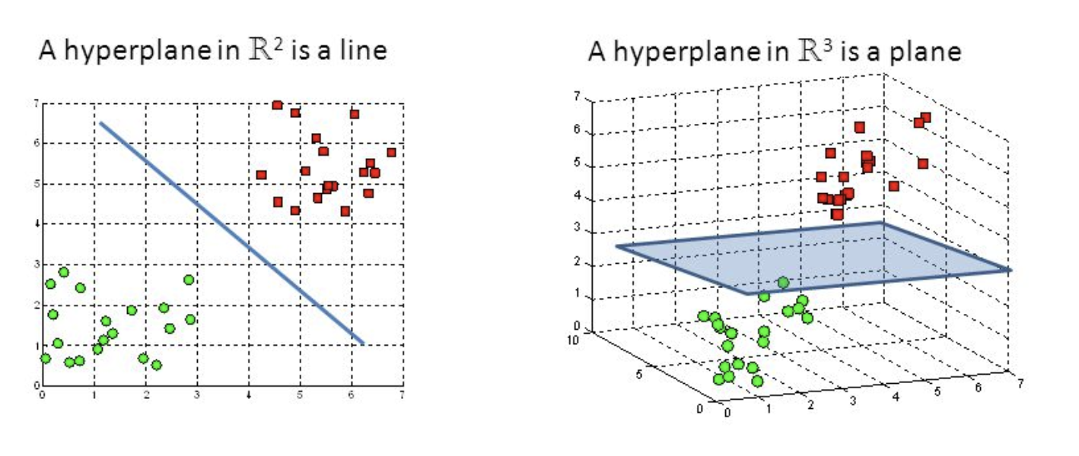
Linear Classifiers
Notes:
https://pierpaolo28.github.io/blog/blog6/

Slide 7
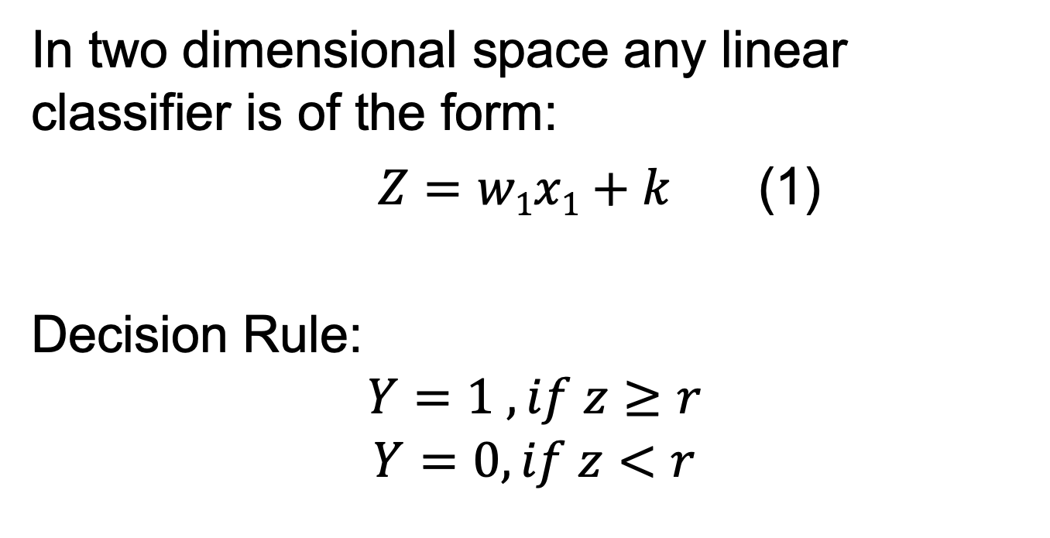
Binary Linear Classifier
In two dimensional space any linear classifier is of the form:
$Z=w1x1+k$ (1)
Decision Rule:
$$Y=1 , if z≥r$$
$$Y=0, if z<r$$

Slide 8
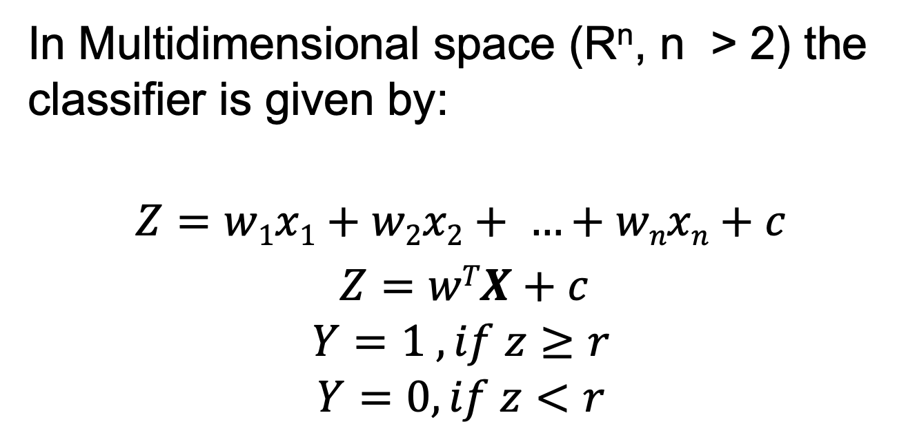
Binary Linear Classifier
In Multidimensional space (R^{n}, n > 2) the classifier is given by:
$$Z=w1x1+w2x2+ …+wnxn+c$$
$Z=wTX+c$
$$Y=1 , if z≥r$$
$$Y=0, if z<r$$

Slide 9
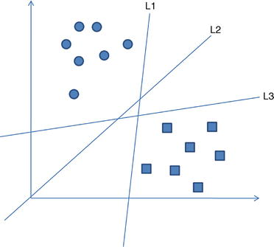
Binary Linear Classifier
Which is the best (optimal) hyperplane or line ?
Different lines have different weight vectors (W) and biases (b)

Slide 10
Linear SVM(Linearly Separable Case)
Instead of using all points to determine the model use points close to the decision boundary.
These points are called Support Vectors. Changing their location will change the decision boundary.
Key Idea: Maximize distance between hyperplane and support vectors
Optimization techniques will produce the best hyperplane.

Slide 11
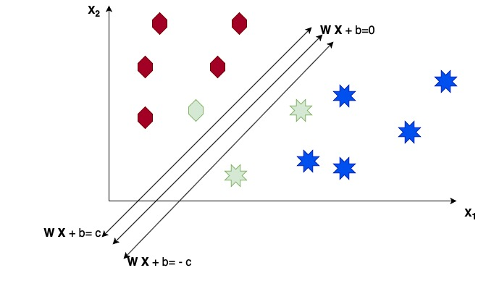
Linear SVM Visual (Not Optimal)

Slide 12
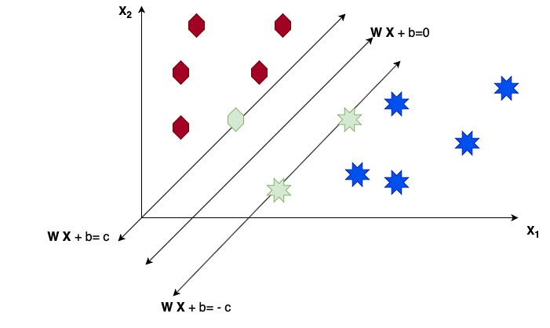
Linear SVM Visual (Optimal)

Slide 13
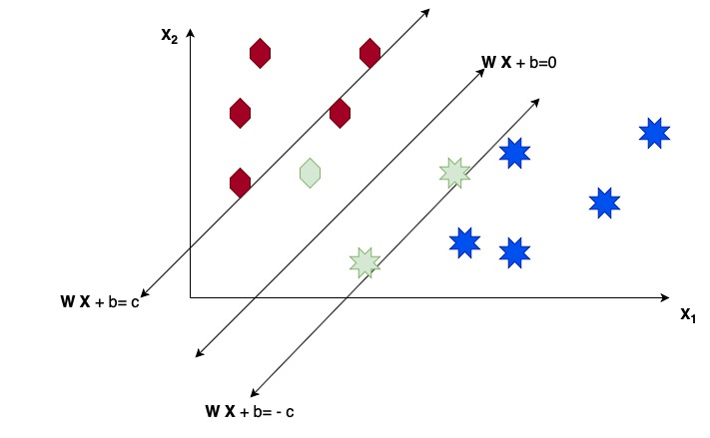
Linear SVM Visual (Not Okay)

Slide 14
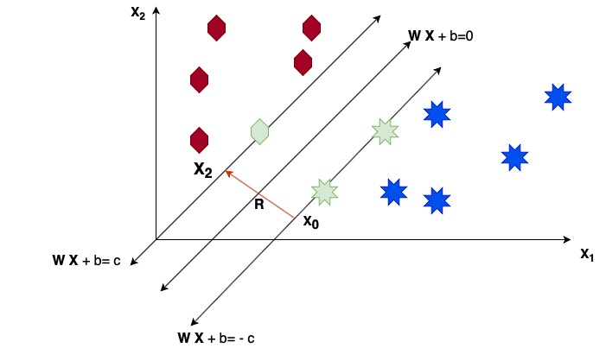
Margin Maximization (R maximized)

Slide 15
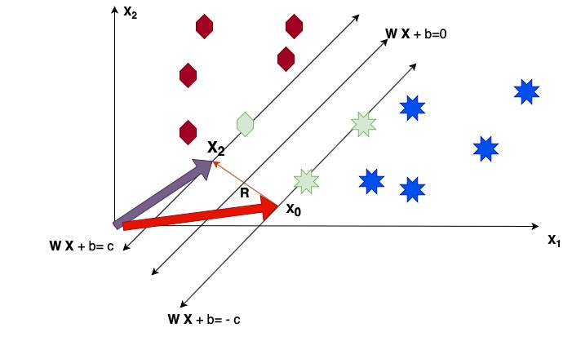
Maximize |R|

Slide 16
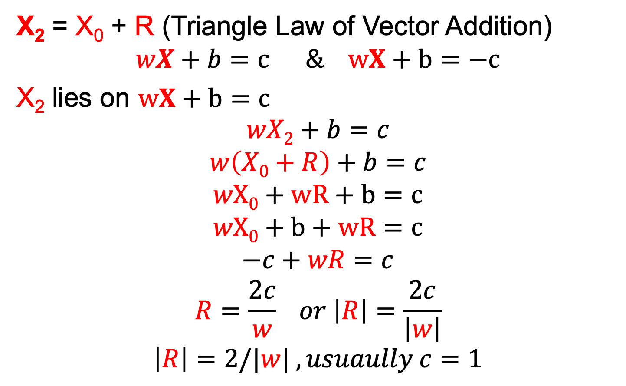
X₂ = X₀ + R (Triangle Law of Vector Addition)
$$wX+b=c \& wX+b=−c$$
X₂ lies on $wX+b=c$
$$wX2+b=c$$
$$w\left(X0+R\right)+b=c$$
$$wX0+wR+b=c$$
$$wX0+b+wR=c$$
$$−c+wR=c$$
$$R=\frac{2c}{w} or \left|R\right|=\frac{2c}{\left|w\right|}$$
$$\left|R\right|=2/|w| , usuaully c=1$$

Slide 17
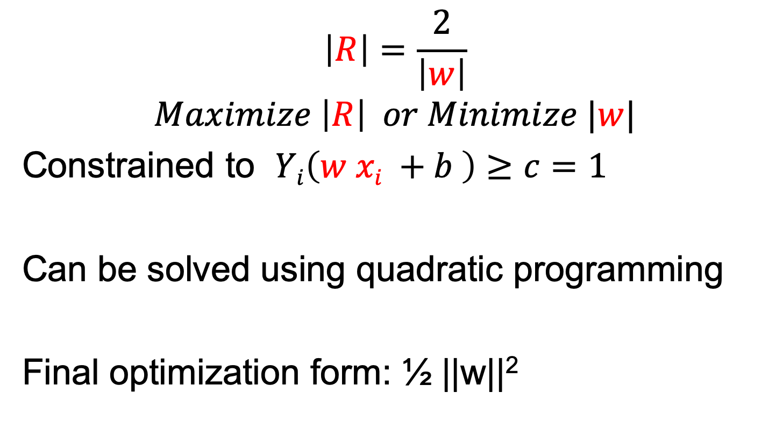
$$\left|R\right|=\frac{2}{\left|w\right|}$$
$$Maximize \left|R\right| or Minimize |w|$$
Constrained to $Yi\left(w xi +b \right)≥c=1$
Can be solved using quadratic programming
Final optimization form: ½ ||w||²

Slide 18
Not Linearly Separable
Apply Kernel Transform ( Guyon 1993)
Apply Soft Margin Penalty ( Cortes 1995)
Current SVM Algorithm Combines both approaches

Slide 19
Kernel Transform R^{n} to R^{m} (m >n )

Slide 20
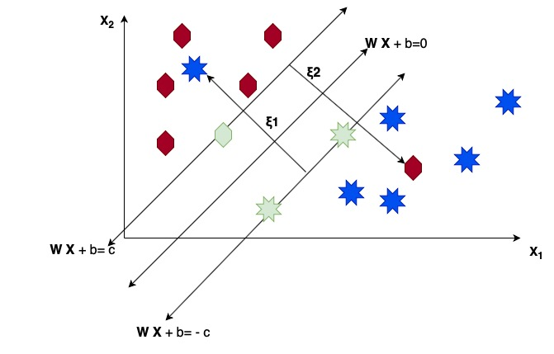
Soft Margin or Slack Variable

Slide 21
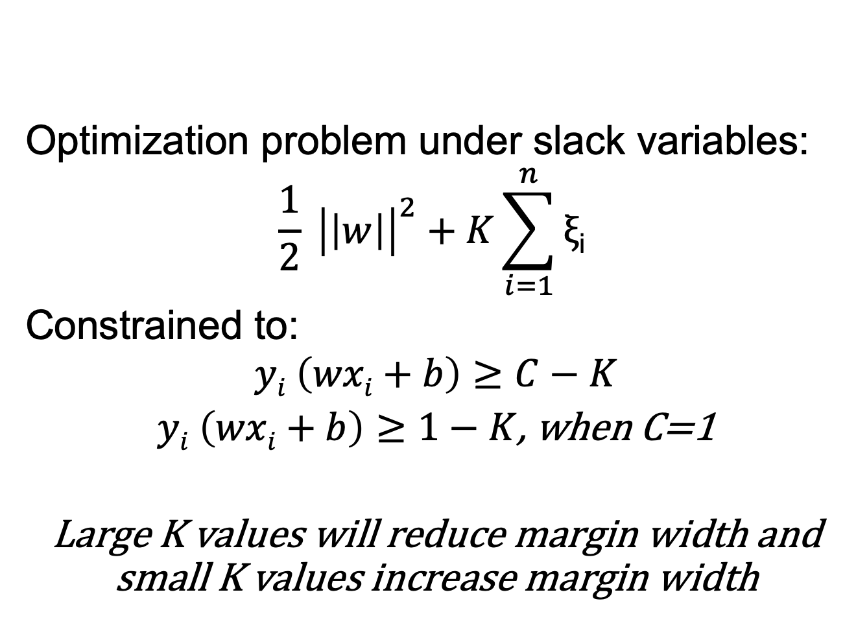
Optimization problem under slack variables:
$$\frac{1}{2} {\left|\left|w\right|\right|}^{2}+K\sum_{i=1}^{n}{\text{ξ}\text{i}}$$
Constrained to:
$$yi \left(wxi+b\right)≥C−K$$
$yi \left(wxi+b\right)≥1−K$, when C=1
Large K values will reduce margin width and small K values increase margin width

Slide 22
Python Implementation
shorturl.at/floLY

Slide 23
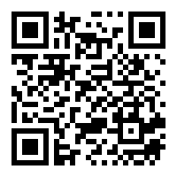
Exit Survey
https://forms.gle/8dL8EsB6gyqccRZs7

Slide 24
END

