Slide 1
CLUSTERING
-TDAC

Slide 2
Overview
Data has only independent features.
No dependent features or labels, unsupervised learning problem.
Group similar datapoints together in a cluster and dissimilar datapoints in other clusters.

Slide 3
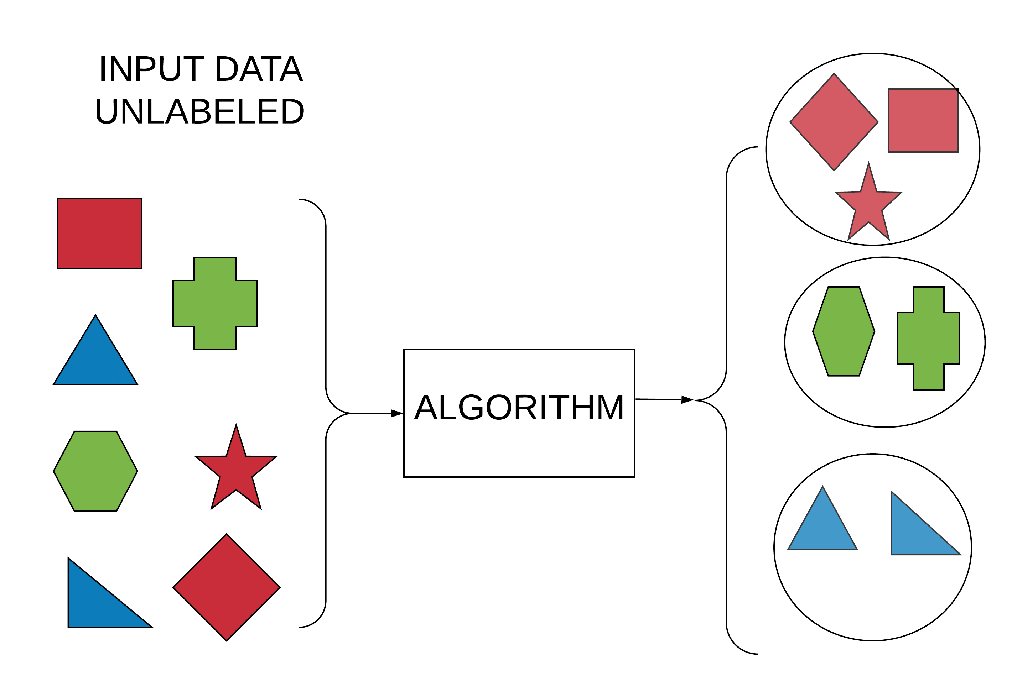
Cluster by color

Slide 4
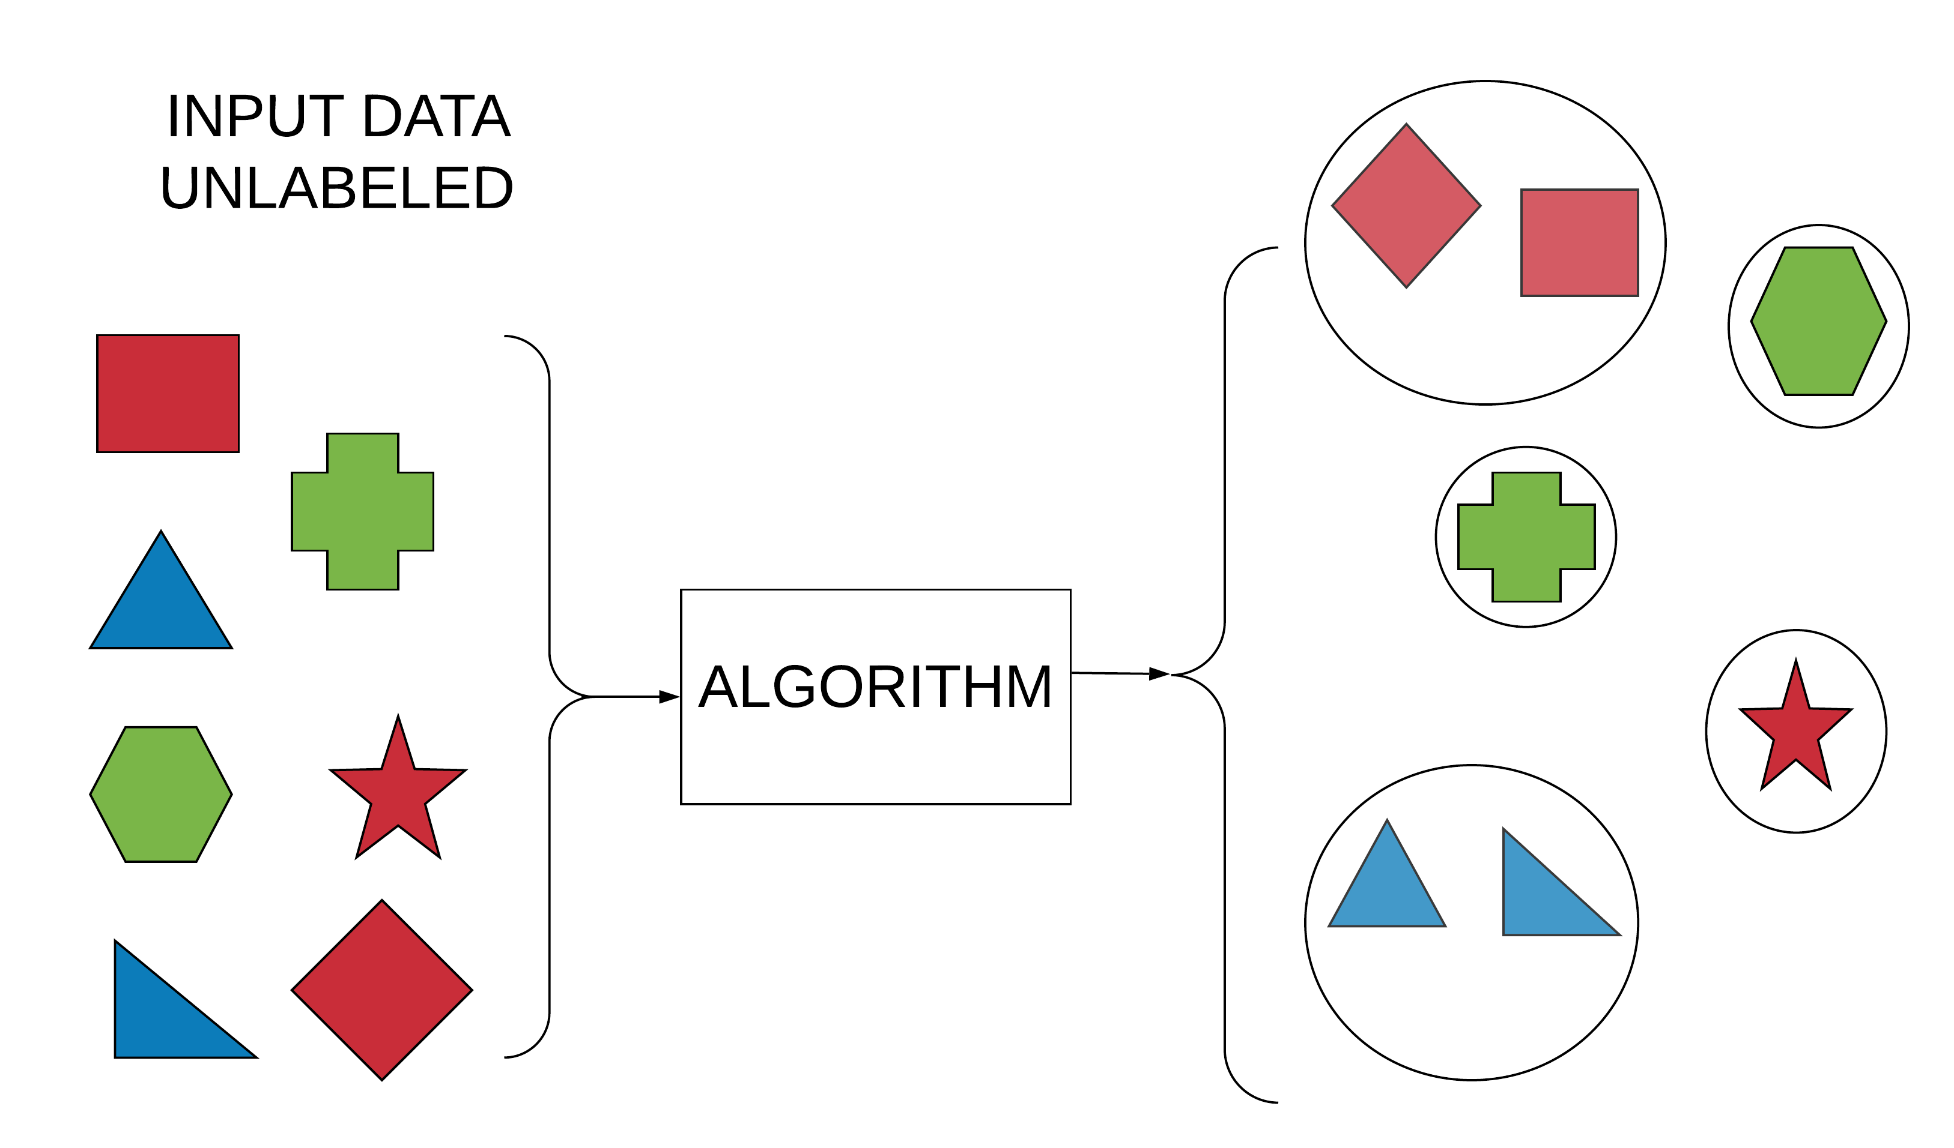
Cluster by shape

Slide 5
Application
Genomics: group similar genes together with similar expression
Astronomy: cluster similar galaxies together
Business: group customers with similar shopping interest

Slide 6
Algorithms
K Means Clustering
Hierarchical Clustering
Expectation Maximization
Self Organizing Maps

Slide 7
K Means Algorithm
1. Choose ‘k’ points randomly, these are the initial ‘k’ centroids.
2. Compute the sum of the squared distance between data points and all centroids.
3. Assign each data point to the closest cluster (centroid).
4. Compute the new centroids for the clusters by taking the average of the all data points that belong to each cluster.
5. Repeat steps 2-4, until there is no change to the centroids. i.e assignment of data points to clusters isn’t changing.

Slide 8
Notes:
https://stanford.edu/~cpiech/cs221/handouts/kmeans.html

Slide 9
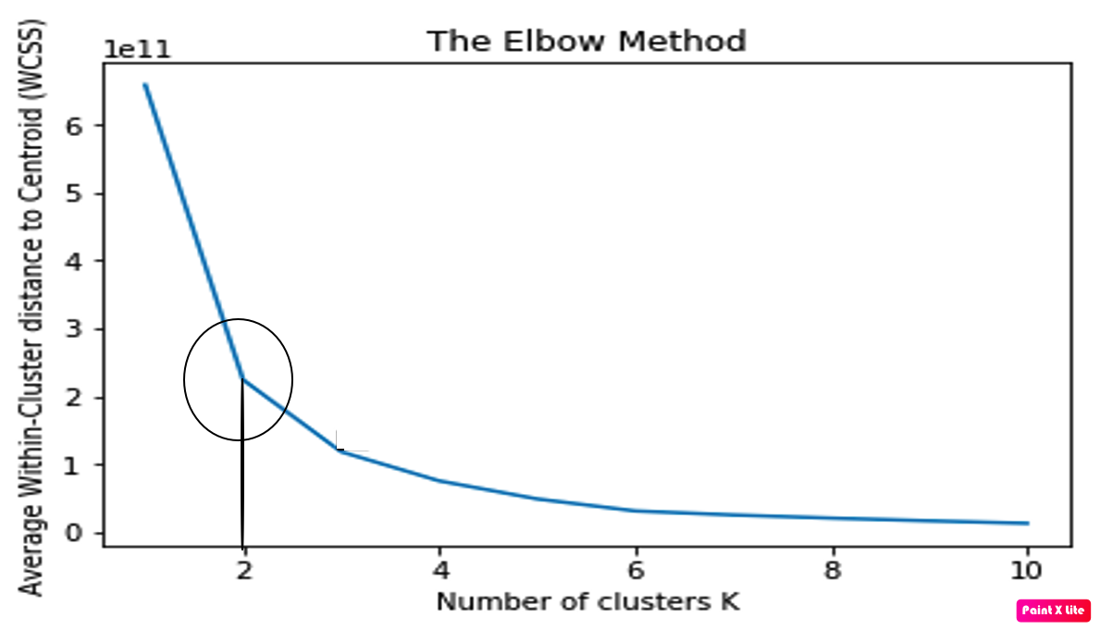
Optimal Clusters: Elbow method
Notes:
https://www.facebook.com/mlsubhadip/photos/pcb.2393861470697198/2393855884031090/?type=3&theater

Slide 10
Hierarchical Clustering
Agglomerative Clustering
Divisive Clustering

Slide 11
Hierarchical Clustering
Agglomerative Clustering:
Each data point is a cluster.
Compute distances matrix and merge clusters close to each other.
Repeat steps 1 and 2 till only one cluster remains.

Slide 12
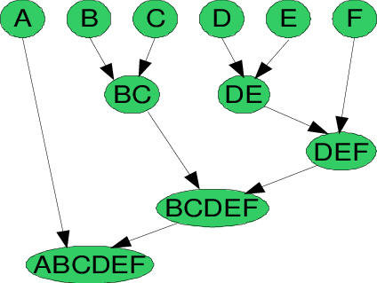
Hierarchical Clustering
Notes:
https://towardsdatascience.com/understanding-the-concept-of-hierarchical-clustering-technique-c6e8243758ec

Slide 13
Hierarchical Clustering Dendrogram
Vertical Axis Represent Cluster Dissimilarity
Notes:
https://towardsdatascience.com/understanding-the-concept-of-hierarchical-clustering-technique-c6e8243758ec

Slide 14
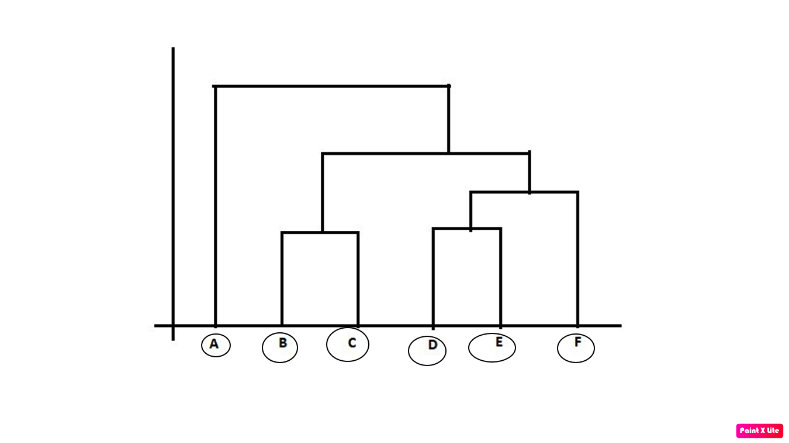
Hierarchical Clustering Dendrogram
Vertical Axis Represent Cluster Dissimilarity
Number of clusters =6
Notes:
https://towardsdatascience.com/understanding-the-concept-of-hierarchical-clustering-technique-c6e8243758ec

Slide 15
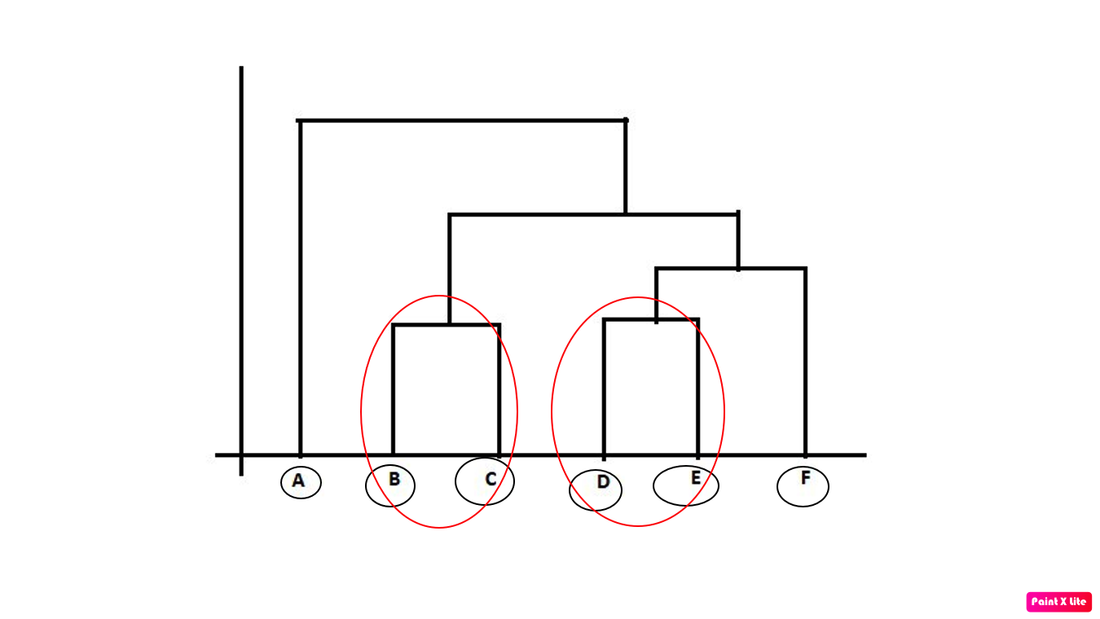
Hierarchical Clustering Dendrogram
Vertical Axis Represent Cluster Dissimilarity
Number of clusters =4
Notes:
https://towardsdatascience.com/understanding-the-concept-of-hierarchical-clustering-technique-c6e8243758ec

Slide 16
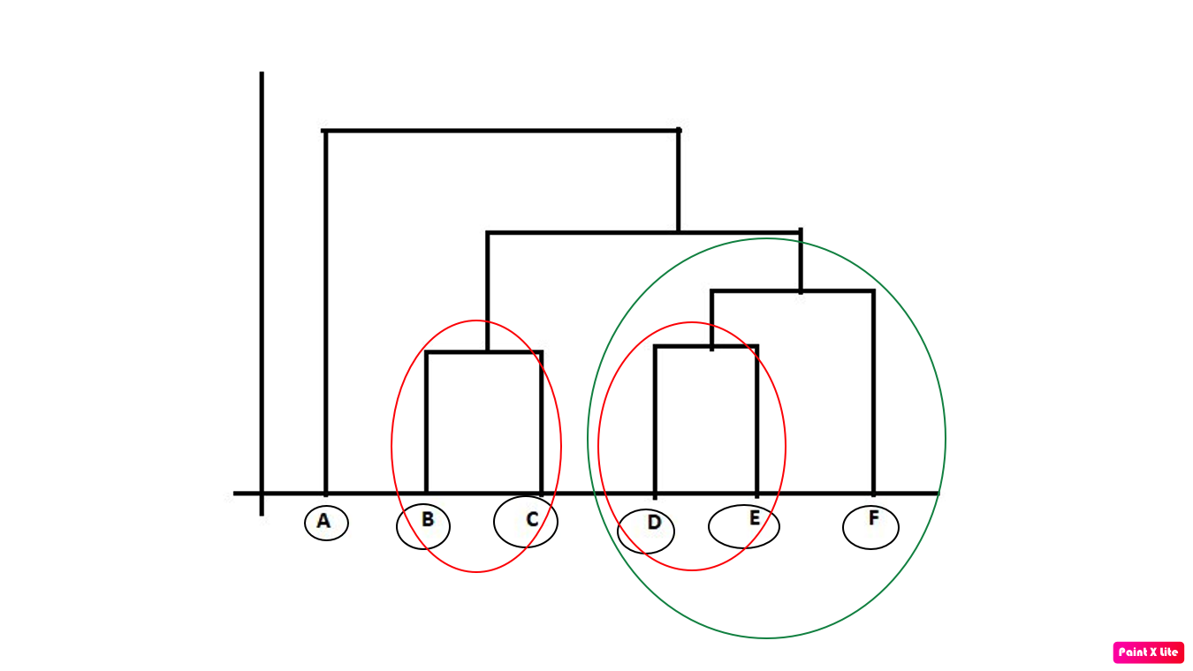
Hierarchical Clustering Dendrogram
Vertical Axis Represent Cluster Dissimilarity
Number of clusters =3
Notes:
https://towardsdatascience.com/understanding-the-concept-of-hierarchical-clustering-technique-c6e8243758ec

Slide 17
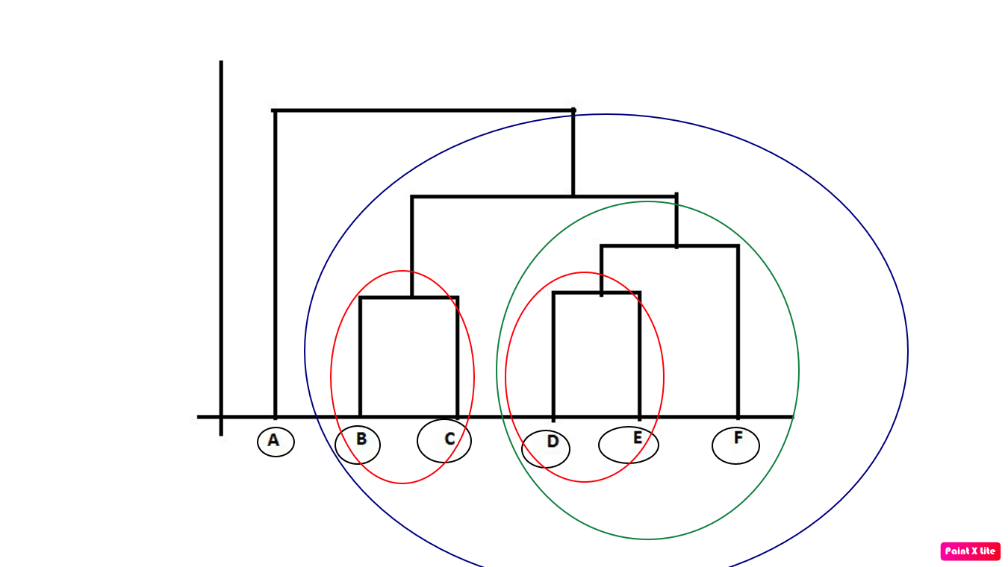
Hierarchical Clustering Dendrogram
Vertical Axis Represent Cluster Dissimilarity
Number of clusters =2
Notes:
https://towardsdatascience.com/understanding-the-concept-of-hierarchical-clustering-technique-c6e8243758ec

Slide 18
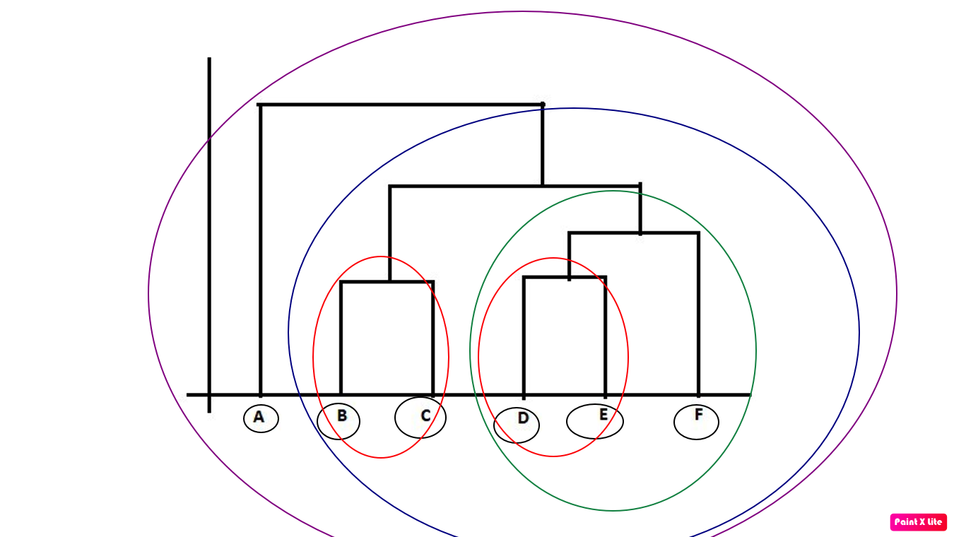
Hierarchical Clustering Dendrogram
Vertical Axis Represent Cluster Dissimilarity
Number of clusters =1
Notes:
https://towardsdatascience.com/understanding-the-concept-of-hierarchical-clustering-technique-c6e8243758ec

Slide 19
Optimal Cluster Determination
Choose the longest vertical line that does not cross any black horizontal lines. Intersection of colored horizontal lines with black vertical represent the number of clusters formed by each vertical lines enclosed in circle. Optimal cluster here is 6.
Notes:
Choose the vert

Slide 20
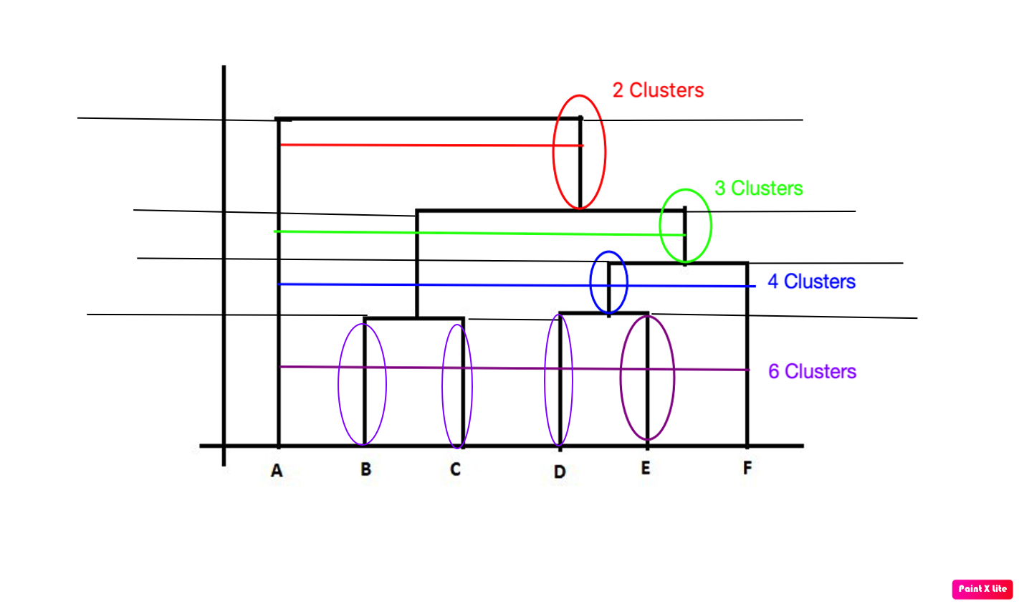
Optimal Cluster Determination
Choose the longest vertical line that does not intersect any black horizontal lines. Intersection of colored horizontal lines with black vertical represent the number of clusters formed by each vertical lines enclosed in ovals. Optimal cluster here is 6.
Notes:
Choose the vert

Slide 21
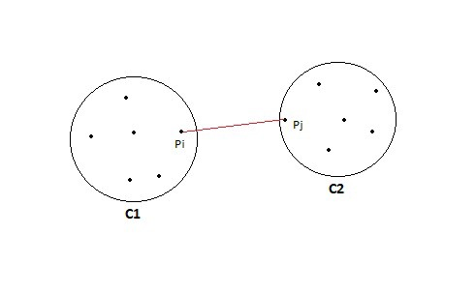
Measuring Similarity
Single Linkage
Notes:
https://towardsdatascience.com/understanding-the-concept-of-hierarchical-clustering-technique-c6e8243758ec

Slide 22
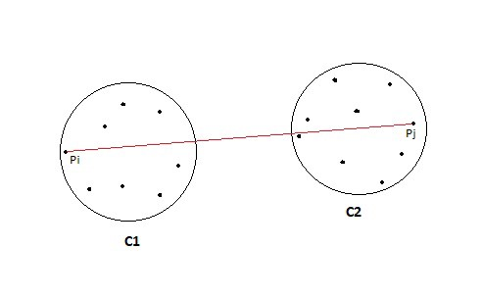
Measuring Similarity
Complete Linkage
Notes:
https://towardsdatascience.com/understanding-the-concept-of-hierarchical-clustering-technique-c6e8243758ec

Slide 23
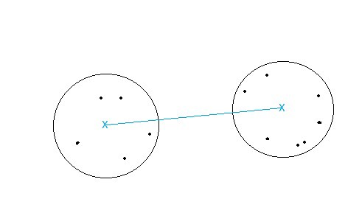
Measuring Similarity
Centroid Linkage
Notes:
https://towardsdatascience.com/understanding-the-concept-of-hierarchical-clustering-technique-c6e8243758ec

Slide 24
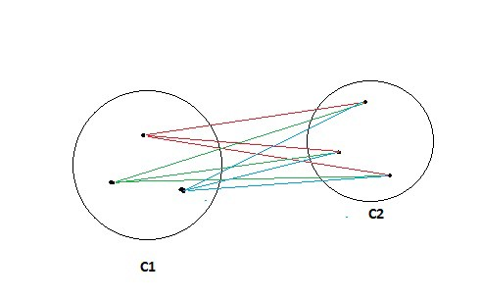
Measuring Similarity
Average Linkage
Notes:
https://towardsdatascience.com/understanding-the-concept-of-hierarchical-clustering-technique-c6e8243758ec

Slide 25
END

