Slide 1



MSDS 6372 Project 2
Jessica, rafia, caleb
Notes:
Welcome
Jessica will do intro
Rafia Mirza is the Digital Scholarship Librarian at SMU. She has a background in digital humanities and is currently getting her masters in data science.

Slide 2
Introduction
Introduction and Objective Summary
Notes:
R package aplore3, use the glow_bonemed data set. Assessing risk factors and predicting if a woman with osteoperosis will have a bone fracture within the first year after joining the
Study.
?glow_bonemed for data description of variables.

Slide 3
Group members:
Jessica mcphaul – background in data infrastrure & Security and a former dod consultant with over 10 years experience in it
Rafia mirza: the Digital Scholarship Librarian at SMU. She has a background in digital humanities
Caleb thornsbury: Certified molecularal diagnostics technologist w/ acs certified bachelors degree in biochemistry.
The 3 of us are currently seeking a masters degree in data science from smu

Slide 4
GLOW study
Introduction to GLOW Study
The Global Longitudinal study of Osteoporosis in Women (GLOW) is a comprehensive research initiative that encompasses data from a vast cohort of women across the globe. The study's objective is to identify risk factors contributing to osteoporosis and to monitor the occurrence of bone fractures over a year.

Slide 5
Scope of the Study: GLOW collected data from tens of thousands of women internationally, focusing on osteoporosis risk factors.
Purpose and Method: The primary goal is to use logistic regression models to predict fracture incidences based on pre-identified risk factors.
Sample Characteristics: The subset for analysis includes 500 U.S. participants, with fracture cases intentionally over-represented to constitute 25% of the sample for robust analysis.
Contextual Contrast: Emphasize that the sampled fracture rate is a strategic increase from the actual rate of 4% observed in the general population, which allows for more effective study of risk factors.
Predictive Analysis Goal: Through the use of Hosmer and Lemeshow's methodology, the study aims to accurately predict which participants are more likely to experience bone fractures within a year.

Slide 6


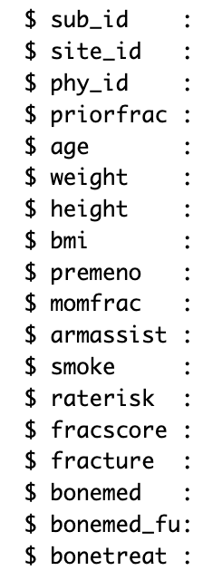
Data Description
These are the different variables in the dataset we decided to analyze.
Fracture – if happened in 1st year of study
The response variable
Priorfrac – history of prior fraction
Raterisk – self reported risk of fracture
Fracscore – Fracture risk score
Bonemed – meds at enrollment
Bonemed_fu – meds at follow up
Bonetreat – meds at both above

Slide 7
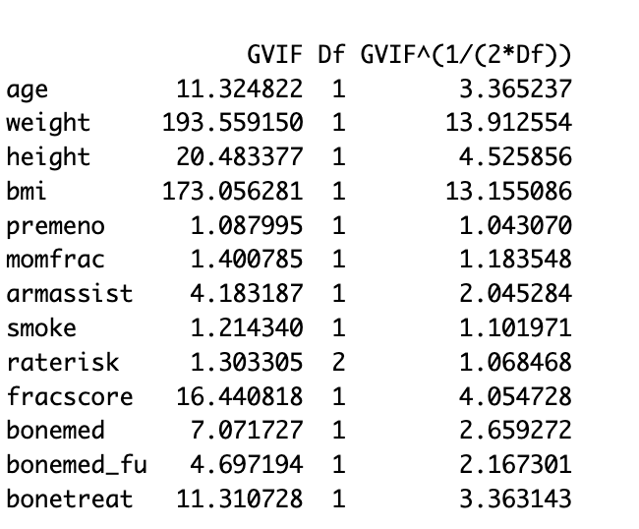
Exploratory Data Analysis
The first step we took in the Eda was to check variance inflation factors (vifs)
The reason for this is to look for multicollinearity within the explanatory variables
Looking at the table we can see that weight and bmi have extremely high vif, along with fracscore and the 3 bone treatments.
To combat this, we will take out the fracscore and bmi, the reasoning behind this is because they are calcualated variables and we want to work off the observations in this dataset.

Slide 8
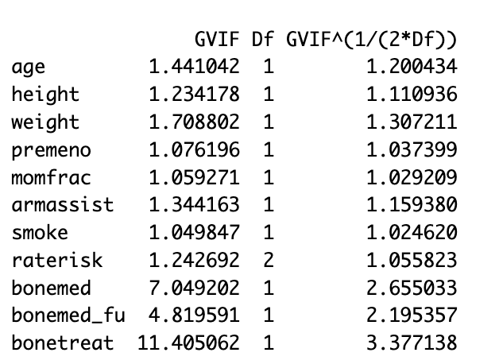
This is the new vif table.
We can see that the vifs are mostly below 5, except for bonemed and bonetreat.
These are multicollinear we because bonetreat included patients that took the med at enrollment and after the follow up. Which happens to be the other 2 variables talking about medicine

Slide 9
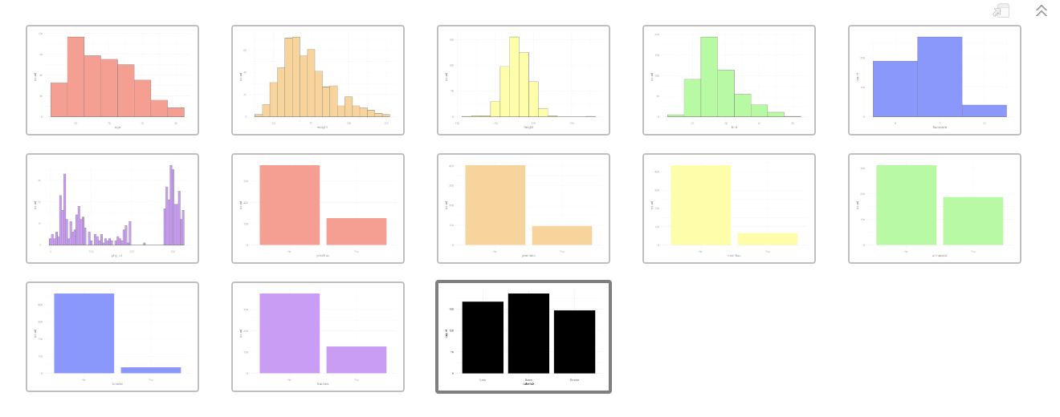
Distribution plots
Looking at the plots we can see the numerical variables have a pretty good distribution. While some of the categorical variables do not, this is not an issue with logistic regression because we only care about the multicollinearity.

Slide 10
Objective 1
Display the ability to perform EDA and build a logistic regression model for interpretation purposes.
Notes:
Caleb will talk about objective 1

Slide 11
In this section address
Objective 1: Must include a high-level explanation of the model fitting approach.

Slide 12
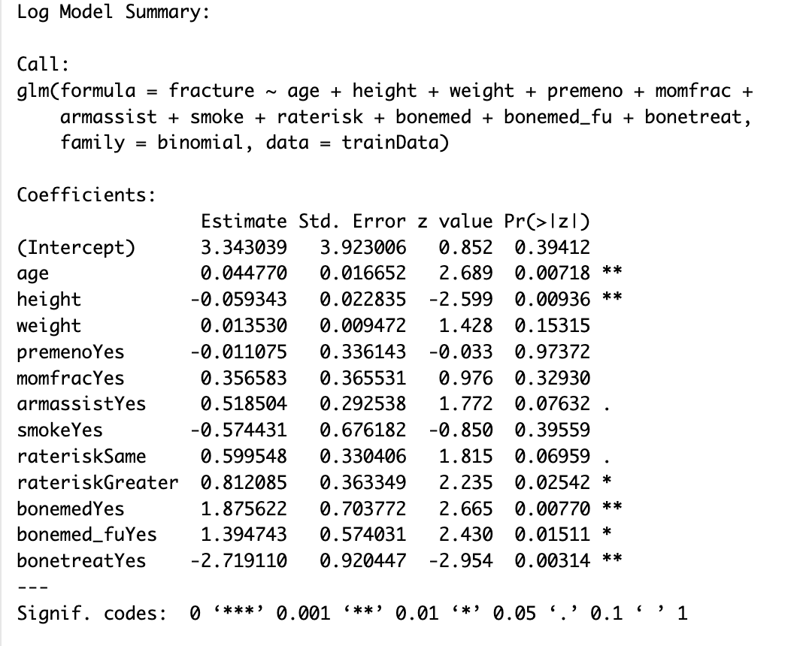
Model 1
Height: the log odds of experiencing a fracture decreases by -0.059, holding all other variables constant.
To get the odds ratio, you do e^(-0.059) which comes out to .942. That means with each 1-unit increase of height (cm) the chance of experiencing a fracture goes down 5.76%.
Raterisk-greater: the log odds of experiencing a fracture increase by 0.812, holding all other variables constant.
Odds ratio: 2.252, this means that with each 1-unit increase of raterisk-Greater the chance of experiencing a fracture goes up 125%.

Slide 13
Model 1 odds ratios
Variable | Odds Ratio
Intercept | 28.305
Age | 1.045
Height | 0.942
Weight | 1.013
Premeno | 0.988
Momfrac | 1.428
Armassist | 1.679
Smoke | 0.563
RateriskSame | 1.821
RateriskGreater | 2.252
Bonemed | 6.524
Bonemed_fu | 4.033
Bonetreat | .065
To interpret the models' odds ratios:
> 1 means the event (fracture) is more likely as the predictor increases
= 1, the predictor has no change on the event as it increases
< 1, the event is less likely to happen as the predictor increases

Slide 14
Objective 2
: With a simple logistic regression model as a baseline, perform additional competing models to improve on prediction performance metrics.
Notes:
Rafia
Summary of approach to include complexity in the logistic model
Discussion of what metrics really make the most sense to evaluate your models
Model comparisons
ROC curves
Insights as to why one tool worked better than the other. Or perhaps why they are all equally good…or bad?

Slide 15
complex logistic regression model
Goal: add interaction or polynomial terms to allow model to capture non-linear relationships between independent variables and outcome
Does this improve model accuracy?
Answer: slightly but model is still weak.
Notes:
Objective 2: Complex Logistic Regression Model
Variables: Determine if variables are categorical or numerical.
For Categorical Variables: Convert to numeric format using methods such as transforming "yes/no" to "1/0" (Required by glmnet for numeric input).
Polynomial Transformation with poly():
Purpose: Centers and scales variables to prevent multicollinearity by shifting polynomial terms to a mean of zero and scaling by standard deviations.
Function: Models the relationship between independent and dependent variables using nth degree polynomials. Ideal for complex relationships or when the link between predictors and outcome is not straightforward.
Example: poly(BMI, 3) generates terms for BMI (BMI to the first power, BMI squared, BMI cubed), useful for non-linear relationships like BMI variations.
Application: Use polynomial terms (squared, cubic, etc.) to enhance curve fitting to the data and improve model accuracy.

Slide 16
Variable selection
For this second model we wanted to build upon the first one, but also select variables that we believed to have the most influence on the outcome, having a fracture during the first year of the study
To do this we looked at the first model, with all the variables, and decided to narrow them down based off p-value. This metric was picked because p-value gives you the relevance of each variable to the outcome.
For the following models we decided to reduce the variables down to:
Age, height, raterisk, bonemed, bonemed_fu, bonetreate

Slide 17
Create model 1: complex logistic regression model
Model based on variable selection:
x_validation_matrix <- model.matrix(~ poly(age, 2) + poly(height, 2) + poly(raterisk, 2) + bonemed * bonemed_fu * bonetreat, data = validationData)
Based on eda kept:
Age, height, raterisk
Polynomial degree option 2 (quadratic)
Have binary outcome variable (fracture)
Medication
Interactions terms : see if taking medications in combination affected fractures
Notes:
change poly (3) remove bmi as similar data to weight/height look at medication variable this made fit slightly worse

Slide 18
Feature Selection: complex logistic regression model
logistic regression model
Fit Ridge, Lasso and Elastic net
Chose elastic net
Ridge (l2)
Lasso (l1)
Elastic Net (0.5: split between L1 & L2)
Elastic Net had:
lowest SE
middle amount of coefficients (more than lasso, less then ridge)
best choice for prediction accuracy
Notes:
> ridge_cvmodel Call: cv.glmnet(x = x_model_matrix, y = y_var, family = "binomial", alpha = 0) Measure: Binomial Deviance Lambda Index Measure SE Nonzero min 0.01 100 1.057 0.07219 13 1se 55.94 7 1.129 0.04971 13 > lasso_cvmodel Call: cv.glmnet(x = x_model_matrix, y = y_var, family = "binomial", alpha = 1) Measure: Binomial Deviance Lambda Index Measure SE Nonzero min 0.00216 42 1.046 0.06024 12 1se 0.06139 6 1.100 0.03742 3 > Elastic_cvmodel Call: cv.glmnet(x = x_model_matrix, y = y_var, family = "binomial", alpha = 0.5) Measure: Binomial Deviance Lambda Index Measure SE Nonzero min 0.00247 48 1.034 0.04977 12 1se 0.08463 10 1.078 0.04797 5

Slide 19
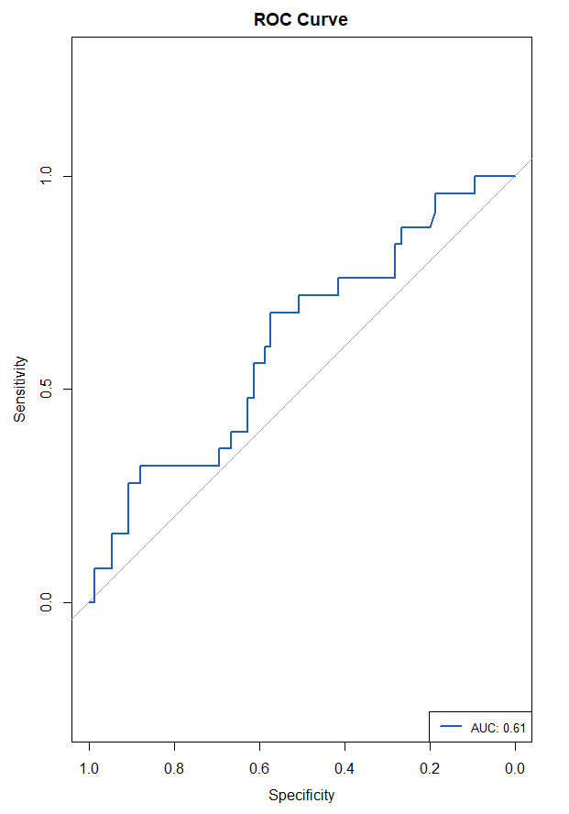
complex logistic regression model
Call: roc.default(response = actual_outcomes, predictor = predicted_probs) Data: predicted_probs in 75 controls (actual_outcomes 0) < 25 cases (actual_outcomes 1).
Area under the curve: 0.6104
Notes:
Area Under the Curve (AUC) metric in ROC analysis quantifies the overall ability of the model to correctly classify the cases and controls across all possible threshold values.
AUC value ranges from 0 to 1, where: 0.5 represents a model with no discrimination ability, 1 represents a perfect model that perfectly discriminates between the two classes.
AUC of 0.616 means model better then random guessing (0.5)

Slide 20
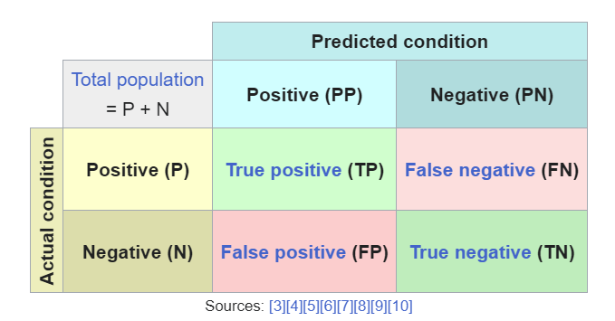
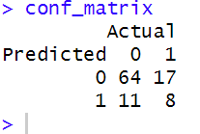
Confusion Matrix
PPV=tp/tp+fp
NPV=TN/FN+TN
Sensitivity=Tp/FN+TP
Specificity=TN/FP+TN
Prevalence=TP+fn/tp+TN+fp+fn
Notes:
https://en.wikipedia.org/wiki/Confusion_matrix

Slide 21
Confusion Matrix
Confusion Matrix
True Negatives (TN): 64 (Prediction 0, Reference 0)
False Positives (FP): 17 (Prediction 0, Reference 1)
False Negatives (FN): 11 (Prediction 1, Reference 0)
True Positives (TP): 8 (Prediction 1, Reference 1)
Notes:
0 (no Fracture)
1 (Fracture)
Notes:
https://en.wikipedia.org/wiki/Confusion_matrix
#TRUE becomes 1 and FALSE becomes 0. numeric vector - each "Yes" in the original fracture factor is 1, and each "No" is 0.
#yes/Fracture =1 No fracture=0

Slide 22
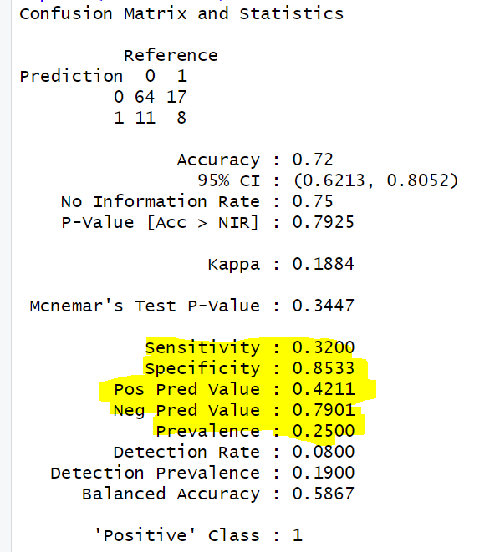
Metrics for complex logistic regression model
This model correctly Identifies 32% of true positive cases (aka Recall, aka Sensitivity)
This model correctly Identifies 85% of true Negative cases (aka Specificity)
25% of the cases in dataset are positive (prevalence)
When this model predicts an instance as positive it is correct 42.11% of the time (aka ppv/positive prediction value, aka precision)
When this model predicts an instance as Negative it is correct 79.01% of the time (aka Npv/Negative prediction value)
Area Under the ROC Curve (AUROC) is tells us how well the model distinguishes positive & negative classes. the AUROC is 0.6163, which is slightly better than a value of 0.5 (no discrimination)

Slide 23
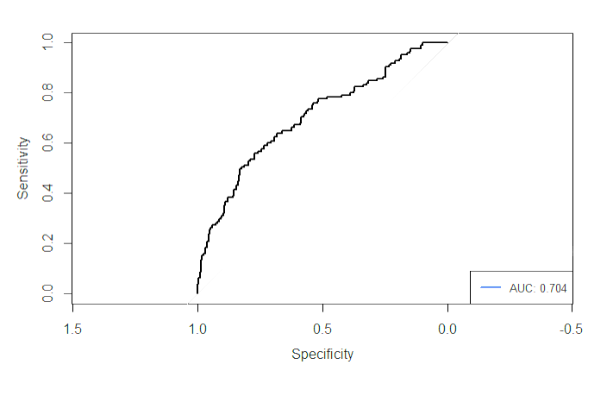
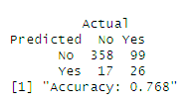
LDA/QDA
lda_model = lda(fracture ~ age + height + weight+ raterisk + bonemed + bonemed_fu + bonetreat)
Accuracy = 76.8%
Area under roc curve: 0.0736

Slide 24
Xgboost
Accuracy: 88%
Sensitivity (Recall): 82.67%
Specificity: 93.33%
Positive Predictive Value (Precision): 92.54%
Negative Predictive Value: 84.34%
Balanced Accuracy: 88.00%

Slide 25
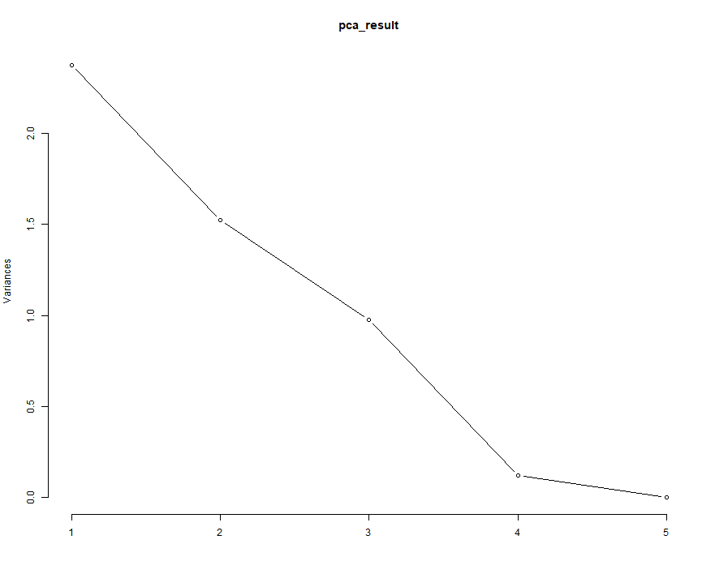
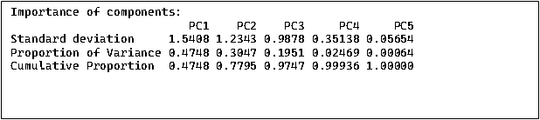
Standardizing
To address multicollinearity – the variables were standardized

Slide 26
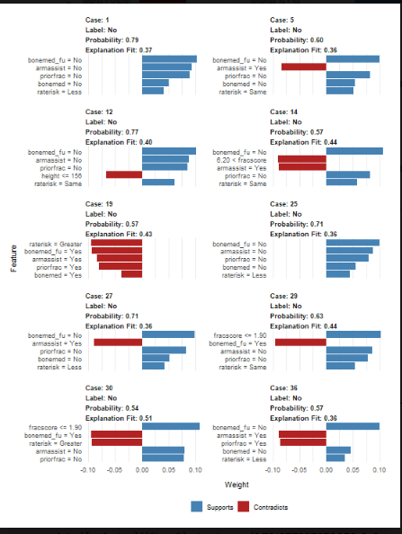
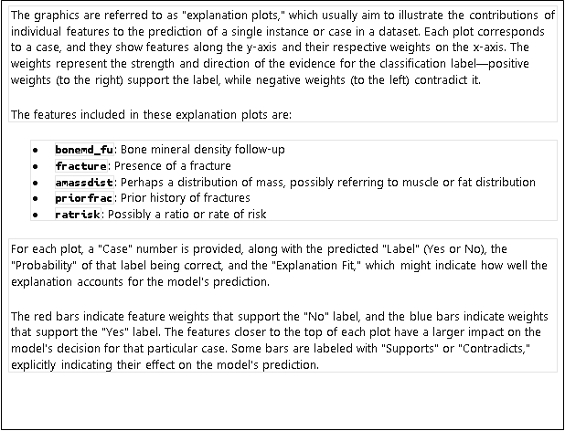

Slide 27
RANDOM Forest
Accuracy: 86.67%
Sensitivity (Recall): 78.67%
Specificity: 94.67%
Positive Predictive Value (Precision): 93.65%
Negative Predictive Value: 81.61%
Balanced Accuracy: 86.67%

Slide 28
ensemble
Accuracy: 88.67%
Sensitivity (Recall): 82.67%
Specificity: 94.67%
Positive Predictive Value (Precision): 93.94%
Negative Predictive Value: 84.52%
Balanced Accuracy: 88.67%

Slide 29
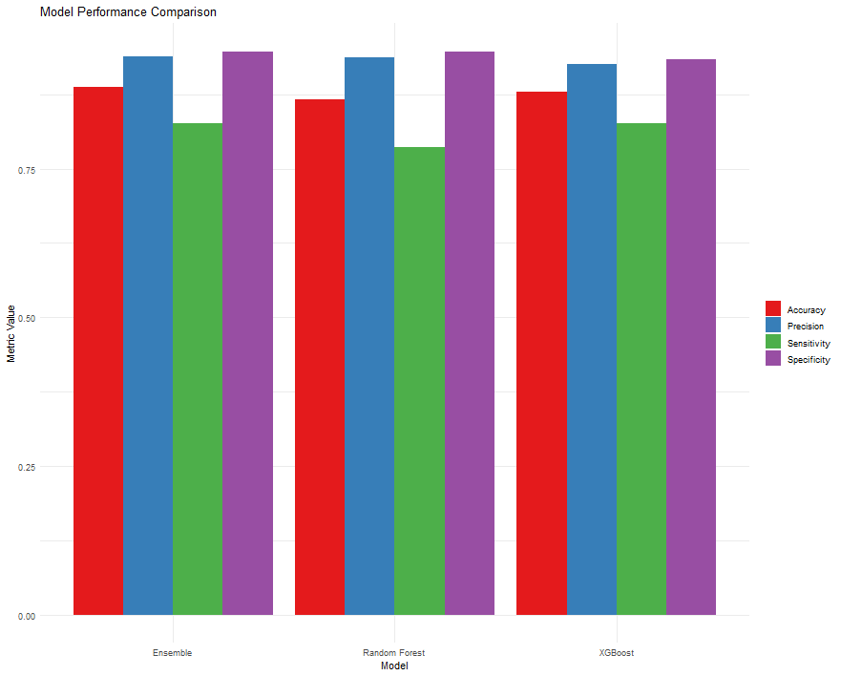

Slide 30
ensemble
Accuracy (0.94):
Ensemble model correctly predicts the positive and negative classes 94% of the time.
This is significantly better than the No Information Rate (NIR), which is 0.5. This rate is the accuracy that would be achieved by always predicting the most frequent class.
Kappa (0.88):
The Cohen's Kappa score is 0.88, indicating very good agreement between the predictions and the actual values, corrected for random chance. This suggests that the model is highly effective in classifying the outcomes beyond what would be achieved by random chance.
Sensitivity (0.96) or True Positive Rate:
The model has a sensitivity of 96%, meaning it correctly identifies 96% of the actual positive cases. This high sensitivity is crucial for scenarios where missing a positive case would have severe consequences.
Specificity (0.92):
The specificity is 92%, indicating that the model correctly identifies 92% of the actual negatives. This is also a strong performance, showing the model's effectiveness at ruling out negative cases when they are truly negative.
Positive Predictive Value (PPV) (0.9231):
Also known as precision, this metric shows that 92.31% of the positive predictions made by the model are correct. This is important in contexts where the cost of a false positive is high.
Negative Predictive Value (NPV) (0.9583):
The NPV is 95.83%, indicating that 95.83% of the negative predictions made by the model are correct. High NPV is crucial in scenarios where it's important not to classify an actual negative as positive.
Balanced Accuracy (0.94):
Balanced accuracy, which averages sensitivity and specificity, is also 94%. This confirms the model's robust performance across both positive and negative predictions, especially important in imbalanced datasets.
Mcnemar's Test P-Value (0.505):
Mcnemar's test assesses the marginal homogeneity of the confusion matrix. A p-value of 0.505 suggests there is no significant difference in the performance of the model between the types of errors (Type I vs. Type II).

Slide 31
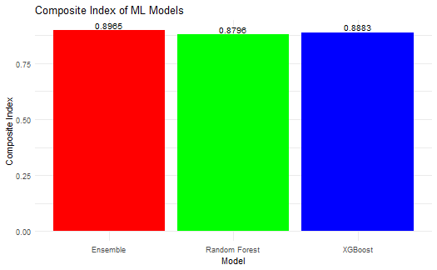
Model <chr> | Accuracy <dbl> | Precision <dbl> | Sensitivity <dbl> | Specificity <dbl> | CompositeIndex <dbl>
Ensemble | 0.8867 | 0.9394 | 0.8267 | 0.9467 | 0.89651
Random Forest | 0.8667 | 0.9365 | 0.7867 | 0.9467 | 0.87964
XGBoost | 0.8800 | 0.9254 | 0.8267 | 0.9333 | 0.88829
Weights assigned for medical test: Accuracy 20%
Precision 30%
Sensitivity: 30%
Specificity: 20%

Slide 32
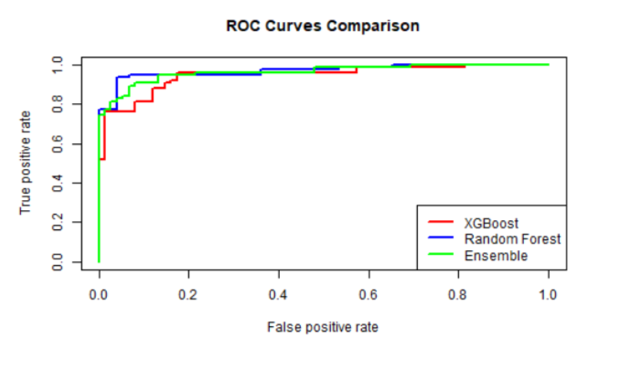
AUC for XGBoost: 0.9454222
AUC for Random Forest: 0.9672889
AUC for Ensemble: 0.9624889

Slide 33
Comparative analysis
Accuracy: All models perform comparably with the Ensemble model slightly outperforming the others.
Sensitivity (Recall):
XGBoost and Ensemble have the same recall, both higher than Random Forest.
Specificity: Random Forest and Ensemble share the highest specificity.
Precision: The Ensemble model has the highest precision.
Negative Predictive Value: Random Forest has the lowest NPV, indicating it is less reliable when predicting the negative class.
Balanced Accuracy: The Ensemble model has a marginally higher balanced accuracy, showing it balances recall and specificity slightly better than the others.

Slide 34
Objective 2 comparison table
 | Complex GLM | LDA/QDA | Jessicas Model
Sensitivity | 0.32 | 0.208 | 0.82
Specificity | 0.85 | 0.9546667 | 0.78
Prevalence | 0.25 | 0.25 | 0.25
PPV (+ Predictive Value) | 0.4210526 | 0.6046512 | 0.9394
NPV (- Predictive Value) | 0.7901235 | 0.7833698 | 0.8452
AUROC | 0.6104 | 0.7036 | 0.9624

Slide 35
Conclusion

Slide 36
Thank you. Please contact us with any questions
Jessica, rafia, caleb

