Slide 1
Cancer Epidemiology in Somaliland?
Dr. Omar Bihi, (MD, Consultant Pathologist in HGH and CAP Fellow)
Hargeisa Somaliland

Slide 2
Cancer Epidemiology in Somaliland.......
It is estimated that the global cancer burden caused 19.1 million new cases and 10 million deaths.
Cancer ranks the leading cause of morbidity and mortality world wide.
In Africa, there is 1,055,172 new cancer cases (5.8% of the global total)
Notes:
Cancer is a general term that includes a wide range of diseases that can affect any part of the body. Other terms used are malignant tumors and neoplasms. A hallmark of cancer is the rapid generation of abnormal cells that grow outside their usual boundaries.
and 693,487 cancer deaths (7.3% of the global total) in 2020
Globally, one 1:5 men 1:6 develop cancer in their lifetime, while one in eight men and one in 11 women die of this disease. CVS

Slide 3
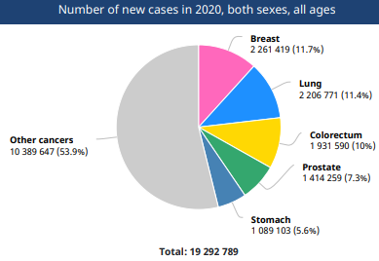
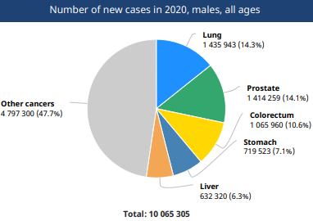
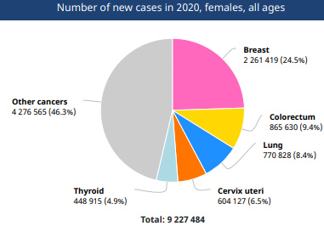
Notes:
For the 1st time, female breast cancer has become the most commonly diagnosed cancer( surpassing lung cancer, in particular due to (LMICs). Lung cancer remains the leading cause(link is external) of cancer deaths, not only in many LMICs 2.3 million new cases, representing 11.7% of all cancer 5TH Leading
Lung cancer and prostate cancer are the most common among men, together accounting for nearly one-third of all maleBreast cancer represents 1 in 4 cancers diagnosed among women globally. Colorectal, lung, cervical, and thyroid cancers are also common among women. cause of mortality worldwide. HDI reproductive and hormonal risk factors lifestyle risk factors pportunistic mammographic screeni such as BRCA1 and BRCA2 Jewsih

Slide 4
Cancer Incidence and Distribution in Eastern Africa?.......
In East Africa, Kenya, Uganda, and Ethiopia have high prevalence of cancer incidences.
In Kenya, cancer is the 3rd cause of morbidity, causing 7% of deaths per year, after infectious diseases CVS.
The leading cancers are breast cancer for women , Cervical, prostate cancer for men, and Esophageal.
In Uganda, cancer prevalence is one of the highest in East Africa, with about 300 cases reported in every 100,000 people.
Prostate and cervical cancers are the leading causes of death.
In Ethiopia, cancer accounts for 6% of total national deaths, with about 60,960 new cases and 44,000 deaths per year.

Slide 5
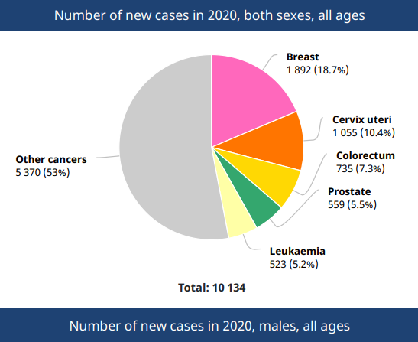
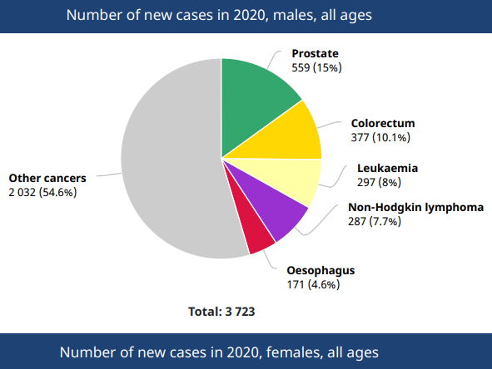
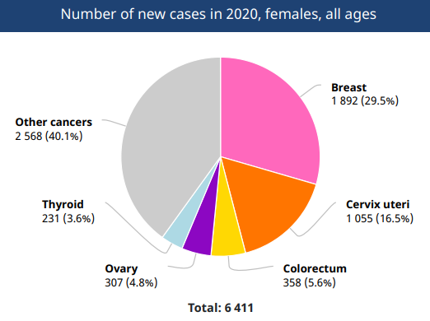
Notes:
global cancer statistics estimates cannot obtain local data from 32 countries, including Somalia, they indicate the cancer incidence estimates according to the average rates of neighboring countries. Cancer incidence estimates in Somalia are based on the average of Ethiopia and Kenya as there is no local data.

Slide 6
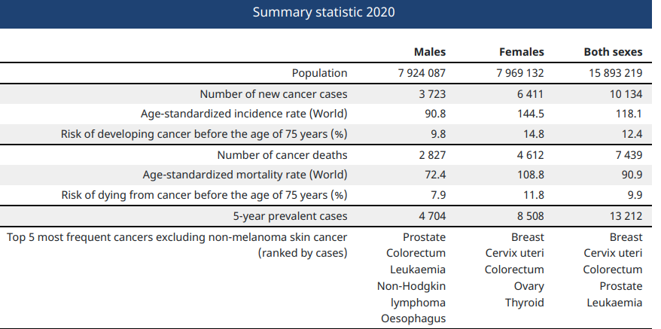

Slide 7
Tertiary Care Hospital (Digfeer) in Somalia from 2017 to 2020
1306 patients included in the study, 50.9% were female and 49.1% were male, and the mean age was 51.1±19.4 years. Of the cases, 5.1% (n=67) were pediatric (0–17 years) and 35.8% (n=468) were in the 18–50 years range.
The most common cancer was esophageal cancer (EC) for the overall data (n=284; 21.7%) and in both genders. EC peaked in the fifth decade.
Notes:
Cancer Incidence and Distribution at a Tertiary Care Hospital in Somalia from 2017 to 2020: An Initial Report of 1306 Cases

Slide 8
Liver cancer was the second most common cancer overall (n=99; 7.6%) and in men (n=67; 10.5%).
Cervical cancer was the second most common cancer among women (n=88; 13.3%) and ranked fourth in terms of overall incidence (n=88; 6.7%).
Breast cancer was the third most common overall (n=95; 7.3%) and in women (n= 87; 13.1%).
Notes:
igh-risk HCC areas (China, Korea, and sub-Saharan Africa), key determinants are chronic HBV infection, aflatoxin exposure, both ncidence and mortality rates of liver cancer have decreased in many high-risk countries in eastern asia Taiwan, these trends likely reflect declines in the population seroprevalence of HBV and HCV as well as a reduction in aflatoxin exposure

Slide 9
Department of Pathology in HGH
A total of 61 cancer cases were diagnosed b/w April 04, 2023 and July 20, 2017.
The youngest patient is 3 years of age, the oldest was 97, and the average age was 53.4 years.
The 10 most common types of cancer are esophageal (n = 14, 23%), Breast (n = 8, 13.1%), Colorectal (n = 7, 11.4%), Prostate (n = 6, 9.8%), Leukemia( n=5, 8.1%), Endometrial (n = 5, 8.1%) thyroid (n = 4, 6.5%), ovary (n = 4, 6.5%), soft tissue and bone (n = 4, 6.5%), liver (n = 2, 3.2%), and kidney (n = 2, 3.2%).
The most common site of cancer in both males and females was the esophagus.
Notes:
These results show a high incidence of esophageal cancer in Somaliland, Environmental factors and dietary habits may have an effect.
The excessive use of hot tea and rice and intake of tobacco and khat and drinking beverages are likely associated R/F. Serious and extensive research on the etiology of esophageal cancer is required.
Most cases inoperable 3 4 pallituve therapy pt education is required t able to undergo chemo-radiotherapy
herefore, global cancer statistics data are different from the results of our study.

Slide 10
Relationship between Food Type and Increased Risk of Cancer
The type and nature of food affect the risk of developing cancer.
A third of deaths from cancer are attributed to tobacco use, BMI, alcohol use, low intake of fruits and vegetables, and lack of physical activity.
Cancer-causing infections, such as hepatitis and HPV, are responsible for 30% of cancer cases in low- and middle-income countries.
Currently, between 30% and 50% of cancer cases can be prevented by avoiding disease risk factors
The burden of cancer can also be reduced by detecting the disease and treatment early.

Slide 11
Effect of food type on Cancer
Canned and processed foods occupy a large space in the daily diet of families.
A scientific study held at the Paris-Sorbonne University, which included more than 10,000 participants, indicated that excessive consumption of canned and processed foods increases the risk of cancer, especially breast cancer.
the researchers concluded that for every 10% increase in consumption of processed foods, increases the risk of cancer incidence by 12%.
Notes:
, most of which are easy and quick to prepare, and suit the fast pace of working life.
The study monitored the diet of these participants, taking into account their age, health status, and family history of cancer, and as a result,
Sodas: Grilled red meat Alcohol: Fried Potato fried in trans fats and then heavily salted heated to a high temperature produce acrylamide, a known carcinogen found in cigarette smoke.

Slide 12
There is no national cancer registry system in Somaliland, the population-based cancer incidence is not known.
Notes:
true incidence of cancer is not yet known in Somaliland as in all other Sub-Saharan Africa (SSA) countries with Population-based cancer registries are the gold standard for a comprehensive understanding of the cancer burden.

Slide 13
Cancer Incidence and Distribution in Somaliland????

Slide 14
References
https://doi.org/10.1053/j.seminoncol.2017.10.007 The distribution of cancer cases in Somalia.
https://doi.org/10.3322/caac.21660 GLOBOCAN 2020
WHO 2020 Somalia Data
10.2147/CMAR.S277202 Cancer incidence and distribution in a tertiary hospital in Somalia

Slide 15
Thank You

