Slide 1
The Current State of Neurosurgery in Somaliland

Slide 2
Global neurosurgery is an area of clinical practice, research, advocacy, and health care systems innovation that seeks to address global health care by applying the tools of public health to the development of neurosurgery. This presentation provides a picture of the current state of neurosurgery in Somaliland, a land whose social, political, and economic context is unique in Africa, yet representative of the struggles for health care equity in many postcolonial settings.

Slide 3
We provide brief biographical sketches of key actors in Somaliland neurosurgery. an overview of the current state of neurosurgical health care delivery, and first steps toward capacity-building initiatives. In conclusion is a recommendations to guide the international neurosurgery community in future contributions and collaborations.

Slide 4
Current Status of Health Care in Somaliland and Key Actors Somaliland's public health sector remains regulated. In addition to a few private sector institutions, active participants include a host of United Nations agencies, such as the World Health Organization (WHO), United Nations Children's Fund (UNICEF), and United Nations Population Fund, and nongovernmental organizations, such as Save the Children, Health Poverty Action, World Vision, and Population Services International. Taken together, these groups provide most health services in the country. Much of the emphasis has been placed on primary care and maternal and child health. Significant gaps exist in surgical care capacity, including deficiencies in workforce, infrastructure, equipment, and service provision.

Slide 5
The Somaliland Government does not have access to development loans through standard international banking mechanisms, making the government weaker than civil society. Currently, health care facilities include 1 national referral hospital, 1 national mental health hospital, 5 regional referral hospitals, and 3 district hospitals.

Slide 6
Neurosurgery Epidemiology There has never been an epidemiological appraisal of Somaliland's neurological and neurosurgical disease burden. The relatively recent introduction of data collection systems and resources in the country further increases the difficulty of surveying the incidence and prevalence of neurosurgical disease. Preliminary data from 2022 indicate that 35,000 cases of external trauma presented to Hargeisa Group Hospital and 45,000 presented to other district hospitals for a combined total trauma burden of 80,000. By my experience in Hargeisa group hospital that cerebrovascular disease and neurotrauma are the leading contributors to the current neurosurgical disease burden. The day-to-day case volume primarily consists of emergency neurotrauma and pediatric hydrocephalus and myelomeningocele repair.

Slide 7
All neurosurgery care is provided in Hargeisa at hospitals like: 1. Hargeisa Group Hospital (public) 2. Amal grand Hospital (private) 3. Royal Care Hospital (private) 4. Haldoor Hospital (private) 5. Hargeisa Neurological Hospital (private) 6. Edna Adan Hospital (public) 7. Mohamed Adan Shiekh pediatric Hospital (public)

Slide 8
Hargeisa Group Hospital neurosurgery department had been actively working since 2019. which is currently national main neurosurgery care center. Facility is limited but covers all basic needs. Morbidity and mortality are about only 5% for facility capacity cases.

Slide 9
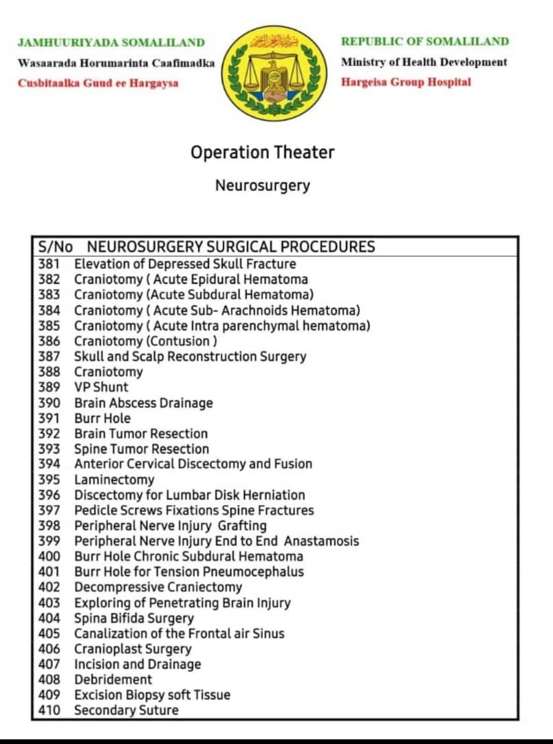

Slide 10
Conclusions Through joint efforts, global partners in neurosurgery may find in Somaliland a unique opportunity to design and implement systems that will save lives, prevent disability, and make lasting, impactful contributions, all in a cost-effective manner.

Slide 11
THANK YOU

