Slide 1
Introduction to Seminar Project
Lars Neuser – Group A9

Slide 2
TABLE OF CONTENT
Prerequisites
Presentation of process
Preprocessing
Detection & counting
Tracking
ML approach

Slide 3

Prerequisites:
General Task: count all fruits on a tree
Data:RGB & thermal image
Upper perspective: 19 images
Lower perspective: 14 images
Taken on a single day (no multiple measurements)
Fruits are ripe (red)
Fruits are warmer than surrounding

Slide 4
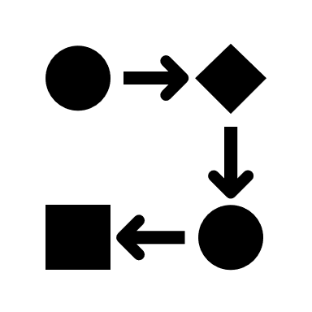




Main Tasks
pre-processing
tracking
counting
detection

Slide 5
Preprocessing
Idea: Preparing images so that CV techniques can be applied
Normalization of thermal images
Undistortion of images
Possibly change color space (RGB → HSV)
Histogram equalization to increase contrast
Filtering out noise (e.g. Wiener Filter)
Minimize image overlap
Overlap of thermal and RGB needs external calibration

Slide 6
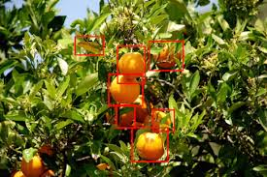
2. Detection
Segmentation used to identify objects
Occlusion needs to be considered
Avoiding:
false positive detection (noise)
false negative clustering → might detect 2 close fruits as 1
false positive clustering → a branch dividing a fruit counts as 2 fruits
Considering different lighting conditions

Slide 7
3. Tracking
Idea: Tracking fruits across different images
Merging fruit counts without creating duplicates
Using e.g. 3D reconstruction
Size of fruit may vary
Visibility varies due to occlusion (not every peach is visible in every image)

Slide 8
4. Counting
Distinction between trees → counting fruits on one tree
No fruits from the ground must be counted

Slide 9

Machine Learning
Training a NN needs labeled datasets
→ might be acquired online
Training data generalizes (fruit colors, temperatures, sizes)
→ might not reach desired accuracy
high class imbalance (most of the picture is not fruit)
Model could be perfectly overfitted if trained on fitting data

Slide 10
Thank you!
Lars Neuser – Group A9

