Slide 1
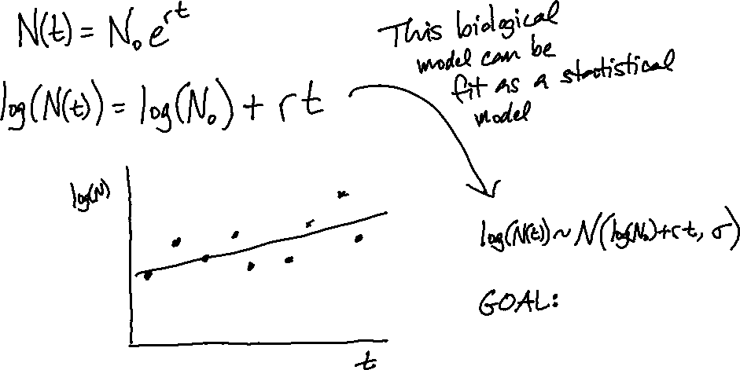
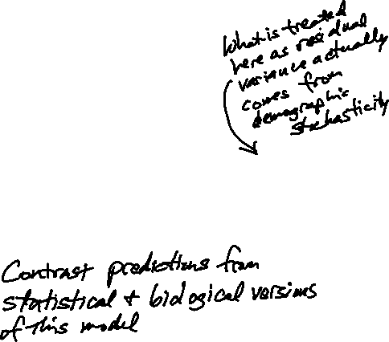

Slide 2
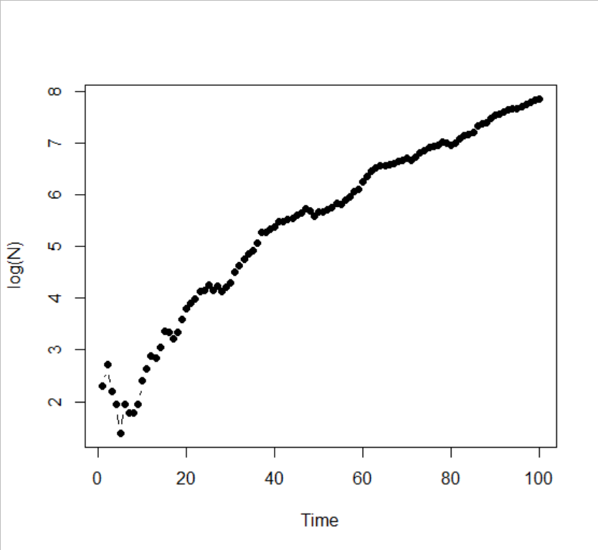
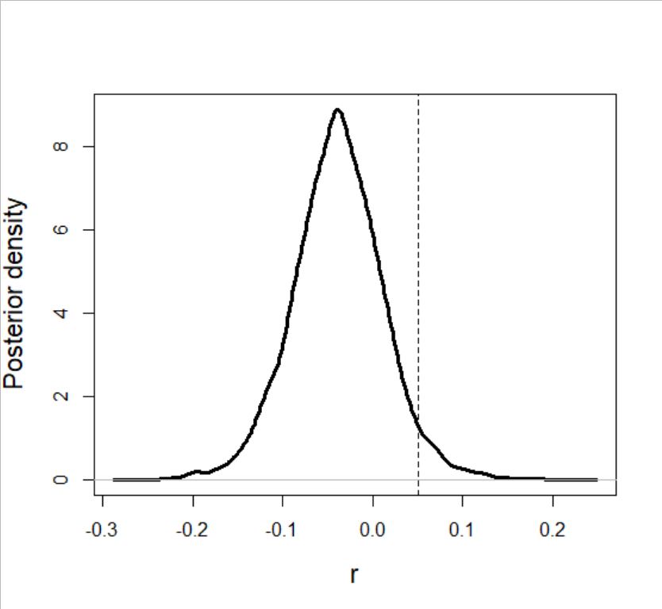
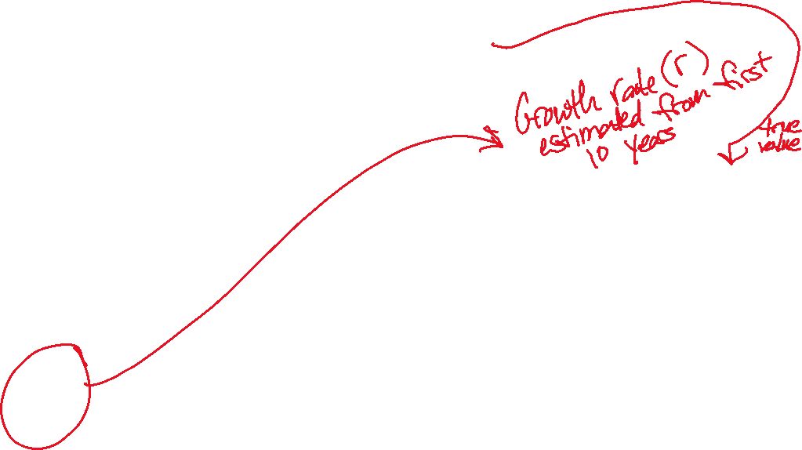
N[1] <- 10
for(t in 2:time.steps){
N[t] = rpois(1,discrete.logistic(N[t-1],r=0.05,K=Inf))
}

Slide 3
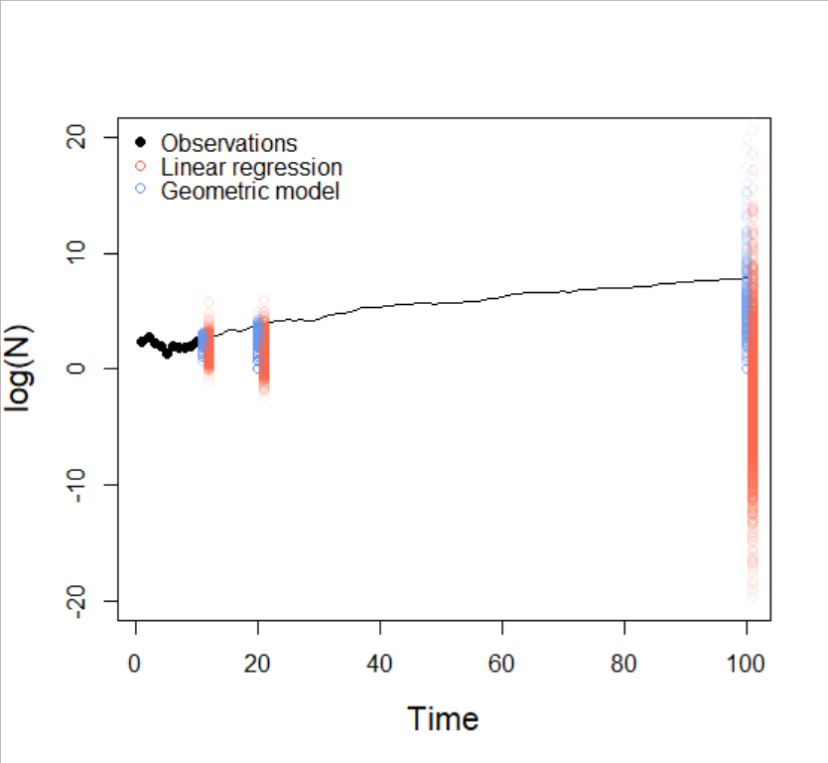
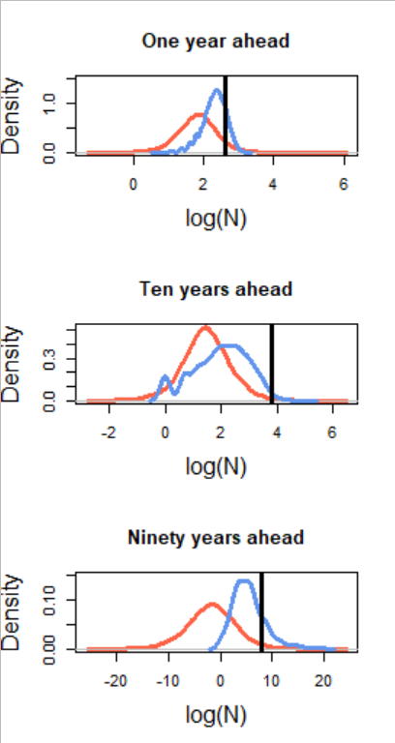
Extinction risk from geometric model
0%
24%
87%

Slide 4
What does this illustrate?
Even for a model that has a convenient statistical re-packaging, forecasting via the ecological dynamics improves estimation of uncertainty in population projections and extinction risk
The value of a theory-based approach becomes more evident over longer time horizons
What statistical models treat as “residual variance” may be an intrinsic and informative feature of ecological dynamics

