Slide 1

Decentralized Systems
Presented by: [Name] @[twitter handle]
Part of the Ethereum 101 Series: www.ethereum101.org

Slide 2

Information and control are held by a centralized source.
CENTRALIZED SYSTEMS

Slide 3
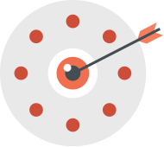
If the main node fails, the entire network fails.
CENTRALIZED SYSTEMS

Slide 4
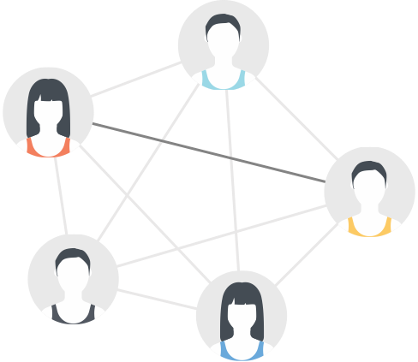
Decentralized networks are also known as peer-to-peer, or P2P.
The network is a connection of nodes known as peers.
DECENTRALIZED SYSTEMS
PEER (A)
PEER (B)

Slide 5
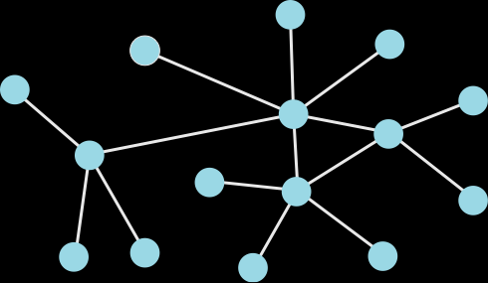
Information and control are distributed in a peer-to-peer network.
DECENTRALIZED SYSTEMS

Slide 6
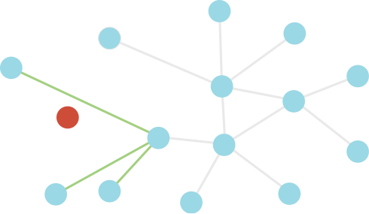
If a node fails, the network can easily repair itself.
DECENTRALIZED SYSTEMS

Slide 7

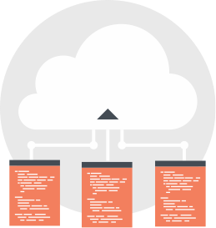
If you save a file on your computer, and the hard drive fails, you lose all the data on it - forever.
CENTRALIZED VS DECENTRALIZED
Cloud services help store multiple copies of your file,
keeping it safe in the case of a hard drive failure.
Distribution of data and control leads to more fault-tolerant systems.

Slide 8
Open Source code explanation
slide to show human trust vs. code trust

Slide 9
Extra slides

Slide 10
If you back up to a cloud service the file will be safe.
DECENTRALIZED SYSTEM

Slide 11
If your hard drive fails, you lose all the data on it - forever.
DECENTRALIZED SYSTEM

