Slide 1
Tech and Mental Health
Teya Robinson

Slide 2
Problem
Lack of awareness of mental illness in tech industry

Slide 3
Data

Slide 4
Data Source
Open Sourcing Mental Illness
Open Sourcing Mental Illness is a non-profit, 501(c)(3) corporation dedicated to raising awareness, educating, and providing resources to support mental wellness in the tech and open source communities.
Open Source survey (https://osmi.typeform.com/to/E1aoi6)
Annually since 2014
33 questions
418 responses in 2018

Slide 5
Data Source
A mental health disorder is defined as a mental illness that has been diagnosed by a doctor
A mental health issue is defined as a potential mental illness, which may or may not have been diagnosed by a doctor.

Slide 6
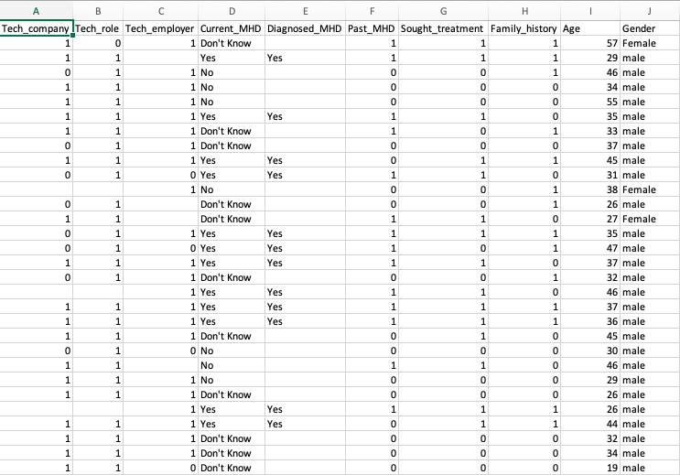
Cleaning data
Excel
Pandas
Python
Jupyter Notebook

Slide 7
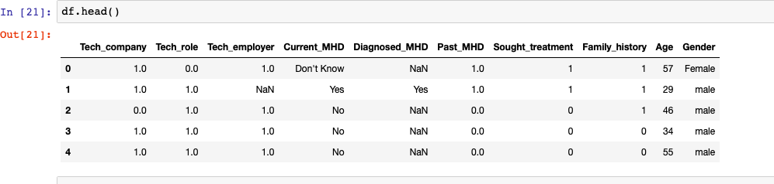
Cleaning data
Excel
Pandas
Python
Jupyter Notebook

Slide 8
analysis

Slide 9
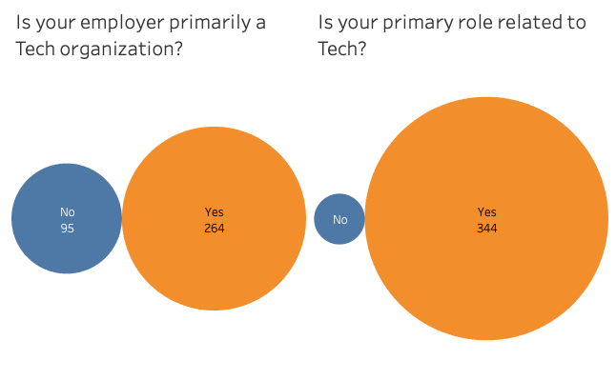
Tech Employer
74% - Yes
26% - No
Tech Primary Role
96% - Yes
4% - No

Slide 10
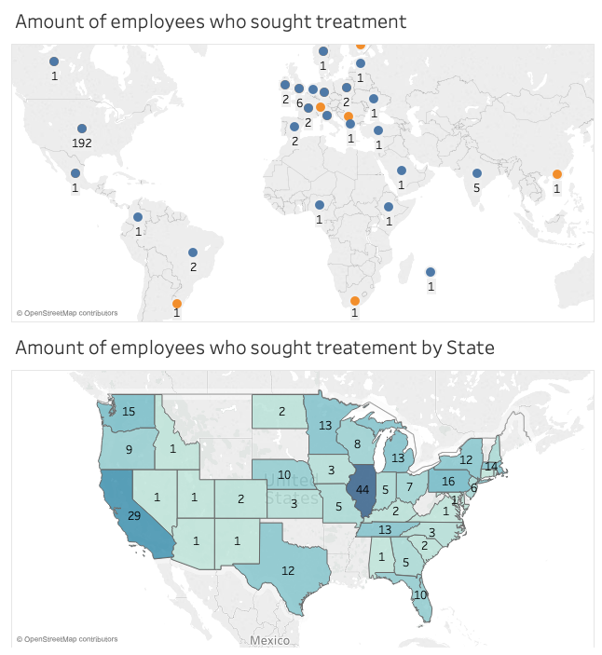
Top 3 Countries
United States – 192
United Kingdom - 6
India – 5
Top 3 States
Illinois - 44
California – 29
Pennsylvania – 16

Slide 11
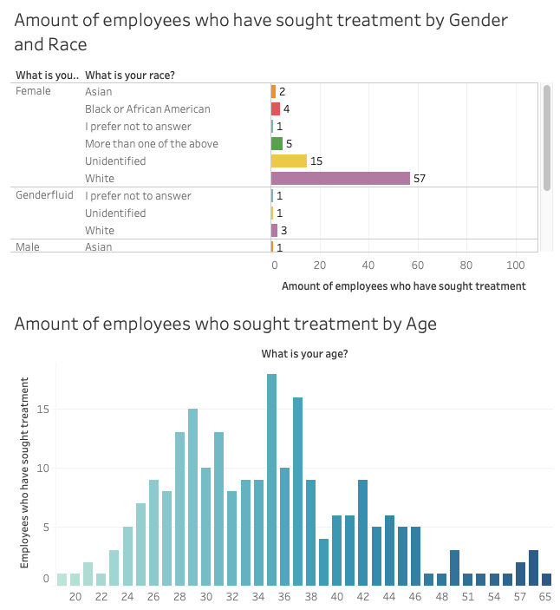
Gender
Male – 62%
Female – 31%
Non-Binary – 3%
Gender Fluid – 1.7%
Trans - <1.5%
Age
19-29 – 30%
30-39 – 46%
40+ - 24%

Slide 12
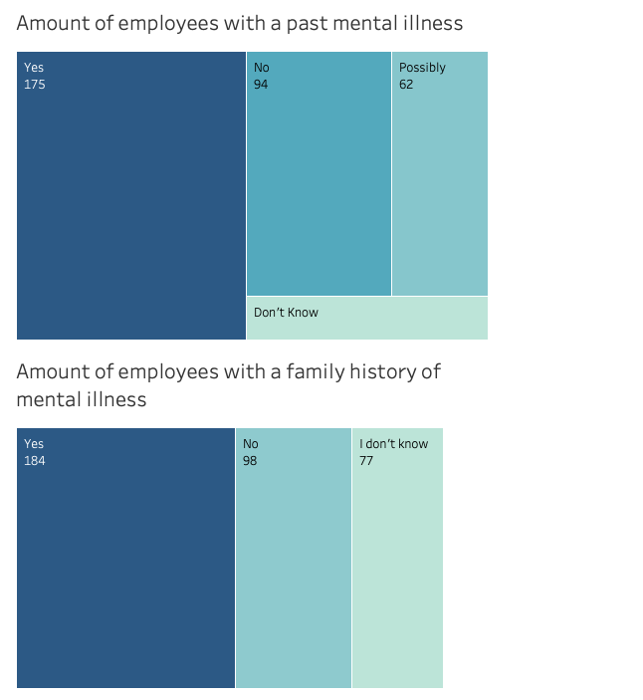
Past mental illness
Yes – 44%
No – 26%
Possibly – 18%
I don’t know - ~8%
Family history
Yes – 51%
No – 27%
I don’t know - ~22%

Slide 13
conclusion

Slide 14
solutions
Implement Employee Resource Groups centered around mental illness
Spread awareness of mental wellness programs
Dedicate spaces for mental wellness in the office
Provide a safe space for employees to address mental illness concerns

Slide 15
Machine learning

Slide 16
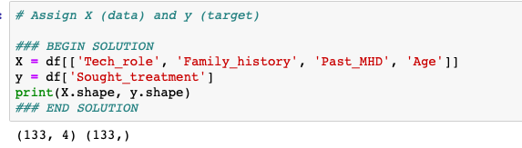
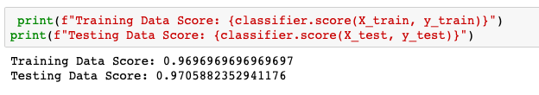
Based on certain factors can ml predict if this person will seek treatment?
Logistics Regression
- Discrete output or category

Slide 17
Based on certain factors can ml predict if this person will seek treatment?
Logistics Regression
- Discrete output or category

Slide 18
Thank You!

