Slide 1
Must Read
Code structure
http://www.chromium.org/developers/how-tos/getting-around-the-chrome-source-code

Slide 2
Process Module
Process-per-site-instance
Process-per-site(--process-per-site)
Process-per-tab(--process-per-tab)
Single process(--single-process)
Notes:
http://www.chromium.org/developers/design-documents/process-models

Slide 3
Process-per-site-instance
A site instance is a collection of connected pages from the same site.
User navigates to one from the other (e.g., by opening a link in a new tab)
The pages share a script connection (e.g., if one page opened the other in a new window using Javascript)

Slide 4
Process-per-site-instance
Strengths
Isolates content from different sites. This provides a meaningful form of fate sharing for web content, where pages are isolated from failures caused by other web sites.
Isolates independent tabs showing the same site. Visiting the same site independently in different tabs will create different processes. This will prevent contention and failures in one instance from affecting other instances.
Weaknesses
More memory overhead. While this increases stability and may add opportunities for parallelism, it also consumes more process, thus increases memory overhead.
May require proxying for some JavaScript calls. A small set of JavaScript interactions are permitted between pages from different origins, such as accessing certain properties of the window object. A complete implementation should proxy such interactions between renderer processes.

Slide 5
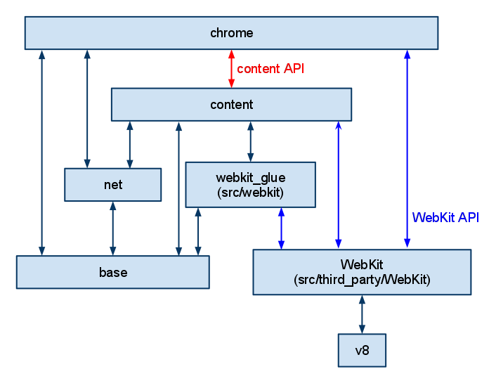
Architectural Diagram
A module that is lower can't include code from a higher module directly, but talks to it using embedder APIs.
Notes:
https://sites.google.com/a/chromium.org/dev/developers/how-tos/getting-around-the-chrome-source-code
https://sites.google.com/a/chromium.org/dev/developers/content-module

Slide 6
Content Module
Located in src\content
Core code needed to render a page using a multi-process sandboxed browser
Includes all the web platform features (i.e. HTML5) and GPU acceleration
Does NOT include Chrome features(i.e. extensions/autofill/spelling, etc)
Notes:
https://sites.google.com/a/chromium.org/dev/developers/how-tos/getting-around-the-chrome-source-code
https://sites.google.com/a/chromium.org/dev/developers/content-module

Slide 7
Content API
The Content API is how code in content can indirectly call Chrome.
  Where possible, Chrome features try to hook in by filtering IPCs and listening to events per How to Add New Features (without bloating RenderView/RenderViewHost/TabContents).
  When there isn't enough context (i.e. callback from WebKit) or when the callback is a one-off, we have a ContentClient interface that the embedder (Chrome) implements.
ContentClient is available in all processes. Some processes also have their own callback API as well, i.e. ContentBrowserClient/ContentRendererClient/ContentPluginClient.
Task: http://code.google.com/p/chromium/issues/detail?id=98716
Notes:
Content API task: http://code.google.com/p/chromium/issues/detail?id=98716
https://sites.google.com/a/chromium.org/dev/developers/how-tos/getting-around-the-chrome-source-code
https://sites.google.com/a/chromium.org/dev/developers/content-module
https://sites.google.com/a/chromium.org/dev/developers/content-module/content-api

Slide 8
Chrome
'Chrome' refers to the frame of an application - the toolbars, titlebars and buttons that surround your primary content.
Google Chrome strove to eliminate as much of this as possible
  it leads to a simpler, cleaner design
  web applications should not appear to be constrained within the bulky cruft of a browser, they should feel like first-class applications on your desktop.
Notes:
http://blog.chromium.org/2008/10/content-not-chrome.html

Slide 9
User Experiences
http://dev.chromium.org/user-experience
Notes:
http://dev.chromium.org/user-experience

Slide 10
Chromium
How webpage displayed

Slide 11
Keyword
WebKit
WebKit port
WebKit glue
IPC
WebContents
TabContentsWrapper
Render Process
RenderView
RenderWidget
RenderThread
Browser Process
RenderViewHost
RenderWidgetHost
RenderProcessHost

Slide 12
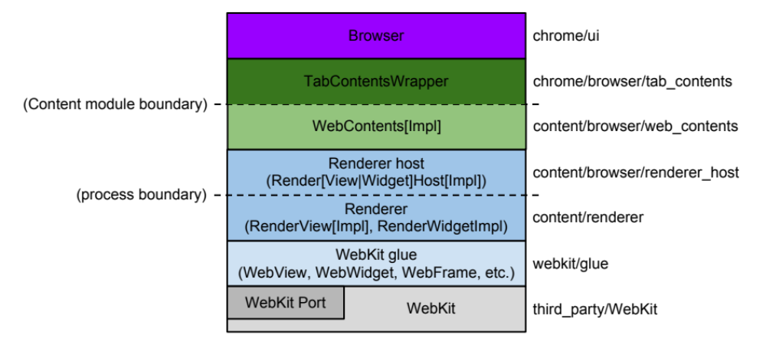
Application Layers
WebKit Port: Integrates with platform-dependent system services(resource loading/graphics)
Glue: Converts WebKit types to Chromium types.
Renderer/Render host: Proxies notifications/commands across process.
WebContents: A reusable component, easily embeddable to render HTML into a view.
TabContentWrapper: Contains a single WebContents, and is the connection point for all the additions ("TabHelpers") that Chrome wants to keep in 1:1 relation with the WebContents.
Browser: Represents the browser window, contains multiple TabContentsWrappers.
Notes:
The original Google Doc for this illustration is http://goo.gl/MsEJX which is open for editing by any @chromium.org
WebKit: Rendering engine shared between Safari, Chromium, and all other WebKit-based browsers. The Port is a part of WebKit that integrates with platform dependent system services such as resource loading and graphics.
Glue: Converts WebKit types to Chromium types. This is our "WebKit embedding layer." It is the basis of two browsers, Chromium, and test_shell (which allows us to test WebKit).
Renderer / Render host: This is Chromium's "multi-process embedding layer." It proxies notifications and commands across the process boundary.
WebContents: A reusable component that is the main class of the Content module. It's easily embeddable to allow multiprocess rendering of HTML into a view. See the content module pages for more information.
TabContentWrapper: Contains a single WebContents, and is the connection point for all the additions ("TabHelpers") that Chrome wants to keep in 1:1 relation with the WebContents.
Browser: Represents the browser window, it contains multiple TabContentsWrappers.

Slide 13
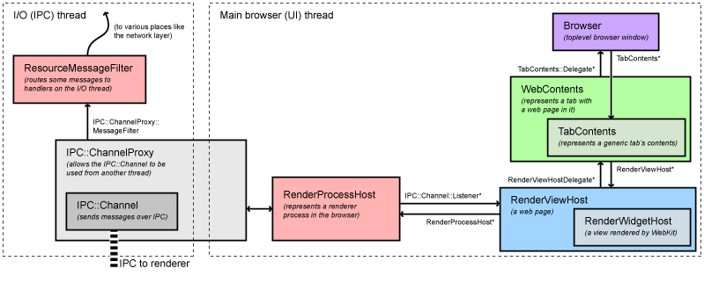
Browser
io thread
main thread (ui thread)
RenderProcessHost
Running in UI thread
Dispatching all view-specific messages to the appropriate RenderViewHost
RenderViewHost and RenderWidgetHost
Map to the RenderView and the RenderWidget in the renderer
WebContents
Top-level object in content module, represents the contents of a webpage
Notes:
http://www.chromium.org/developers/design-documents/displaying-a-web-page-in-chrome#TOC-The-browser-process
- Low-level browser process objects
All IPC communication with the render processes is done on the I/O thread of the browser. This thread also handles all network communication which keeps it from interfering with the user interface.
When a RenderProcessHost is initialized on the main thread (where the user interface runs), it creates the new renderer process and a ChannelProxy IPC object with a named pipe to the renderer. This object runs on the I/O thread of the browser, listening to the named pipe to the renderer, and automatically forwards all messages back to the RenderProcessHost on the UI thread. A ResourceMessageFilter will be installed in this channel which will filter out certain messages that can be handled directly on the I/O thread such as network requests. This filtering happens in ResourceMessageFilter::OnMessageReceived.
The RenderProcessHost on the UI thread is responsible for dispatching all view-specific messages to the appropriate RenderViewHost (it handles a limited number of non-view-specific messages itself). This dispatching happens in RenderProcessHost::OnMessageReceived.
- High-level browser process objects
View-specific messages come into RenderViewHost::OnMessageReceived. Most of the messages are handled here, and the rest get forwarded to the RenderWidgetHost base class. These two objects map to the RenderView and the RenderWidget in the renderer (see "The Render Process" above for what these mean). Each platform has a view class (RenderWidgetHostView[Aura|Gtk|Mac|Win]) to implement integration into the native view system.
Above the RenderView/Widget is the WebContents object, and most of the messages actually end up as function calls on that object. A WebContents represents the contents of a webpage. It is the top-level object in the content module, and has the responsibility of displaying a web page in a rectangular view. See the content module pages for more information.
The WebContents object is contained in a TabContentsWrapper. That is in chrome/ and is responsible for a tab.

Slide 14
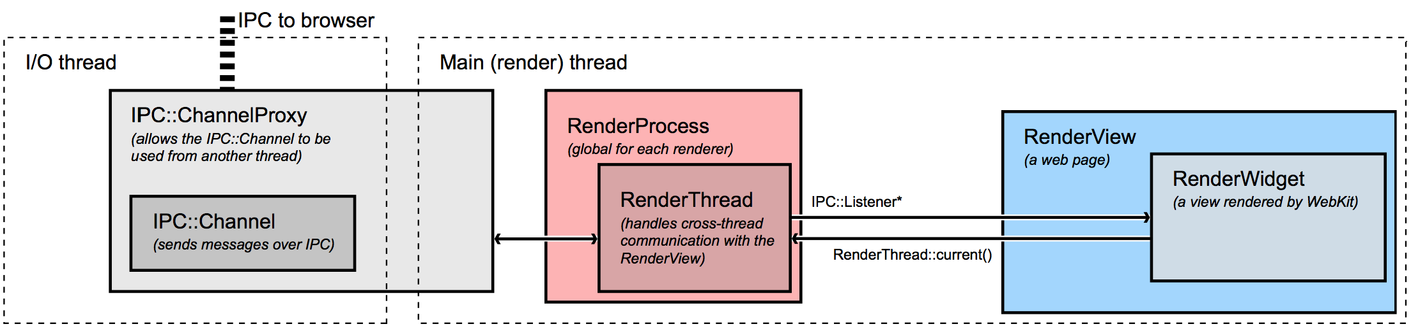
Render
main thread
render thread
RenderWidget
A Window on the screen that receives input events
Maps to WebCore::Widget, implementing WebWidgetDelegate(glue interface)
Renderview (/content/renderer/render_view_impl.cc)
Inherited from RenderWidget, represents the web page
Handles navigational commands
Render thread post messages to main thread
Main thread dispatches the message to the browser process
Notes:
http://www.chromium.org/developers/design-documents/displaying-a-web-page-in-chrome#TOC-The-browser-process#TOC-The-render-process
Chromium's render process embeds our WebKit port using the glue interface. It does not contain very much code: its job is primarily to be the renderer side of the IPC channel to the browser..
The most important class in the renderer is the RenderView, located in /content/renderer/render_view_impl.cc. This object represents a web page. It handles all navigation-related commands to and from the browser process. It derives from RenderWidget which provides painting and input event handling. The RenderView communicates with the browser process via the global (per render process) RenderProcess object.
- RenderWidget and RenderView
RenderWidget maps to one WebCore::Widget object by implementing the abstract interface in the glue layer called WebWidgetDelegate.. This is basically a Window on the screen that receives input events and that we paint into. A RenderView inherits from RenderWidget and is the contents of a tab or popup Window. It handles navigational commands in addition to the painting and input events of the widget. There is only one case where a RenderWidget exists without a RenderView, and that's for select boxes on the web page. These are the boxes with the down arrows that pop up a list of options. The select boxes must be rendered using a native window so that they can appear above everything else, and pop out of the frame if necessary. These windows need to paint and receive input, but there isn't a separate "web page" (RenderView) for them.
- Threads in the renderer
Each renderer has two threads (see the multi-process architecture page for a diagram, or threading in Chromium for how to program with them). The render thread is where the main objects such as the RenderView and all WebKit code run. When it communicates to the browser, messages are first sent to the main thread, which in turn dispatches the message to the browser process. Among other things, this allows us to send messages synchronously from the renderer to the browser. This happens for a small set of operations where a result from the browser is required to continue. An example is getting the cookies for a page when requested by JavaScript. The renderer thread will block, and the main thread will queue all messages that are received until the correct response is found. Any messages received in the meantime are subsequently posted to the renderer thread for normal processing.

Slide 15
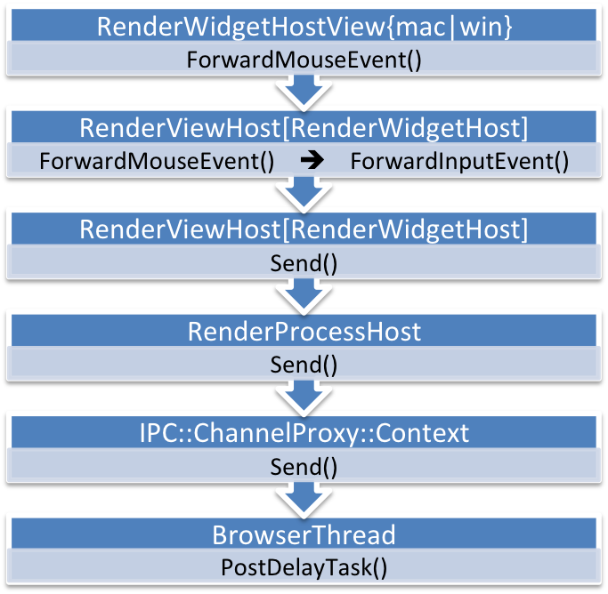
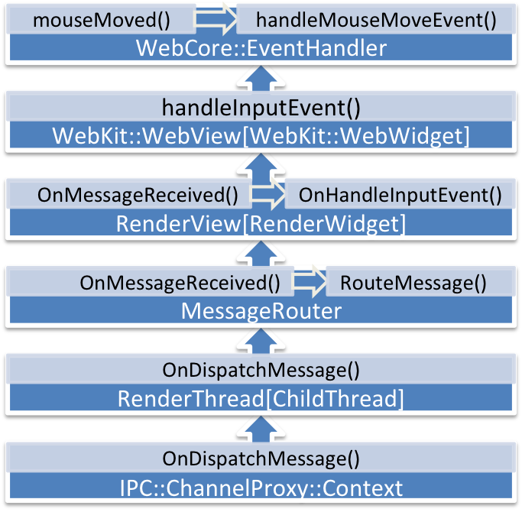
MouseMove
Browser Process
Render Process
Notes:
CallStack of Render Process
#0 IPC::SyncChannel::Send (this=0x79220cc0, message=0x79675ed0) at ../../ipc/ipc_sync_channel.cc:430
#1 ChildThread::Send (this=0x79220e64, msg=0x79675ed0) at ../../content/common/child_thread.cc:169
#2 RenderThreadImpl::Send (this=0x79220e60, msg=0x79675ed0) at ../../content/renderer/render_thread_impl.cc:451
#3 RenderWidget::Send (this=0x7b27b800, message=0x79675ed0) at ../../content/renderer/render_widget.cc:276
#4 RenderViewImpl::Send (this=0x7b27b800, message=0x79675ed0) at ../../content/renderer/render_view_impl.cc:4245
#5 RenderWidget::didChangeCursor (this=0x7b27b800, cursor_info=@0xbffb91b0) at ../../content/renderer/render_widget.cc:1255
#6 virtual thunk to RenderWidget::didChangeCursor(WebKit::WebCursorInfo const&) () at ../../content/renderer/render_widget.cc:1257
#7 WebKit::ChromeClientImpl::setCursor (this=0x7b27e64c, cursor=@0xbffb91b0) at ../../third_party/WebKit/Source/WebKit/chromium/src/ChromeClientImpl.cpp:833
#8 WebKit::ChromeClientImpl::setCursor (this=0x7b27e64c, cursor=@0xbffb92dc) at ../../third_party/WebKit/Source/WebKit/chromium/src/ChromeClientImpl.cpp:822
#9 WebCore::Chrome::setCursor (this=0x7962fe60, cursor=@0xbffb92dc) at ../../third_party/WebKit/Source/WebCore/page/Chrome.cpp:474
#10 WebCore::Widget::setCursor (this=0x7ba46800, cursor=@0xbffb92dc) at ../../third_party/WebKit/Source/WebCore/platform/chromium/WidgetChromium.cpp:62
#11 WebCore::EventHandler::handleMouseMoveEvent (this=0x7b27a214, mouseEvent=@0xbffb94f8, hoveredNode=0xbffb9438, onlyUpdateScrollbars=false) at ../../third_party/WebKit/Source/WebCore/page/EventHandler.cpp:1818
#12 WebCore::EventHandler::mouseMoved (this=0x7b27a214, event=@0xbffb94f8) at ../../third_party/WebKit/Source/WebCore/page/EventHandler.cpp:1699
#13 WebKit::PageWidgetEventHandler::handleMouseMove (this=0x7b27e62c, mainFrame=@0x7b279c00, event=@0x7c810988) at ../../third_party/WebKit/Source/WebKit/chromium/src/PageWidgetDelegate.cpp:197
#14 WebKit::PageWidgetDelegate::handleInputEvent (page=0x7b27e800, handler=@0x7b27e62c, event=@0x7c810988) at ../../third_party/WebKit/Source/WebKit/chromium/src/PageWidgetDelegate.cpp:118
#15 WebKit::WebViewImpl::handleInputEvent (this=0x7b27e600, inputEvent=@0x7c810988) at ../../third_party/WebKit/Source/WebKit/chromium/src/WebViewImpl.cpp:1937
#16 RenderWidget::OnHandleInputEvent (this=0x7b27b800, message=@0x7c810938) at ../../content/renderer/render_widget.cc:573
#17 IPC::Message::Dispatch<RenderWidget, RenderWidget> (msg=0x7c810938, obj=0x7b27b800, sender=0x7b27b800, func={ptr = 107828000, ptr = 0}) at ipc_message.h:170
#18 RenderWidget::OnMessageReceived (this=0x7b27b800, message=@0x7c810938) at ../../content/renderer/render_widget.cc:243
#19 RenderViewImpl::OnMessageReceived (this=0x7b27b800, message=@0x7c810938) at ../../content/renderer/render_view_impl.cc:1063
#20 MessageRouter::RouteMessage (this=0x79220e78, msg=@0x7c810938) at ../../content/common/message_router.cc:47
#21 MessageRouter::OnMessageReceived (this=0x79220e78, msg=@0x7c810938) at ../../content/common/message_router.cc:39
#22 ChildThread::OnMessageReceived (this=0x79220e64, msg=@0x7c810938) at ../../content/common/child_thread.cc:275
#23 IPC::ChannelProxy::Context::OnDispatchMessage (this=0x79220d00, message=@0x7c810938) at ../../ipc/ipc_channel_proxy.cc:261
#24 base::internal::RunnableAdapter<void (IPC::ChannelProxy::Context::*)(IPC::Message const&)>::Run (this=0xbffbaf90, object=0x79220d00, a1=@0x7c810938) at bind_internal.h:190
#25 base::internal::InvokeHelper<false, void, base::internal::RunnableAdapter<void (IPC::ChannelProxy::Context::*)(IPC::Message const&)>, void ()(IPC::ChannelProxy::Context* const&, IPC::Message const&)>::MakeItSo (runnable={method_ = {ptr = 48799680, ptr = 0}}, a1=@0x7c810934, a2=@0x7c810938) at bind_internal.h:898
#26 base::internal::Invoker<2, base::internal::BindState<base::internal::RunnableAdapter<void (IPC::ChannelProxy::Context::*)(IPC::Message const&)>, void ()(IPC::ChannelProxy::Context*, IPC::Message const&), void ()(IPC::ChannelProxy::Context*, IPC::Message)>, void ()(IPC::ChannelProxy::Context*, IPC::Message const&)>::Run (base=0x7c810920) at bind_internal.h:1256
#27 base::Callback<void ()()>::Run (this=0xbffbb244) at callback.h:389
#28 MessageLoop::RunTask (this=0xbffbcfb8, pending_task=@0xbffbb230) at ../../base/message_loop.cc:470
#29 MessageLoop::DeferOrRunPendingTask (this=0xbffbcfb8, pending_task=@0xbffbb230) at ../../base/message_loop.cc:482
#30 MessageLoop::DoWork (this=0xbffbcfb8) at ../../base/message_loop.cc:661
#31 base::MessagePumpCFRunLoopBase::RunWork (this=0x7ab12d50) at ../../base/message_pump_mac.mm:250
#32 base::MessagePumpCFRunLoopBase::RunWorkSource (info=0x7ab12d50) at ../../base/message_pump_mac.mm:228
#33 __CFRUNLOOP_IS_CALLING_OUT_TO_A_SOURCE0_PERFORM_FUNCTION__ ()
#34 __CFRunLoopDoSources0 ()
#35 __CFRunLoopRun ()
#36 CFRunLoopRunSpecific ()
#37 CFRunLoopRunInMode ()
#38 RunCurrentEventLoopInMode ()
#39 ReceiveNextEventCommon ()
#40 BlockUntilNextEventMatchingListInMode ()
#41 _DPSNextEvent ()
#42 -[NSApplication nextEventMatchingMask:untilDate:inMode:dequeue:] ()
#43 -[NSApplication run] ()
#44 base::MessagePumpNSApplication::DoRun (this=0x7ab12d50, delegate=0xbffbcfb8) at ../../base/message_pump_mac.mm:574
#45 base::MessagePumpCFRunLoopBase::Run (this=0x7ab12d50, delegate=0xbffbcfb8) at ../../base/message_pump_mac.mm:169
#46 MessageLoop::RunInternal (this=0xbffbcfb8) at ../../base/message_loop.cc:427
#47 MessageLoop::RunHandler (this=0xbffbcfb8) at ../../base/message_loop.cc:400
#48 base::RunLoop::Run (this=0xbffbcbe8) at ../../base/run_loop.cc:45
#49 MessageLoop::Run (this=0xbffbcfb8) at ../../base/message_loop.cc:307
#50 RendererMain (parameters=@0xbffbd2a8) at ../../content/renderer/renderer_main.cc:239
#51 content::RunNamedProcessTypeMain (process_type=@0xbffbd2c8, main_function_params=@0xbffbd2a8, delegate=0xbffbd4f8) at ../../content/app/content_main_runner.cc:441
#52 content::ContentMainRunnerImpl::Run (this=0x79419a30) at ../../content/app/content_main_runner.cc:734
#53 content::ContentMain (argc=6, argv=0xbffbd570, delegate=0xbffbd4f8) at ../../content/app/content_main.cc:35
#54 ChromeMain (argc=6, argv=0xbffbd570) at ../../chrome/app/chrome_main.cc:32
#55 main (argc=6, argv=0xbffbd570) at ../../chrome/app/chrome_exe_main_mac.cc:16

Slide 16
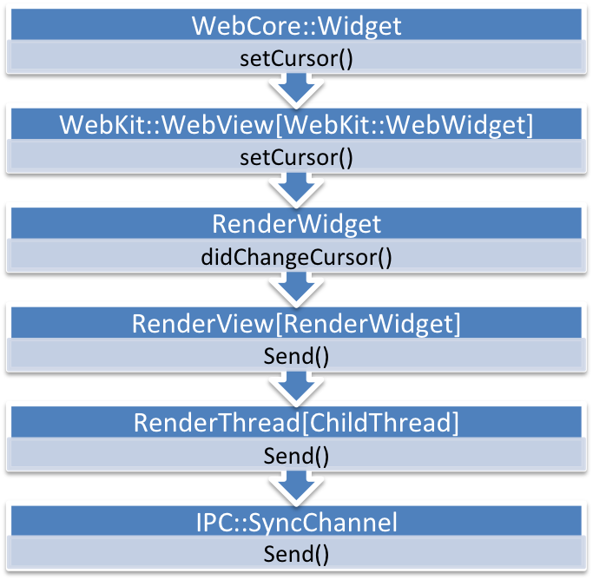
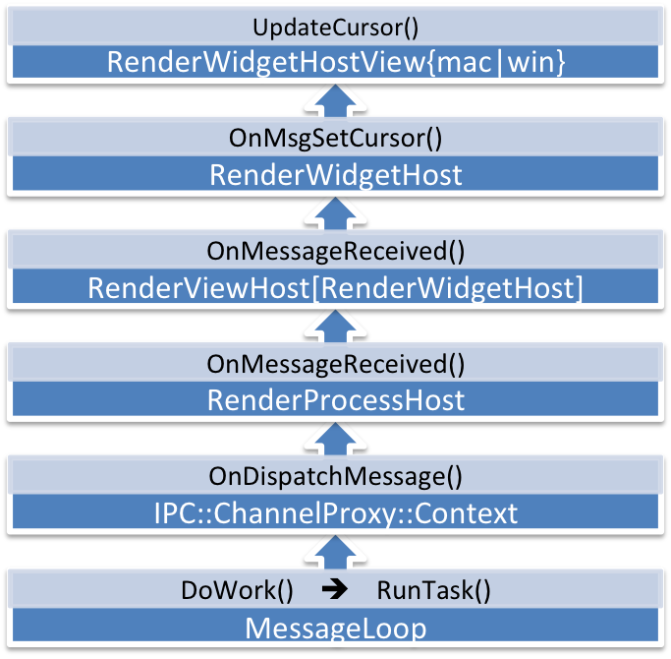
SetCursor
Render Process
Browser Process
Notes:
CallStack of Render Process
#0 IPC::SyncChannel::Send (this=0x79220cc0, message=0x79675ed0) at ../../ipc/ipc_sync_channel.cc:430
#1 ChildThread::Send (this=0x79220e64, msg=0x79675ed0) at ../../content/common/child_thread.cc:169
#2 RenderThreadImpl::Send (this=0x79220e60, msg=0x79675ed0) at ../../content/renderer/render_thread_impl.cc:451
#3 RenderWidget::Send (this=0x7b27b800, message=0x79675ed0) at ../../content/renderer/render_widget.cc:276
#4 RenderViewImpl::Send (this=0x7b27b800, message=0x79675ed0) at ../../content/renderer/render_view_impl.cc:4245
#5 RenderWidget::didChangeCursor (this=0x7b27b800, cursor_info=@0xbffb91b0) at ../../content/renderer/render_widget.cc:1255
#6 virtual thunk to RenderWidget::didChangeCursor(WebKit::WebCursorInfo const&) () at ../../content/renderer/render_widget.cc:1257
#7 WebKit::ChromeClientImpl::setCursor (this=0x7b27e64c, cursor=@0xbffb91b0) at ../../third_party/WebKit/Source/WebKit/chromium/src/ChromeClientImpl.cpp:833
#8 WebKit::ChromeClientImpl::setCursor (this=0x7b27e64c, cursor=@0xbffb92dc) at ../../third_party/WebKit/Source/WebKit/chromium/src/ChromeClientImpl.cpp:822
#9 WebCore::Chrome::setCursor (this=0x7962fe60, cursor=@0xbffb92dc) at ../../third_party/WebKit/Source/WebCore/page/Chrome.cpp:474
#10 WebCore::Widget::setCursor (this=0x7ba46800, cursor=@0xbffb92dc) at ../../third_party/WebKit/Source/WebCore/platform/chromium/WidgetChromium.cpp:62
#11 WebCore::EventHandler::handleMouseMoveEvent (this=0x7b27a214, mouseEvent=@0xbffb94f8, hoveredNode=0xbffb9438, onlyUpdateScrollbars=false) at ../../third_party/WebKit/Source/WebCore/page/EventHandler.cpp:1818
#12 WebCore::EventHandler::mouseMoved (this=0x7b27a214, event=@0xbffb94f8) at ../../third_party/WebKit/Source/WebCore/page/EventHandler.cpp:1699
#13 WebKit::PageWidgetEventHandler::handleMouseMove (this=0x7b27e62c, mainFrame=@0x7b279c00, event=@0x7c810988) at ../../third_party/WebKit/Source/WebKit/chromium/src/PageWidgetDelegate.cpp:197
#14 WebKit::PageWidgetDelegate::handleInputEvent (page=0x7b27e800, handler=@0x7b27e62c, event=@0x7c810988) at ../../third_party/WebKit/Source/WebKit/chromium/src/PageWidgetDelegate.cpp:118
#15 WebKit::WebViewImpl::handleInputEvent (this=0x7b27e600, inputEvent=@0x7c810988) at ../../third_party/WebKit/Source/WebKit/chromium/src/WebViewImpl.cpp:1937
#16 RenderWidget::OnHandleInputEvent (this=0x7b27b800, message=@0x7c810938) at ../../content/renderer/render_widget.cc:573
#17 IPC::Message::Dispatch<RenderWidget, RenderWidget> (msg=0x7c810938, obj=0x7b27b800, sender=0x7b27b800, func={ptr = 107828000, ptr = 0}) at ipc_message.h:170
#18 RenderWidget::OnMessageReceived (this=0x7b27b800, message=@0x7c810938) at ../../content/renderer/render_widget.cc:243
#19 RenderViewImpl::OnMessageReceived (this=0x7b27b800, message=@0x7c810938) at ../../content/renderer/render_view_impl.cc:1063
#20 MessageRouter::RouteMessage (this=0x79220e78, msg=@0x7c810938) at ../../content/common/message_router.cc:47
#21 MessageRouter::OnMessageReceived (this=0x79220e78, msg=@0x7c810938) at ../../content/common/message_router.cc:39
#22 ChildThread::OnMessageReceived (this=0x79220e64, msg=@0x7c810938) at ../../content/common/child_thread.cc:275
#23 IPC::ChannelProxy::Context::OnDispatchMessage (this=0x79220d00, message=@0x7c810938) at ../../ipc/ipc_channel_proxy.cc:261
#24 base::internal::RunnableAdapter<void (IPC::ChannelProxy::Context::*)(IPC::Message const&)>::Run (this=0xbffbaf90, object=0x79220d00, a1=@0x7c810938) at bind_internal.h:190
#25 base::internal::InvokeHelper<false, void, base::internal::RunnableAdapter<void (IPC::ChannelProxy::Context::*)(IPC::Message const&)>, void ()(IPC::ChannelProxy::Context* const&, IPC::Message const&)>::MakeItSo (runnable={method_ = {ptr = 48799680, ptr = 0}}, a1=@0x7c810934, a2=@0x7c810938) at bind_internal.h:898
#26 base::internal::Invoker<2, base::internal::BindState<base::internal::RunnableAdapter<void (IPC::ChannelProxy::Context::*)(IPC::Message const&)>, void ()(IPC::ChannelProxy::Context*, IPC::Message const&), void ()(IPC::ChannelProxy::Context*, IPC::Message)>, void ()(IPC::ChannelProxy::Context*, IPC::Message const&)>::Run (base=0x7c810920) at bind_internal.h:1256
#27 base::Callback<void ()()>::Run (this=0xbffbb244) at callback.h:389
#28 MessageLoop::RunTask (this=0xbffbcfb8, pending_task=@0xbffbb230) at ../../base/message_loop.cc:470
#29 MessageLoop::DeferOrRunPendingTask (this=0xbffbcfb8, pending_task=@0xbffbb230) at ../../base/message_loop.cc:482
#30 MessageLoop::DoWork (this=0xbffbcfb8) at ../../base/message_loop.cc:661
#31 base::MessagePumpCFRunLoopBase::RunWork (this=0x7ab12d50) at ../../base/message_pump_mac.mm:250
#32 base::MessagePumpCFRunLoopBase::RunWorkSource (info=0x7ab12d50) at ../../base/message_pump_mac.mm:228
#33 __CFRUNLOOP_IS_CALLING_OUT_TO_A_SOURCE0_PERFORM_FUNCTION__ ()
#34 __CFRunLoopDoSources0 ()
#35 __CFRunLoopRun ()
#36 CFRunLoopRunSpecific ()
#37 CFRunLoopRunInMode ()
#38 RunCurrentEventLoopInMode ()
#39 ReceiveNextEventCommon ()
#40 BlockUntilNextEventMatchingListInMode ()
#41 _DPSNextEvent ()
#42 -[NSApplication nextEventMatchingMask:untilDate:inMode:dequeue:] ()
#43 -[NSApplication run] ()
#44 base::MessagePumpNSApplication::DoRun (this=0x7ab12d50, delegate=0xbffbcfb8) at ../../base/message_pump_mac.mm:574
#45 base::MessagePumpCFRunLoopBase::Run (this=0x7ab12d50, delegate=0xbffbcfb8) at ../../base/message_pump_mac.mm:169
#46 MessageLoop::RunInternal (this=0xbffbcfb8) at ../../base/message_loop.cc:427
#47 MessageLoop::RunHandler (this=0xbffbcfb8) at ../../base/message_loop.cc:400
#48 base::RunLoop::Run (this=0xbffbcbe8) at ../../base/run_loop.cc:45
#49 MessageLoop::Run (this=0xbffbcfb8) at ../../base/message_loop.cc:307
#50 RendererMain (parameters=@0xbffbd2a8) at ../../content/renderer/renderer_main.cc:239
#51 content::RunNamedProcessTypeMain (process_type=@0xbffbd2c8, main_function_params=@0xbffbd2a8, delegate=0xbffbd4f8) at ../../content/app/content_main_runner.cc:441
#52 content::ContentMainRunnerImpl::Run (this=0x79419a30) at ../../content/app/content_main_runner.cc:734
#53 content::ContentMain (argc=6, argv=0xbffbd570, delegate=0xbffbd4f8) at ../../content/app/content_main.cc:35
#54 ChromeMain (argc=6, argv=0xbffbd570) at ../../chrome/app/chrome_main.cc:32
#55 main (argc=6, argv=0xbffbd570) at ../../chrome/app/chrome_exe_main_mac.cc:16

Slide 17

Message
RenderWidgetHostView
(Event Listener)
RenderViewHost
ForwardXXXEvent
RenderWidgetHost
ForwardXXXEvent
RenderProcessHost
RenderView
Send
OnMessageReceived
IPC::ChannelProxy
RenderWidget
Send
OnMessageReceived
RenderThread
OnMessageReceived

