Slide 1
Configuration
Martez Killens
Platform Architect
October 1, 2018

Slide 2
What is configuration?
Anything that varies between deployments
  Database, backing services, external services, etc
    Code (Drivers, Data Access, etc) that communicates with the database should stay the same.
    Connection Strings, User Name and Passwords

Slide 3
How Should Configuration Be Stored?
In Code
  Redeploy code for a configuration change
  Sensitive data checked into source control
Configuration Files
  Often language or framework specific
  Sensitive data checked into source control
Environment Variables
  Every OS has a concept of Environment variables
  Typically language agnostic
  Don’t have to worry about them getting checked into source control

Slide 4
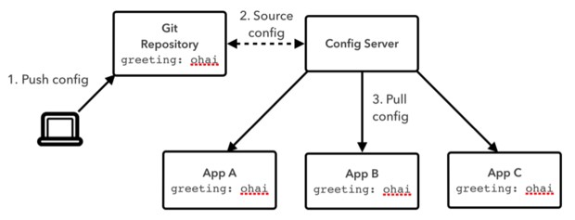
Spring Cloud Config Server
Enables centralizing application configurations
Supports different back end storage options
  Git repositories
  File System
  Hashicorp Vault
  Composite
Configuration file format support
  Java properties (.properties)
  YAML (.yml)
Exposes configurations via REST based API, http://localhost:8080/
  Data returned in JSON
Client pulls configuration providing
  {AppName}
  {Profile} – one or more
  {Label} – zero or more, meaning varies by back end
Cloud Foundry version of Config server installed with Spring Cloud Services (SCS)
  Version is protected by OAuth 2.0 tokens
  Uses TLS/SSL connections
108

Slide 5
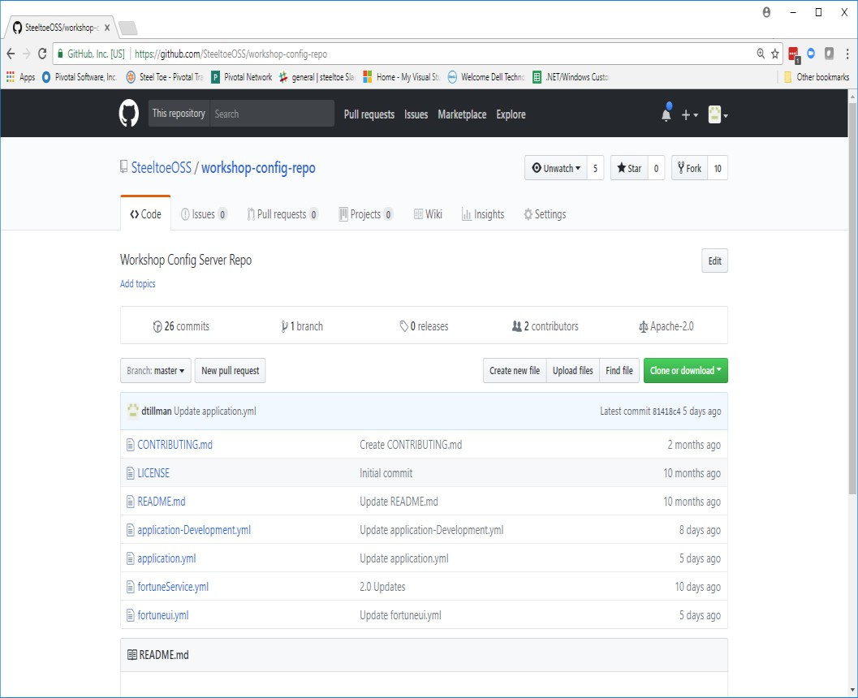
Spring Cloud Config Server – Git Backend
Client request parameter mappings
  {AppName} -> file name pattern in Git repo
  {Profile} -> file name pattern in Git repo
  {Label} -> Git branch, tag, commit-id, defaults to ‘master’
Selects configuration files from Git repo with patterns
  /application.{suffix}
  /{AppName}.{suffix}
  /application-{Profile}.{suffix}
  /{AppName}-{Profile}.{suffix}
Selected files returned in a list with precedence
  Above shows list order - least to highest precedence
  Values in higher precedence files override lower
Example Config Server requests
  e.g. `curl localhost:8888/{AppName}/{Profile}`
  e.g. `curl localhost:8888/{AppName}/{Profile1},{Profile2}`
  e.g. `curl localhost:8888/{AppName}/{Profile}/{Label}`

Slide 6
Steeltoe Configuration Overview
Simplifies integration of additional sources of application configuration data into .NET applications
  Built on .NET Configuration and Options services
Several Configuration Providers
  Cloud Foundry
  Spring Cloud / Spring Cloud Services Config Server Client
Application type support
  ASP.NET - MVC, WebForm, WebAPI, WCF
  ASP.NET Core (.NET Framework and .NET Core)
  Console apps (.NET Framework and .NET Core)

