Slide 1
Agenda
Ben Bertka
Brent Shepard
Martez Killens

Slide 2
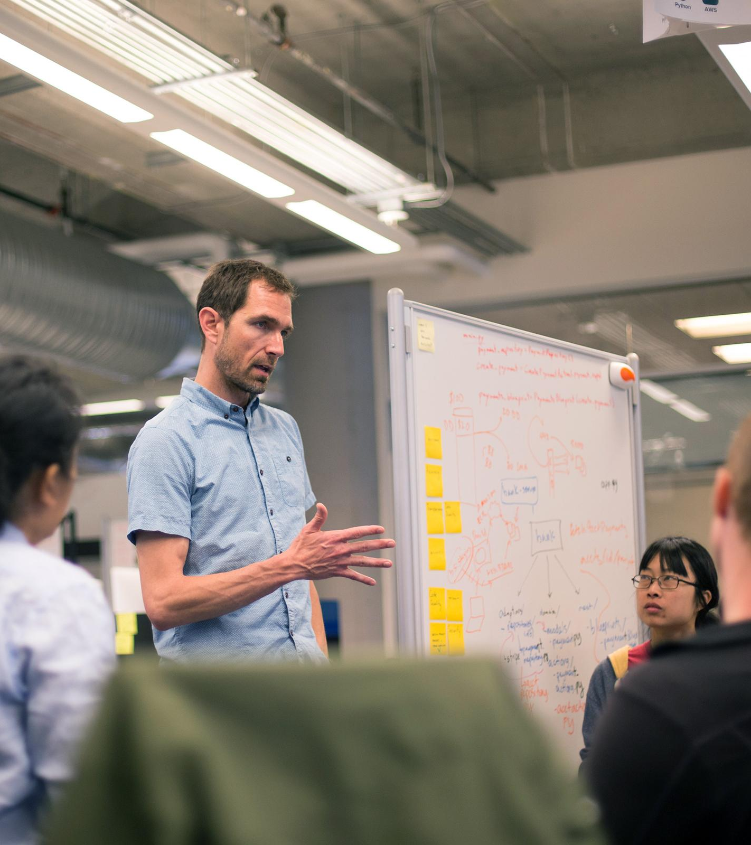
Agenda
8:30: Intro's, agenda review
9.00 - 10:00: PCF 101 Overview
10.00 - 11:00: Hands on - pushing a .NET app to PCF
11:00 - 12:00: Getting Micron .NET Apps on PCF
12.30 Working Lunch discussions - Containers and Container Orchestration in PCF
2:00 - 4:00 The Operator Experience

