Slide 1
The Future of Pivotal Cloud Foundry
Istio – Service Mesh

Slide 2
Service Mesh
Overview – Follow the Value Line

Slide 3
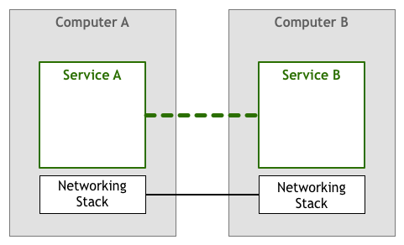
The Early Days of Networking
Start with expensive machines with few connections
Shift to less expensive computers with more connections and data
Questions Arise
How will computers find one another?
How do you handle multiple simultaneous connections
How do machines talk when not directly connected
How to encrypt traffic

Slide 4
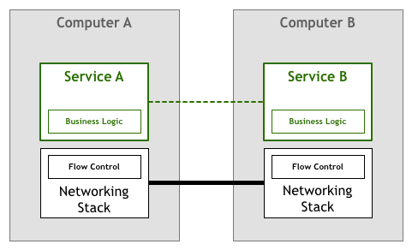
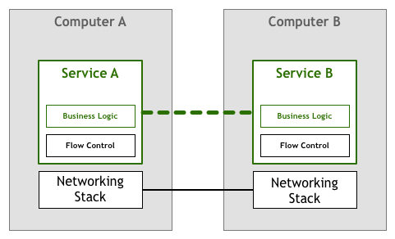
Control Flow
Prevents one service from overwhelming a downstream service
Computer A has no idea what B is doing or if it’s capable of processing messages
Computer B could be slow
Computer B could be doing something in parallel
Standards Like TCP/IP eventually came around to control this but prior to their implementation this sat next to your application code!

Slide 5

Networking Stack is Highly Successful
Networking Stack becomes standardized
No need to implement complex networking logic within your application for most cases
Computer become even cheaper
Even more distributed systems are created
We have seen moves to Service Oriented Architectures

Slide 6
We Are Doing More with Distributed Systems
Rapid provisioning of compute resources
Rapid deployment
Easy to provision storage
Easy access to the edge
Fallacies of Distributed Computing remain true
The network is reliable
Latency is zero
Bandwidth is infinite
The network is secure
Topology doesn’t change
There is one administrator
Transport cost is zero
The network is homogeneous

Slide 7
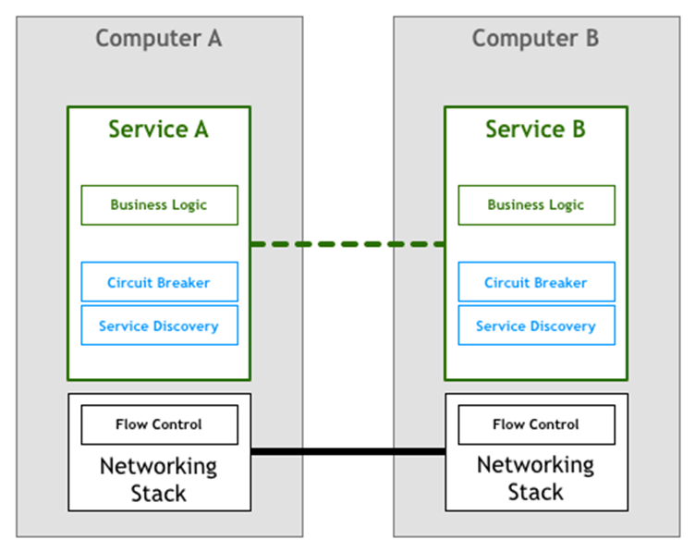
A Familiar Position
Custom application code to create common patterns
Libraries emerge to avoid reimplementation in each service
Issues arise
Effort to incorporate libraries into your code base
Libraries target specific languages
Library must still be maintained across service instances

Slide 8
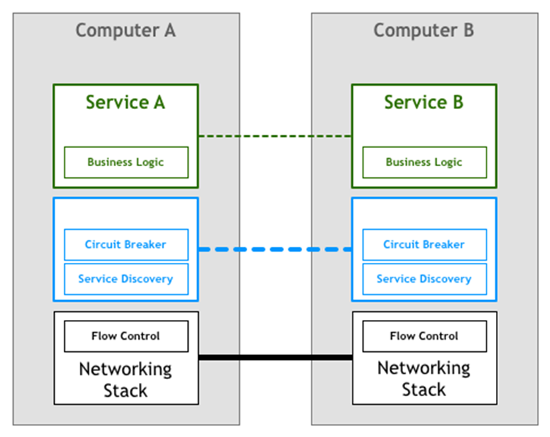
What if…?
Not feasible to change the network stack

Slide 9
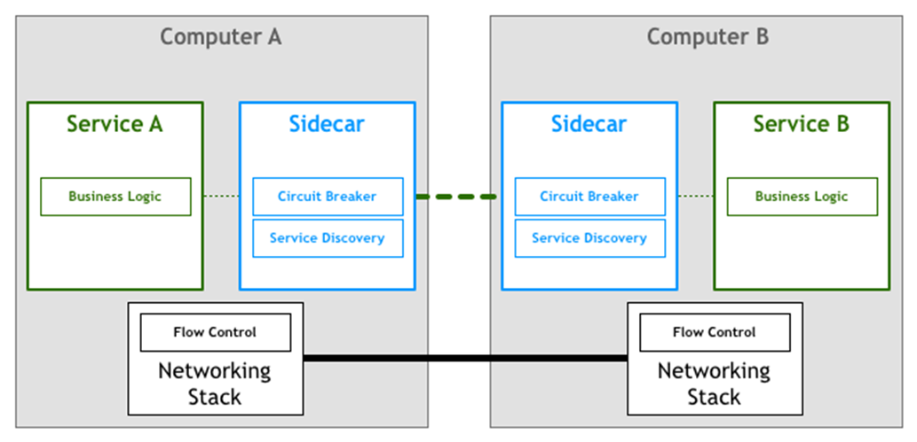
Sidecar Proxies
Runs side by side with your application and provides extra features
Instead of connecting to the service directly all traffic goes through the proxy that transparently add features.

Slide 10
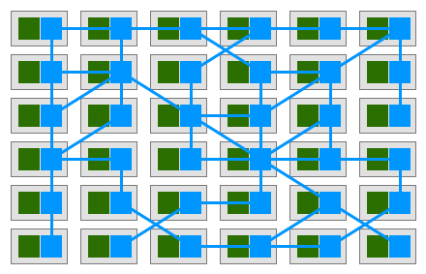
Coming into focus
Each service has a companion proxy
The focus shifts from isolated components to an interconnection of proxies forming a mesh network.

Slide 11
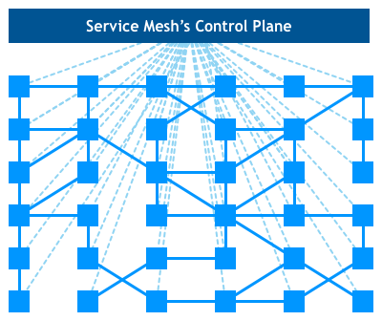
Bringing it all together
A service mesh is a dedicated infrastructure layer for handling service-to-service communication. It’s responsible for the reliable delivery of requests through the complex topology of services that comprise a modern, cloud native application. In practice, the service mesh is typically implemented as an array of lightweight network proxies that are deployed alongside application code, without the application needing to be aware.
-William Morgan
CEO Buoyant

Slide 12
Service Mesh
From a code perspective, now all your apps need to do is make a simple remote procedure call. The logic required to make those calls robust happens further down the stack
No custom code for microservices architecture
Access control in the control plane
Metrics collection in the control plane
Simplified Security – Certificates managed at control plane and proxy and not your application
Load Balancing

Slide 13
Istio
Open Source Service Mesh
Pivotal is a major contributor
To see the roadmap and how Pivotal is Implementing Istio into Cloud Foundry:
https://content.pivotal.io/blog/happy-birthday-istio-a-closer-look-at-how-pivotal-is-embedding-the-service-mesh-to-cloud-foundry-kubernetes-and-knative

