Slide 1
Service Discovery
Martez Killens
Platform Architect
August 8, 2017

Slide 2
Background
On-Demand Infrastructure
Containers
VMs
Ephemeral Infrastructure
Short lived
Cloud Infrastructure
Servers, Instances go down
Scalability
Meet short term demand
Scale out vs up

Slide 3
Distributed Service
Challenge
Trying to hand configure each client or use some form of convention can be very difficult to do and can be very brittle.
How have we discovered services in the past?
Service Locators
Dependency Injection
Service Registries

Slide 4
Service Discovery
Server Side Service Discovery
Client request through load balancer
Load balancer queries service registry
Service registry abstracted away from clients
Failure in service registry brings down entire system.
Client Side Service Discovery
Client responsible for determining service location and load balancing
Registry is typically replicated in each client.
No single point of failure
Service registry coupled to (logic in each) client

Slide 5
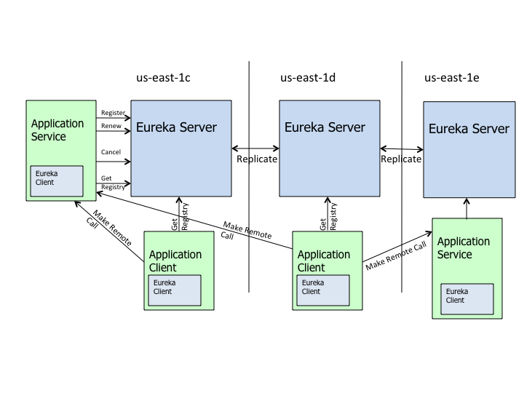

Slide 6
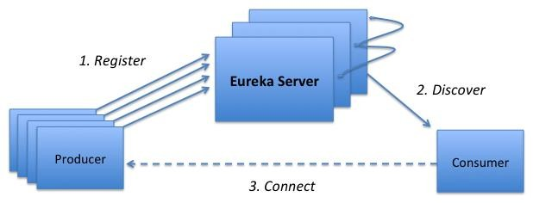
Spring Cloud Eureka Server
Server for registering and discovering services
Exposes a REST based API http://localhost:8761/eureka
Applications register addresses by name with Eureka Server
Heartbeats renew leases (30 seconds)
Three strikes, you’re out (90 seconds)
Registrations optionally replicated to peers
Eureka Client pulls entire service registry
Cached, used to lookup services by name
Resilience
Multiple Eureka Servers
Clients cache copy of registry
Cloud Foundry version of Eureka server installed with Spring Cloud Services (SCS)
Version is protected by OAuth 2.0 tokens
Uses TLS/SSL connections

Slide 7
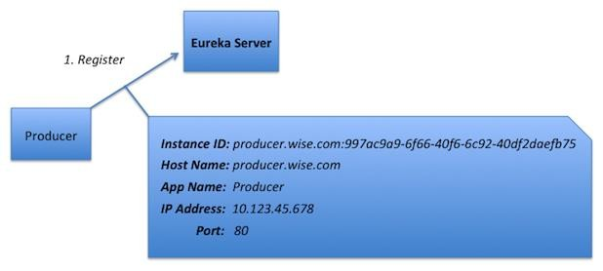
Spring Cloud Eureka Server – Service Registration
Application instances register with Eureka Server providing
Application Name
Host Name
Port
Instance ID
IP Address
Other metadata
Default is to register by Host Name
Optionally register by IP Address

Slide 8
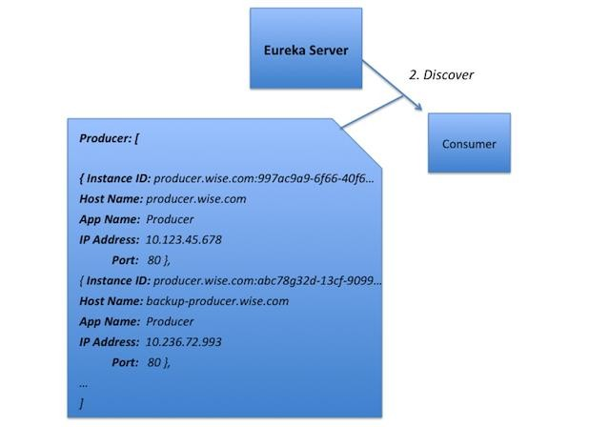
Spring Cloud Eureka Server – Service Discovery
Application instances periodically fetch the registry
Default every 30 second
Cached locally
Deltas retrieved after full fetch
Application uses cache to lookup
instances of other applications
Client load balancing possible

Slide 9
Steeltoe Discovery Overview
Provides configurable generalized interface for Service Registry interaction
Steeltoe.Common.Discovery.IDiscoveryClient
Single provider
Eureka – client for Netflix / Spring Cloud Services Eureka Server
Application type support
ASP.NET - MVC, WebForm, WebAPI, WCF
ASP.NET Core (.NET Framework and .NET Core)
Console apps (.NET Framework and .NET Core)

Slide 10
Eureka Server Client – Add NuGet References
Spring Cloud Eureka Server
Console, ASP.NET 4 - Steeltoe.Discovery.Eureka.Client
ASP.NET Core - Steeltoe.Discovery.ClientCore
ASP.NET 4 Autofac -Steeltoe.Discovery.ClientAutofac
Namespace- #using Steeltoe.Discovery.Client;
Spring Cloud & Spring Cloud Services Eureka Server
Console, ASP.NET 4 - Pivotal.Discovery.Eureka.Client
ASP.NET Core - Pivotal.Discovery.ClientCore
ASP.NET 4 Autofac - Pivotal.Discovery.ClientAutofac
Namespace- #using Pivotal.Discovery.Client

