Slide 1
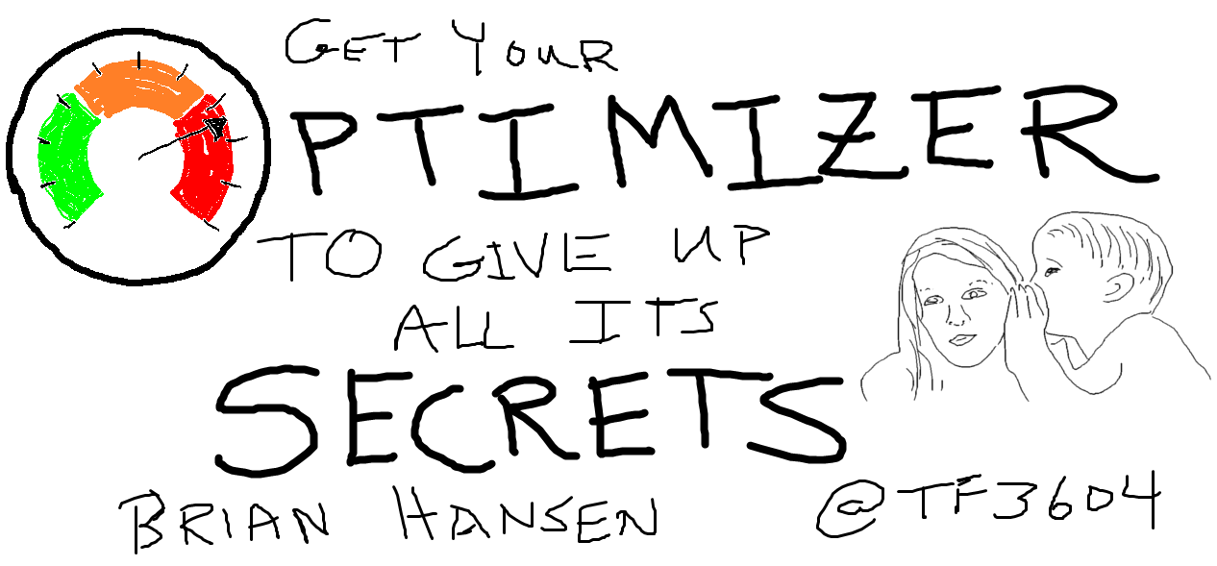
Oklahoma City, OK – August 27, 2016
Notes:
This is a session about optimizer internals. The optimizer is already pretty much a black box, but there is a lot of unofficial information about how it works. I intend to dig in even deeper and examine some mostly undocumented commands, DMVs and structures. If this isn’t your cup of tea, I won’t be offended if you decide to find a different session. This is also mostly a theoretical session. It is intended to help you write better queries, but we aren’t going actually discuss how to do that.

Slide 2
Get Your Optimizer to Give up All Its Secrets
Brian Hansen
Oklahoma City, OK – August 27, 2016
Notes:
This is a session about optimizer internals. The optimizer is already pretty much a black box, but there is a lot of unofficial information about how it works. I intend to dig in even deeper and examine some mostly undocumented commands, DMVs and structures. If this isn’t your cup of tea, I won’t be offended if you decide to find a different session. This is also mostly a theoretical session. It is intended to help you write better queries, but we aren’t going actually discuss how to do that.

Slide 3



Brian Hansen
15+ Years working with SQL Server
Development work since 7.0
Administration going back to 6.5
Fascinated with SQL internals
brian@tf3604.com
@tf3604.com
children.org
www.tf3604.com/optimizer

Slide 4
About This Session
What this session is not
An end-to-end optimizer session
A performance tuning session
Goals of this session
Additional understanding of SQL Server internals
Provide an additional skill for performance tuning

Slide 5
Agenda
Background:
Logical processing order
Physical processing considerations
Executing a query: parse, bind, transform, optimize, execute
Heuristics, transformation rules, parse trees, memos
Limitations & DMVs
Notes:
My goal is to spend about the first 40-45% of this session discussing some of the background material related the SQL Optimizer, and then to spend the balance of our time looking at some of the undocumented internals of optimization.

Slide 6
A Word of Warning
Virtually everything we are discussing is undocumented.
Also, a lot of this stuff is undocumented.
Oh, and there are undocumented commands, trace flags, and so forth, in this presentation.
Be careful out there.
Notes:
Yeah, it’s undocumented. It’s unsupported. Just don’t run this stuff on a system you can’t lose, and you should be fine.

Slide 7
Poll (1 of 4)
What is logical processing order?
I understand what it is and could give a general explanation to someone else.
I have heard of it before.
What is logical processing order?

Slide 8
Poll (2 of 4)
What is a query tree?
I know what it is and how to get SQL Server to show it.
I know what it is but I don’t know how to see it in SQL Server.
What is a query tree?

Slide 9
Poll (3 of 4)
What is a memo structure in SQL Server?
I know what it is and how to get SQL Server to show it.
I know what it is but I don’t know how to see it in SQL Server.
What is a memo?

Slide 10
Poll (4 of 4)
What is TF3604?
I know what it is.
I know what “TF” means but not 3604 specifically.
A random sequence of alphanumerics.

Slide 11
Logical Processing Order
Defines the sequence in which SQL elements are logically processed
Forms the starting basis for parsing the submitted query
Usually discussed from the perspective of a SELECT query; similar for UPDATE / DELETE / INSERT / MERGE
Declarative vs procedural programming
“What” vs “How”

Slide 12
Logical Processing Order
FROM
ON
JOIN / APPLY
PIVOT / UNPIVOT
WHERE
GROUP BY
WITH CUBE / ROLLUP
HAVING
SELECT
DISTINCT
ORDER BY
TOP
OFFSET … FETCH
For more details, see this and subsequent articles from Itzik Ben-Gan

Slide 13
select top 5 od.ProductId, sum(od.Quantity) - 20 ExcessOrders
from dbo.OrderHeader oh
inner join dbo.OrderDetail od on oh.OrderId = od.OrderId
inner join dbo.Customer cust on oh.CustomerId = cust.CustomerID
where cust.State = 'OK'
group by od.ProductId
having sum(od.Quantity) >= 20
order by od.ProductId;
Table | Columns | Rows
OrderHeader | 3 | 301,811
OrderDetail | 5 | 603,133
Customer | 6 | 70,132
Notes:
As we work through the example, what efficiency problems would we encounter if SQL Server simply followed logical processing order?

Slide 14
select top 5 od.ProductId, sum(od.Quantity) - 20 ExcessOrders
from dbo.OrderHeader oh
inner join dbo.OrderDetail od on oh.OrderId = od.OrderId
inner join dbo.Customer cust on oh.CustomerId = cust.CustomerID
where cust.State = 'OK'
group by od.ProductId
having sum(od.Quantity) >= 20
order by od.ProductId;
Step 1: FROM
OrderHeader joined to OrderDetail
Perform Cartesian join
Result is 182,032,173,863 rows / 8 columns
This is result table R1

Slide 15
select top 5 od.ProductId, sum(od.Quantity) - 20 ExcessOrders
from dbo.OrderHeader oh
inner join dbo.OrderDetail od on oh.OrderId = od.OrderId
inner join dbo.Customer cust on oh.CustomerId = cust.CustomerID
where cust.State = 'OK'
group by od.ProductId
having sum(od.Quantity) >= 20
order by od.ProductId;
Step 2: FROM
R1 joined to Customer (Cartesian join)
Result is 12,766,280,417,359,916 rows / 14 columns
This is result table R2
Notes:
That’s 12.7 quadrillion!

Slide 16
select top 5 od.ProductId, sum(od.Quantity) - 20 ExcessOrders
from dbo.OrderHeader oh
inner join dbo.OrderDetail od on oh.OrderId = od.OrderId
inner join dbo.Customer cust on oh.CustomerId = cust.CustomerID
where cust.State = 'OK'
group by od.ProductId
having sum(od.Quantity) >= 20
order by od.ProductId;
Step 2: ON
Find rows in R2 where OrderId = OrderId
Result is 42,298,923,556 rows / 14 columns
This is result table R3
Notes:
Down to 42 billion.

Slide 17
select top 5 od.ProductId, sum(od.Quantity) - 20 ExcessOrders
from dbo.OrderHeader oh
inner join dbo.OrderDetail od on oh.OrderId = od.OrderId
inner join dbo.Customer cust on oh.CustomerId = cust.CustomerID
where cust.State = 'OK'
group by od.ProductId
having sum(od.Quantity) >= 20
order by od.ProductId;
Step 4: ON
Find rows in R3 where CustomerId = CustomerId
Result is 603,133 rows / 14 columns
This is result table R4

Slide 18
select top 5 od.ProductId, sum(od.Quantity) - 20 ExcessOrders
from dbo.OrderHeader oh
inner join dbo.OrderDetail od on oh.OrderId = od.OrderId
inner join dbo.Customer cust on oh.CustomerId = cust.CustomerID
where cust.State = 'OK'
group by od.ProductId
having sum(od.Quantity) >= 20
order by od.ProductId;
Step 5: WHERE
Find rows in R4 where State = ‘OK’
Result is 8,612 rows / 14 columns
This is result table R5

Slide 19
select top 5 od.ProductId, sum(od.Quantity) - 20 ExcessOrders
from dbo.OrderHeader oh
inner join dbo.OrderDetail od on oh.OrderId = od.OrderId
inner join dbo.Customer cust on oh.CustomerId = cust.CustomerID
where cust.State = 'OK'
group by od.ProductId
having sum(od.Quantity) >= 20
order by od.ProductId;
Step 6: GROUP BY
Arrange rows into groups by ProductId
Within each group compute SUM(Quantity)
Result is 4,409 rows / 2 columns
This is result table R6 (ProductId, SUM(Quantity))
Only these 2 columns are available in downstream steps
Notes:
One interesting aspect of the GROUP BY step is that it requires knowledge of future steps – specifically, what aggregations will be required downstream?

Slide 20
select top 5 od.ProductId, sum(od.Quantity) - 20 ExcessOrders
from dbo.OrderHeader oh
inner join dbo.OrderDetail od on oh.OrderId = od.OrderId
inner join dbo.Customer cust on oh.CustomerId = cust.CustomerID
where cust.State = 'OK'
group by od.ProductId
having sum(od.Quantity) >= 20
order by od.ProductId;
Step 7: HAVING
Find rows in R6 where SUM(Quantity) >= 20
Result is 39 rows / 2 columns
This is result table R7

Slide 21
select top 5 od.ProductId, sum(od.Quantity) - 20 ExcessOrders
from dbo.OrderHeader oh
inner join dbo.OrderDetail od on oh.OrderId = od.OrderId
inner join dbo.Customer cust on oh.CustomerId = cust.CustomerID
where cust.State = 'OK'
group by od.ProductId
having sum(od.Quantity) >= 20
order by od.ProductId;
Step 8: SELECT
Evaluate expressions in the select list
ProductId → ProductId
SUM(Quantity) – 20 → ExcessOrders
Result is 39 rows / 2 columns
This is result table R8

Slide 22
select top 5 od.ProductId, sum(od.Quantity) - 20 ExcessOrders
from dbo.OrderHeader oh
inner join dbo.OrderDetail od on oh.OrderId = od.OrderId
inner join dbo.Customer cust on oh.CustomerId = cust.CustomerID
where cust.State = 'OK'
group by od.ProductId
having sum(od.Quantity) >= 20
order by od.ProductId;
Step 9: ORDER BY
Sort R8 by ProductId
Result is 5 rows / 2 columns
This is result table R9

Slide 23
select top 5 od.ProductId, sum(od.Quantity) - 20 ExcessOrders
from dbo.OrderHeader oh
inner join dbo.OrderDetail od on oh.OrderId = od.OrderId
inner join dbo.Customer cust on oh.CustomerId = cust.CustomerID
where cust.State = 'OK'
group by od.ProductId
having sum(od.Quantity) >= 20
order by od.ProductId;
Step 10: TOP
Keep the first 5 rows in R9
Remaining rows get discarded
Result is 5 rows / 2 columns
This is result table R10
Logical processing is complete

Slide 24
How SQL Server Sees the Query
from dbo.OrderHeader oh
inner join dbo.OrderDetail od
inner join dbo.Customer cust
on oh.OrderId = od.OrderId
on oh.CustomerId = cust.CustomerID
where cust.State = 'OK'
group by od.ProductId
having sum(od.Quantity) >= 20
select od.ProductId, sum(od.Quantity) - 20 ExcessOrders
order by od.ProductId
top 5;

Slide 25
Query Tree
from dbo.OrderHeader oh
inner join dbo.OrderDetail od
inner join dbo.Customer cust
on oh.OrderId = od.OrderId
on oh.CustomerId = cust.CustomerID
where cust.State = 'OK'
group by od.ProductId
having sum(od.Quantity) >= 20
select od.ProductId,
sum(od.Quantity) - 20 ExcessOrders
order by od.ProductId
top 5;
Notes:
After this slide, type in a demo!
Then run through Parse Trees demo script.

Slide 26
Logical Operators
Get
Join (inner ⋈, outer ⟕⟖⟗, Cartesian ×, semi ⋉⋊, anti-semi ▷)
Apply
Union ∪, intersection ∩, except ∖
Select σ (SQL: where)
Project π (SQL: select)
Aggregate G
1
Notes:
Based on the mathematics of relational algebra.
Example of a semi join:
-- Find customers who have orders.
select *
from CorpDB.dbo.Customer c
where exists
(
select *
from CorpDB.dbo.OrderHeader oh
where oh.CustomerID = c.CustomerID
);
Example of an anti-semi join:
select *
from CorpDB.dbo.Customer c
where not exists
(
select *
from CorpDB.dbo.OrderHeader oh
where oh.CustomerID = c.CustomerID
);

Slide 27
Physical Operators: Logical “get”
Scan
Seek
Lookups
Heap vs clustered index vs non-clustered index
Ordered vs unordered
Forward vs backward

Slide 28
Physical Operators: Other
Join
Merge
Nested loops
Hash
Aggregate
Stream aggregate
Hash aggregate
Select
Filter
Notes:
Merge join generally the best performing, but requires sorted input on join columns. Only valid for equijoins.
Nested loops best when inputs are of significantly different size. Only join operator that works for joins using inequalities.
Hash join works well with large inputs without sorted input, but is only valid for equijoins.

Slide 29
Process of Executing a Query
Parsing and binding
Optimization
Execution

Slide 30
Process of Executing a Query - Graphical

Slide 31
Parsing and Binding (1 of 3)
2
Algebrizer (the “normalizer” in SQL 2000)
Parser: validate syntactical correctness
Build initial parse tree
Identify constants
select col1
form objA
wear col2 = 1
orderby col3

Slide 32
Parsing and Binding (2 of 3)
Algebrizer (the “normalizer” in SQL 2000)
Expand views
select c.CustomerID, c.FirstName, c.LastName, oh.OrderDate
from CorpDB.dbo.ImportantCustomers c
inner join CorpDB.dbo.OrderHeader oh on oh.CustomerId = c.CustomerId
where c.LastName = 'Hansen';
select c.CustomerID, c.FirstName, c.LastName, oh.OrderDate
from
(
select c.CustomerId, c.FirstName, c.LastName, c.State
from CorpDB.dbo.Customer c
where c.State = 'OK'
) c
inner join CorpDB.dbo.OrderHeader oh on oh.CustomerId = c.CustomerId
where c.LastName = 'Hansen';

Slide 33
Parsing and Binding (3 of 3)
Algebrizer (the “normalizer” in SQL 2000)
Binding
Metadata discovery / name resolution
Constant folding
Data type resolution (i.e., UNION)
Aggregate binding
Notes:
Constant folding refers to pre-computing as much of an expression as possible, for example: 2 * pi() * radius => 6.28319 * radius
As an example, data type resolution with the UNION operator will ensure that data types between the upper expression are compatible with the lower expression.
Aggregate binding checks if invalid columns are referenced downstream of the GROUP BY logical processing step.

Slide 34
Optimization
Simplification
Trivial plan
Auto-parameterization
Retrieve statistics; do cardinality estimation
Create / update auto stats
Search phases 0 through 2
Construct execution plan
Add plan to cache (query text hash, set options)
3
4
Notes:
A trivial plan is one which can only be executed in one possible way. A common example is select * from table, or select * from table where col = value (if there are no index on “col”). The query can be relatively complex, but only contain one table. Having a subquery or a an inequality predicate automatically make the query non-trivial. Trivial plans can be avoided using TF8757.
The Optimization Level property on a query plan will be “Trivial” or “Full”
The concept of Statistics and Cardinality Estimation is a complex topic to itself. It is important to note that the CE underwent a significant re-write starting in SQL Server 2014 which can lead to very different plans being selected.

Slide 35
Search Space
“Every possible execution plan that achieves the directive of a given query”
Can be an enormous number of plans
Consider:
select ...
from a join b on ... join c on ... join d on ...
Assume a, b, c, d are tables with clustered index & 3 non-clustered indexes each

Slide 36
select ...
from a join b on ... join c on ... join d on ...
Physical access methods (per table)
Unordered clustered index scan | 1
Unordered nonclustered index scan (covering) | 3
Ordered clustered index scan | 1
Ordered nonclustered index scan (covering) | 3
Nonclustered seek + ordered partial scan + lookup | 3
Unordered nonclustered index scan + lookup | 3
Clustered index seek + ordered partial scan | 1
Nonclustered index seek + ordered partial scan (covering) | 3
Indexed views | 0
Index intersection* | 54
Total | 72
6 combinations of 2 indexes; 1 join per pair = 6 joins; 3 join methods each = 18
6 combinations of 3 indexes; 2 joins per triplet = 12 joins; 3 join methods each = 36; total = 54
5

Slide 37
select ...
from a join b on ... join c on ... join d on ...
Logical Join Orders: 24 Total (or are there more?)
a⋈b⋈c⋈d | c⋈a⋈b⋈d
a⋈b⋈d⋈c | c⋈a⋈d⋈b
a⋈c⋈b⋈d | c⋈b⋈a⋈d
a⋈c⋈d⋈b | c⋈b⋈d⋈a
a⋈d⋈c⋈b | c⋈d⋈a⋈b
a⋈d⋈b⋈c | c⋈d⋈b⋈a
b⋈a⋈c⋈d | d⋈a⋈b⋈c
b⋈a⋈d⋈c | d⋈a⋈c⋈b
b⋈c⋈a⋈d | d⋈b⋈a⋈c
b⋈c⋈d⋈a | d⋈b⋈c⋈a
b⋈d⋈a⋈c | d⋈c⋈a⋈b
b⋈d⋈c⋈a | d⋈c⋈b⋈a

Slide 38
Join Order Considerations
So far we’ve only considered “left-deep” trees
n!

Slide 39
Join Order Considerations, continued
There are also “bushy” trees
(2n-2)!/(n-1)!
Optimizer normally does not consider these
6

Slide 40
select ...
from a join b on ... join c on ... join d on ...
72 possible physical data access methods
120 possible logical join orders
3 physical joins possible per logical join
May require intermediate sort operation
= 25,920 possible plans
Much larger for more complex queries
Optimizer uses heuristics to limit search space
Notes:
Point out that in reality, there will be fewer than 25,920 plans because of logical limitations. For instance, if a join condition is not an equality, a merge join and hash join are not possible.

Slide 41
Full Optimization Phases
Search 0 – “Transaction Processing Phase”
Mostly heuristics
Minimum 3 tables
Small, selective tables first
Continue if cost >= 0.2*
Search 1 – “Quick Plan Phase”
Additional heuristics & transformation rules
Limited join orders
Explore parallel option if cost > CTFP
Continue if cost >= 1.0*
* Unofficial

Slide 42
Full Optimization Phases, continued
Search 2 – “Full Optimization Phase”
Uses advanced transformation rules
Minimum 5 tables
Aborts on timeout

Slide 43
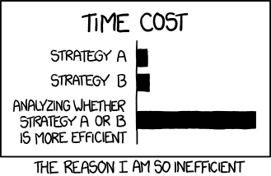
Smart Optimization
http://imgs.xkcd.com/comics/efficiency.png

Slide 44
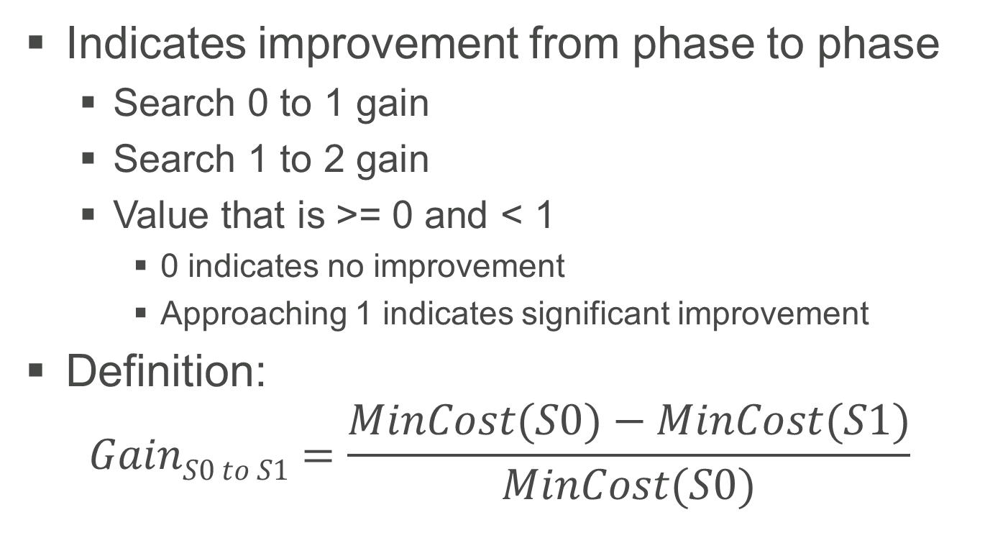
An Interesting Metric: Gain
Indicates improvement from phase to phase
Search 0 to 1 gain
Search 1 to 2 gain
Value that is >= 0 and < 1
0 indicates no improvement
Approaching 1 indicates significant improvement
Definition:
$$GainS0 to S1=\frac{MinCost(S0)−MinCost(S1)}{MinCost(S0)}$$
Notes:
Gain will have a value from 0 to 1, where 0 means no improvement, and values approaching 1 indicate significant improvement.

Slide 45
sys.dm_exec_query_optimizer_info
7
Documented. Sort of.
Three columns:
counter: Name of the observation
occurrence: Number of times observation was recorded
value: Average per occurrence
Collect before and after images of this view on a quiet system
Notes:
Show BOL for this DMV, then show 2005 version of BOL.

Slide 46
Heuristics and Transformations
Heuristics
Rules that can eliminate entire branches of the search space
Transformations
Find equivalent operations to get same output
Rule-based
DBCC SHOWONRULES
DBCC RULEON / RULEOFF
Four types
Simplification, exploration, implementation, property enforcement

Slide 47
Transformations: Simplification*
8
Subqueries to joins
Predicate pushdown
Foreign key table removal
Contradiction detection
Aggregates on unique keys
Convert outer join to inner
* A somewhat overloaded term. Some simplification activities happen earlier in the process than others.
Notes:
Where the simplification rules really come into play is with queries that are generated by tools such as Entity Framework.
Other examples of simplification are
Select collapse (remove redundancies from WHERE clause)
Range simplification (multiple range predicates that can be collapsed into a single range or value)
Computed column matching

Slide 48
Transformations: Exploration
Start from a logical operation (may be a sub-branch of the full query): the pattern
Find equivalent logical operations: the substitute
Examples:
Join commutativity: A⋈B → B⋈A
Join associativity: (A⋈B)⋈C → A⋈(B⋈C)
Aggregate before join
9

Slide 49
Transformations: Implementation
Start from a logical operation
Find equivalent physical operation
Example:
A⋈B → A (nested loops join) B
A⋈B → A (merge join) B
A⋈B → A (hash join) B
Obtain costing on physical operations
Can prune expensive branches from tree

Slide 50
Transformations: Property Enforcement
Properties associated with parse tree nodes
Uniqueness, type, nullability, sort order
Constraints on column values
Transformation rules may cause certain properties to be enforced
Example: sort order for a merge join

Slide 51
sys.dm_exec_query_transformation_stats
10
One row per transformation rule
“Promise” – How useful might the rule be for this query?
“Built-Substitute” – Number of times the rule generated an alternate tree
“Succeeded” – Number of times the rule was incorporated
Collect before and after images of this view on a quiet system
Notes:
Unlike sys.dm_exec_query_optimizer_info, this one is completely undocumented.
“Promise” values are, presumably, unitless.

Slide 52
Factors Considered by the Optimizer
Memory grants
Costing
Cold cache
Sequential vs random I/O
But not the nature of the I/O subsystem
CPU costs, core count, available memory
Cardinality estimator
What do cost units really mean?
Notes:
Supposedly at one time there was a developer at Microsoft by the name of Nick who based the cost units on his development PC. Now completely meaningless except (perhaps) to compare queries. Not really. May not even be valid comparison within a query.
Costing doesn’t account for modern hardware. (Story about DR exercise in Iowa City). Is the I/O subsystem a USB 1.1 drive or a PCI solid state card?

Slide 53
Parse Trees
Internal representation of query operation
Nodes may be logical or physical operators
0 to infinity inputs, 1 output
SQL Server will output parse trees at various phases of optimization
A variety of trace flags will trigger output

Slide 54
Example Parse Tree
11
select top 5
od.ProductId,
sum(od.Quantity) - 20 ExcessOrders
from CorpDB.dbo.OrderHeader oh
inner join CorpDB.dbo.OrderDetail od
on oh.OrderId = od.OrderId
inner join CorpDB.dbo.Customer cust
on oh.CustomerId = cust.CustomerID
where cust.State = 'OK'
group by od.ProductId
having sum(od.Quantity) >= 20
order by od.ProductId;
Notes:
After this slide, type in a demo!
Then run through Parse Trees demo script.

Slide 55
Memo Structure
Used to explore different alternatives to a portion of the query tree
Can think of it as a matrix
Rows (groups) represent substitutes – each entry is logically equivalent
Columns represent application of a transformation rule
Each entry is hashed to prevent duplication
Physical substitutes are costed
Notes:
One copy of the memo structure is created for each optimization and is then destroyed when optimization is completed.
Alternatives can be either logical or physical.
New groups can be created as options are explored.

Slide 56
Example Memo
select *
from CorpDB.dbo.OrderDetail od
inner join CorpDB.dbo.OrderHeader oh on od.OrderId = oh.OrderId
inner join CorpDB.dbo.Customer c on c.CustomerID = oh.CustomerId;
Group | Option 0
4 | Join 2 ⋈ 3
3 | Get Customer
2 | Join 0 ⋈ 1
1 | Get OrderHeader
0 | Get OrderDetail

Slide 57
Example Memo
Apply join associativity:
(OD ⋈ OH) ⋈ C → OD ⋈ (OH ⋈ C)
Group | Option x.0 | Option x.1
5.x |  | Join 1.0 ⋈ 3.0
4.x | Join 2.0 ⋈ 3.0 | Join 0.0 ⋈ 5.1
3.x | Get Customer
2.x | Join 0.0 ⋈ 1.0
1.x | Get OrderHeader
0.x | Get OrderDetail

Slide 58
Example Memo
12
Apply join commutativity:
(OD ⋈ OH) ⋈ C → (OH ⋈ OD) ⋈ C
Group | Option x.0 | Option x.1 | Option x.2
5.x |  | Join 1.0 ⋈ 3.0
4.x | Join 2.0 ⋈ 3.0 | Join 0.0 ⋈ 5.1 | Join 2.2 ⋈ 3.0
3.x | Get Customer
2.x | Join 0.0 ⋈ 1.0 |  | Join 1.0 ⋈ 0.0
1.x | Get OrderHeader
0.x | Get OrderDetail
Notes:
Now we can imagine additional options that implement physical rules. For instance, Group 2 might explore a nested loops join on either 0.0 and 1.0 or on 1.0 and 2.0.
We can envision this as a multi-dimensional tree of parent-child relationships between options.

Slide 59
The Optimizer Is Exceptionally Complex
It has to deal with many things we’ve not discussed
DML (updates, deletes, inserts, merges; output clause)
Halloween protection, triggers, index updates
Wide vs. narrow updates
Data warehouse optimization
Columnstore, full-text, spatial, xml, filtered indexes and sparse columns
Partitioned tables, Hekaton, Stretch DB, other new features
Row vs. batch mode
And much more

Slide 60
Conclusions
SQL is a declarative language
In theory, it shouldn’t matter how SQL is written
We are effectively giving SQL Server a set of requirements and asking it to write a program for us
In practice, it does matter because no optimizer is perfect
It will give us correct results
In the real world, efficiency matters
Writing “better” queries
Sometimes we need to “out-smart” the optimizer

Slide 61
Appendix: Trace Flags
TF | Meaning
2372 | Show memory usage at each phase
2373 | Show memory usage for rules and properties
3604 | Output to client (“Messages” tab)
7352 | Show final query tree (post-optimization rewrites)
8605 | Show initial parse tree (converted)
8606 | Show transformed parse trees (input, simplified, join-collapsed, normalized)
8607 | Show output tree
8608 | Show initial memo structure
8609 | Show task and operation type counts

Slide 62
Appendix: Trace Flags, continued
TF | Meaning
8612 | Add cardinality info to tree
8615 | Show final memo structure
8619 | Show applied rules (SQL 2012+)
8620 | Show applied rules and memo arguments (SQL 2012+)
8621 | Show applied rules and resulting tree (SQL 2012+)
8649 | Force parallel plan
8666 | Add debugging info to query plan (in the “F4” properties)
8675 | Show optimization search phases and times
8757 | Disable trivial plan generation
9130 | Show pushed predicate
* And many more …

Slide 63
Appendix: Commands
DBCC TRACEON / TRACEOFF
DBCC RULEON / RULEOFF
DBCC SHOWONRULES
DBCC SHOWOFFRULES
option (recompile, querytraceon ####)
sys.dm_exec_query_optimizer_info
sys.dm_exec_query_transformation_stats

Slide 64
Appendix: History of SQL’s Optimizer
Volcano Optimizer (April 1993) (PDF)
Goetz Graefe, William J. McKenna
Based on Graefe’s earlier Exodus Optimizer
Cascades Framework (1995) (PDF)
Goetz Graefe
Refinement of the Volcano Optimizer
Basis for rewritten optimizer in SQL Server 7.0
Major innovation: the memo structure

Slide 65
References
Benjamin Nevarez (Blog)
Inside the SQL Server Query Optimizer
Paul White
Page Free Space blog (especially this series)
SQL Performance blog
Conor Cunningham (Blog)
Microsoft SQL Server 2012 Internals (Kalen Delaney, editor), chapter 11

Slide 66
Thank You
This presentation and supporting materials can be found at www.tf3604.com/optimizer.
Slide deck
Scripts
Sample database
SQL Server Parse Tree Viewer binaries & source
brian@tf3604.com • @tf3604

