Slide 1

Brian Hansen brian@tf3604.com @tf3604
Remember Back When?
Temporal Tables in SQL Server 2016 / 2017
Notes:
Immediately before the session
Restore the bkhUtility database (Script 000)
Create the AutoTracker database (Script 010)
Create workload stored procedures (Script 011)
Start the workloads (Scripts 012a and 012b)
Verify the workload is running (Script 013)

Slide 2


Welcome to SQLSaturday #767! Hosted by Lincoln SQL Server User Group
Visit http://Lincoln.pass.org for meeting & group information

Slide 3












Be sure to give our sponsors some #SQLLove

Slide 4
Platinum Sponsors
Special lunch presentations in the Nebraska Room and Red Oak Room
Bring your lunch
Presentations will start between 11:45 and Noon
Special prize drawing only for those who attend

Slide 5
Things to Know
Coffee and Tea will be served in the concourse until lunch
Snacks/Tailgate in parking lot between sessions
Fajita lunch buffet in the cafeteria
Present your pre-paid lunch ticket
Platinum sponsor presentations & special raffle
End of day wrap-up and raffle in the Nebraska Room

Slide 6
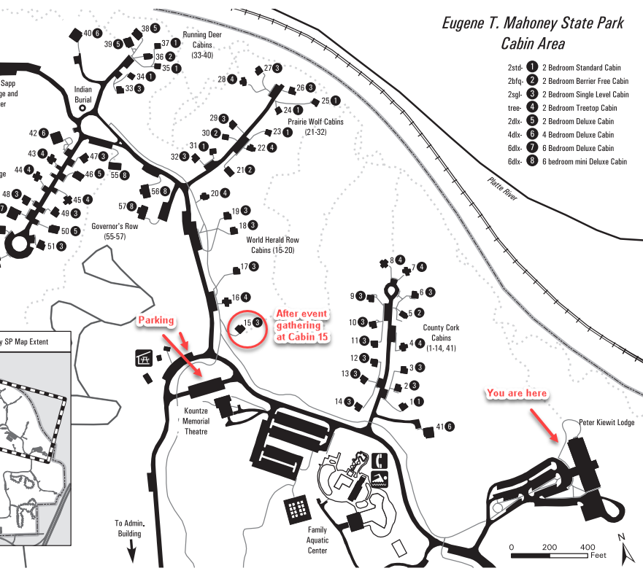
After Event Networking Gathering
Stop over to Cabin #15 after the event to network with #SQLFamily

Slide 7



Brian Hansen
20 Years working with SQL Server
Development work since 7.0
Administration going back to 6.5
Fascinated with SQL internals
brian@tf3604.com
@tf3604.com
children.org
www.tf3604.com/internals

Slide 8
Temporal Tables
Temporal = time-based = system versioned
Main purposes
Logging / Reversal of changes / Anomaly detection
Point-in-time business analytics / trends
Other purposes – but with complexity / caveats
Auditing
Change detection
Slowly-changing dimensions
Notes:
Most real-world databases have long have temporal components:
We keep track of when a row was inserted or updated
We want to know what changed – when, what, who?
Traditionally accomplished with triggers, CDC/CT or other methods (in the app, for instance)
These methods usually require some form of coding

Slide 9

The Scenario
Congratulations! You have just been awarded a lucrative contract with international automobile manufacturer FordoyotaBenz.
Notes:
Our assigned task is track ownership of automobiles for purposes of notifying customers of recalls.
I’ve never tracked automobiles, but I have tracked “things” before.
We’ll keep things really simple.
Just going to track automobiles, customers, dealers and who owns what car when.
Real world would probably need a breakdown of parts -> graph database?!

Slide 10
Demo
Automobile Tracking
Notes:
Scripts 020 through ???

Slide 11
Summary

Slide 12
Summary
Temporal querying: FROM TableName FOR SYSTEM_TIME _____
Point in time | AS OF '2017-02-06 11:30:00'
Full history | ALL
Between (‘start’ < EndTime AND ‘end’ >= StartTime) | BETWEEN '2017-01-11 18:55:04' AND '2017-05-06 11:30:00'
From (‘start’ < EndTime AND ‘end’ > StartTime) | FROM '2017-01-11 18:55:04' TO '2017-05-06 11:30:00'
Contained in (‘start’ >= EndTime AND ‘end’ <= StartTime) | CONTAINED IN ('2017-01-11 18:55:04', '2017-05-06 11:30:00')

Slide 13
Summary
select
cast('2017-06-10 10:10:00' as datetime2)
at time zone 'Central Standard Time' at time zone 'UTC';
select * from sys.time_zone_info;

Slide 14
Summary
New catalog objects
sys.periods (view)
sys.tables.temporal_type (column)
sys.tables.temporal_type_desc (column)
sys.tables.history_table_id (column)
sys.columns.generated_always_type (column)
sys.columns.generated_always_type_desc (column)

Slide 15
SQL 2017 Enhancements: Retention
-- Note: This is usually ON by default
alter database AutoTracker set temporal_history_retention on;
select is_temporal_history_retention_enabled
from sys.databases
where name = 'AutoTracker';

Slide 16
SQL 2017 Enhancements: Retention
create table dbo.Customer
(
…
)
with (system_versioning = on
(history_table = history.CustomerHistory,
history_retention_period = 3 months));
Notes:
In order to automatically cleanup old rows, the history table MUST have a clustered index (either rowstore or columnstore)

Slide 17
SQL 2017 Enhancements: Retention
alter table dbo.Customer
set (system_versioning = on
(history_retention_period = 7 weeks));

Slide 18
SQL 2017 Enhancements: Retention
select history_retention_period,
history_retention_period_unit,
history_retention_period_unit_desc
from sys.tables
where name = 'Customer';

Slide 19
Thank You
This presentation and supporting materials can be found at www.tf3604.com/temporal.
Slide deck
Scripts
Sample database
brian@tf3604.com • @tf3604

