Slide 1
Ski Resort Data Analysis
Tom Fahland

Slide 2
Outline of Presentation
Problem identification
Recommendation and key findings
Modeling results
Summary

Slide 3
Problem Identification
To derive a pricing model for ski resort ticket prices for our market segment. Determine if our current price is maximizing returns.
Data: 2 sets of data
Details of all major ski resorts including information about size, lifts, snowfall, etc
Details about each state’s population
Combine data so relationships can be determined

Slide 4
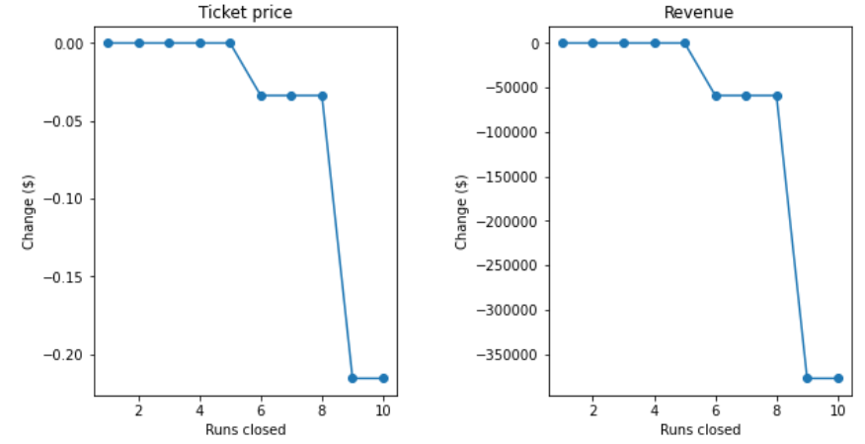
Key Findings
The overall finding is that our machine learning model predicts that we are undercharging relative to our competition.
We are charging $81 and the model predicts we can charge $90.65.
We looked at many amenities that change price, # of runs was an important one.

Slide 5
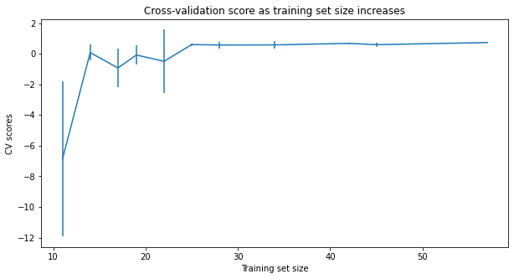
Modeling details
By using a cleaned-up and filtered dataset, we created a random forest machine learning model that predicted the price of results fairly well. We employed a grid-search to optimize for parameters
Score as a function of training set size.

Slide 6
Summary
We advise a price increase based on a comprehensive dataset.
Further work could be done by enhancing the modeling with additional cost information to probe further expansions and determine profitability of proposed changes.

