Slide 1

Real GDP Forecast of USA
Comparison between USA and India
By Tahsin Fairooz

Slide 2
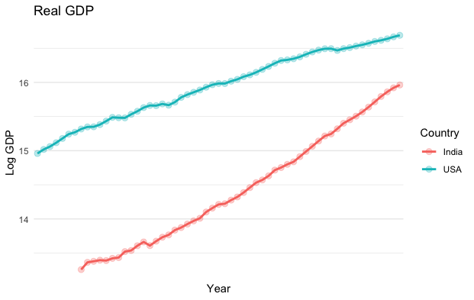
Things to Note:
$I = $US
Log-Normal GDP

Slide 3
Why Real GDP?
Wanted to study the increase in productivity
Compare the data between India and USA and see how the gap changes between the two countries.

Slide 4
GDP Shock Recovery Debate: Who do you think is right?
“If real GDP contains a unit root, shocks tend to permanently change real GDP’s growth path. A 1% negative shock to real GDP would lead to a permanent reduction in the growth path of even more than 1%. After a recession, one would therefore expect no rebound in real GDP.” Mankiw, 2009
“A fall in production that does not also change the unemployment rate will in all likelihood be permanent. A fall in production that is accompanied by a big rise in the unemployment rate will in all likelihood be reversed. You have to do a bivariate analysis—to look at two variables, output and unemployment.” DeLong, 2009

Slide 5
Data
Annual Data
1961-2019
Train set 1961-2014
Real GDP, Inflation and Discount rate - FRED

Slide 6
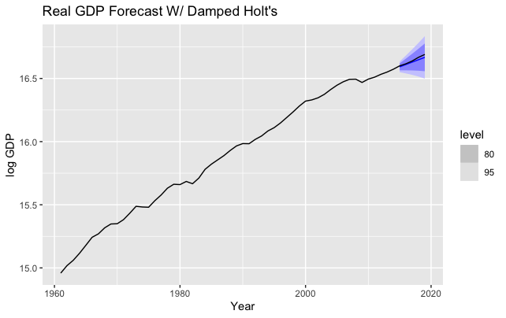
Exponential Smoothing (Damped Holt’s)
Model Specifications:
AICc: -200
BIC: -198
RMSE: 0.0186 (train)

Slide 7
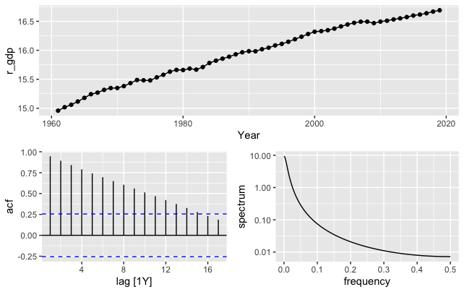
ARIMA: 1) Unit-root Determination
Kpss Test:
P- value < 0.05
Unit root Process

Slide 8
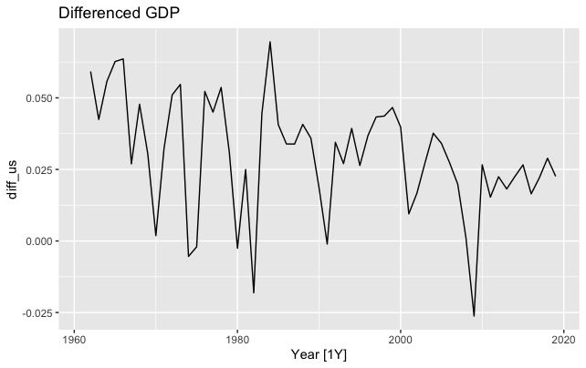
ARIMA: 2) Differencing the data
Kpss Test:
P-value: 0.0567 Stationary Data

Slide 9
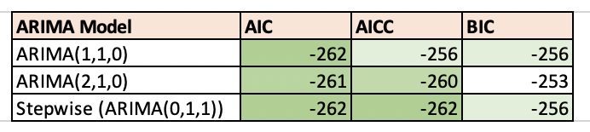
ARIMA: 3) Estimating models
From the chart, top pick is the Stepwise followed by ARIMA(1,1,0).

Slide 10
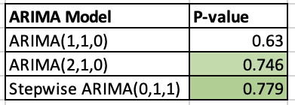
ARIMA: 4) White-Noise Test
Ljung-Box Test results to determine white noise process for the estimated ARIMA Models.
Based on the AICc and BIC and the white noise test, I choose ARIMA(0,1,1) model to forecast GDP.

Slide 11
ARIMA: 5) Forecast on Test Set
Model Specification:
ARIMA(0,1,1) AICc: -262 BIC: -256

Slide 12
VAR Model Estimation
A correlation matrix to decide the 2nd variable for VAR model. From the matrix I chose discount Rate.
 | Inflation | Real gdp | Discount R | Emplyed
Inflation | 1
Real gdp | 0.114899 | 1
Discount | -0.197741 | -0.44709 | 1
emplyd | 0.096033 | 0.996246 | -0.430059 | 1

Slide 13
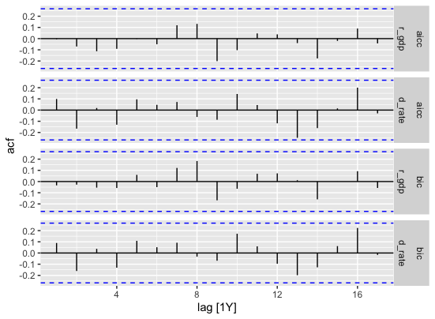
VAR: White Noise Test
Both the AICC and BIC VAR(2) models are white noise processes.

Slide 14
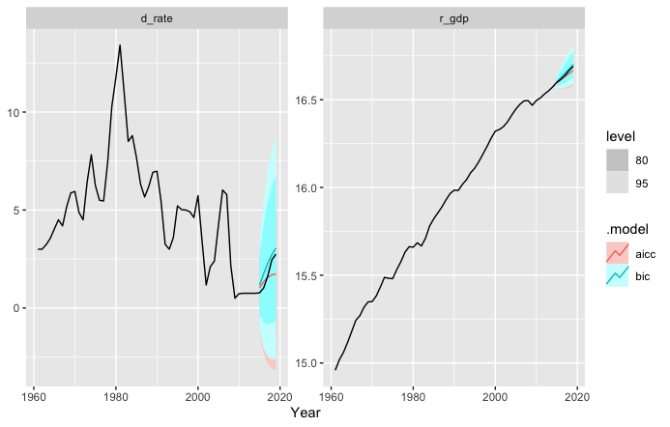
Model Specification:
VAR(2)aicc:
AICC: -88.7 BIC: -72.7 VAR(2)bic:
AICC: -88.7
BIC: -88.5
Forecast of GDP and Discount rate using VAR

Slide 15
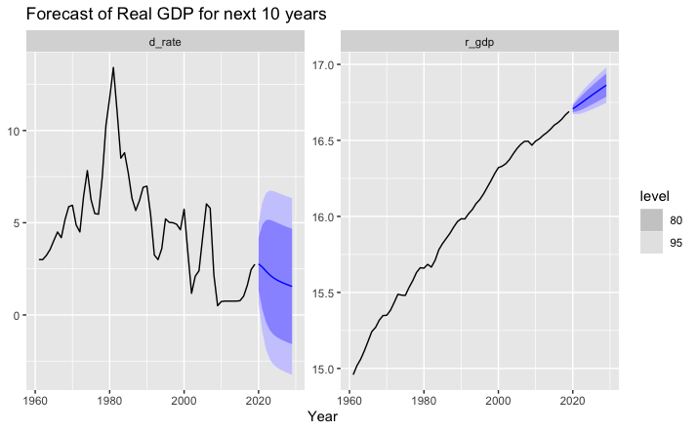
Forecast for Next 10 Years w/ VAR

Slide 16
Conclusion
My final project will be forecasting India’s real GDP, followed by a comparison and contrast between the forecasts of the two.
It should be noted that none of the forecasts are accurate as we all know what happened during 2020.
This motivated me to study this variable to see what was expected after 2019 if covid did not exist!

