Slide 1
Chapter 11: Simply Extensions
Basic Types / The Unit Type
Derived Forms: Sequencing and Wildcard
Ascription / Let Binding
Pairs/Tuples/Records
Sums/Variants
General Recursion / Lists

Slide 2
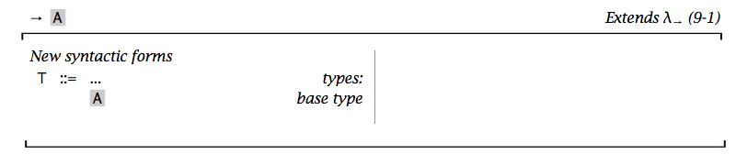
Base Types
Base types in every programming language:
sets of simple, unstructured values such as numbers, Booleans, or characters, and
primitive operations for manipulating these values.
Theoretically, we may consider our language is equipped with some uninterpreted base types.
A, B, C, …

Slide 3
λx:A. x; <fun>: A→A
λx:B. x;
<fun>: B→B
λf:A→A. λx:A. f(f(x));
<fun>: (A→A)→A→A

Slide 4
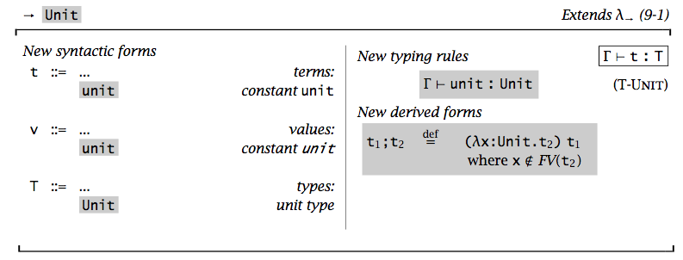
The Unit Type
It is the singleton type (like void in C).
Application: Unit-type expressions care more about “side effects”
rather than “results”.

Slide 5


Derived Form: Sequencing t₁ ; t₂
A direct extension λ^{E}
t ::= …
t1 ; t2
New valuation relation rules
New typing rules

Slide 6


Derived Form: Sequencing t₁ ; t₂
Derived form (λ^{I}): syntactic sugar
Theorem [Sequencing is a derived form]: Let
e ∈ λ^{E} → λ^{I}
be the elaboration function (desugaring) that translates from the external to the internal language by replacing every occurrence of t1;t2 with (λx:Unit.t2) t1. Then
Notes:
Induction on t

Slide 7
Derived Form: Wildcard
A derived form
λ_:S.t ➔ λx:S.t
where x is some variable not occurring in t.

Slide 8
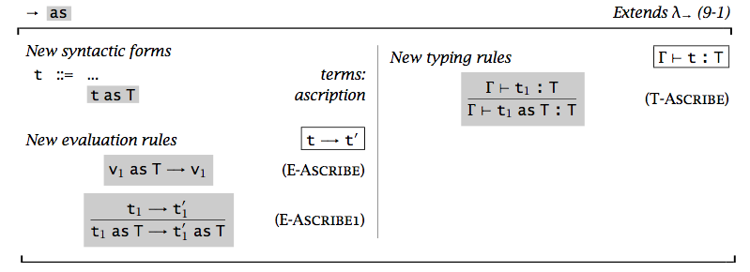
Ascription: t as T
t as T
checking if the term t has the type T
Useful for documentation and pinpointing error sources
Useful for controlling type printing
Useful for specializing types (after learning subtyping)
verification

Slide 9
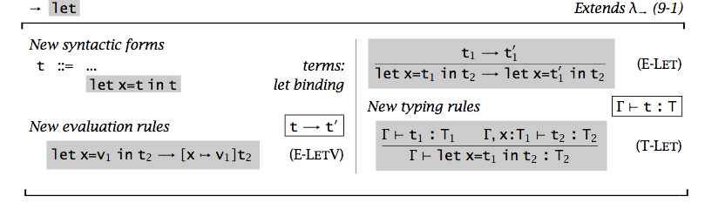
Let Bindings
To give names to some of its subexpressions.
Notes:
let x=t1 in t2 = (λx:T1.t2) t1

Slide 10
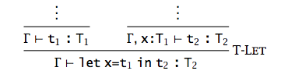
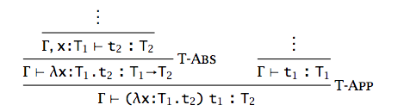
Is “let binding” a derived form?
Yes, let x=t₁ in t₂ ➔ (λx:T₁.t₂) t₁
Desugaring is not on terms but on typing derivations

Slide 11
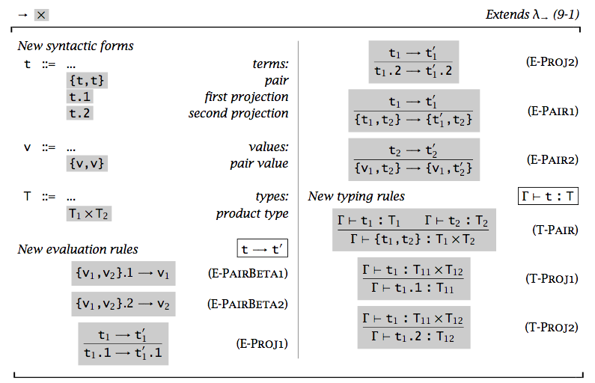
Pairs
To build compound data structures.

Slide 12
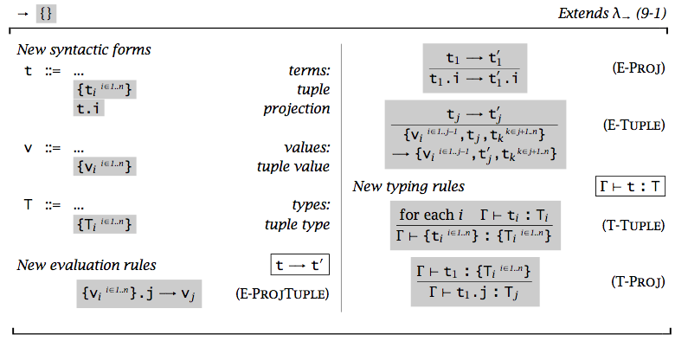
Tuples
^{Generalization:} ^{binary ➔ n-ary products}

Slide 13
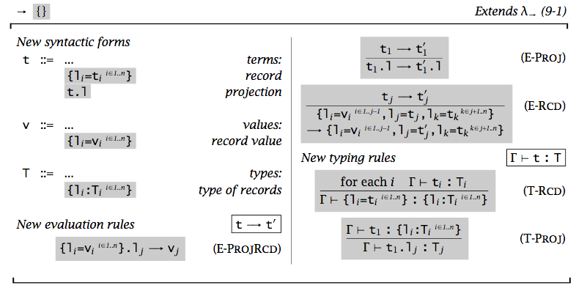
Records
^{Generalization:} n-ary products ➔ labeled records
Question: {partno=5524, cost=30.27} = {cost=30.27,partno=5524}?

Slide 14




Sums
To deal with heterogeneous collections of values.
An Example: Address books
Injection by tagging (disjoint unions)
Processing by case analysis

Slide 15
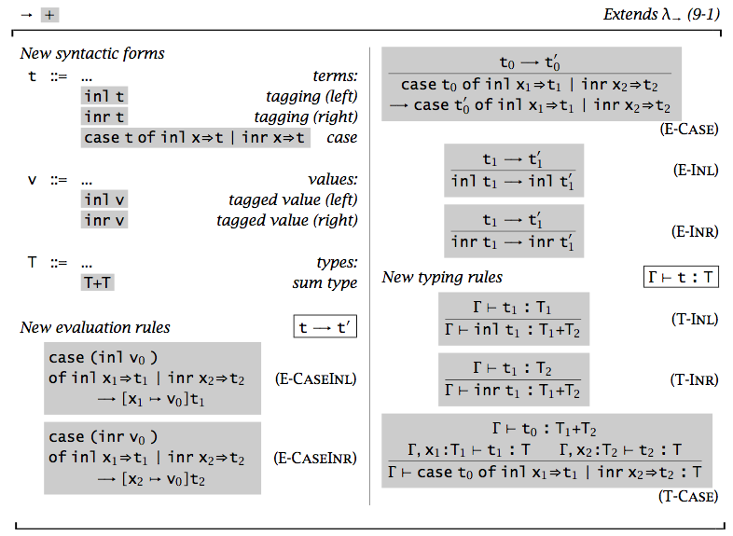
Sums
To deal with heterogeneous collections of values.
Notes:
To deal with T2, we may give it by the user, derived by the system, or treat it as a universal.

Slide 16
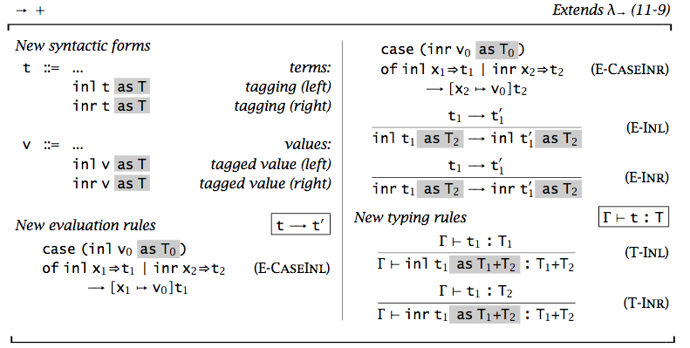
Sums (with Unique Typing)

Slide 17
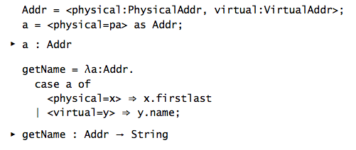
Variant
Generalization: Sums ➔ Labeled variants
T1 + T2 ➔ <l1:T1, l2:T2>
inl t as T1+T2 ➔ <l1=t> as <l1:T1, l2:T2>
Example:

Slide 18
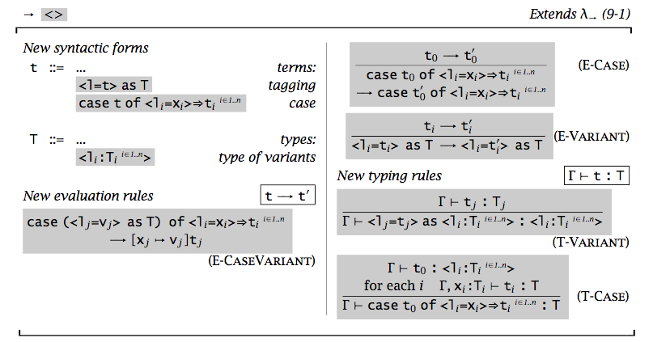

Slide 19
Special Instances of Variants
Options
OptionalNat = <none:Unit, some:Nat>;
Enumerations
Weekday = <monday:Unit, tuesday:Unit, wednesday:Unit,
thursday:Unit, friday:Unit>;
Single-Field Variants
V = <l:T>
Operations on T cannot be applied to elements of V without first unpackaging them: a V cannot be accidentally mistaken for a T.

Slide 20
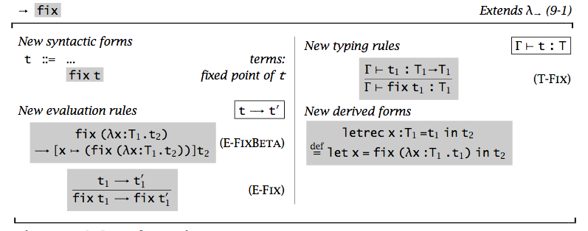
General Recursions
Introduce “fix” operator: fix f = f (fix f)
(It cannot be defined as a derived form in simply typed lambda calculus)

Slide 21
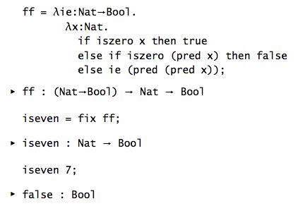
Example 1:

Slide 22
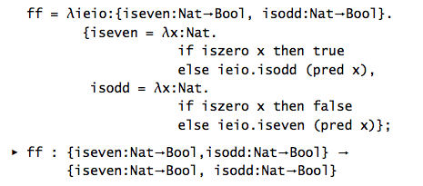

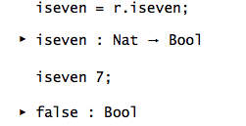
Example 2:

Slide 23

Example 3: Given any type T, can you define a term that has type T?
x as T
fix (λx:T. x)

Slide 24
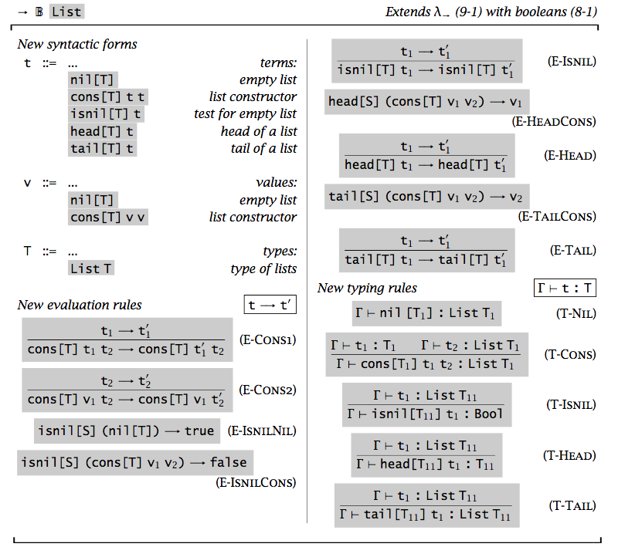
Lists
List T describes finite-length lists whose elements are drawn from T.

Slide 25
Homework
Read Chapter 11.
Do Exercise 11.11.1.

