Slide 1
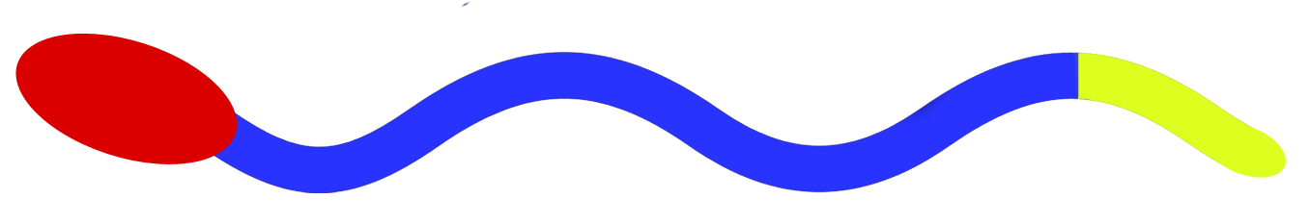
Head
Passive Tail
Active Tail

