Slide 1
Advanced Fluid Mechanics in Real Life

Slide 2
Mohammad Ali Remon ID: 19203011 Department of Mathematics University of Chittagong

Slide 3
Introduction
What is fluid mechanics?
Fluid mechanics is the science of how fluids flow and how forces affect that flow.
Difference between basic and advanced fluid mechanics
Basic fluid mechanics: Ideal fluids, incompressible flow, steady-state conditions
Advanced fluid flow: Real fluids(viscous fluid), compressible and unsteady flow, complex boundary conditions

Slide 4
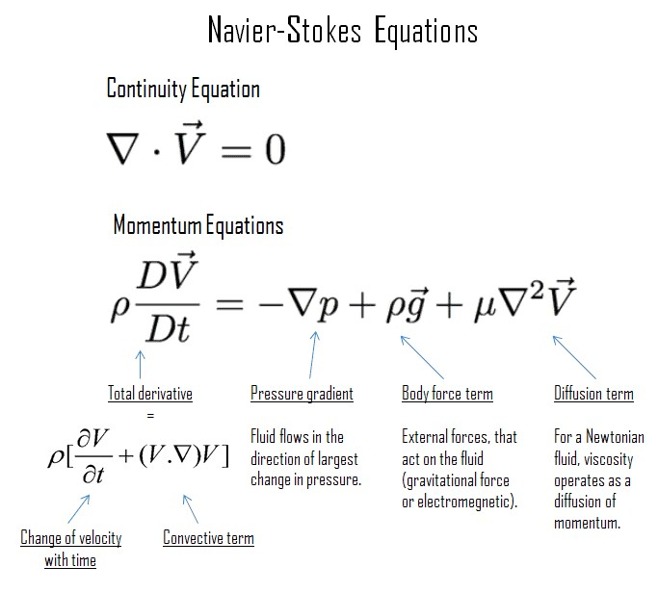
Governing Equations
Navier-Stokes Equations

Slide 5
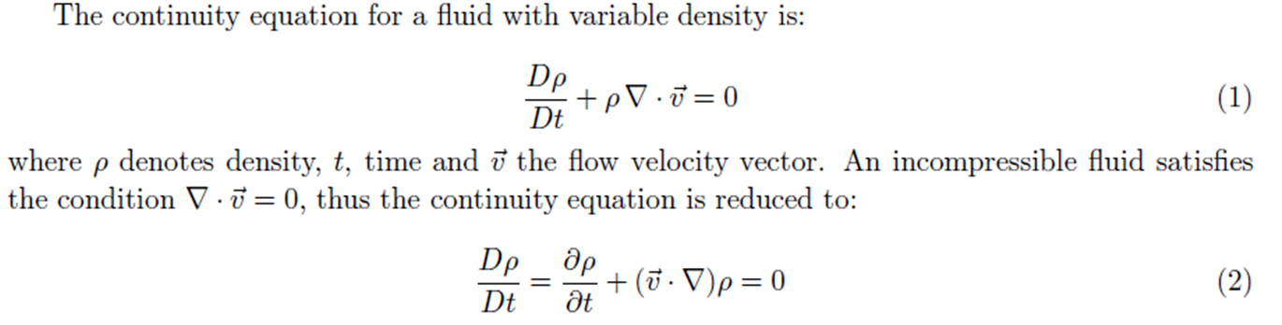
Governing Equations
Continuity Equation

Slide 6
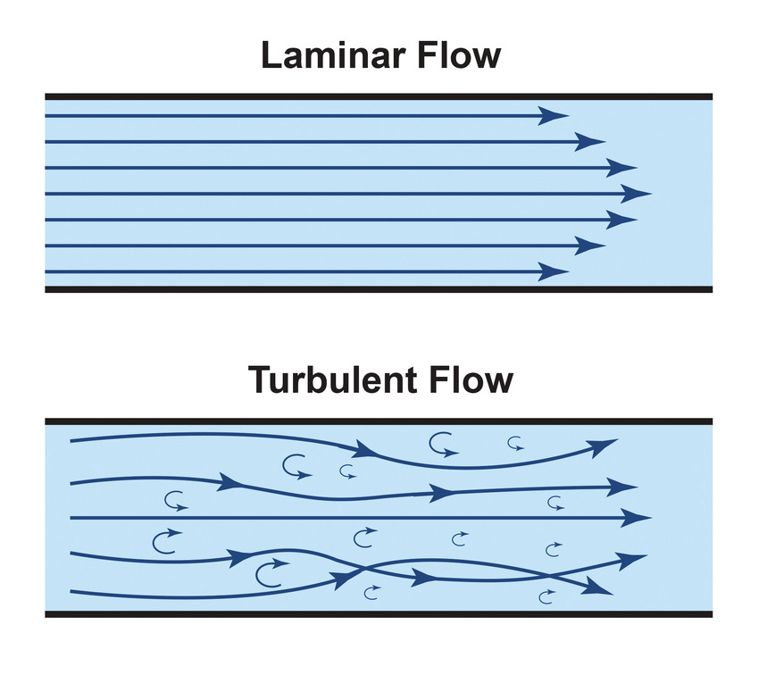
Laminar flow and turbulent flow
laminar flow occurs at low Reynolds numbers, where viscous forces are dominant, and is characterized by smooth, constant fluid motion;
turbulent flow occurs at high Reynolds numbers and is dominated by inertial forces, which tend to produce chaotic eddies, vorices and other flow instabilities

Slide 7
CFD – Computational Fluid Dynamics
What is CFD?
CFD stands for Computational Fluid Dynamics. It is a branch of fluid mechanics that uses numerical methods and algorithms to analyze and solve problems involving fluid flows (like air, water, or gas). CFD is widely used in engineering and scientific research to simulate how fluids behave under various conditions.
Solving complex flow problems using numerical methods
Airflow Optimization in a Car Engine Cooling System

Slide 8
Solving complex flow problems using numerical methods
Automotive industry
How air flows around vehicles
Drag reduction improves fuel efficiency
Use of CFD in car design
Aerospace Industry
Jet propulsion and lift dynamics
Supersonic and hypersonic flow
Design of jet engines and spacecraft

Slide 9
Real-Life Importance of Fluids
Fluids in motion are everywhere: water, air, oil, blood
Fluid mechanics underpins modern civilization: transportation, energy, health

Slide 10
Hydrodynamics in Marine Engineering
Hull design for ships and submarines
Wave resistance, buoyancy, and stability
Model testing and CFD usage

Slide 11
Environmental Fluid Mechanics
Modeling pollutant dispersion in air and water
Predicting flood and stormwater behavior
Urban drainage and climate resilience

Slide 12
Meteorology and Weather Prediction
How atmospheric flows are modeled
Navier-Stokes used in weather simulations
Forecasting with satellite and models

Slide 13
Biomedical Applications
Blood flow dynamics in arteries and veins
Non-Newtonian fluid models of blood
CFD in heart valve and stent design

Slide 14
HVAC and Building Systems
Airflow and heat transfer in buildings
Ventilation optimization
Ensuring thermal comfort and energy efficiency

Slide 15
Energy Systems – Wind and Hydropower
Fluid dynamics in turbines and dams
Maximizing energy through blade design
Simulation-based improvements

Slide 16
Fire and Smoke Modeling
Fire safety engineering
Modeling of heat, smoke, and air in buildings
Used in tunnels and skyscrapers

Slide 17
Fluid Mechanics in Oil & Gas Industry
Multiphase flow in pipelines
Slug flow, pressure drop, flow assurance
Pipeline and riser design

Slide 18
Flow in Microfluidics and Lab-on-Chip
Fluid behavior at microscale
Capillary action, surface tension
Applications in diagnostics

Slide 19
Sports and Performance Optimization
Swimsuit and helmet design
Ball trajectory modeling
Use in Formula 1 and Olympics

Slide 20
Challenges in Advanced Fluid Mechanics
Non-linear, chaotic systems
High computational cost of CFD
Turbulence modeling limitations

Slide 21
Future Trends
AI-integrated CFD
Real-time simulation for VR/AR
Data-driven flow predictions

Slide 22
Conclusion & Takeaways
Fluid mechanics is vital across industries
Advances in modeling are transforming design
“To master flow is to master the future.”

