Slide 1
How an Airplane Stays in the Air
The Role of Bernoulli's Principle in Flight
Md. Ruhul Amin
ID: 19203003 Department of Mathematics University of Chittagong

Slide 2
Introduction to Flight
• Overview of flight
• Importance in transport, military, cargo
• Main question: How does an airplane stay aloft?

Slide 3
The Four Forces of Flight
• Lift (upward)
• Weight (gravity pulling down)
• Thrust (forward)
• Drag (resistance/backward)

Slide 4
Diagram: 4 forces acting on an airplane

Slide 5
What is Lift?
• Lift opposes weight to keep the plane in the air
• Generated mainly by the wings (airfoils)

Slide 6
Anatomy of a Wing (Airfoil)
• Wings are curved on top, flatter on the bottom
• Key parts: leading edge, trailing edge, chord line

Slide 7
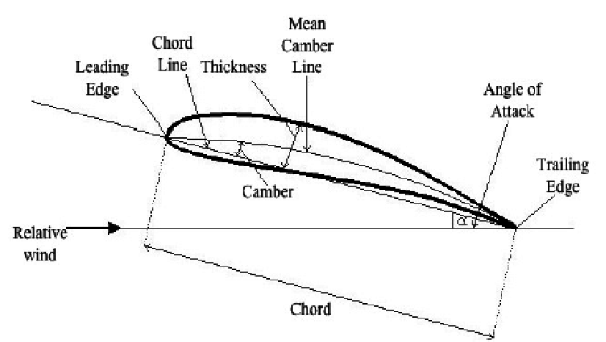
Airfoil cross-section

Slide 8
Bernoulli’s Principle
• As the speed of a fluid increases, its pressure decreases
• Applies to gases like air too
• Fundamental to lift generation

Slide 9
Applying Bernoulli to Wings
• Air moves faster over curved top, slower under flat bottom
• Lower pressure above, higher pressure below
• Result: Lift

Slide 10
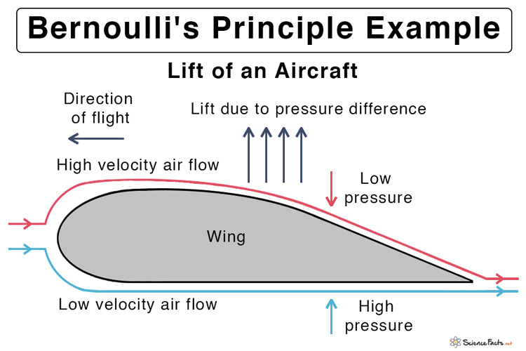
Visualizing Airflow

Slide 11
Complementing Newton's Third Law
• Action: wing pushes air down
• Reaction: air pushes wing up
• Newton and Bernoulli together explain lift

Slide 12
Angle of Attack
• Tilt of the wing affects lift
• Small angle increases lift
• Too much angle = stall
Diagram: Wing at angles

Slide 13
Role of Engine and Thrust
• Engines provide thrust to move the plane
• Thrust overcomes drag
• Maintains airflow over wings

Slide 14
Real-World Applications
• Modern aircraft use winglets, flaps, and design optimizations
• Bernoulli’s principle guides design

Slide 15
Misconceptions about Bernoulli
• Not acting alone
• 'Longer path = lift' is an oversimplification
• Works with Newtonian mechanics

Slide 16
Summary
• Lift is key to flight
• Bernoulli explains pressure difference
• Newton’s laws complement Bernoulli’s explanation

Slide 17
THANK YOU

