Slide 1
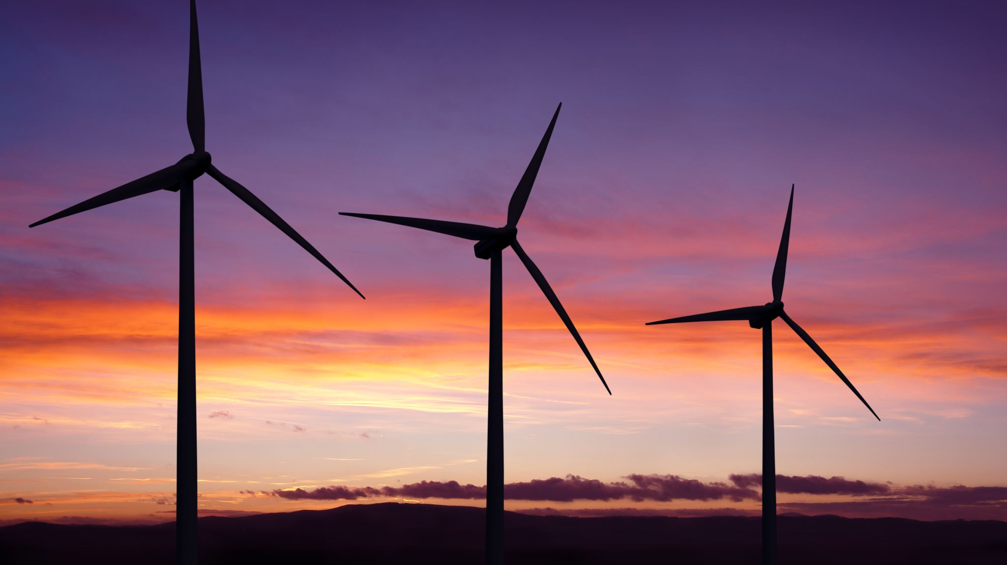
Contoso Energy
Weather Station Architecture
IoT Systems and Subsystems

Slide 2
IoT Architecture
Reporting
Azure Function
Data Lake Analytics
IoT Devices
Cloud Gateway
Stream Processing
Warm Path Storage
Cold Path Storage
Things
Insights
Action

Slide 3
Systems and SubSystems
Systems
Devices
Cloud gateway (IoT Hub)
Stream Processing
Warm Path Storage
Business Integration (provided by Data Lake Analytics)
UI & Reporting Tools (Storage Explorer and Excel – not part of the Azure Resource group)
Subsystems:
Azure Function
Runs in real-time
Provides feedback on Device
Cold Path Storage
For later analysis with DataLake Analytics (aggregation)

