Slide 1
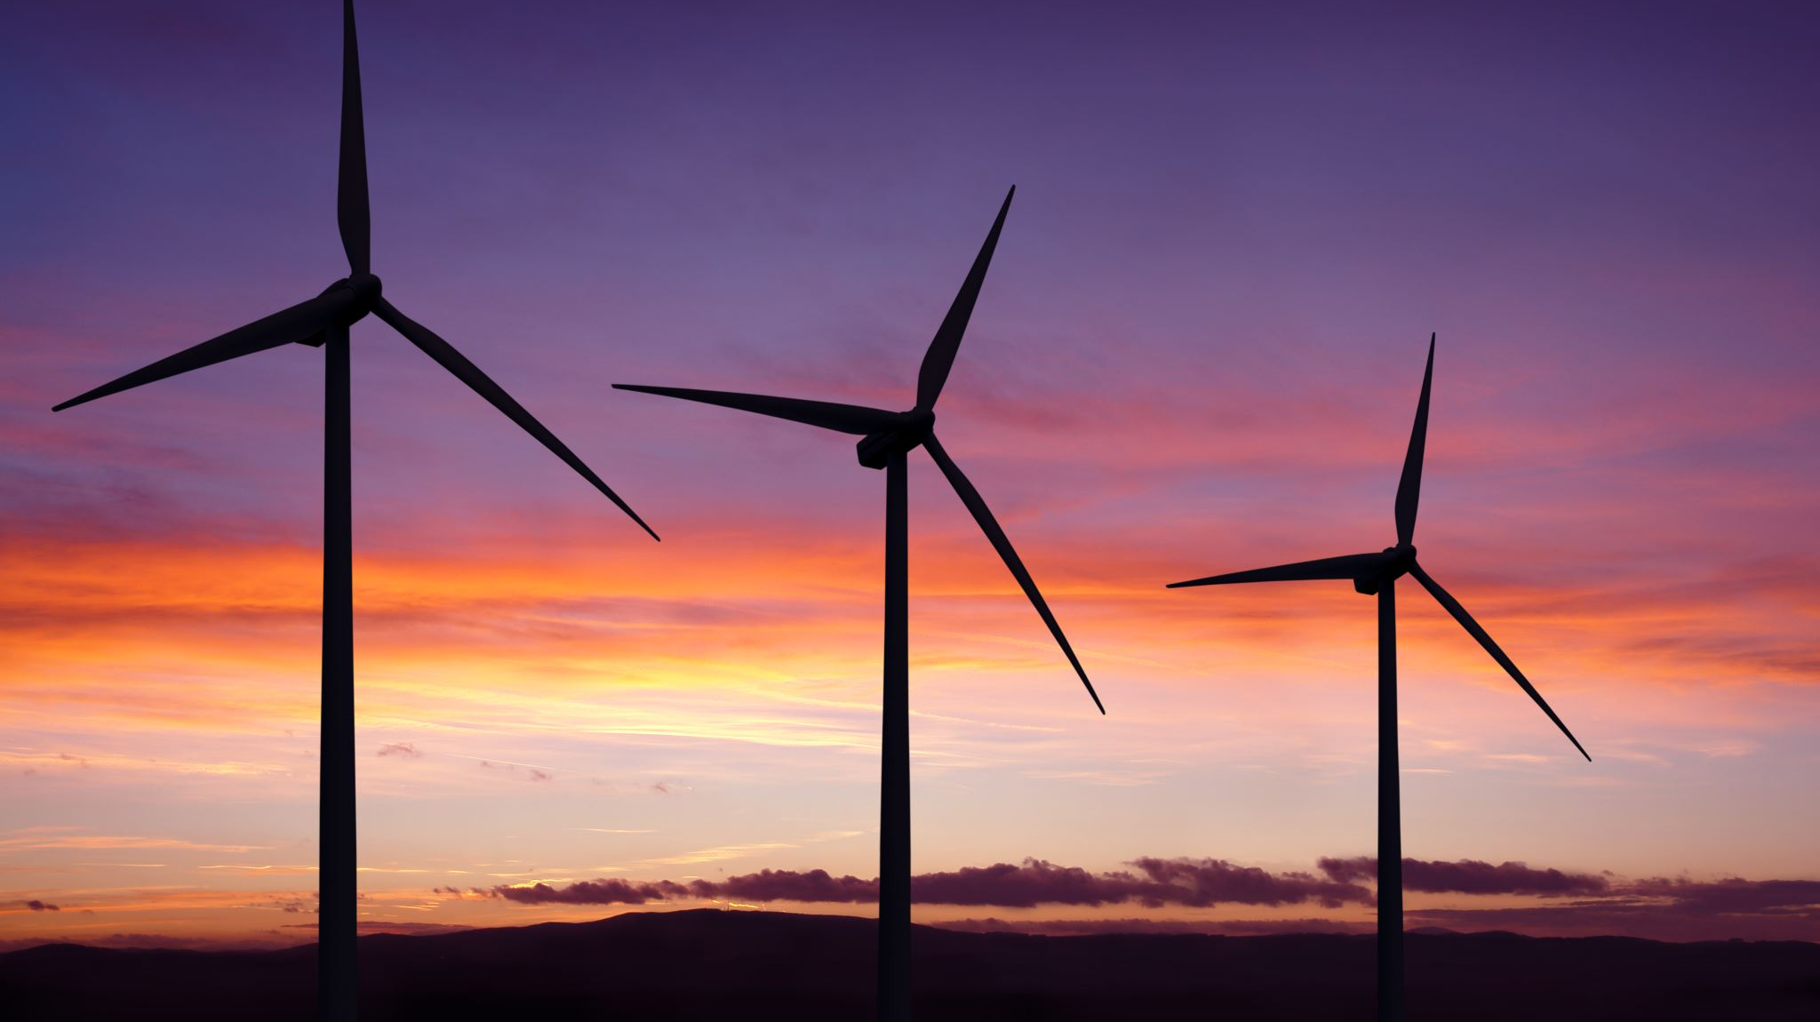
Contoso Energy
Weather Station Architecture
IoT Systems and Subsystems

Slide 2
IoT Architecture
Reporting
Azure Function
IoT Devices
Cloud Gateway
Warm Path Storage
Business Integration
Stream Processing
Cold Path Storage
Things
Insights
Action

Slide 3
Systems and SubSystems
Systems
Devices
Cloud gateway (IoT Hub)
Stream Processing
Warm Path Storage (Time Series Insights)
Business Integration
UI & Reporting Tools (Power BI, TSI)
Subsystems:
Cold Path Storage
Cosmos DB for Power BI dashboards
Azure Data Lake for subsequent analysis
Azure Function
Runs in real-time
Provides feedback on Device

