Slide 1
Jamming in
Wireless Sensor Networks
Ertan Onur
December 13th, 2006
Boğaziçi University

Slide 2
Outline
What is jamming?
Jammer attack models,
Detecting jamming attacks,
Defense strategies,
Possible research topics.

Slide 3



What is jamming?
Radio jamming is the transmission of radio signals that disrupt communications by decreasing the signal to noise ratio.
Intentional communications jamming is usually aimed at radio signals to disrupt control of a battle.
A transmitter, tuned to the same frequency as the opponents' receiving equipment and with the same type of modulation, can with enough power override any signal at the receiver
@#$%%$#@&…
Hello …
Hi …
Bob
Alice
Mr. X
Wikipedia

Slide 4
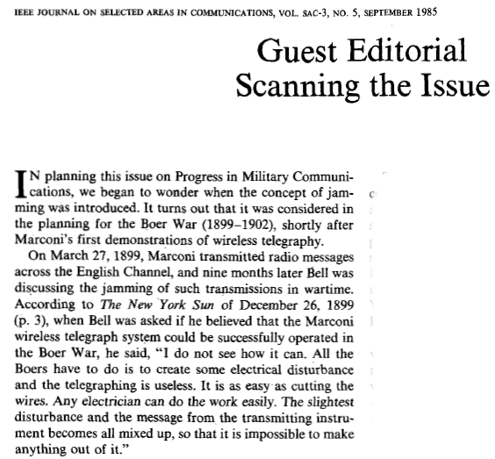

Slide 5


Bats are jammed by moths
  Echolocation: by emitting high-pitched sounds and listening to the echoes, the microbats locate nearby objects.
  A few moths have exploited the bat's senses:
    In one group (the tiger moths), the moths produce ultrasonic signals to warn the bats that the moths are chemically-protected (aposematism);
    In the other group (Noctuidae) the moths have a type of hearing organ called a tympanum which responds to an incoming bat signal by causing the moth's flight muscles to twitch erratically, sending the moth into random evasive maneuvers.

Slide 6
History of Jamming?
During World War II a variation of radio jamming was used where ground operators would attempt to mislead pilots by false instructions in their own language.
Jamming of foreign radio broadcast stations has often been used in wartime to prevent or deter citizens from listening to broadcasts from enemy countries.
Jamming has also occasionally been used by the Governments of Germany (during WW2), Cuba, Iran, China, Korea and several Latin American countries
Jamming has also occasionally been attempted by the authorities against pirate radio stations including Radio Nova in Ireland and Radio Northsea International off the coast of Britain.
Saddam's government obtained special electronic jamming equipment from Russia that was set up around several sites in Iraq. The jammers attempted to disrupt the signals sent by U.S. GPS satellites that are used to guide joint direct attack munitions, the military's premier satellite-guided bombs.
In 2004, China acquired radio jamming technology and technical support from French state-owned company, Thales Group. It is used for jamming foreign radio stations broadcasting to China.

Slide 7


Jammer Attack Models
Constant jammer:
  Continuously emits a radio signal
Deceptive jammer:
  Constantly injects regular packets to the channel without any gap between consecutive packet transmissions
  A normal communicator will be deceived into the receive state
&F*(SDJFFD(*MC*(^%&^*&(%*)(*)_*^&*FS…….
Preamble
CRC
Payload
Payload
Payload
Payload
Payload
…

Slide 8
Jammer Attack Models
Random jammer:
  Alternates between sleeping and jamming
    Sleeping period: turn off the radio
    Jamming period: either a constant jammer or deceptive jammer
Reactive jammer:
  Stays quiet when the channel is idle, starts transmitting a radio signal as soon as it senses activity on the channel.
  Targets the reception of a message
&F*(SDJF
^F&*D(
D*KC*I^
…
Underling normal traffic
Payload
Payload
Payload
&F*(SDJ
^%^*&
CD*(&FG
…

Slide 9
Detecting Jamming Attacks
Signal processing techniques
  Received signal strength indicator
  Excessive received signal level
  Low SNR
  Collisions
  Channel sensing time
Utility based detection
  Repeated inability to access channel
  Bad framing
  Checsum failures
  Illegal field values
  Protocol violations
  Repeated collisions
  Duration of condition
  Packet delivery ratio
Anthony D. Wood, John A. Stankovic and Sang J. Son
JAM: A Jammed-Area Mapping Service for Sensor Networks
RTSS 2003

Slide 10
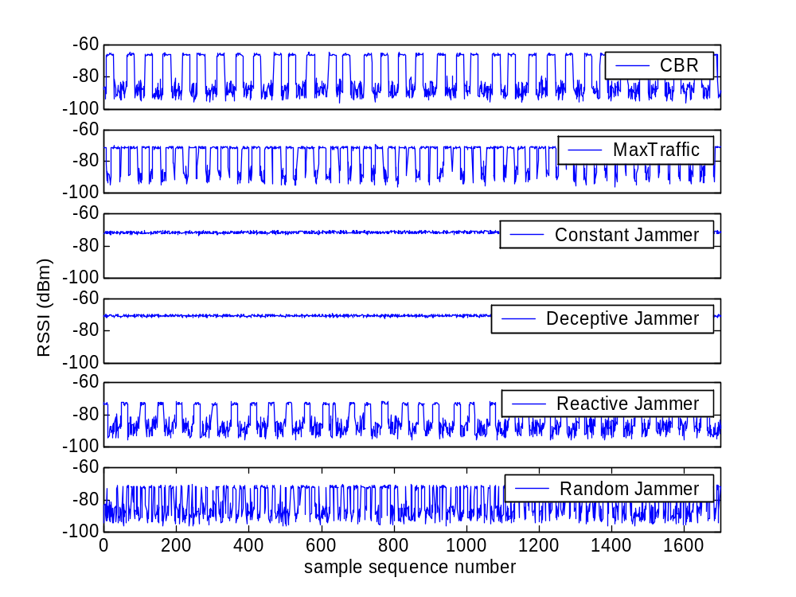
Basic Statistics I
Idea:
  Network devices can gather measurements during a time period prior to jamming and build a statistical model describing basic measurement in the network
Measurement
  Signal strength
    Moving average
    Spectral discrimination
  Carrier sensing time
  Packet delivery ratio

Slide 11


Basic Statistics II
Can basic statistics differentiate between jamming scenario from a normal scenario including congestion?
Differentiate jamming scenario from all network dynamics, e.g. congestion, hardware failure
  PDR is a relative good statistic, but cannot do hardware failure
  Consistency checks --- using Signal strength
    Normal scenarios:
      High signal strength → a high PDR
      Low signal strength → a low PDR
    Low PDR:
      Hardware failure or poor link quality → low signal strength
      Jamming attack → high signal strength
 | Signal strength |  | Carrier sensing time | Packet delivery ratio
 | Average | Spectral Discrimination
Constant Jammer
Deceptive Jammer
Random Jammer
Reactive Jammer
✗
✗
✗
✗
✗
✗
✗
✗

Slide 12
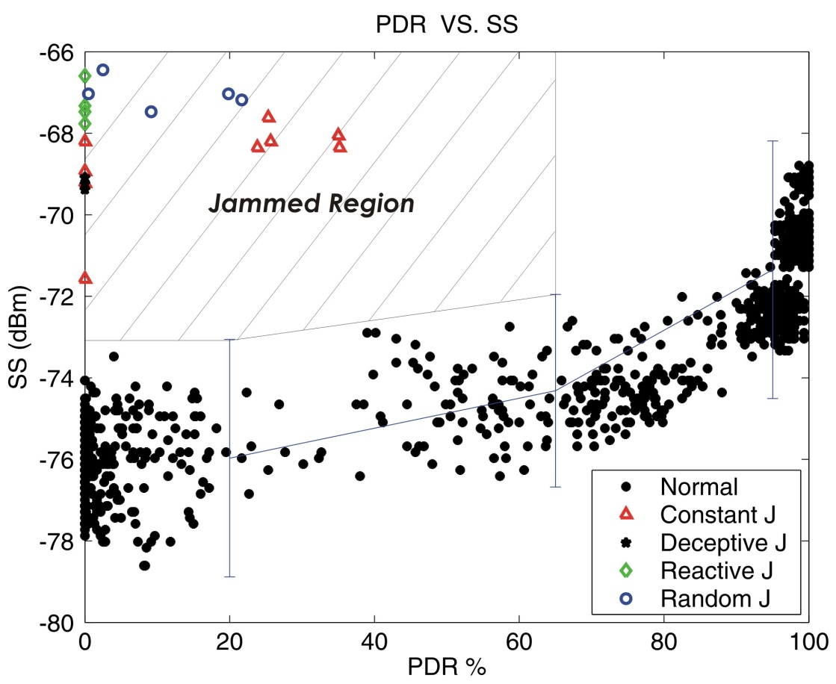
Jamming Detection with Consistency Checks
Build a (PDR,SS) look-up table empirically
  Measure (PDR, SS) during a guaranteed time of non-interfered network.
  Divide the data into PDR bins, calculate the mean and variance for the data within each bin.
  Get the upper bound for the maximum SS that world have produced a particular PDR value during a normal case.
  Partition the (PDR, SS) plane into a jammed-region and a non-jammed region.
Measure PDR(N)
{N Є Neighbors}
PDR VS. SS
PDR(N) < PDRThresh ?
No
Not Jammed
Jammed Region
Yes
SS(dBm)
PDR(N) consistent
with signal strength?
Yes
No
Jammed!
PDR %

Slide 13


Defense Strategies
Use spread-spectrum techniques
Priority messages
Lower duty cycle
Region mapping and adapting to situation
Mode change
Frequency hopping (physical layer)
Channel Surfing (on-demand, link layer)
Spatial retreat, escape from the jammer
C
D
B
A
X
E
F
H
G
I

Slide 14
Channel Surfing
  Idea:
    If we are blocked at a particular channel, we can resume our communication by switching to a “safe” channel
    Inspired by frequency hopping techniques, but operates at the link layer in an on-demand fashion.
  Challenge
    Distributed computing, scheduling
    Asynchrony, latency and scalability
Jammer
Jammer
Node working in channel 1
channel 1
Node working in channel 2
channel 2

Slide 15
Channel Surfing
Coordinated Channel Switching
  The entire network changes its channel to a new channel
Spectral Multiplexing
  Jammed node switch channel
  Nodes on the boundary of a jammed region serve as relay nodes between different spectral zones
Jammer
Jammer
Coordinated channel surfing
Spectral Multiplexing
Node working in channel 1
channel 1
Node working in channel 2
channel 2
Node working in both channel 1 & 2

Slide 16
Channel Surfing
Coordinated Channel Switching
  The entire network changes its channel to a new channel
Spectral Multiplexing
  Jammed node switch channel
  Nodes on the boundary of a jammed region serve as relay nodes between different spectral zones
Jammer
Jammer
Coordinated channel surfing
Spectral Multiplexing
Node working in channel 1
channel 1
Node working in channel 2
channel 2
Node working in both channel 1 & 2

Slide 17
Spatial Retreat
C
D
B
Targeted Networks—Nodes in the network should have
  Mobility
  GPS or similar localization
Idea:
  Nodes that are located within the jammed area move to “safe” regions.
Escaping:
  Choose a random direction to evacuate from jammed area
  If no nodes are within its radio range, it moves along the boundary of the jammed area until it reconnects to the rest of the network.
A
X
E
F
H
G
I

Slide 18
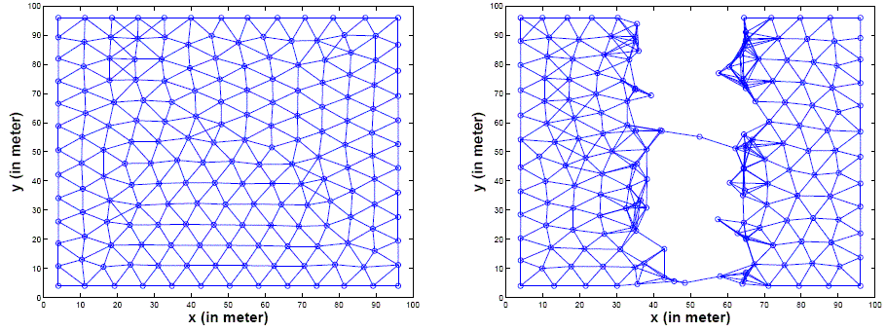
Spatial Retreat
Issues:
  A mobile adversary can move through the network
  The network can be partitioned
  After Escape Phase we need Reconstruction phase to repair the network
Reconstruction phase—Virtual force Model
  “Forces” only exist between neighboring sensors
  Forces are either repulsive or attractive
  Forces represent a need for sensors to move in order to improve system behavior
  virtual force is calculated based on its distance to all its neighboring sensors
  Direct its movement according to its force
  When all sensors stop moving, the spatial coverage of the whole network is maximized

Slide 19
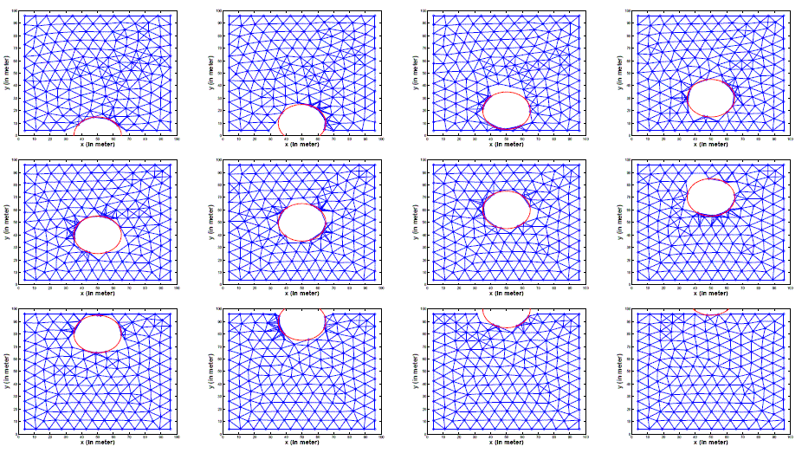
Spatial Retreat Example

Slide 20
Energy efficient link-layer jamming
Jammer power is low, as well.
Jammer is alike sensors, randomly deployed.
Attacker goals:
  Disrupt network by preventing message arrival at the sink,
  Increase the energy consumption of sensors.
Assumptions: the attacker knows
  The preamble sequence
  How to measure packet length
  Which MAC protocol is used
Employ MAC protocol properties and design an appropriate attack
  Eg. SMAC: attack control or synchronization messages

Slide 21
Research Issues - I
Identification of MAC and network layer layer protocol employed by just sniffing the radio traffic.
  Needed to design a generic jammer to be applicable to all MAC protocols

Slide 22
Research Issues - II
Effects of Jamming on Deployment Quality Measure
  Sensing is useless if the sensor cannot communicate

Slide 23
Research Issues - III
Differentiation of jamming from network congestion or sensor failures
  Packet delivery ratio can decrease because of failures and congestion, as well.
Use a combination of below parameters:
  Signal processing techniques
    Received signal strength indicator
    Excessive received signal level
    Low SNR
    Collisions
    Channel sensing time
  Utility based detection
    Repeated inability to access channel
    Bad framing
    Checsum failures
    Illegal field values
    Protocol violations
    Repeated collisions
    Duration of condition
    Packet delivery ratio

Slide 24
Research Issues - IV
Designing jammer-resistant MAC and network layers
  Appropriate precautions are to be taken against intelligent jammers
Cross-layer protocol research to resist jamming.

Slide 25
Research Issues - V
What we did
Holes problem
  Coverage: partially sensed area
  Routing: routing break-down
  Jamming: partially sensed area because of inability to communicate
  Physical attack: bombs, grenades, tanks…
Designing efficient & adaptive MAC, network, transport layer protocols to resist holes.
Designing efficient (re)deployment schemes to decrease the effect of holes.

Slide 26
Research Issues - V
Jamming sensing
  Eg. Acoustic sensors (especially underwater)

Slide 27

Questions?

